Slide 1
Updates on IMPAACT 2016:
A Group-Based Intervention to Improve Mental Health and ART Adherence Among Youth Living with HIV in Low Resource Settings
Geri Donenberg, PhD
Professor and Director, Center for Dissemination and Implementation Science, University of Illinois at Chicago
Incoming Director, Office of AIDS Research, NIH
Dorothy Dow, MD, MSc
Associate Professor,
Duke Pediatric Infectious Diseases
Duke Global Health Institute
24 September 2024
Notes:
Thank you to the Brain and mental health committee for inviting us to share a research update today. We are the co-chairs of IMPAACT 2016.

Slide 2
Scientific Question
Can a group-based, peer-led mental health intervention improve mental health outcomes for youth living with HIV?
  Population: Youth 15-19 years of age with mental distress
  Primary Outcome: Change in mental distress
  Secondary Outcome: Change in objective measures of ART adherence and HIV RNA

Slide 3

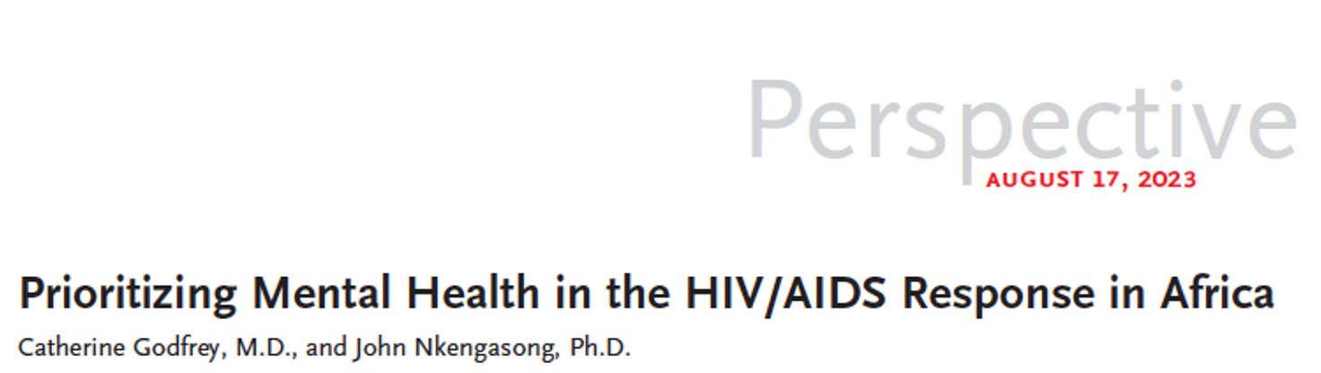
Why is IMPAACT 2016 important?
Adolescents living with HIV
  key population
  high risk of virologic failure
Mental health challenges
  ~50% present by 14 years-old
  75% present by 24 years-old
  overlooked and unaddressed
Improving mental health → ↑ ART adherence → better viral outcomes
Notes:
We know that ALWH are a key population that due to many factors related to this development stage, body transitioning through puberty; peer networks becoming more important; starting romantic and sexual relationships the stigma of living with HIV coupled with well described onset of mental health challenges such as depression and anxiety can detrimentally impact adherence to ART and therefore viral suppression. We know that adolescents have worse outcomes compared to children and adults, and that mental health can be a big driver affecting adherence to medication. Yet little has been done to address the problem. This is true globally, but especially true in low income countries with fewer mental health professionals to tackle the problem. Last year there was an excellent perspective on the need to prioritize MH in the HIV response in Africa and we are very grateful to be trying a peer led, task sharing model to tackle the problem.

Slide 4




Study Location
4 countries
Malawi
Zimbabwe
Botswana
South Africa
8 sites
5 languages
Notes:
Delivering a manualized intervention is not easy across four countries, 8 sites and 5 languages. The manuals have to be translated and back translated to fit the need. Terminology for mental health is difficult with limited vocabulary to express things like depression, anxiety, stress. But with a huge team effort, we managed.

Slide 5
Intervention Content
  Mental health literacy
  Trauma-informed Cognitive Behavioral Therapy
    Thoughts → Feelings → Behavior
    Change unhelpful/unhealthy T-F-B to helpful/healthy T-F-B
  Coping with stress
  Relaxation techniques
  HIV education
  Adherence strategies
  Gender-based violence and gender roles
  Safe sex practices
  6 sessions
  120 minutes
  Group-based
  Peer-led
  2 caregiver sessions
Notes:
Thank manualized intervention content includes key topics such as …Content is delivered in 6 sessions that last approximately 2 hours. There are 2 caregiver sessions. Youth are asked to invite a caregiver to participate if they are willing. Caregivers attend separate groups, not together with the youth. Caregiver content is focused on communication and adherence support for their youth.

Slide 6
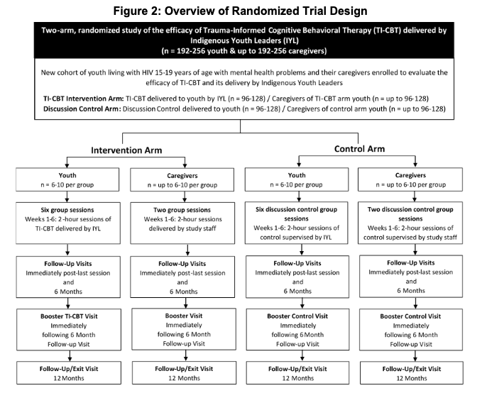
Inclusion Criteria
15-19 years old
Living with HIV
Fully disclosed
Symptoms of mental distress based on:
  PHQ-9 >10 GAD-7 >10 UCLA PTSD-RI score > 35
Notes:
Here we present the trial design of the trial, but just to note that a pilot came before the trial and I’ll talk about that in a minute. The inclusion criteria were….read the slide. Youth were randomized at the entry visit, which was also the day of the first session. They were randomized to either the intervention arm or the discussion control arm. Both arms met in groups and had a youth leader. Only the intervention arm had a content manual. The discussion group was free to discuss any topic agreed by the group. Youth leaders for the discussion control arm received basic training in managing safety of the group, but their training was minimal compared to the 2 week intensive and subsequent weekly training of the youth leaders in the intervention arm. Youth formed groups of 6 to 10, and again met for 6 weekly sessions, though sites were allowed to combine two sessions in one day. Study follow up visits occur immediately after the intervention, then at 6 months, a single session booster and a 12 month exit visit.

Slide 7
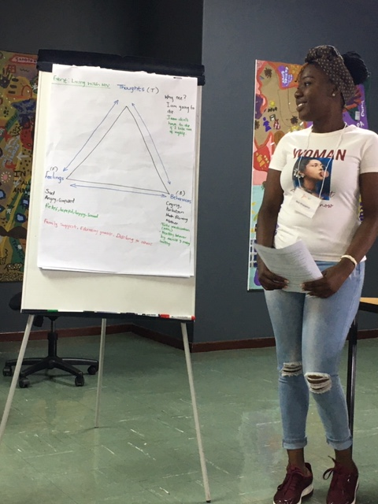
Study Timeline
2023
Youth leader training completed in country for all sites
Regional training completed in country for all study teams
Pilot enrollment
2018
IMPAACT 2016 Study protocol approved
2025
Primary Outcome, 6-month visit, expected March 2025
2020
South Africa Youth leader training
March 2020 trial paused
due to COVID 19
2019
IRB approval at all sites
DAIDS protocol registration ADAPT-ITT process began
  Stakeholder meetings
  Focus Groups
  Manual updates & translations
October 2022
Trial was allowed to resume
2024
RCT enrollment March 2024 will be complete September
Notes:
Its been a great journey launching IMPAACT 2016. In 2018 the protocol was approved, we made completed all the regulatory requirements and began the ADAPT-ITT process of the ensuring the original Rwandan manual was culturally appropriate and made some updates. By 2020 we were all set for group leader trainings and completed SA training in January 2024. We were getting ready to board the plane to Botswana in March 2020 when every thing stopped. When we were allowed to resume in 2022 and returned to pick up where we left off with youth leader training we heard in 2023 from the SA youth leaders just how important the training had been in their own lives in managing distress during the pandemic. This really reignited our passion to scale this intervention for more youth benefit. Incredibly, we completed all group leader and regional trainings in person trainings the span of 6 months and the pilot enrolled in November 2023. We just randomized the last site of a second wave and are looking forward to seeing the data of the primary outcome in early 2025.

Slide 8
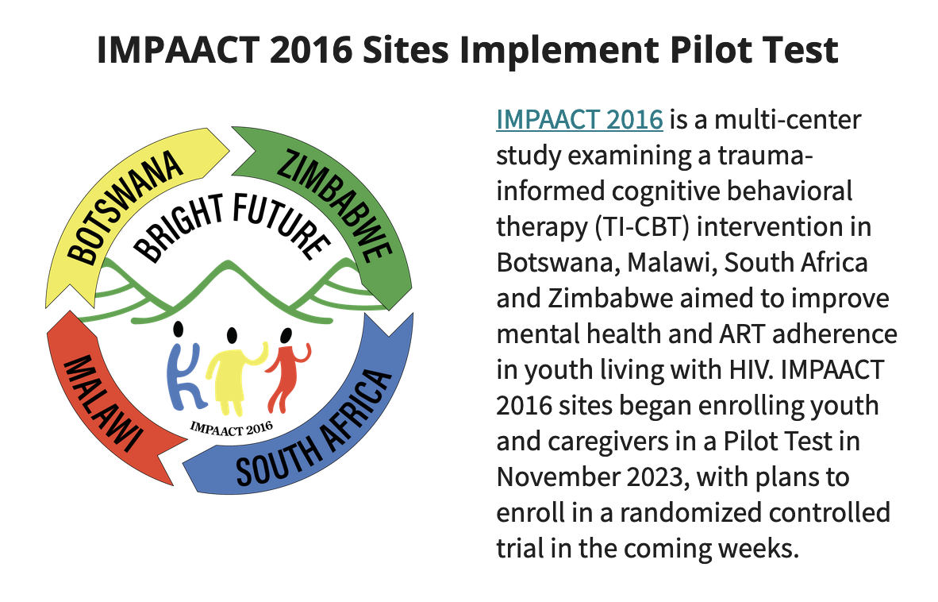
Notes:
The pilot was very important to help us learn about participant recruitment, screening, conducting pre-entry visits, seeing how the data management system and tablets worked and how to efficiently enroll youth on Day 1. The pilot was not randomized, but helped the group leaders and adult study staff have a real practice run in managing group dynamics, teaching the material and generating discussion with a actual participants. The experience really built their confidence and was a success. This was the last step in the ADAPT-ITT process and based on the pilot site survey feedback, team calls, or supervision sessions there were no major adaptations required for the trial. Youth and caregivers were excited, enjoyed, and wanted the program to continue. Youth leaders, youth caregivers, and site supervisors reported qualitative benefits in confidence, adherence, and communication.

Slide 9
Randomized Controlled Trial
366 Screened
Demographics | Youth Enrolled* N=242
Age, years median (Q1, Q3) | 17.0 (16.0, 18.0)
min, max | 15.0, 19.0
Sex at birth, female | 138 (57%)
Black African | 242 (100%)
Transmission, perinatal | 220 (91%)
HIV RNA, fully suppressed | 192 (86%)
Attendance to all sessions | >95%
Retention, post intervention visit | 99% to date
242 Enrolled
66%
symptoms of mental distress
*Data as of September 16, 2024
Target enrollment 256 youth participants;
Notes:
Screening and enrollment of youth happened very quickly. Sites were encouraged to screen all YLWH age 15-19 years and not to approach only those they thought had challenges. The rates of youth who screened into the study with self-reported symptoms of depression, anxiety, or post-traumatic stress symptoms is alarmingly high. As you can see there were slightly more females, all Black African, most perinatally infected and 86% fully suppressed. Attendance was excellent. These data are as of August and we just randomized the last wave of the trial on September 21st to reach the target of 256. What these data say to us is the need for this intervention is tremendous. The unmet need of youth living with HIV and suffering from mental distress is even higher than we anticipated. We are anxious to know the results of the trial in about six months.
*<10% with HIV RNA >1

Slide 10
Preliminary data, Entry criteria
71% screened positive on >1 measure
40% screened positive on all three measures
There is a critical need for effective interventions to address the mental health challenges among youth living with HIV.

Slide 11
Caregiver demographics
90% of youth agreed to caregiver participation
Most caregivers were eager to participate, had excellent attendance, and reported improved communication with their youth
Demographics | Caregivers Enrolled* N=219
Age, years median (Q1, Q3) | 42.0 (36.0, 49.0)
min, max | 19, 74
Sex at birth, female | 191 (87%)
Black African | 219 (100%)
Attendance to all sessions | >95%
Retention, post intervention visit | 98% to date

Slide 12
Potential Global Impact
Improved mental health for adolescents living with HIV
Increased ART adherence and better viral outcomes
  Reduced transmission to others
  Prevention of mother-to-child transmission as adolescents become mothers
  Increased health and productivity for the community
Scalability (4 countries, 8 sites)
Capacity development
Notes:
IMPAACT 2016 and other peer-led intervention studies like it could create a major paradigm shift in demonstrating that peer youth leaders are capable of supporting common symptoms of depression and triaging youth who require more intensive therapy. The shared lived experience is crucial in youth in distress opening up, having their symptoms somewhat normalized, and provided coping strategies anchored within the importance of ART medication adherence. If IMPAACT 2016 can improve the mental health of YLWH and also improve adherence and viral suppression, this will reduce transmission to sexual partners, to the next generation of HIV exposed infants, and improved productivity in society. And I just want to emphasize the potential benefits not only to youth, but also to the youth leaders who lead these discussion groups. The skills, confidence, empathy, and knowledge they gain could really build a cadre of future social workers, psychologists, community health workers, and pave a real path towards sustainable mental health care integration within the HIV clinical setting.

Slide 13
Acknowledgments
THANK YOU to the….
teams in Botswana, Malawi, South Africa, Zimbabwe;
the youth, caregivers, supervisors, and community;
Clinical Research Managers, Data Managers, Statisticians, Medical officers: Ellen Townley, Hans Spiegel& Olga Varechtchouk (DAIDS), Pim Brouwers & Susannah Allison (NIMH), Sonia Lee (NICHD); IMPAACT Network leadership.
We sincerely thank you.
Overall support for the International Maternal Pediatric Adolescent AIDS Clinical Trials Network (IMPAACT) was provided by the National Institute of Allergy and Infectious Diseases (NIAID) with co-funding from the Eunice Kennedy Shriver National Institute of Child Health and Human Development (NICHD) and the National Institute of Mental Health (NIMH), all components of the National Institutes of Health (NIH), under Award Numbers UM1AI068632-15 (IMPAACT LOC), UM1AI068616-15 (IMPAACT SDMC) and UM1AI106716-09 (IMPAACT LC), and by NICHD contract number HHSN275201800001I. The content is solely the responsibility of the authors and does not necessarily represent the official views of the NIH.
Notes:
There are so many people to thank for the progress we have made in IMPAACT 2016. One slide is not enough, but we are so grateful to numerous people who have worked on, enrolled in, funded, and advocated for this unique study within the network.

Slide 14
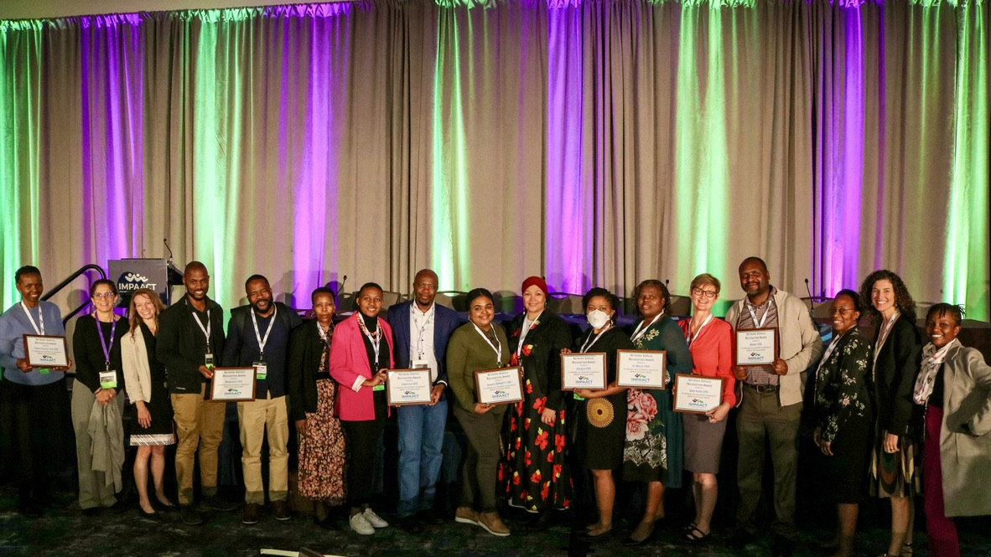
Questions?
Geri Donenberg
gerid@uic.edu
Dorothy Dow
dorothy.dow@duke.edu
Impaact Annual Meeting, October 2023
Notes:
We are happy to take questions during the panel discussion. If there are specific questions feel free to reach out to us. This is a picture of a few of the many many people who have worked tirelessly to make the study a success. Thanks so much.

