Slide 1

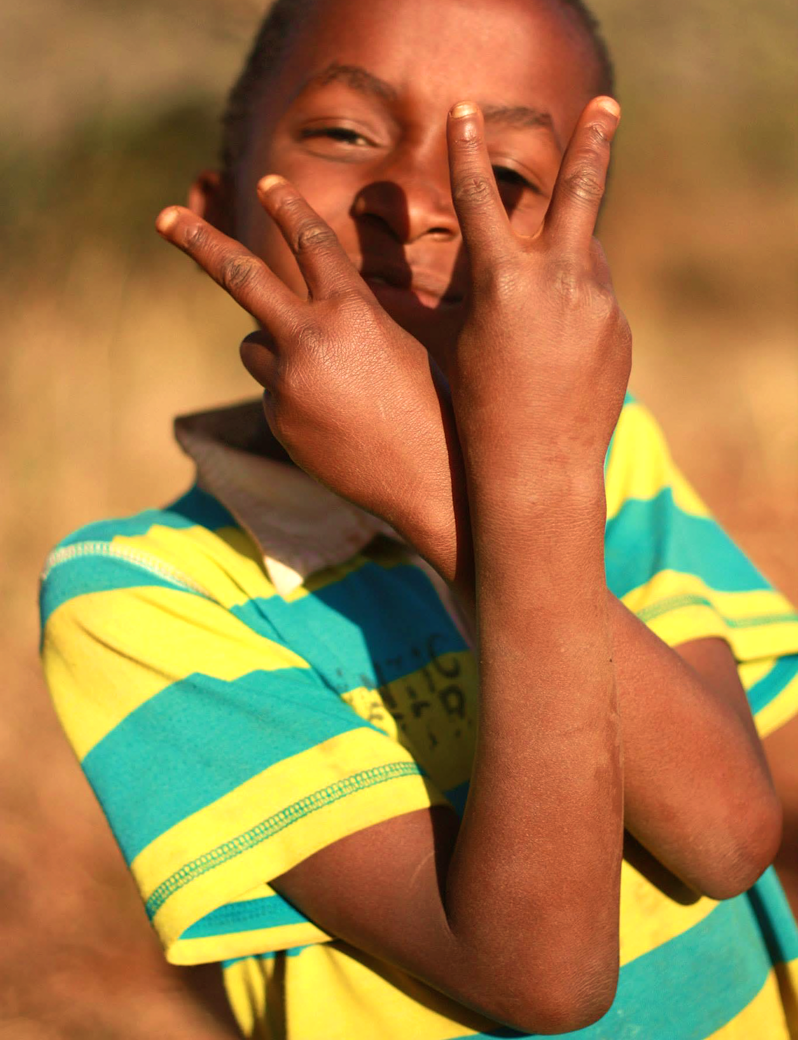
FAMILY MATTERS: RELATIONSHIPS DYNAMICS & FATHER INVOLVEMENT
Michelle Bulterys, PhD, MPH
IMPAACT BMHSC
September 2024

Slide 2
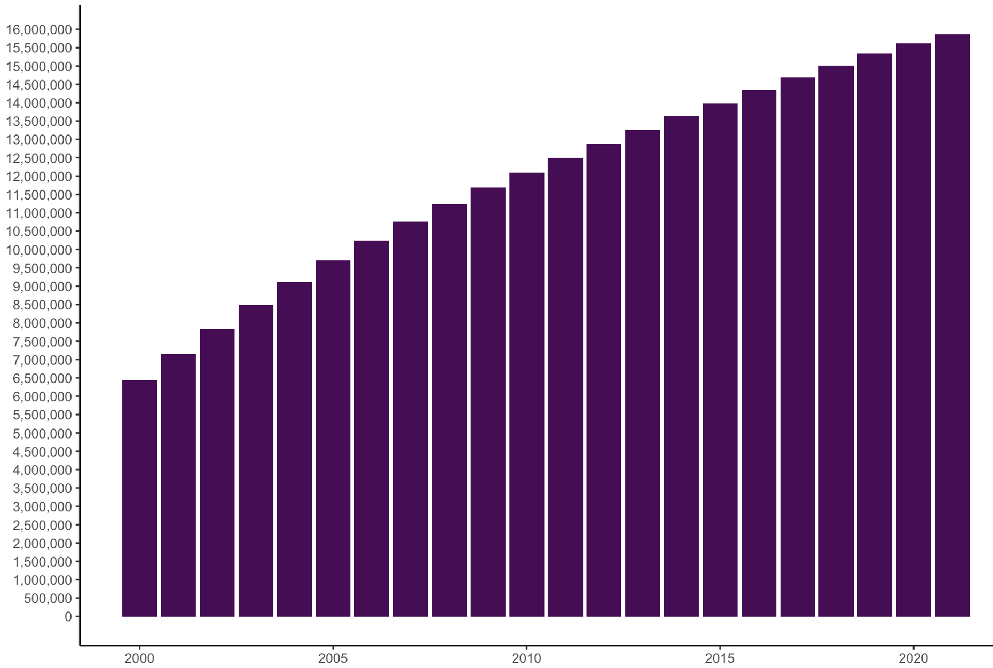
Children who HIV-exposed and not living with HIV
16+ million
1+ million more born every year in sub-Saharan Africa
Population size
UNAIDS figures by Michelle Bulterys and Mary Mahy
Notes:
Thanks to the massive success of HIV programs over the last 2 decades, we now have a rapidly growing population of children who are HIV exposed and not living with HIV
For the last 4 years I have worked with UNAIDS to track the growth and geographic clustering of these young populations. We now estimate this population to have over 16 million children, with 1 million more born every year in SSA.

Slide 3
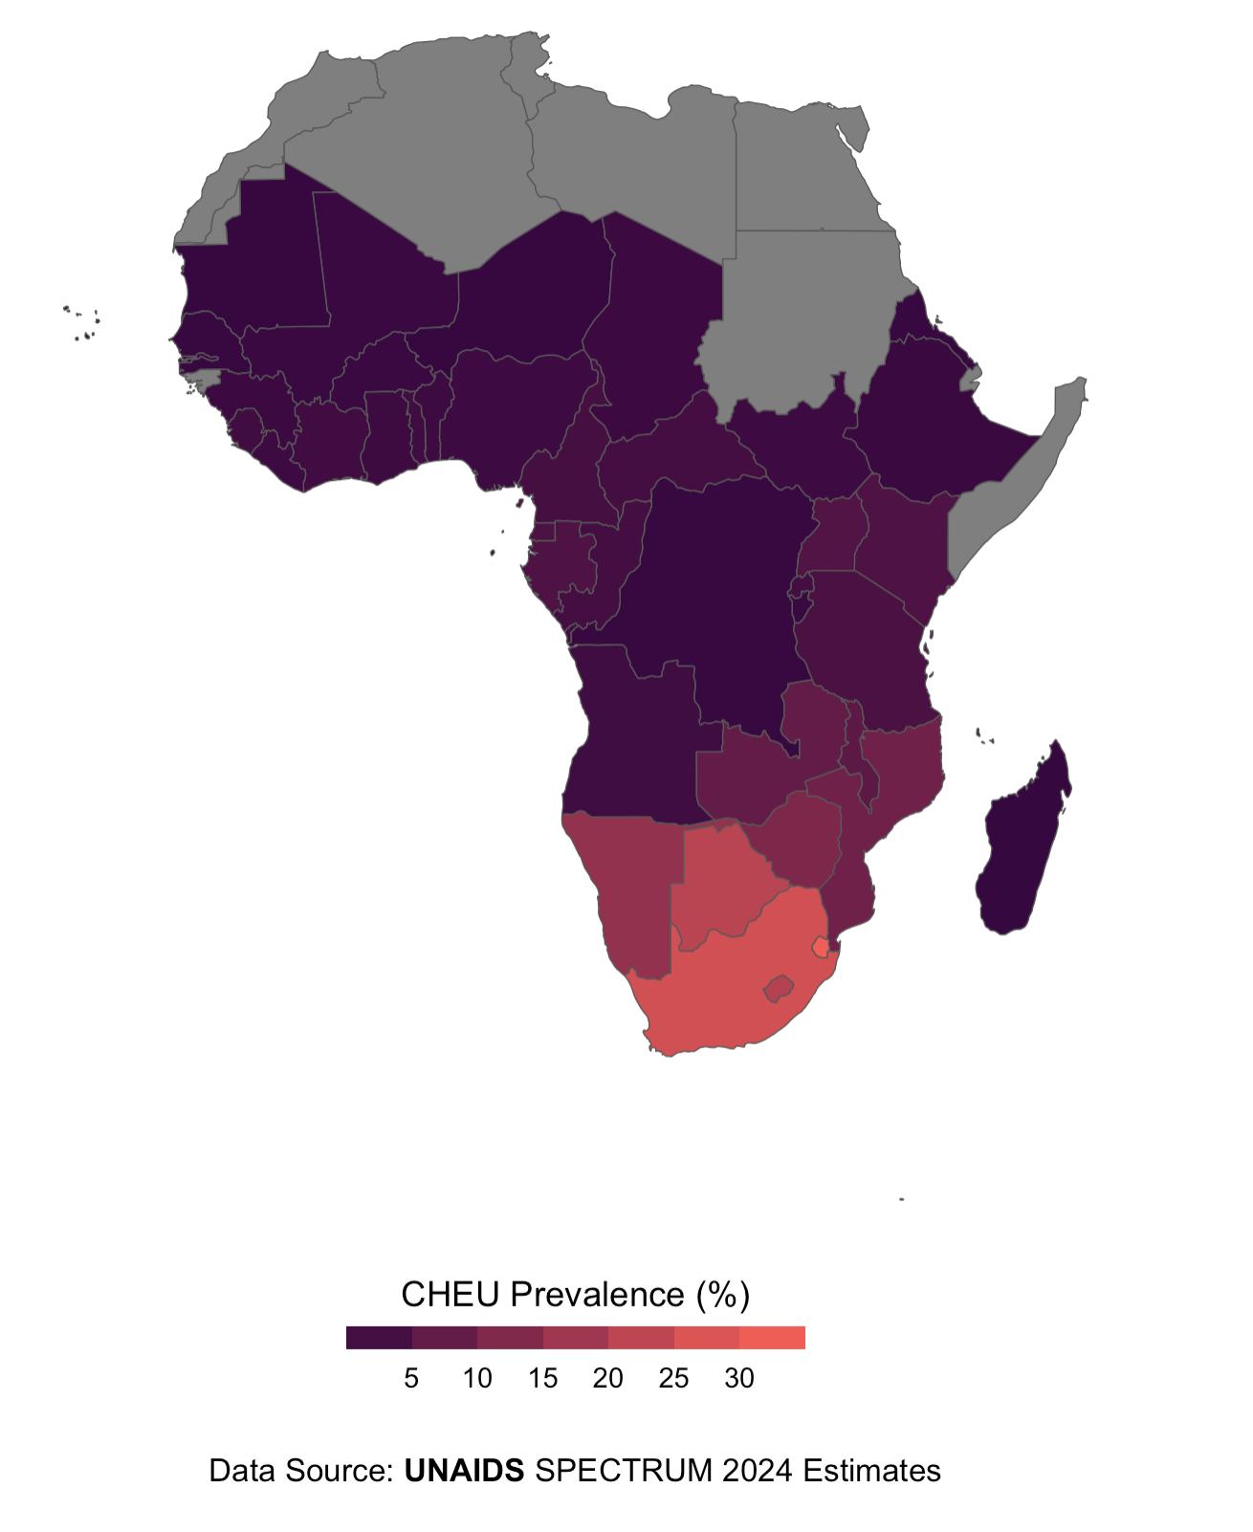
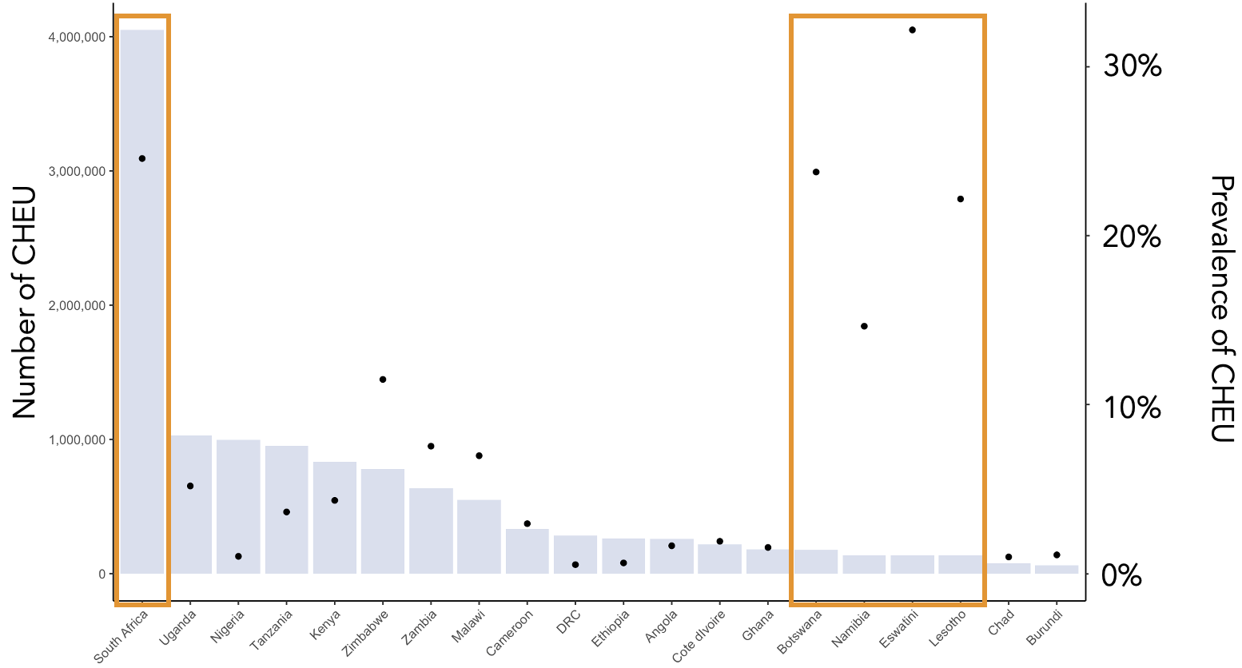
Prevalence by countries with high HIV burden
Prevalence of HIV exposure, 2024
Population size and prevalence among children <15 years, by country, 2024
Prevalence
UNAIDS figures by Michelle Bulterys and Mary Mahy
Notes:
In several sub-Saharan African countries, the prevalence of children under 15 years old who are CHEU exceeds 20%, sometimes as high as 30%.
This means that in certain settings with very high HIV burdens, like South Africa, Botswana, and Eswatini, over a quarter of all children are born HIV-exposed uninfected.

Slide 4
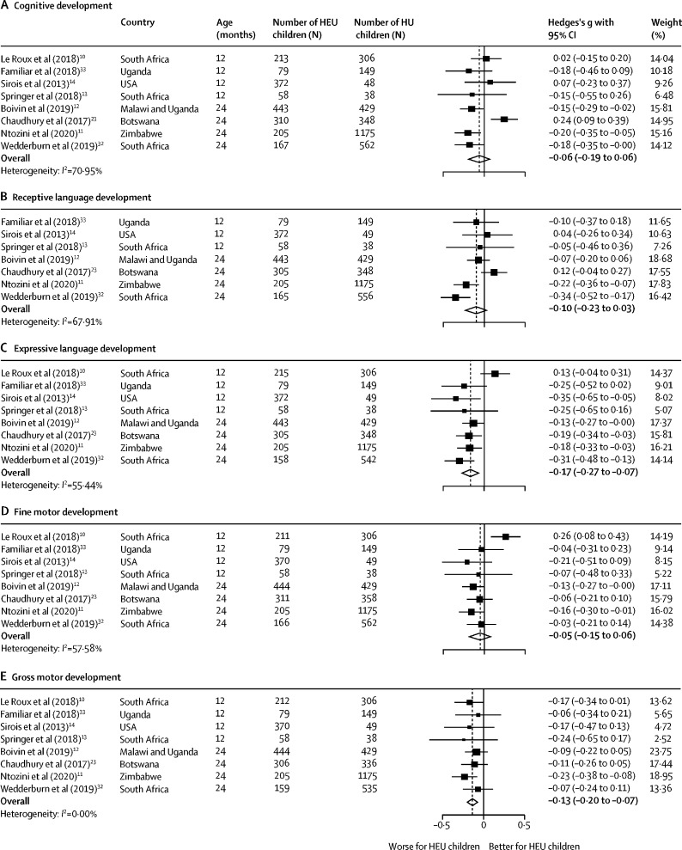

Signals of poorer neurodevelopment among children who are HIV-exposed
Catherine Wedderburn, MD, PhD
Univ. of Cape Town
Most, but not all, studies have found that children who are HIV-exposed and not living with HIV have poorer neurodevelopment outcomes compared to children who are not HIV exposed
Wedderburn et al. Lancet Ch Ad Health, 2022
Notes:
And despite living HIV-free, CHEU still face high risk of mortality, hospitalizations, and poor development.
My colleague, Dr. Catherine Wedderburn at University of Cape Town, recently conducted a systematic review and meta-analysis of 31 studies comparing neurodevelopmental outcomes between children who are HIV exposed uninfected with children who are HIV unexposed – and most, but not all, studies found that CHEU have poorer neurodevelopment than HIV-unexposed children. There is some heterogeneity in the findings, however, this still begs the question of what factors could be driving this difference?

Slide 5
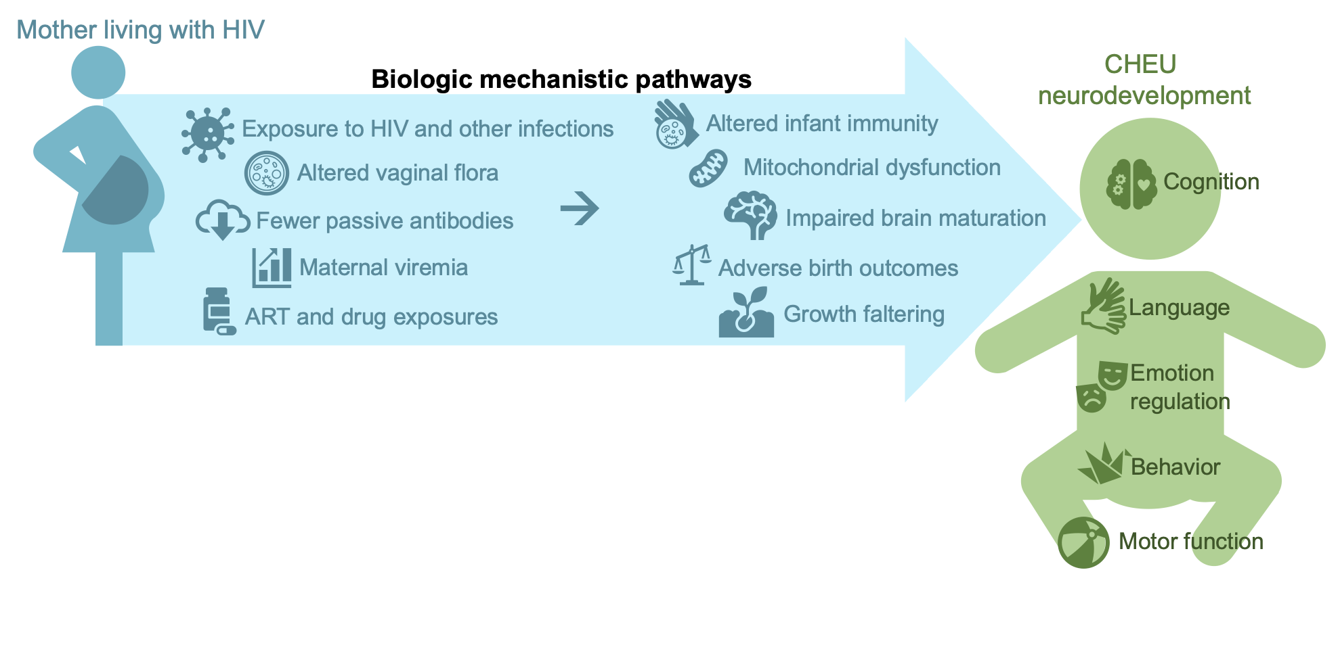
What factors influence neurodevelopment?
Child
Bulterys et al. Journal of International AIDS Society, 2023
Notes:
Dr. Wedderburn and I came together with our colleagues from UNAIDS and UNICEF to take a deep dive into the literature and understand all the possible mechanistic pathways through which HIV exposure could impact neurodevelopment.
We found that perinatal exposures to HIV, ART drugs, and other biological phenomenon could lead to altered infant immunity, impaired brain maturation, adverse birth outcomes, and growth faltering --- all of which could negatively impact neurodevelopment.
But the biologic factors are only part of the story ---

Slide 6
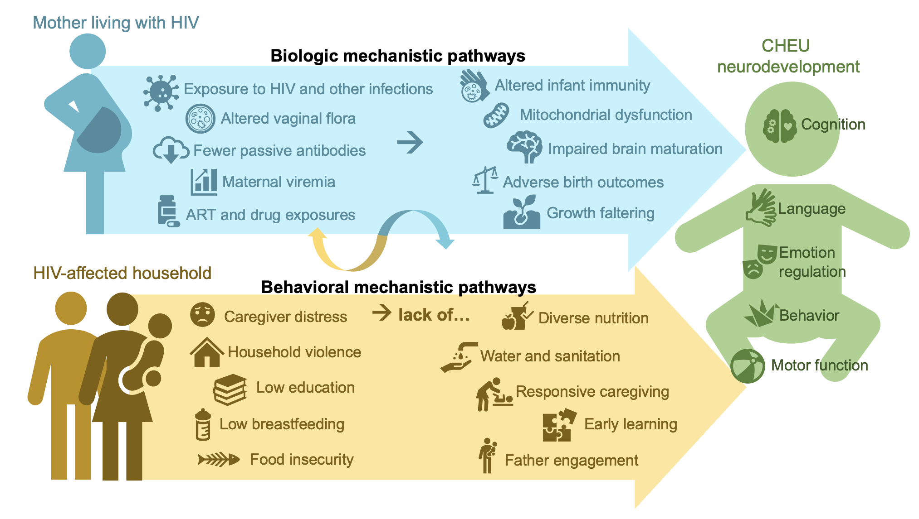
What factors influence neurodevelopment?
Child
Household affected by HIV
Bulterys et al. Journal of International AIDS Society, 2023
Notes:
We must consider the social inequities associated with growing up in households affected by HIV…. Such as caregiver distress, HIV stigma, household violence, and food insecurity.
Based on the current state of the literature, the biologic factors are much better understood than the social behavioral factors, on which very little data exist.
There is an urgent need for rigorous, multidisciplinary research to identify the household factors that impact child neurodevelopment, because these factors will be more approachable and readily modifiable through interventions.
In my PhD and postdoc, I’ve been trying to fill these knowledge gaps within the Kenyan HOPE Study:

Slide 7
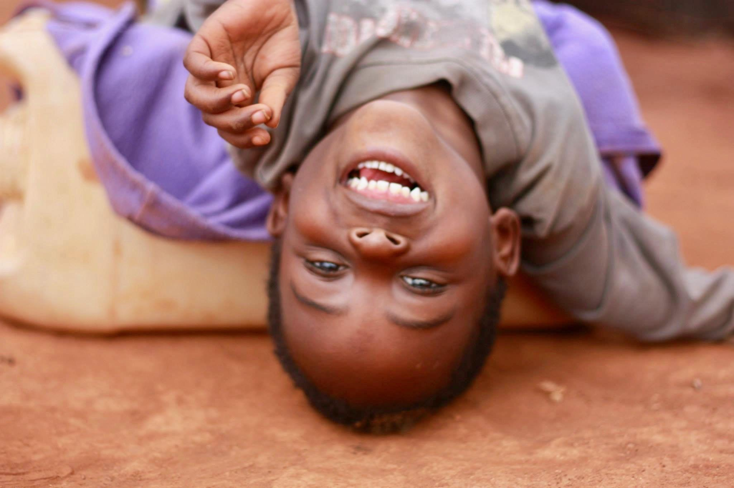


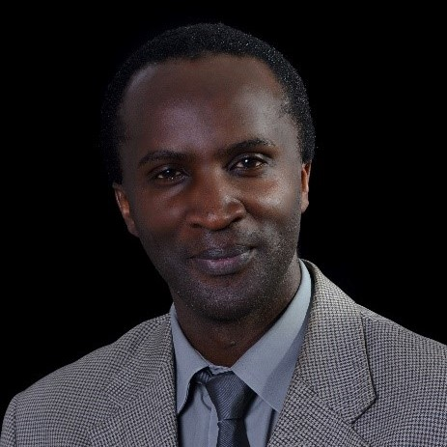
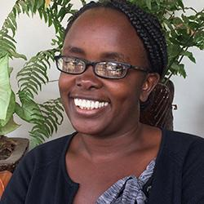
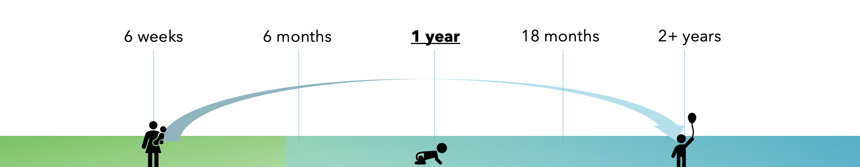
HOPE Study (Kenya)
Grace John-Stewart
University of Washington
Dalton Wamalwa
University of Nairobi
Irene Njuguna
Kenyatta National Hospital
Image by Michelle Bulterys with parental consent
Study Design: Multi-site prospective longitudinal cohort
Population: 1,000 mothers living with HIV and 1,000 mothers living without HIV, and their infants
Notes:
The HOPE study is a multi-site prospective longitudinal cohort study involving 1,000 mothers living with HIV and their CHEU, and 1,000 mothers not living with HIV and their children. We have followed these mother-infant pairs every six months since birth, and the HOPE children are turning 3 years old now.

Slide 8




HOPE Study (Kenya)
Family factors of interest
Maternal HIV status
Relationship dynamics
Father engagement
Shutterstock Image
Notes:
I’m particularly interested in understanding the roles of maternal HIV, relationship dynamics, and father engagement in child development.

Slide 9









Comparing household factors between children, by HIV exposure status
p < 0.001
Older mothers
(31 vs. 28 years)
Father 40+ years
(44% vs. 18%)
<7yrs education
(48% vs. 27%)
Food insecurity
(18% vs. 9%)
No father support
(11% vs. 7%)
Multiple separations
(31 vs. 28 years)
Polygamous marriage
(8% vs. 4%)
Relationship dissatisfaction
(multiple measures)
Notes:
We found that CHEU in our cohort, compared to CHUU, were more likely to have older mothers and fathers,

Slide 10
Comparing household factors between children, by HIV exposure status
p < 0.001
Older mothers
(31 vs. 28 years)
Father 40+ years
(44% vs. 18%)
<7yrs education
(48% vs. 27%)
Food insecurity
(18% vs. 9%)
No father support
(11% vs. 7%)
Multiple separations
(31 vs. 28 years)
Polygamous marriage
(8% vs. 4%)
Relationship dissatisfaction
(multiple measures)
Notes:
Parents with lower levels of education

Slide 11
Comparing household factors between children, by HIV exposure status
p < 0.001
Older mothers
(31 vs. 28 years)
Father 40+ years
(44% vs. 18%)
<7yrs education
(48% vs. 27%)
Food insecurity
(18% vs. 9%)
No father support
(11% vs. 7%)
Multiple separations
(31 vs. 28 years)
Polygamous marriage
(8% vs. 4%)
Relationship dissatisfaction
(multiple measures)
Notes:
Food security

Slide 12
Comparing household factors between children, by HIV exposure status
p < 0.001
Older mothers
(31 vs. 28 years)
Father 40+ years
(44% vs. 18%)
<7yrs education
(48% vs. 27%)
Food insecurity
(18% vs. 9%)
No father support
(11% vs. 7%)
Multiple separations
(31 vs. 28 years)
Polygamous marriage
(8% vs. 4%)
Relationship dissatisfaction
(multiple measures)
Notes:
Lower father support

Slide 13
Comparing household factors between children, by HIV exposure status
p < 0.001
Older mothers
(31 vs. 28 years)
Father 40+ years
(44% vs. 18%)
<7yrs education
(48% vs. 27%)
Food insecurity
(18% vs. 9%)
No father support
(11% vs. 7%)
Multiple separations
(31 vs. 28 years)
Polygamous marriage
(8% vs. 4%)
Relationship dissatisfaction
(multiple measures)
Notes:
And worse measures of relationship stability and satisfaction between mother and father.

Slide 14
Comparing household factors between children, by HIV exposure status
p < 0.001
Risk factors for poorer child development
Older mothers
(31 vs. 28 years)
Father 40+ years
(44% vs. 18%)
<7yrs education
(48% vs. 27%)
Food insecurity
(18% vs. 9%)
No father support
(11% vs. 7%)
Multiple separations
(31 vs. 28 years)
Polygamous marriage
(8% vs. 4%)
Relationship dissatisfaction
(multiple measures)
Notes:
All of these are known risk factors for poorer child dev, and they are all magnified among families affected by HIV.

Slide 15

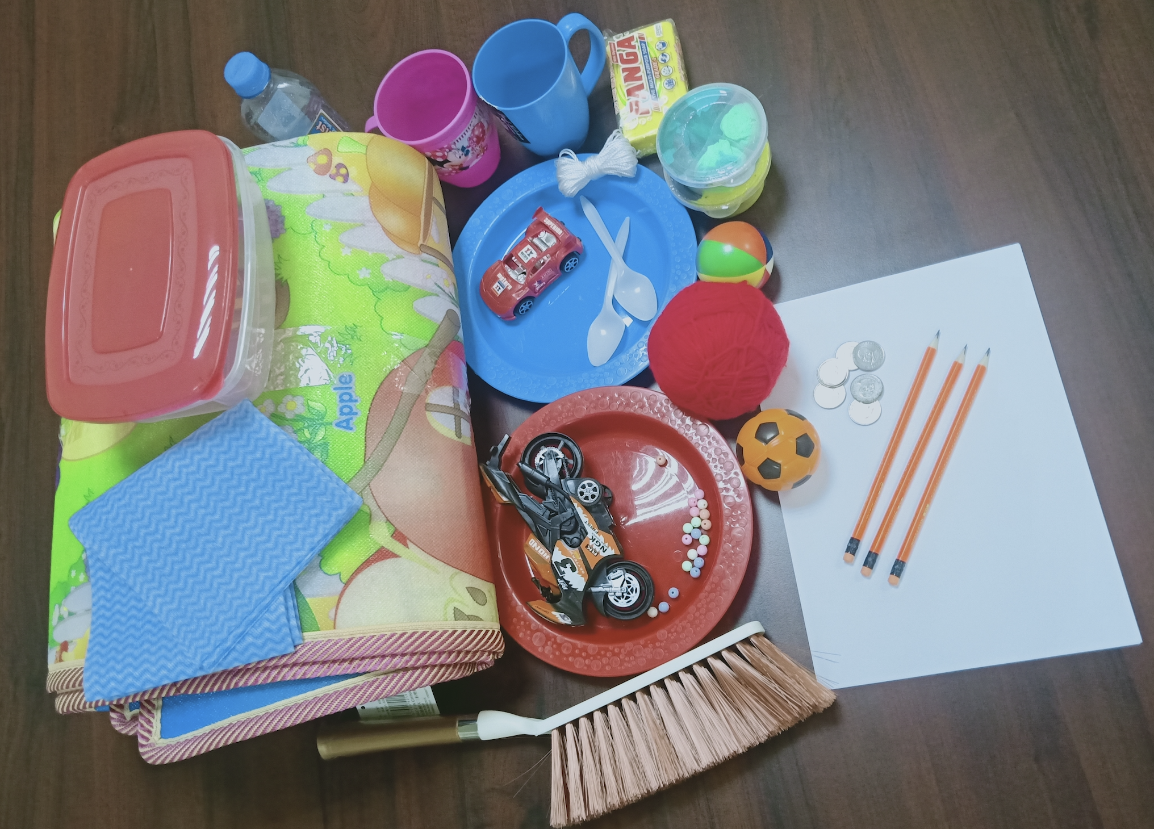
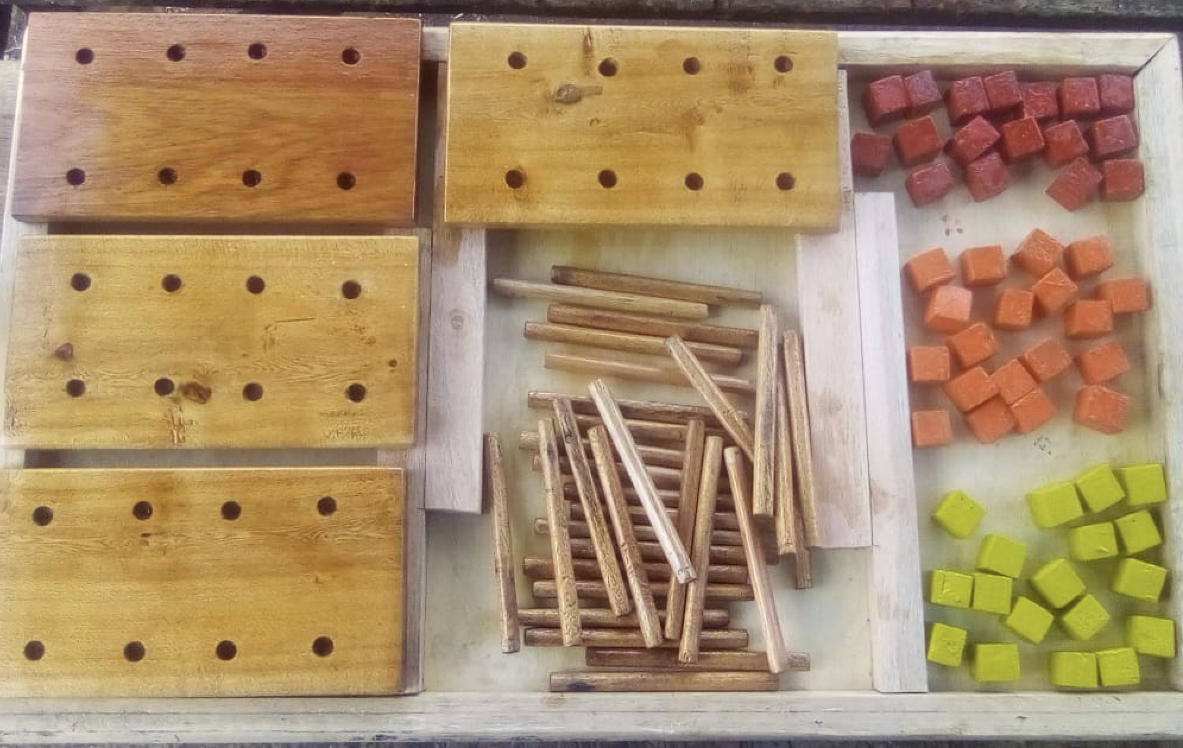
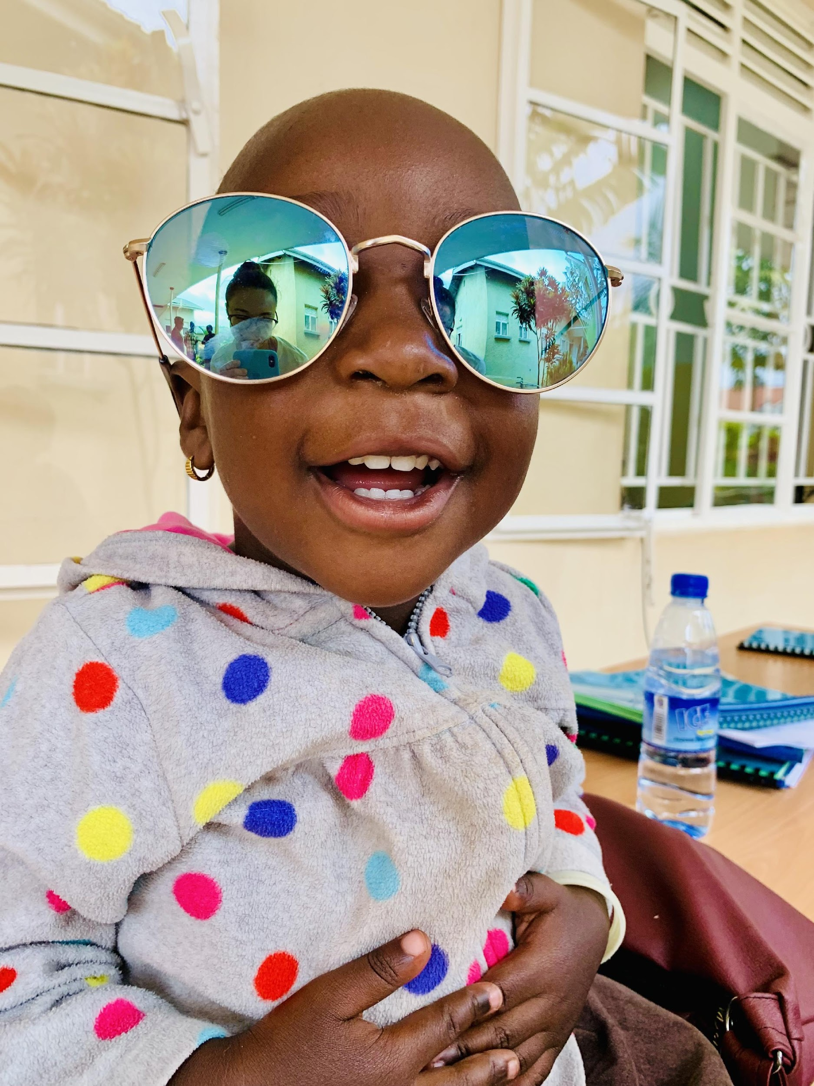
Malawi Developmental Assessment Tool (MDAT)
Locally sourced items from the MDAT kit
Photo credit: Team member Felix Otiento
Notes:
We assessed neurodevelopment using the MDAT, a culturally validated tool in SSA that measures social, language, fine motor, and gross motor domains.

Slide 16
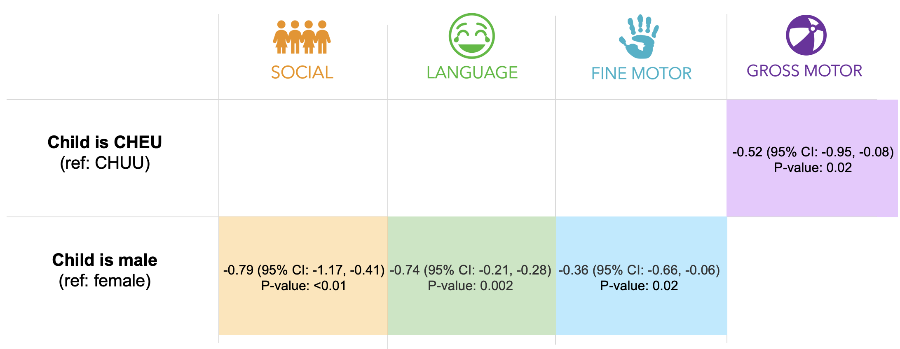
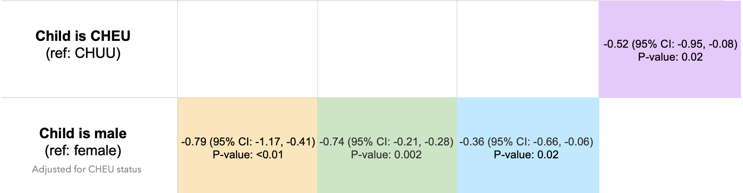
Cofactors associated with child neurodevelopment at 2 years
Coefficient <0 = negative association
Child is HIV exposed and not living with HIV
(ref: not exposed to HIV)
CHEU exposure to Efavirenz-based regimens
(ref: Dolutegravir)
-0.52 (95% CI:-1.01,-0.03)
P-value: 0.04
Manuscript in preparation
Notes:
Blank cells represent no statistically significant associations – to spare everyone’s eyes
We found that at 2 years of age, CHEU had significantly worse gross motor development compared to CHUU, primarily in terms of ability to walk and run. In a sub-analysis, I found that this was likely attributed to CHEU whose mothers were on efv-based ART regimens during pregnancy – as CHEU who were exposed to DTG-based regimens performed just as well as children without HIV exposure. DTG scale up
We also saw that among all children, adjusting for HIV exposure status, kids who were assigned male at birth performed worse developmentally in almost all domains.

Slide 17
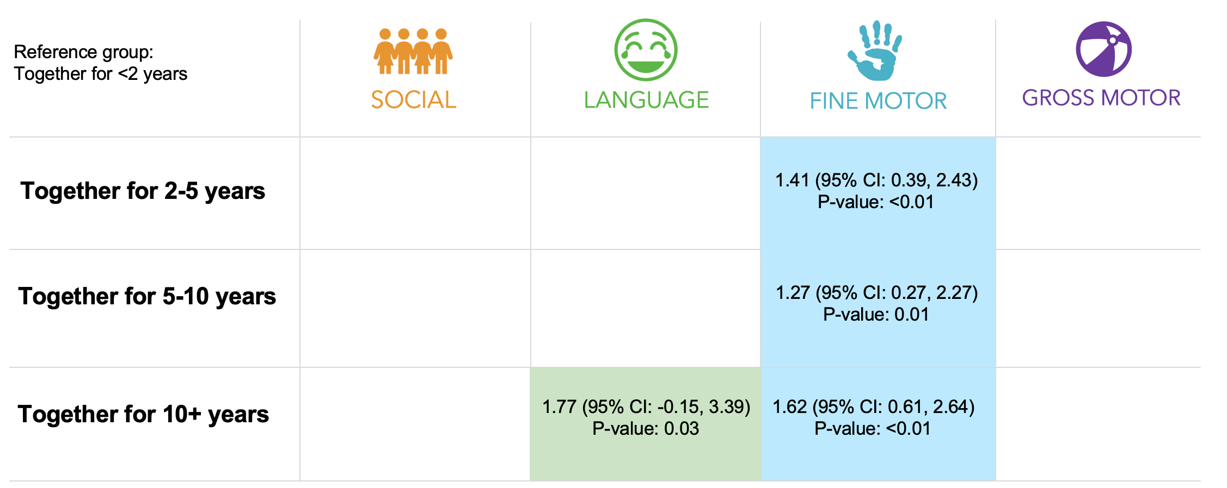
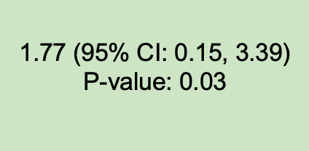
Length of parental relationship
Manuscript in preparation
Notes:
We saw that the longer parents were together, the better children performed in language and fine motor domains.

Slide 18
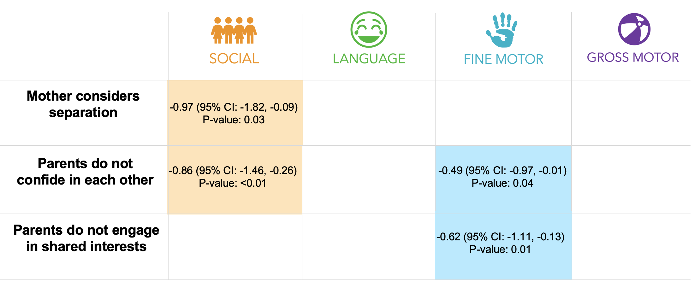
Relationship satisfaction
more than half the time
Manuscript in preparation
Notes:
We also saw that relationship satisfaction measures played a role… we found lower scores among children whose mothers considered separation more than half the time, if parents did not confide in each other, or if parents did not engage in shared interests.

Slide 19
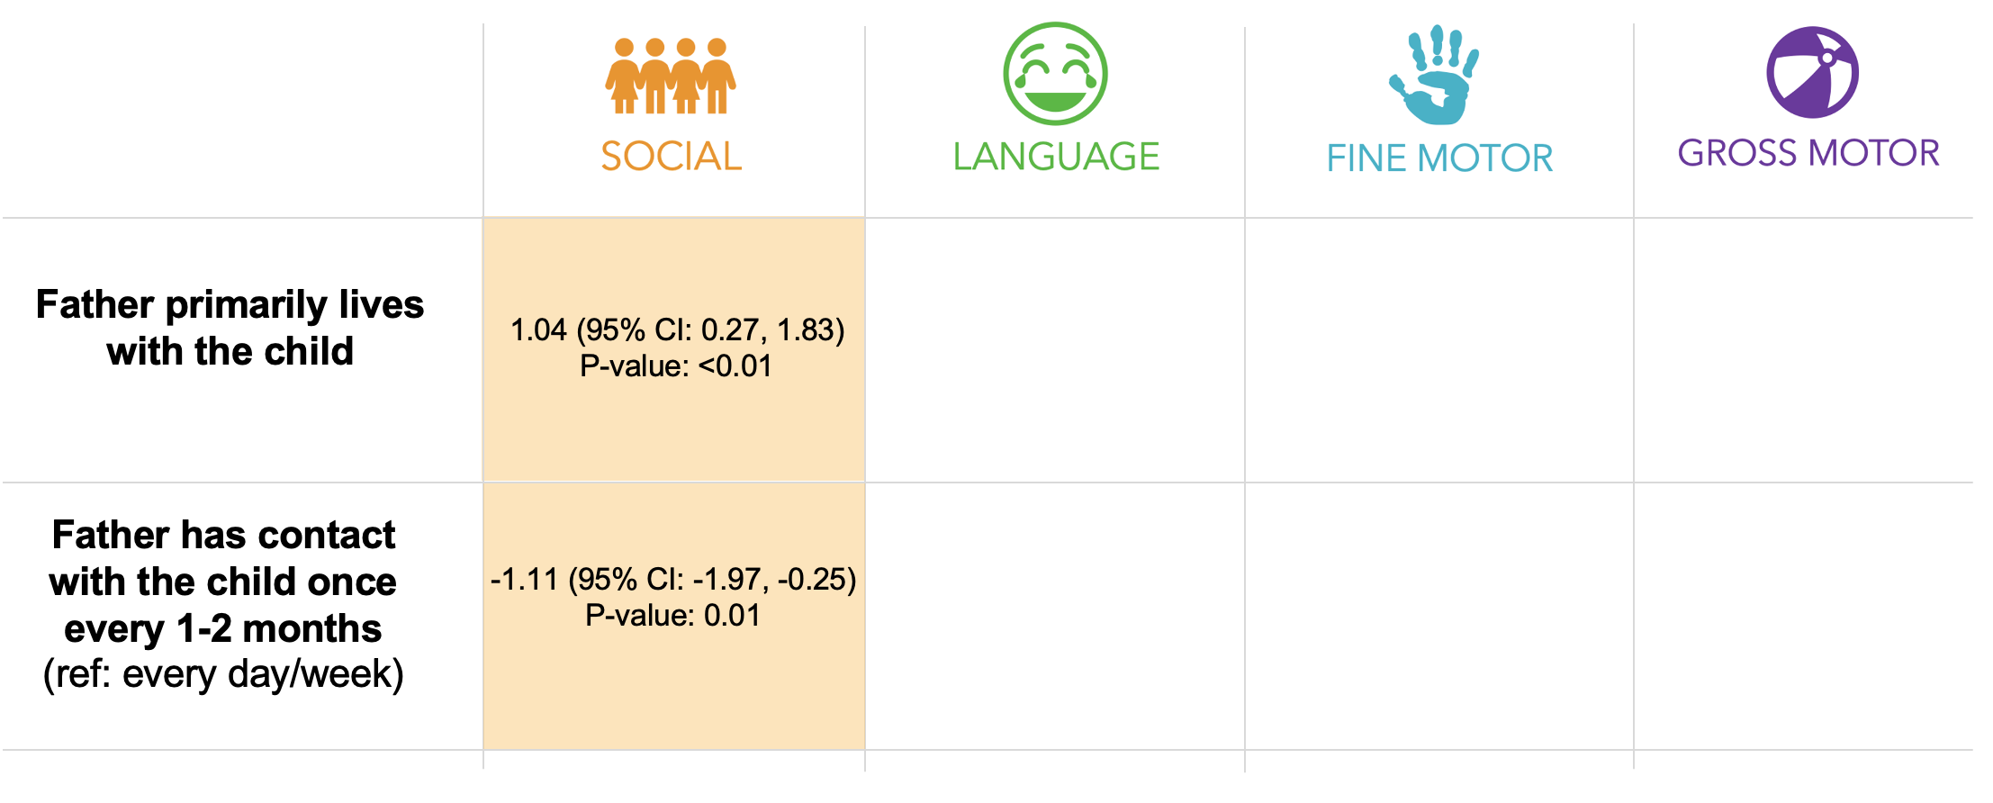
Father involvement
Manuscript in preparation

Slide 20
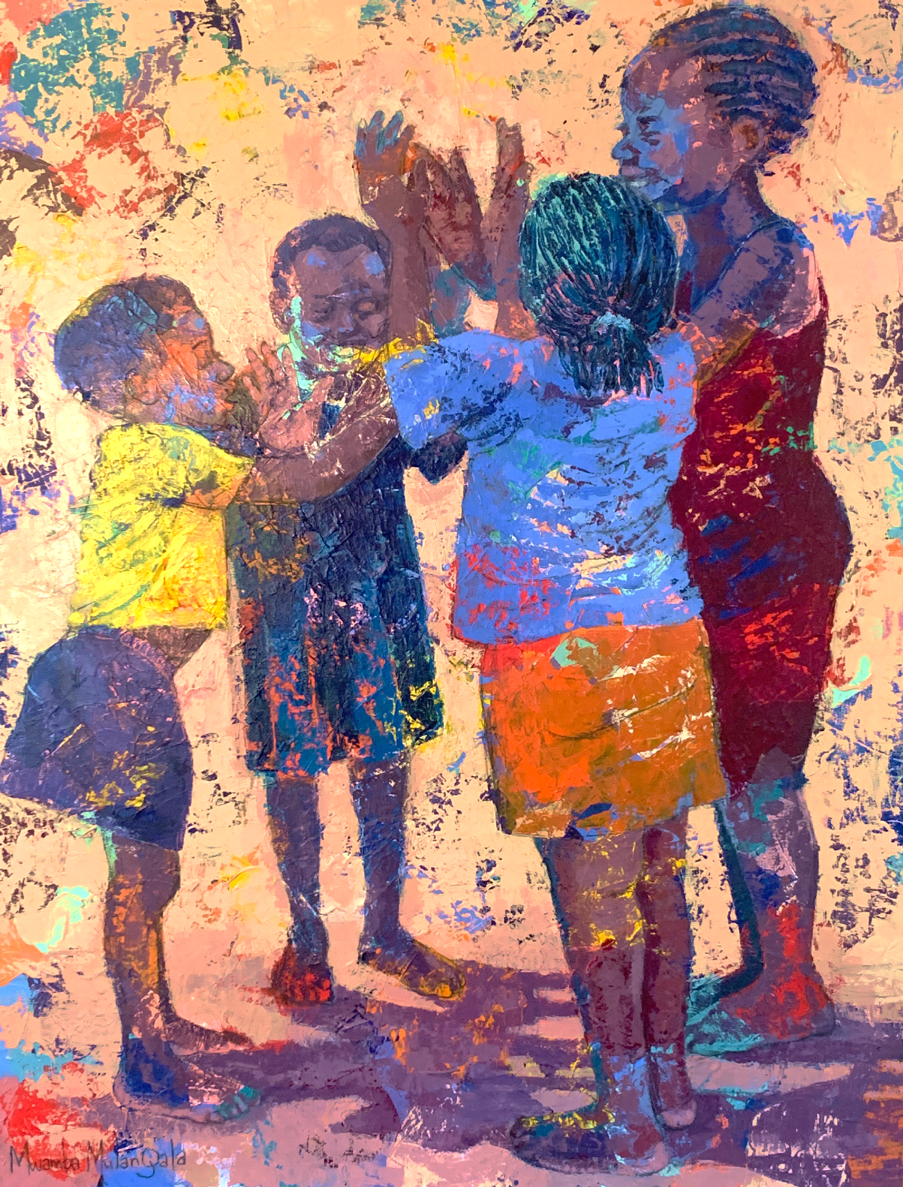
Conclusions
Gross motor differences by child HIV exposure
Relationship satisfaction and father engagement factors are critical
Caregiver-based interventions can be useful to support families affected by HIV and relationship instability
    Father’s voice are needed
Painting by Mwamba Mulangala (Zambia), purchased by Michelle
Notes:
We found subtle but significant differences in gross motor scores between CHEU and CHUU
Relationship satisfaction and father engagement factors were positively associated with child neurodevelopment, regardless of maternal HIV status
Risk factors were amplified among CHEU
Caregiver-based interventions can be useful to support families affected by HIV and relationship instability
Father’s voice are needed

Slide 21

Photo by Michelle Bulterys
WHAT COMES NEXT?

Slide 22
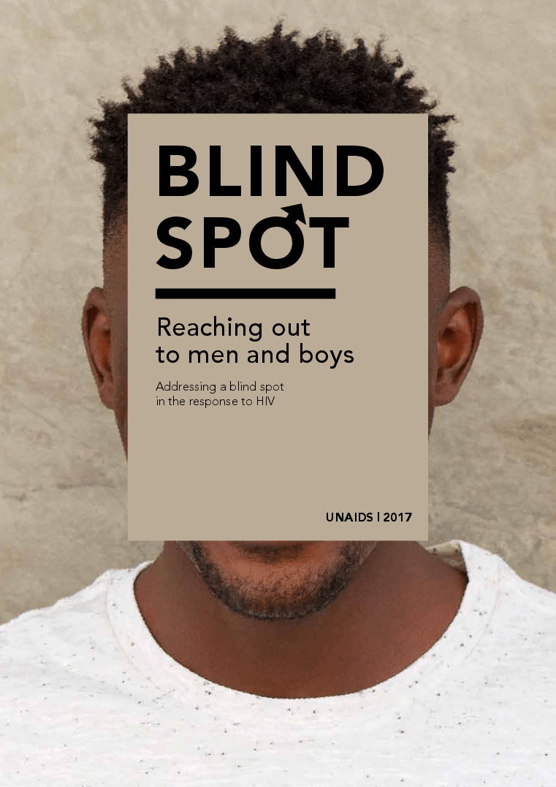
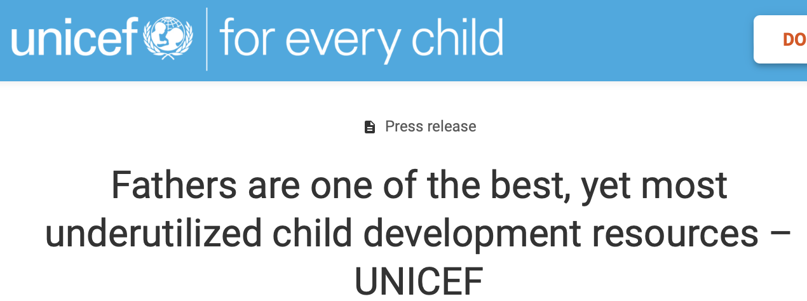

Fathers: Underrepresented voices
UNAIDS
Notes:
In the SSA context, fathers’ voices are underrepresented in both the child development research space as well as the fight against HIV. In recent reports, both UNAIDS and UNICEF have acknowledged the importance of reaching fathers and elevating their voices to promote healthy father involvement.

Slide 23
Fathers: Underrepresented voices
Ongoing and planned research with couples and fathers:
HOPE Qualitative Study with couples regarding nurturing care
HOPE Photovoice Study with fathers
Community advisory board meetings and workshops
Adapting evidence-based interventions for the HIV context
New grant applications to design and test the implementation of new interventions to improve outcomes for caregivers and children
Notes:
In the SSA context, fathers’ voices are underrepresented in both the child development research space as well as the fight against HIV. In recent reports, both UNAIDS and UNICEF have acknowledged the importance of reaching fathers and elevating their voices to promote healthy father involvement.

Slide 24
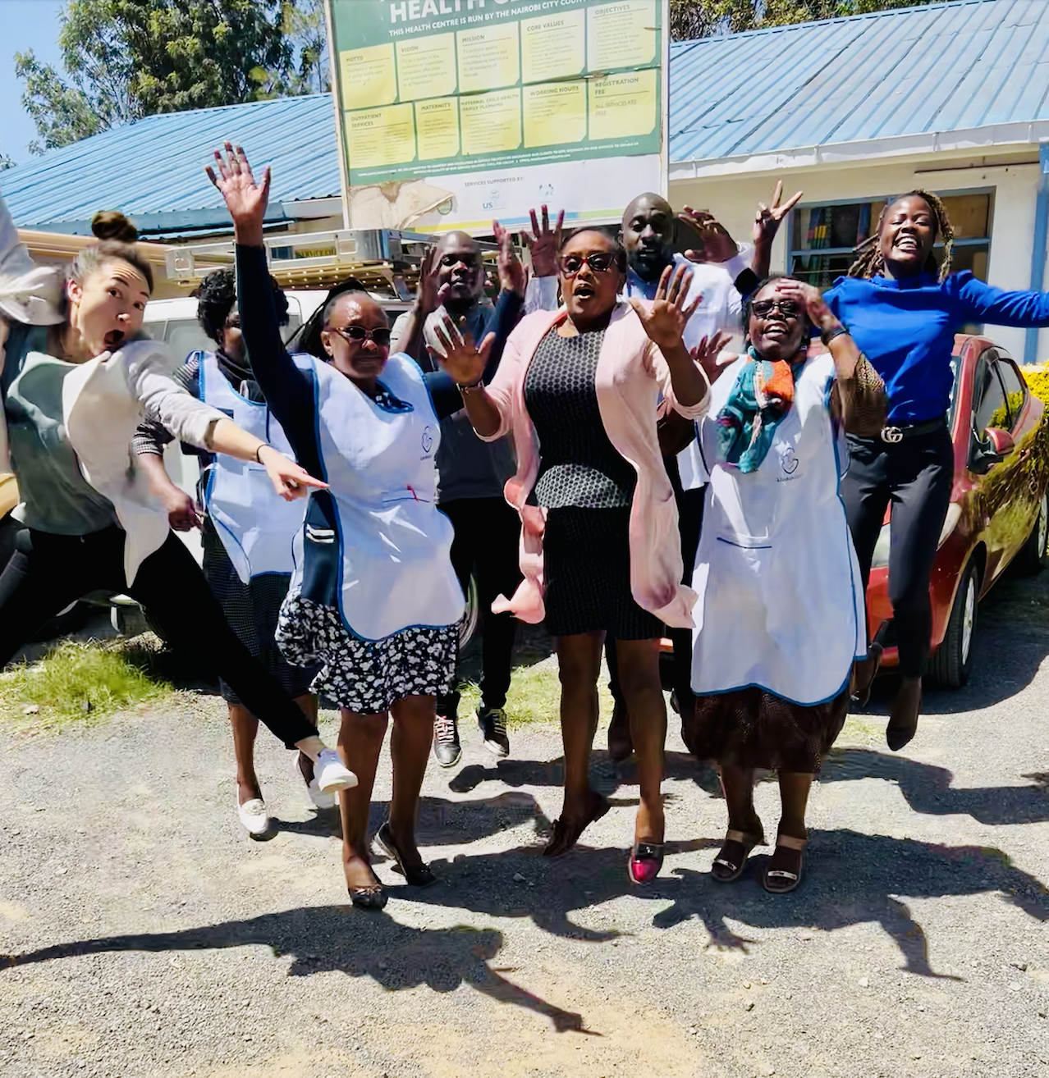
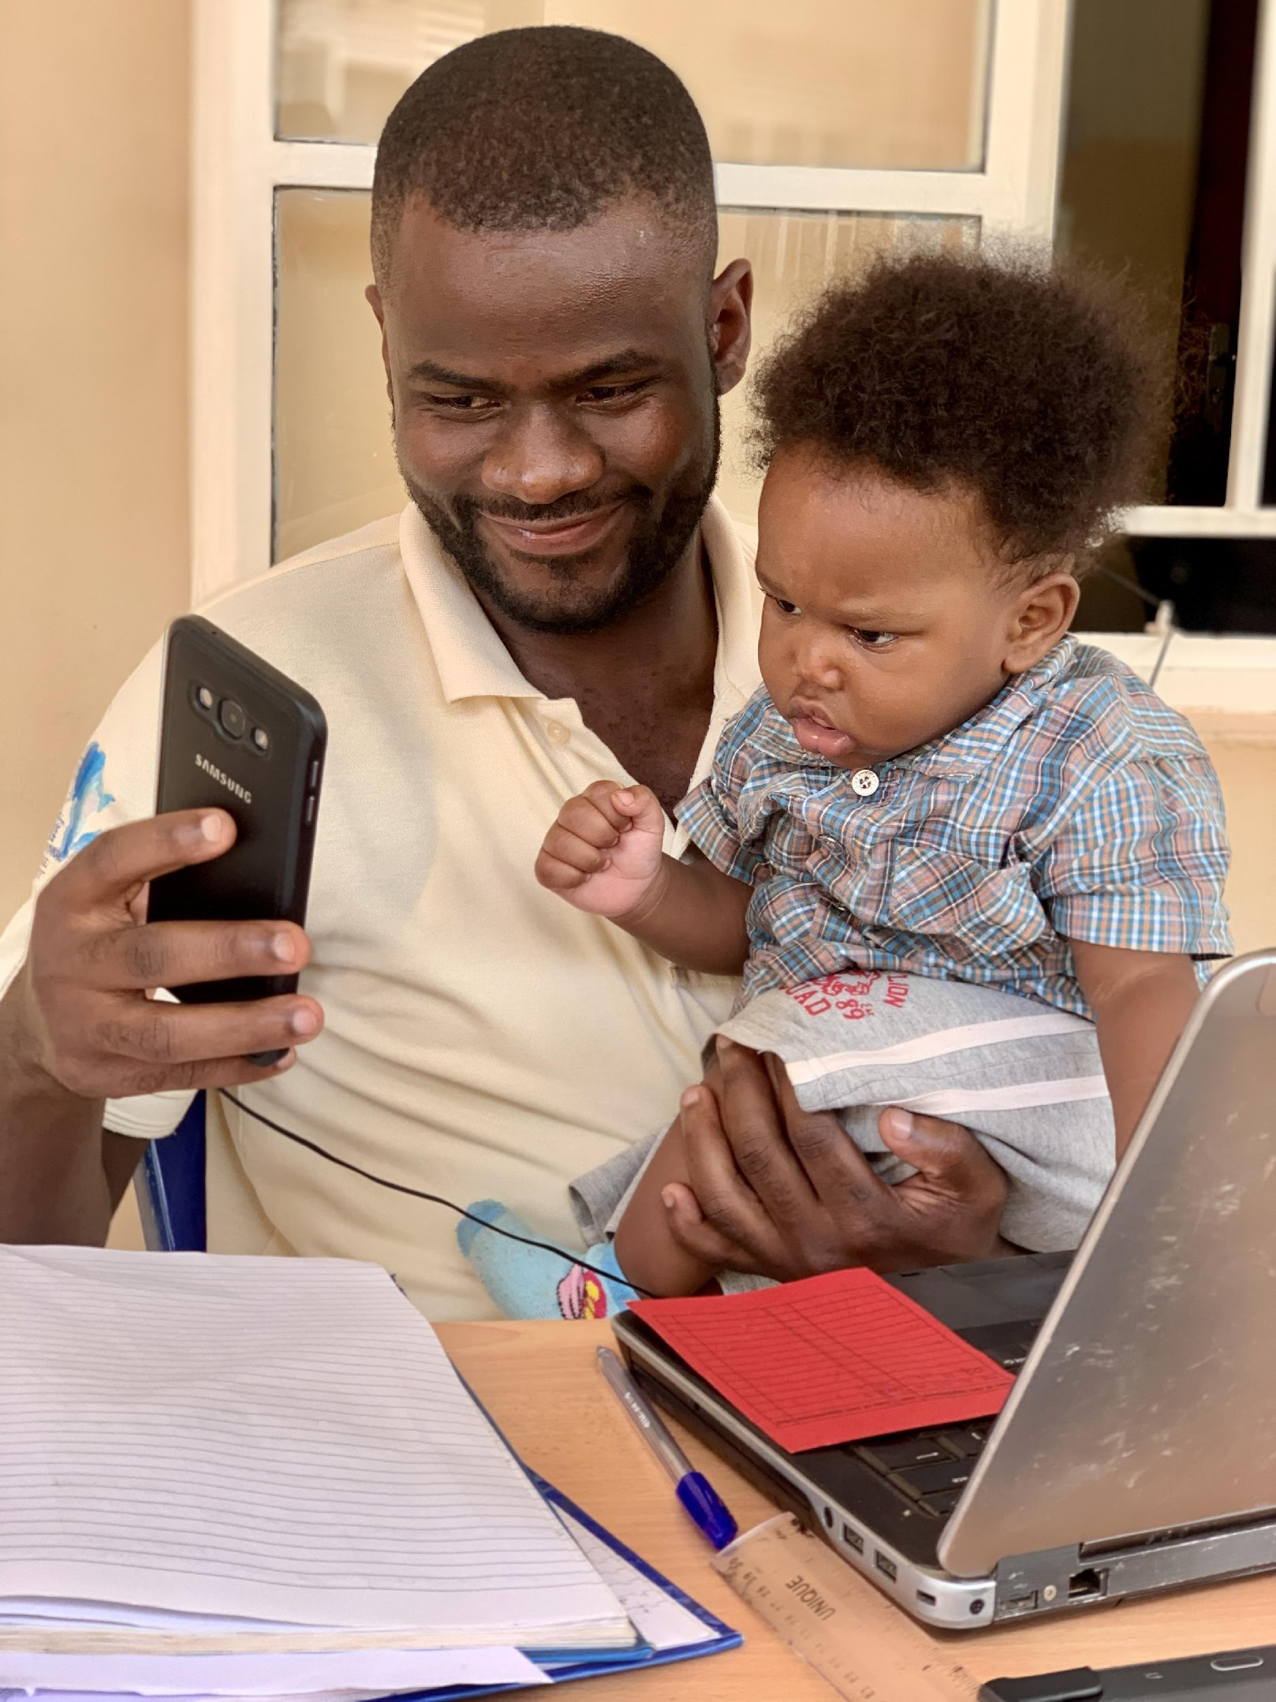

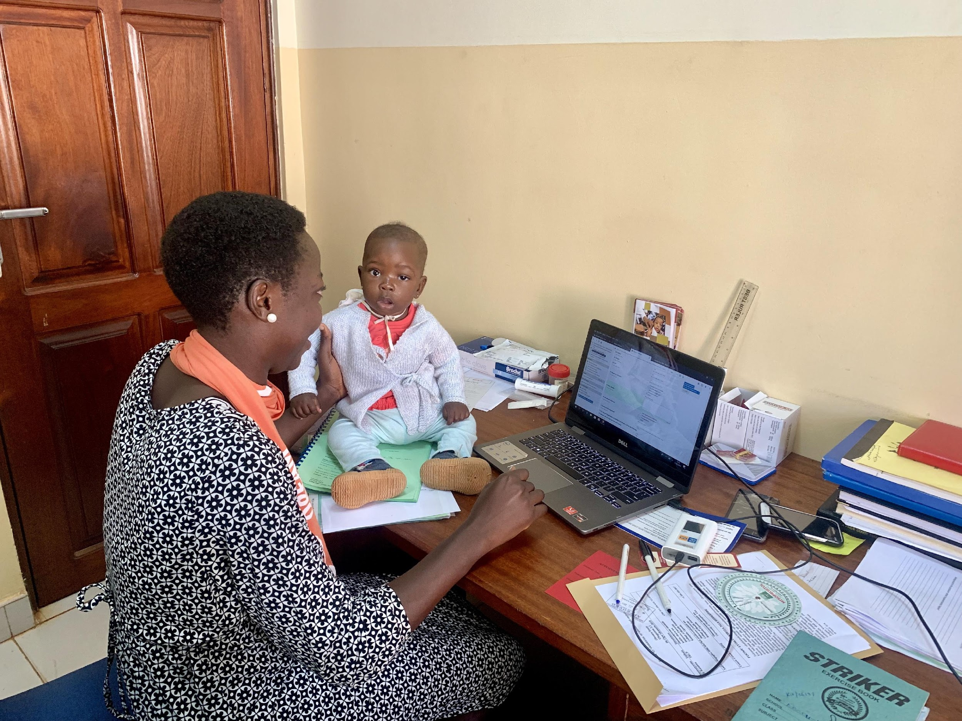
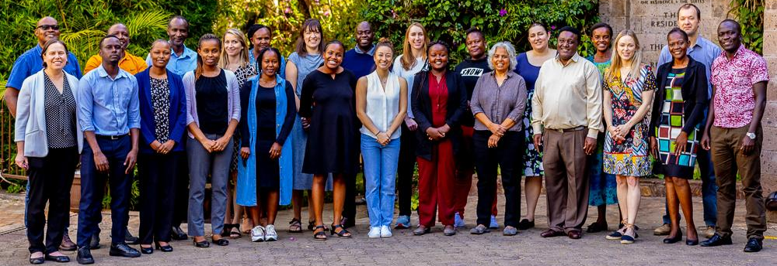
MY ALL-STAR TEAM
THANK YOU
Research teams in Uganda, Kenya, and Botswana

Slide 25







THANK YOU

Slide 26
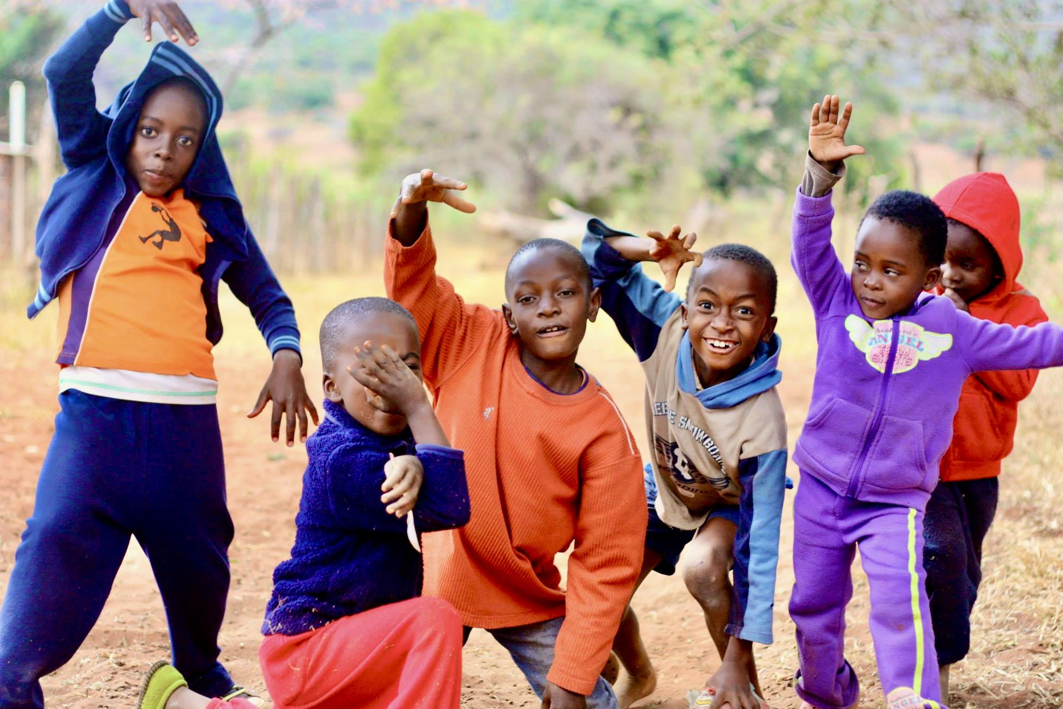
Thank you!
mbult@uw.edu
Photo by Michelle Bulterys

