Slide 1

The current pipeline of LA formulations and products: Implications for infants, children, adolescents, and pregnant women
Charles Flexner, MD
Johns Hopkins University

Slide 2
LA drugs for HIV treatment and prevention:
What’s in the pipeline?

Slide 3
Injectable cabotegravir
and rilpivirine

Slide 4

LONG-ACTING CABOTEGRAVIR + RILPIVIRINE FOR MAINTENANCE THERAPY:
ATLAS WEEK 48 RESULTS
S Swindells,¹ JF Andrade-Villanueva,² GJ Richmond,³ G Rizzardini,⁴ A Baumgarten,⁵
M Masiá,⁶ G Latiff,⁷ V Pokrovsky,⁸ JM Mrus,⁹ J Huang,¹⁰ KJ Hudson,⁹
DA Margolis,⁹ KY Smith,⁹ P Williams,¹¹ WR Spreen⁹
¹University of Nebraska Medical Center, Omaha, NE, United States; ²University of Guadalajara, Guadalajara, Mexico;
³Broward Health Medical Center, Fort Lauderdale, FL, United States; ⁴Fatebenefratelli Sacco Hospital, Milan, Italy;
⁵Center for Infectious Diseases, ZIBP, Berlin, Germany; ⁶Hospital General Universitario de Elche, Alicante, Spain; ⁷Maxwell Centre, Durban, South Africa; ⁸Central Research Institute of Epidemiology, Moscow, Russian Federation; ⁹ViiV Healthcare, Research Triangle Park, NC, United States;
¹⁰GlaxoSmithKline, Mississauga, ON, Canada; ¹¹Janssen Research and Development, Beerse, Belgium

Slide 5
ATLAS Study Design: Randomized, Multicenter, International, Open-Label, Noninferiority Study in Adults with Virologic Suppression (Ongoing)
PI, NNRTI or INSTI†
Current daily oral ART n=308
Screening Phase
Maintenance Phase
Extension Phase‡
CAB LA (400 mg) + RPV LA (600 mg)§
IM monthly n=303
N=705
PI-, NNRTI-, or INSTI-based regimen with
2 NRTI backbone*
Extension Phase or
transition to the
ATLAS-2M study
Randomization
1:1
Oral CAB + RPV n=308
Day 1
Baseline
Week 4‖
Week 48
Week 52
Week 96
Primary Endpoint
ART, antiretroviral therapy; CAB, cabotegravir; CAR, current antiretroviral; IM, intramuscular; INSTI, integrase strand transfer inhibitor;
LA, long-acting; NNRTI, non-nucleoside reverse transcriptase inhibitor; NRTI, nucleoside RTI; PI, protease inhibitor; RPV, rilpivirine; VL, viral load.
*Uninterrupted ART 6 months and VL <50 c/mL at Screening, 2× VL <50 c/mL ≤12 months; †INSTI-based regimen capped at 40% of enrollment; Triumeq excluded from study; ‡Optional switch to CAB LA + RPV LA at Week 52 for those on CAR; §Participants who withdraw/complete IM CAB LA + RPV LA must complete
52 weeks of follow-up; ‖Participants received an initial loading dose of CAB LA (600 mg) and RPV LA (900 mg) at Week 4b. From Week 8 onwards, participants received CAB LA (400 mg) + RPV LA (600 mg) injections every 4 weeks.
- Swindells S, et al. CROI 2019; Seattle, WA. Abstract 1475.

Slide 6
ATLAS Virologic Snapshot Outcomes at Week 48 for ITT-E: Noninferiority Achieved for Primary and Secondary Endpoints
  Virologic Outcomes
CAB LA + RPV LA
CAR
  Adjusted Treatment Difference (95% CI)*
Primary endpoint:
LA noninferior to CAR (HIV-1 RNA
≥50 c/mL) at Week 48
0.6
-1.2
2.5
6% NI
margin
CAR
CAB LA + RPV LA
Difference (%)
Key secondary endpoint:
LA noninferior to CAR (HIV-1 RNA
<50 c/mL) at Week 48
-3.0
−10% NI
margin
-6.7
0.7
Virologic nonresponse (≥50 c/mL)
Virologic success
(<50 c/mL)
No virologic data
Difference (%)
CAB, cabotegravir; CAR, current antiretroviral; CI, confidence interval; ITT-E, intention-to-treat exposed; LA, long-acting; NI, noninferiority; RPV, rilpivirine.
*Adjusted for sex and baseline third agent class.
- Swindells S, et al. CROI 2019; Seattle, WA. Abstract 1475.

Slide 7
ATLAS Confirmed Virologic Failure:
CAB LA + RPV LA Arm
Sex, Country, HIV-1 Subtype | Previous CAR | SVF Timepoint | Viral Load at SVF/CVF (c/mL) | SVF Timepoint RAMs (HIV-1 RNA) |  | Drug Sensitivity at SVF† (Fold Change) | Baseline RAMs (PBMC/HIV-1 DNA; Day 1)
 |  |  |  | RT | INSTI* |  | RT | INSTI*
F, Russia, A/A1 | 3TC, AZT, LPV/r | Week 8 | 79,166 / 25,745 | E138A | L74I | RPV (2.4) CAB (0.8) DTG (0.9) | E138E/A | L74I
F, France, AG | 3TC, AZT, NVP to 3TC, ABC, NVP | Week 12 | 695 / 258 | V108I E138K | None | RPV (3.7) CAB (1.2) DTG (1.0) | V108V/I E138K | None
M, Russia, A/A1 | FTC, RAL, TDF to ABC, EFV, 3TC | Week 20 | 544 / 1841 | E138E/K | N155H L74I | RPV (6.5) CAB (2.7) DTG (1.2) | None | L74I
Plasma CAB and RPV concentrations at the time of failure were below the population means but within the range for the large majority of individuals who maintained virologic suppression
3TC, lamivudine; ABC, abacavir; AZT, azidothymidine; CAB, cabotegravir; CAR, current antiretroviral; CVF, confirmed virologic failure; DTG, dolutegravir; EFV, efavirenz;
FTC, emtricitabine; INSTI, integrase strand transfer inhibitor; LA, long-acting; LPV, lopinavir; NVP, nevirapine; PBMC, peripheral blood mononuclear cell; r, ritonavir;
RAL, raltegravir; RAM, resistance-associated mutation; RPV, rilpivirine; RT, reverse transcriptase; SVF, suspected virologic failure; TDF, tenofovir disoproxil fumarate.
*L74I is not considered an INSTI RAM by IAS-US guidelines and has no impact on CAB activity;
†Monogram biological /clinical cutoffs are: RPV=2.0, CAB=2.5, and DTG=4.0.
- Swindells S, et al. CROI 2019; Seattle, WA. Abstract 1475.

Slide 8

LONG-ACTING CABOTEGRAVIR + RILPIVIRINE FOR HIV MAINTENANCE:
FLAIR WEEK 48 RESULTS
Chloe Orkin,¹ Keikawus Arasteh,² Miguel Górgolas Hernández-Mora,³ Vadim Pokrovsky,⁴ Edgar T. Overton,⁵ Pierre-Marie Girard,⁶ Shinichi Oka,⁷ Ronald D’Amico,⁸ David Dorey,⁹
Sandy Griffith,⁸ David A Margolis,⁸ Peter Williams,¹⁰ Wim Parys,¹⁰ William R Spreen⁸
¹Queen Mary University, London, United Kingdom; ²EPIMED GmbH, Berlin, Germany; ³ Hospital Universitario Fundación Jiménez Díaz, Madrid, Spain;
⁴Central Institute of Epidemiology, Moscow, Russian Federation; ⁵University of Alabama at Birmingham, Birmingham, AL, United States;
⁶Hôpital Saint Antoine, Paris, France; ⁷National Center for Global Health and Medicine, Tokyo, Japan; ⁸ViiV Healthcare, Research Triangle Park, NC, United States;
⁹GlaxoSmithKline, Mississauga, Ontario, Canada; ¹⁰Janssen Research and Development, Beerse, Belgium

Slide 9
FLAIR Study Design: Randomized, Multicenter, International, Open-Label, Noninferiority Study in ART-Naïve Adults (Ongoing)
Screening
Phase
Induction
Phase
Maintenance Phase
Extension Phase
N=809
ART-naïve
HIV-1 RNA ≥1000
Any CD4 count
HBsAg-negative
NNRTI RAMs excluded*
N=629
DTG/ABC/3TC single-tablet regimen for
20 weeks†
DTG/ABC/3TC
Oral daily n=283
Oral CAB
+ RPV n=283
CAB LA (400 mg) + RPV LA (600 mg)‡
IM monthly n=278
Extension
Study Week
−20
−4
Day 1
4§
48
96
100
Confirm HIV-1 RNA
<50 copies/mL
Randomization (1:1)
Primary Endpoint
3TC, lamivudine; ABC, abacavir; ART, antiretroviral therapy; CAB, cabotegravir; DTG, dolutegravir; IM, intramuscular; HBsAg, hepatitis B surface antigen; LA, long-acting;
NNRTI, non-nucleoside reverse transcriptase inhibitor; NRTI, nucleoside reverse transcriptase inhibitor; RAM, resistance-associated mutation; RPV, rilpivirine.
*NNRTI RAMS but not K103N were exclusionary; †DTG plus 2 alternative non-ABC NRTIs was permitted if participant was intolerant or HLA-B*5701-positive (n=30 as last regimen during induction: n=2 discontinued during induction, n=14 randomized to CAB LA + RPV LA, n=14 randomized to DTG/ABC/3TC arm and continued on DTG plus 2 alternative non-ABC NRTIs
in Maintenance Phase); ‡Participants who withdraw/complete CAB LA + RPV LA enter 52-week long-term follow-up; §Participants received initial loading doses of CAB LA 600 mg and
RPV LA 900 mg at Week 4. Beginning Week 8, participants received CAB LA 400 mg + RPV LA 600 mg injections every 4 weeks.
- Orkin C, et al. CROI 2019; Seattle, WA. Abstract 140LB.

Slide 10
FLAIR Virologic Snapshot Outcomes at Week 48 for ITT-E:
Noninferiority Achieved for Primary and Secondary Endpoints
  Virologic Outcomes
  Adjusted Treatment Difference (95% CI)*
CAB LA + RPV LA
DTG/ABC/3TC
Primary endpoint:
LA noninferior to DTG/ABC/3TC
(≥50 c/mL) at Week 48
-0.4
-2.8
2.1
6% NI
margin
Difference (%)
DTG/ABC/3TC
CAB LA + RPV LA
Key secondary endpoint:
LA noninferior to DTG/ABC/3TC
(<50 c/mL) at Week 48
0.4
-10% NI
margin
-3.7
4.5
Virologic nonresponse (≥50 c/mL)
Virologic success
(<50 c/mL)
No virologic data
Difference (%)
3TC, lamivudine; ABC, abacavir; CAB, cabotegravir; CI, confidence interval; DTG, dolutegravir; ITT-E, intention-to-treat exposed; LA, long-acting; NI, noninferiority; RPV, rilpivirine.
*Adjusted for sex and baseline HIV-1 RNA (< vs ≥100,000 c/mL).
- Orkin C, et al. CROI 2019; Seattle, WA. Abstract 3947.

Slide 11
FLAIR Confirmed Virologic Failures:
CAB LA + RPV LA Arm
Sex, Country, HIV-1 Subtype, Virologic Load (Baseline) | Baseline RAMs (HIV-1 RNA) |  | SVF Timepoint | Viral Load at SVF/CVF (c/mL) | SVF Timepoint RAMs (HIV-1 RNA) |  | Drug Sensitivity at SVF† (Fold Change)
 | NNRTI | INSTI* |  |  | NNRTI | INSTI*
F, Russia, A1, 54K | None | L74I | Week 20 | 373 / 456 | E138E/A/K/T | L74I, Q148R | RPV (7.1) CAB (5.2) DTG (1.0)
M, Russia, A1, 23K | None | L74I | Week 28 | 287 / 299 | K101E | L74I, G140R | RPV (2.6) CAB (6.7) DTG (2.2)
F, Russia, A1, 20K | None | L74I | Week 48 | 488 / 440 | E138K | L74I, Q148R | RPV (1.0) CAB (9.4) DTG (1.1)
One additional participant had oral CAB/RPV dosing interrupted due to a false-positive pregnancy test and upon re-initiation of oral therapy had suspected VF that was confirmed
Plasma CAB and RPV concentrations at the time of failure were below the population means but within the range for the large majority
of individuals who maintained virologic suppression
Three participants in the DTG/ABC/3TC arm had CVF at Weeks 8, 12, and 16, respectively; no drug resistance mutations were selected
3TC, lamivudine; ABC, abacavir; CAB, cabotegravir; CVF, confirmed virologic failure; DTG, dolutegravir; INSTI, integrase strand transfer inhibitor; LA, long-acting;
NNRTI, non-nucleoside reverse transcriptase inhibitor; RAM, resistance-associated mutation; RPV, rilpivirine; SVF, suspected virologic failure; VF, virologic failure.
*L74I is not considered an INSTI RAM by IAS-US guidelines and has no impact on CAB activity; †Monogram biological /clinical cutoffs are: RPV=2.0, CAB=2.5, and DTG=4.0.
- Orkin C, et al. CROI 2019; Seattle, WA. Abstract 3947.

Slide 12
Tolerability of injectable RPV and CBT
Margolis et al., Lancet 2017; 390: 1499-1510

Slide 13
Week 48
Patient satisfaction with injectable RPV and CBT
Week 96

Slide 14
LA Cabotegravir and Rilpivirine – Phase 3 Results
LA-CBT and LA-RPV given q monthly were non-inferior to standard of care ART in 2 Phase 3 clinical trials.
Both drugs were very well tolerated in adults.
Resistance to injectable LA-cabotegravir was rare in Phase 2 and 3 clinical trials (8 cases total), but:
  Always seen in subtype A virus, mostly A1 (East Africa and Eastern Europe).
  All patients had L74I in the integrase gene at baseline.
  All patients had CBT and RPV concentrations in lower quartile.
  Implications for future use and development?

Slide 15
New NNRTIs –

Slide 16
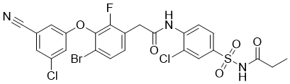
New NNRTIs --
Elsulfavirine

Slide 17
Elsulfavirine Pharmacology
Prodrug of VM1500A (from BMS)
Once-daily or less frequent oral dosing
  Plasma t_{½} ~8 days
Possibility of once-weekly oral dosing
LA subcutaneous formulations in development

Slide 18
Elsulfavirine vs. Efavirenz: Phase 2 Results
Comparable or better ARV activity than efavirenz as a QD drug.
Much better tolerated than efavirenz.
- Murphy RL et al. CROI, 2017, Seattle, WA

Slide 19
New NRTIs–

Slide 20
New NRTIs–
EFdA

Slide 21
Chemical structure of MK-8591 (EFdA)
- Wu VH et al. Antimicrob Agents Chemother 2017

Slide 22
Chemical structure of MK-8591 (EFdA)
- Wu VH et al. Antimicrob Agents Chemother 2017

Slide 23
4’-Ethynyl-2-fluoro-2’-deoxyadenosine (EFdA)
Unique properties
Unique mechanism of action (translocation inhibitor)
Exceedingly potent (possible dose in humans of <5 mg/day)
Lack of cross-resistance with most NRTI’s
Minor impact of M184V
More active against HIV-2 than other NRTI’s
Long half-life of intracellular TP (>72 hours) in rhesus macaques
Possibility of once-weekly oral dosing
Possibility of implant formulation with dosing interval of >one year

Slide 24
MK-8591 (EFdA) Implant Formulations Release Effective Drug Levels for >180 days
>180-day extended release from solid state formulations after a single injection in rats.
Data suggest the potential to provide coverage for durations up to 1 year.
- Grobler JA et al. CROI, 2/22-2/25, 2016, Boston, MA

Slide 25
MK-8591 (EFdA) Implant Formulations Release Effective Drug Levels for >180 days
>180-day extended release from solid state implant formulations after a single injection in rats.
Data suggest the potential to provide coverage for durations up to 1 year.
- Barrett SE et al. Antimicrob Agents Chemother 2018; DOI: 10.1128/AAC.01058-18

Slide 26
Capsid Assembly Inhibitor–
GS-6207

Slide 27
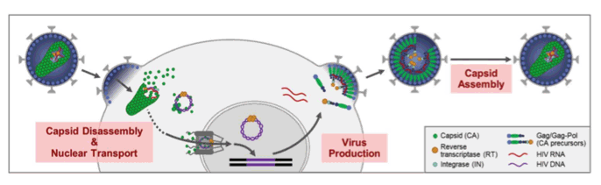
HIV Capsid Inhibitors
X
X
X
- Sager CROI 2019 Abstract #141

Slide 28
GS-6207: HIV Capsid Inhibitor
Novel mechanism of action with unique resistance profile
High antiviral potency (EC₅₀= 50 pM)
Resistant variants have low fitness
Low in vivo clearance
Half-life: 30-43 days
Healthy volunteer PK consistent with long-acting potential
Given as a subcutaneous suspension
GS-6207
- Sagar et al. CROI 2019: Abstract 141

Slide 29
GS-6207 pharmacokinetics following single S.C. administration may support ≥Q3m dosing
Dose | IQ at week 12
450 mg | 4.7
300 mg | 4.1
100 mg | 1.3
30 mg | 0.4
paEC₉₅
At doses ≥100 mg, GS-6207 plasma concentrations at 12 weeks were above the paEC₉₅ of 3.87 ng/mL
  EC₉₅ determined in MT-4 T-Cell Line with WT HIV-1 (IIIB strain). C_{w12}, GS-6207 plasma concentration on Day 84; IQ, inhibitory quotient; paEC₉₅, protein adjusted EC₉₅
- Sagar et al. CROI 2019: Abstract 141

Slide 30
LA/ER technologies:
Implants

Slide 31
LA ARV Implants – Tenofovir Alafenamide
M Gunawardana et al., Antimicrob Agents Chemother 2015; 59: 3913

Slide 32
LA ARV Implants – Tenofovir Alafenamide
M Gunawardana et al., Antimicrob Agents Chemother 2015; 59: 3913

Slide 33
LA/ER technologies:
Transdermal drug delivery?
Microneedles

Slide 34
- Vora LK et al. J Contr Release 2017

Slide 35
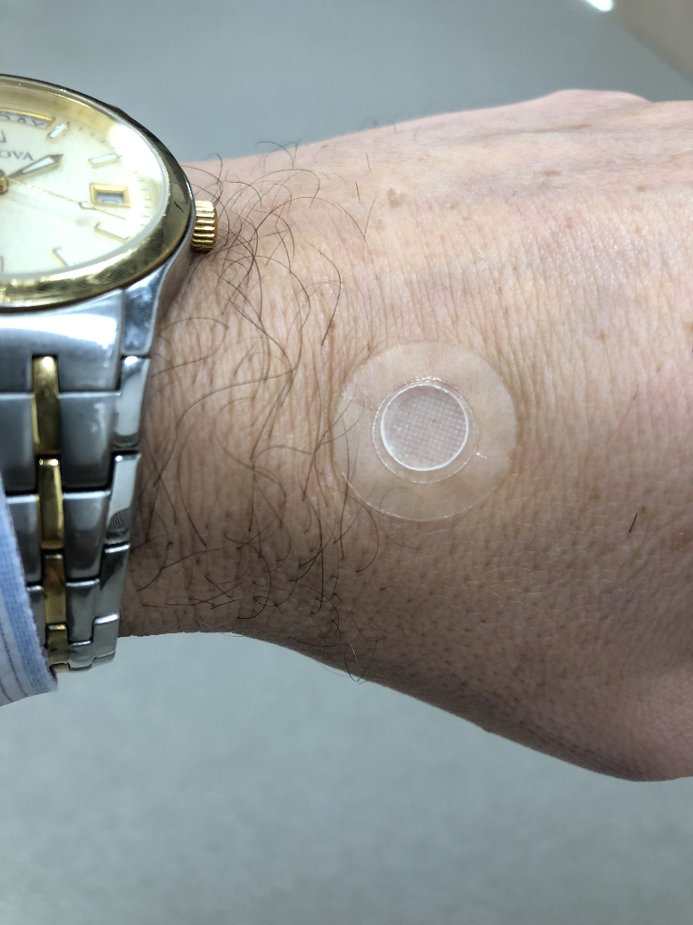
What is it like to wear a microneedle patch?

Slide 36
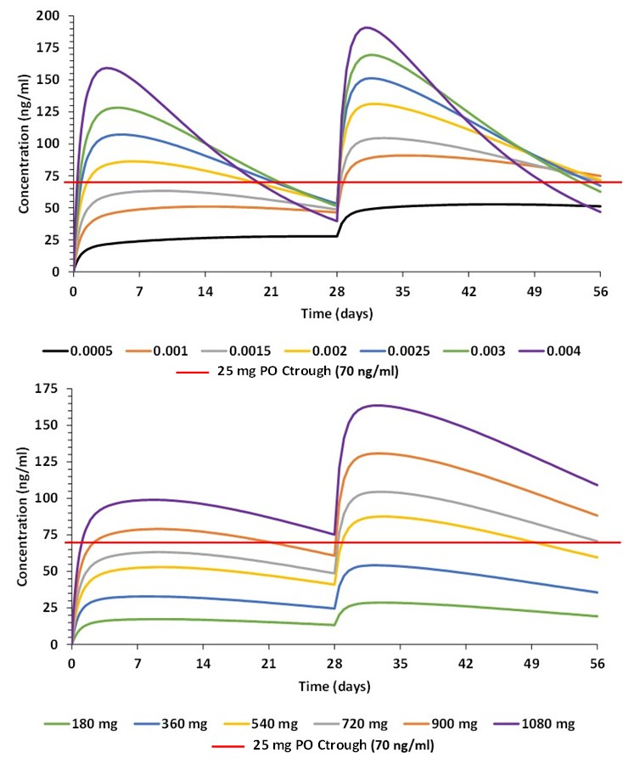
Estimated cabotegravir concentrations after applying a 30-60 cm² microneedle patch (adults)
- Rajoli et al. CROI 2018

Slide 37
Key recommendations for the development of LA/ER formulations for pregnant and breastfeeding women, neonates, children and adolescents:
Results of a Consensus Conference, November, 2017
Sharon Nachman
Elaine Abrams
Claire Townsend
Moherndren Archary
Edmund Capparelli
Polly Clayden
Shahin Lockman
Mark Mirochnick
Kenneth Mayer
Jane McKenzie-White
Patrick Jean-Philippe
Kimberly Struble
Heather Watts
Charles Flexner
- Nachman S et al., Lancet HIV 2019; in press

Slide 38
Key recommendations for the development of LA/ER formulations for pregnant and breastfeeding women, neonates, children and adolescents
Neonates
Neonatal “washout studies” describing the disappearance in the newborn of drug present at birth following in utero exposure are necessary, followed by dosing studies to describe safety and pharmacology in neonates and young infants in order to allow use of novel formulations for neonatal/young infant prophylaxis and early treatment.
Nachman S et al., Lancet HIV 2019; in press

Slide 39
Key recommendations for the development of LA/ER formulations for pregnant and breastfeeding women, neonates, children and adolescents
Children (pre-adolescence)
Protocols for trials of LA/ER formulations in children should be developed alongside adult trials, and pediatric studies should be initiated as soon as early safety data from adult trials are released.
Pediatric clinical trials should simultaneously enroll all pediatric age/weight cohorts, rather than sequentially enrolling cohorts of decreasing age or size.
Long-acting formulations for children should be harmonized across weight bands.
Nachman S et al., Lancet HIV 2019; in press

Slide 40
Key recommendations for the development of LA/ER formulations for pregnant and breastfeeding women, neonates, children and adolescents
Adolescents
Adolescents should be included in adult clinical trials of LA/ER antiretroviral agents, or in separate trials proceeding in close proximity.
Strategies to maximize recruitment and retention of adolescents in clinical trials should be employed.
Nachman S et al., Lancet HIV 2019; in press

Slide 41
Key recommendations for the development of LA/ER formulations for pregnant and breastfeeding women, neonates, children and adolescents
Pregnant and breastfeeding women
Studies of investigational agents conducted in non-pregnant women should allow those becoming pregnant during the trial to remain in the study and on their assigned study drug, with additional informed consent, unless there is clear justification for exclusion.
Pregnant and breastfeeding women should be considered eligible for active enrollment in clinical trials unless there is clear justification for exclusion.
Additional monitoring of maternal, pregnancy and infant outcomes should be undertaken for all women who become pregnant during a clinical trial and all pregnant and breastfeeding women actively enrolled in trials, using a standard protocol.
Nachman S et al., Lancet HIV 2019; in press

Slide 42
Key recommendations for the development of LA/ER formulations for pregnant and breastfeeding women, neonates, children and adolescents
General recommendations
Acceptability studies should be conducted early in the development of LA/ER formulations to understand the attitudes of pregnant and breastfeeding women, children of different ages, and their parents and care providers toward novel drug-delivery systems.
Coordinated action involving all key stakeholders is required from the early stages of development to maximize the chances of success.
Nachman S et al., Lancet HIV 2019; in press

Slide 43


Acknowledgements
Johns Hopkins University
Amer Al-Khouja
David Meyers
Caren Freel Meyers
Jane McKenzie-White
Cornell Weill
Roy “Trip” Gulick
MGH/Partners
Raj Gandhi
Univ. of Liverpool
Rajoth Rajoli
Saye Khoo
Andrew Owen
Marco Siccardi
UNMC
Sue Swindells
FUNDING SOURCES
Bill and Melinda Gates Foundation
NIAID, R24 AI-118397 (LEAP)
NIAID, R01 AI-114405
longactinghiv.org
Notes:
I would like to thank our patients and my coleage for all their hard work on this study.

