Slide 1
Complications & Comorbidities Scientific Committee ICAB 2019

Slide 2
Complications and Comorbidities Scientific Committee
Chair: Allison Agwu
Vice Chair: Mark Abzug⊥
Linda Aurpibul*
Steve Innes*
Suad Kapetanovic
MacPherson Mallewa*
Evans Mpabalwani*
Savita Pahwa
Russell Van Dyke
Adriana Weinberg
Niranjan Karnik
NICHD Rep: Jack Moye
NIAID Rep: Ellen Townley
NIMH Rep: Pim Brouwers
DMC Rep: Alex DiPerna
SDAC Primary Rep: Jane Lindsey
SDAC Secondary Rep: Meredith Warshaw
ICAB Rep: Emanueli Msuya*
LC Rep: Dale Dayton
Ops Center Coordinator: Jen Libous, Sarah Bouisson
SLG Liaison: Grace John-Stewart
*International; ⊥Resigned

Slide 3
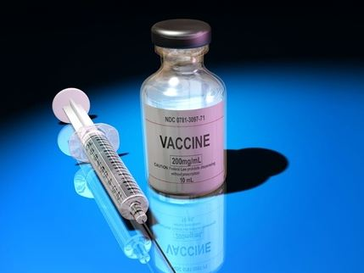
Complications & Comorbidities - 4 Focus Areas
Neurobehavioral impairment
mental health, cognitive impairment
Vaccines (non-HIV)
Chronic inflammation/immune activation
Long Term Complications
HIV and ART

Slide 4
Additional areas that should be fostered include:
Strengthening of community partnership and involvement in all aspects of the research –needs assessment from community (CAB) has highlighted neurocognitive, mental health, cardiovascular disease, adherence (past). Need to reassess in the era of DTG and advancements in HIV treatment
Strengthening of collaboration with commercial or non-commercial product developers in order to facilitate licensure of new ARVs in all pediatric populations…..and to follow the long-term complications
Collaboration with implementors and normative bodies to guide rational and strategic product prioritization and to facilitate, enable and accelerate scale up of efficacious interventions towards maximizing effectiveness. Particularly relevant as we consider making measures and assessment more “field-friendly”; what is scalable?
IMPAACT RFA

Slide 5
Why we should care?
4 year old PHIV suppressed but not talking
16 year old PHIV who “just does not seem right……”
16 year old NPHIV attempted suicide
25 year old pregnant woman with HIV having going into labor at 7 months
23 year old PHIV with heart attack
29 year old PHIV long term suppressed with stroke, neurocognitive deficits, hypertension, hyperlipidemia
34 year old PHIV female not taking her medicine; alive, but not well

Slide 6
Community Research Priorities (2017)
Asia
1. Long term cognitive impairment from ARV
2. Research studies on HIV and HCV co infection
3. Increase rate of bone fracture in HIV infected geriatric (aging population)
Africa
1. More knowledge on HIV and aging
2. Long term effects of drugs to children born to women who are on Option B +
3. Research into methods of counteracting growth and cognitive delays of children infected with HIV.
South America
1. Correlation between congenital HIV infection and psychiatric/psychological problems.
2. Correlation between diseases of the central nervous system and the development of AIDS in patient’s post-infection with HIV.
3. Drugs/medication to avoid lipodystrophy and/or revert lipodystrophy.
United States
1. Long term effects of PrEP and ARV medications in HIV-positive and exposed youth/ young adults as they age (eg bone density, immune functioning, inflammation, cardiovascular, pulmonary, endocrine, renal, liver, memory, vision, hearing).
2. Long term neurocognitive effect of ARVs in HIV+ and exposed children and young adults
3. Relationship of immune activation effects on the body and optimal ways to treat mental health and social support needs of adolescents (depression, anxiety, stigma

Slide 7
Summary of Priorities by Region
Priorities | Asia | Africa | South America | U.S.
Cognitive impairment | X | X | X | X
Psychiatric & mental health (depression, anxiety) | X | X | X | X
HIV & HCV co-infection | X
HIV & aging | X
Long term effects of children born to women on option B+ |  | X
Lipodystrophy (prevention & resolution) |  |  | X
Long term complications of HIV & ART | X |  |  | X
Immune activation |  |  |  | X

Slide 8
Neurobehavioral Studies
Completed recent studies:
IMPAACT 1104S: Longitudinal Developmental and Neuropsychological Assessment of the P1060 Clinical Trial Cohort
IMPAACT 2002: Depression among adolescents (US)
Notes:
PK interactions of ARVs & psychiatric medications*
Methylphenidate , Amphetamine/Dextroamphetamine
Citalopram or Escitalopram
Risperidone
Sertraline
Fluoxetine, Paroxetine
Neurodevelopmental outcomes in African HIV-infected children randomized to LPV/r- v. NVP-based HAART; comparisons to HEU and HUU*
Assess feasibility, reliability, and validity of testing
Compare neuropsychological outcomes

Slide 9
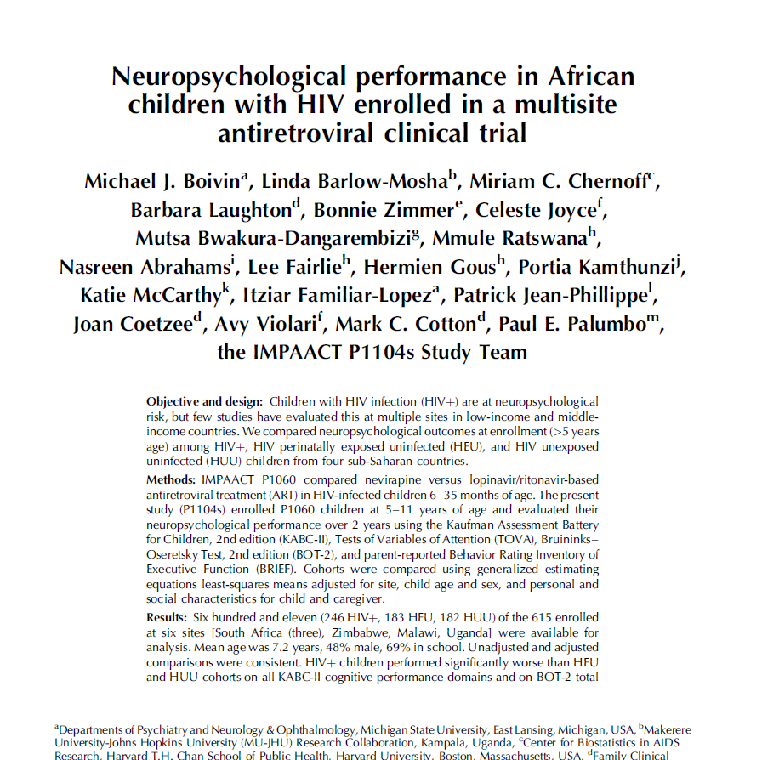
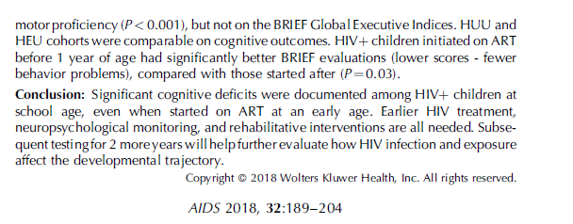
Distal Factors Affecting Neuropsychological Outcomes in Pediatric HIV.
Between-group differences adjusted for site, sex and age at entry, WHO height-for-age Z score, school status, caregiver relation, residential zone, length of time with caregiver, socioeconomic index, MICS disability and MICS development.

Slide 10
Neurobehavioral Studies
NWCS 602 | Neurobehavioral and neuropsych outcomes & inflammation/immune activation (among suppressed) | US
Bearden | Inflammation and neurocognitive outcomes in the broad population (PHACS/1074) | US
2016 | Group intervention for Treatment of Depression among HIV+ youth in low resource settings | INTL
2015 | CSF evaluation of individuals with evidence of decreased neurocognitive function | US
In development:
CAP 548: impact of computerized cognitive rehabilitation training on neurocognitive function. Target population: graduates of P1104s and, possibly, additional, similar patients at P1104s sites. (Boivin R01)
Future planning:
Addition of neurocognitive interventionalist to working group; goal practical, scalable interventions.
Cross-committee collaboration (e.g., neurocognitive complications in P1115)
Notes:
PK interactions of ARVs & psychiatric medications*
Methylphenidate , Amphetamine/Dextroamphetamine
Citalopram or Escitalopram
Risperidone
Sertraline
Fluoxetine, Paroxetine
Neurodevelopmental outcomes in African HIV-infected children randomized to LPV/r- v. NVP-based HAART; comparisons to HEU and HUU*
Assess feasibility, reliability, and validity of testing
Compare neuropsychological outcomes

Slide 11
Vaccines
Completed recent studies:
P1114: Safety and Immunogenicity of RSV Vaccine cps2 (US)
P2000: Safety and Immunogenicity of an RSV Vaccine RSV LID ∆M2-2
P2011, 2012, 2013, and 2018
Notes:
Identify candidate RSV vaccines
HIV uninfected and HIV-infected
Have improved our understanding of the right vehicles, right timing
Complete 1114 & 2000 – RSV vaccines in 6-24 mo old HIV-exposed/uninfected & HIV-unexposed
1114: Accrual completed 10/2014
2000: Enrollment opened 9/2014; suspended
Assessment of preliminary signals: spring 2015

Slide 12
Vaccines
2011 | Phase I Placebo-Controlled Study of the Infectivity, Safety and Immunogenicity of a Single Dose of a Recombinant Live-Attenuated RSV Vaccine, LID ΔM2-2 1030s, Lot RSV#010A, Delivered as Nose Drops to RSV Seronegative Infants 6 to 24 Months of Age | US
2012 | Phase I Placebo-Controlled Study of the Infectivity, Safety and Immunogenicity of a Single Dose of a Recombinant Live-Attenuated RSV Vaccine, LID cp ΔM2-2, Lot RSV#009B, Delivered as Nose Drops to RSV Seronegative Infants 6 to 24 Months of Age | US
2013 | Phase I Placebo-Controlled Study of the Infectivity, Safety and Immunogenicity of a Single Dose of a Recombinant Live-Attenuated RSV Vaccine, D46/NS2/N/ΔM2-2-HindIII, Lot RSV#011B, Delivered as Nose Drops to RSV-Seronegative Infants 6 to 24 Months of Age | US
2018 | Phase I Study of the Infectivity, Safety and Immunogenicity of Two Recombinant Live-Attenuated Respiratory Syncytial Virus (RSV) Vaccines (RSV ΔNS2/Δ1313/I1314L and RSV 276) With Different Modes of Attenuation, Delivered in a Single Dose as Nose Drops to RSV-Seronegative Infants and Children 6 to 24 Months of Age | US
In development:
RSV capsule presented to SLG (approved)
Notes:
Complete 1114 & 2000 – RSV vaccines in 6-24 mo old HIV-exposed/uninfected & HIV-unexposed
1114: Accrual completed 10/2014
2000: Enrollment opened 9/2014; suspended
Assessment of preliminary signals: spring 2015
Identify candidate RSV vaccines
HIV uninfected and HIV-infected

Slide 13
Vaccines
In development: RSV vaccine study among pregnant women (Weinberg)- on hold
Future:
Other vaccines?
Other diseases?
??Hepatitis C among pregnant women and potential use of direct acting antivirals??

Slide 14
Inflammation
NWCS 602 | Neurobehavioral and neuropsych outcomes & inflammation/immune activation (among suppressed) | US
Bearden | Inflammation and neurocognitive outcomes in the broad population (PHACS/1074) | US
Agwu | ASA vs. Fish Oil Statin for those with concern for elevated arterial pressures → risk of cardiovascular disease | US
In development:
CS5020: Low dose ASA for prevention of preterm labor
Future planning: move promising interventions into our populations
-Microbiome working group
-Revisit statins
-Continue to work with PHACS and other networks to identify important co-morbidities to target
Notes:
Agwu protocol not funded. Engaging with Elaine Urbina to try to decipher additional avenues we can pursue

Slide 15
Inflammation/Immune Activation – Next priorities
Assess correlations of inflamm/immune activation & HIV complications (CNS, CV, renal, metabolic)
Inflammation in international settings
Incorporate markers of inflammation into studies of MH interventions
Anti-inflammatory intervention trial?
end-organ assessments (CNS, CVD, renal, metabolic)
neurobehavioral/neuropsych assessments
NOT YET
Notes:
Longitudinal measures of inflammation & CVD risk (PHIV vs. HEU vs. HUU) (R01 1/8/16 submission; baseline data by mid-late 2017??

Slide 16
Complications-Completed studies
1074 | Long-term follow-up study* | US
1076 | Impact of Oral Alendronate on Bone Mineral Density in HIV+ Children & Adolescents with Low Bone Mineral Density⊥ | US/ INTL
1063 | Safety of Atorvastatin for PI-assoc. high LDL cholesterol* | US
1079 | PK of Artemisinin antimalarial therapy within the context of ART | INTL
1084s | Toxicity Related to Tenofovir: Bone & Kidney Substudy of PROMISE* | INTL
*Manuscripts submitted/ in development; ⊥Analysis ongoing
Notes:
Identify candidate RSV vaccines
HIV uninfected and HIV-infected
Have improved our understanding of the right vehicles, right timing
Complete 1114 & 2000 – RSV vaccines in 6-24 mo old HIV-exposed/uninfected & HIV-unexposed
1114: Accrual completed 10/2014
2000: Enrollment opened 9/2014; suspended
Assessment of preliminary signals: spring 2015

Slide 17
Complications & Comorbidities– ongoing studies
PHACS | Pediatric HIV/AIDS Cohort Study/ 219C* | US
In planning/development:
Assessment of DTG and weight gain in PHACS cohort
*Available to query for specific questions

Slide 18
Long Term Complications: Next priorities
Identify key contemporary complications (domestic & international)
DTG and cardiovascular risk??
Assess correlation of inflammation/immune activation with end-organ disease
Domestic and international
Implement one or more intervention studies for specific complications???
Synergize/collaborate with other committees and networks
Notes:
The interventional trial could be the same as the one for inflammation

Slide 19
Other ICAB Priorities
Longterm Observational studies to look for adverse outcomes (e.g., bone toxicity, cardiovascular complications, lipodystrophy, premature aging) of HIV and ART, PMTCT, or PReP
Not high priority for IMPAACT to conduct additional observational or long-term follow-up studies
Attempt to work with other networks (PHACS, NA-ACCORD) to acquire data
Interventional studies!
Studies have been completed for some of the complications (e.g., high lipids, low bone density, ARV-psychiatric medications).
No gold-standard therapies for lipoatrophy and with decreased use of the thymidine analogues, this complication is less commonly seen making studies to address this comorbidity less of a priority to the network.
KEEP TRYING AND TRYING

Slide 20
Other ICAB Priorities
Hepatitis B/C:
Remains a lower priority in IMPAACT.
?Pregnant women??
May consider re-addressing when results of studies of HCV therapies currently in progress in HIV- children are available to inform treatment studies for HIV-HCV-co-infected children.
The Complications and Comorbidities Scientific Committee will consider other interventional studies aimed at priority complications of HIV and its therapy as they become available.

Slide 21
QUESTIONS? DISCUSSION? MORE IDEAS?

