Slide 1
Applications of Antiviral Adherence Monitoring with Dried Blood Spots (DBS)
Kristina Brooks, PharmD, Department of Pharmaceutical Sciences
University of Colorado Anschutz Medical Campus
IMPAACT Lab Director’s Meeting
June 13th, 2019

Slide 2
Objectives
Provide a general overview of the purpose of DBS assessments and relevant interpretations
Review applications of DBS assessments in different populations
Discuss ongoing efforts within IMPAACT and externally to address current research gaps

Slide 3
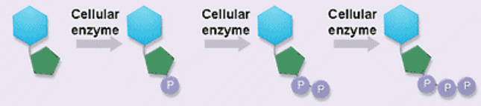
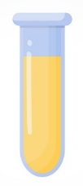


Cell Pharmacology of N(t)RTIs
Active Form
Prodrug/parent
Plasma | PBMCs | RBCs
TDF <5 min TAF ~0.4 hours TFV ~17 hours | TFV-DP ~3-5 days | TFV-DP ~17 days
FTC ~14 hours | FTC-TP ~1.5 days | FTC-TP ~1.5 days
NRTI schematic: https://www.medscape.org/viewarticle/445641_3
Bushman LR J Pharm Biomed Anal. 2011, 56:390-401. Durand-Gasselin AAC 2007 (51):2105-2111. Castillo-Mancilla. 2012 AHRH.
Notes:
Before we fully dive into the DBS assessments, there are a few key concepts regarding the pharmacology of the drugs I’ll be discussing today
Our lab specializes in measuring intracellular concentrations of NRTIs in various cell types
NRTIs are prodrugs – they get activated following entry into target cells following a series of phosphorylation steps, and this is what we ultimately measure in PBMCs and DBS. The intracellular form is critical to measure.
Here on the slide I’m only showing tenofovir and emtricitabine
The half-lives of the parent forms in plasma are MUCH shorter than the active forms within
In plasma the prodrug and parent forms have half-lives on the order of minutes to hours (left column)
Within cells, the phosphorylated moieties have half-lives on the order of days to weeks → “trapped” due to polar charge
FTC-TP has a similar half-life in PBMCs and DBS, but there are notable differences in the half-life of TFV-DP, and the long half-life of 17 days in RBCs is what we really capitalize on for DBS assessments

Slide 4
Adherence Interpretations: Short Half-Life Moieties
Yes/No interpretation (ex: FTC-TP)
→ indicates recent dosing
Yes
(but cannot tell
preceding doses)
Yes
“white coat”
Drug concentrations
Yes
~few days ago
No
Slide adapted from Anderson PL (CROI 2016).
Notes:
Once we quantify NRTIs in DBS, we pair those concentrations with what we know about the drug in question to start working towards an adherence estimate
These can be divided into short half-life moieties and long half-life moieties (covered more on the next slide) – in this case, our short half-life moiety is FTC-TP, but parent drug concentrations in plasma or urine would be other examples to keep in mind
This figure represents drug concentrations at various levels of adherence - daily dosing on the left, missing a few days of dosing, “white coat” adherence where they took a single dose, and then no medication ingestion whatsoever on the right
We cannot differentiate someone who is repeatedly dosing vs. someone who took a single dose right before they came into clinic – drugs with shorter half-lives do no accumulate, so all of these patients look the same even though they have very different adherence patterns

Slide 5
Adherence Interpretations: Long Half-Life Moieties
Accumulation and wide dynamic range (ex: TFV-DP) → estimates cumulative adherence
DOT study to determine 100% adherence “benchmark”
Patient sample
50% of “benchmark” =
50% adherence
Drug concentrations
Misconception: long half-life valuable for detecting “long ago” dosing events
Slide adapted from Anderson PL (CROI 2016).
AY Liu. PLoS ONE 2014 (PMC3885443); Anderson. Sci Transl Med 4, 151ra125 (2012).
Hendrix. AIDS Res Hum Retroviruses. 2016 Jan;32(1):32-43).
Notes:
On the flip side, long half-life moieties, such as TFV-DP, accumulate over time so we end up with a wide, dynamic range of drug concentrations
But critical things to keep in mind are time on therapy relative to time to steady state, and that we ultimately need a study to objectively inform what levels correspond to based on adherence
Then when we collect samples from patients or participants, we can do direct comparisons and estimate that person’s adherence level – in this case, around 50%
Some also think this is helpful for dosing events far in the past, but that’s not where the power of these assessments lie – it’s really the cumulative adherence over time
Another key item to point out is that it’s more difficult to tease out shorter-term changes in adherence owing to the long half-life of TFV-DP

Slide 6
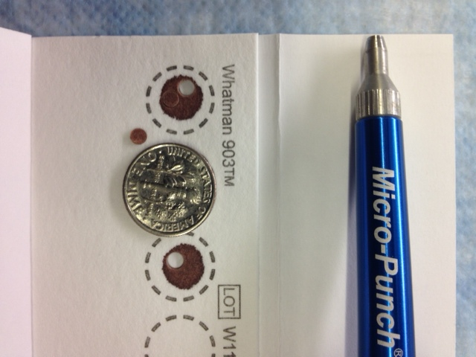
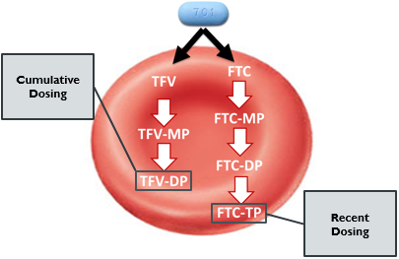
Combining Forces: Short & Long Half-Life Moieties
Pair results from both to gain a better understanding of adherence patterns
Whole blood
(venipuncture or finger-stick)
25µL spot, 3mm punch
Figure from Yager J, et al. CROI 2019. Seattle, WA.
Notes:
This is where combining assessments both TFV-DP and FTC-TP can be very helpful for better examining both long- and short-term medication adherence pattern in patients on both TFV and FTC
We are able to quantify both from the same sample
And what this all starts with is this DBS card on the right – 25 uL whole blood spotted onto a Protein Saver card, we use a standardized punch size, extract and isolate the phosphorylated moieties through a series of steps, then analyze on the LC/MS-MS system

Slide 7
DBS Applications
HIV pre-exposure prophylaxis (PrEP)
HIV treatment
HCV treatment
Notes:
There are multiple examples of how DBS is being integrated into clinical research and being used as a tool for objectively monitoring adherence
Will show examples from three key populations from previous/ongoing research within our groups

Slide 8
PrEP: Adherence and Efficacy
86% RR
(21%-99%)
100% RR (95%CI 86-100)
HIV Incidence
Lower HIV risk
Grant, et al. 2014. Lancet Infect Dis (PMID 25065857).
Notes:
The first few examples regard PrEP PrEP: we do not have a biomarker for monitoring efficacy aside from drug concentrations in this population
We know adherence has been an issue in some PrEP studies – generally have shown that the percentage of participants with detectable concentrations is associated with higher PrEP efficacy, but this is really a yes vs. no interpretation
DBS was a critical addition to the field as this gave the ability to look at cumulative medication adherence in the context of efficacy
This figure comes from the IPREX OLE study which shows the HIV incidence as a function of TFV-DP in DBS.
The DBS concentrations are categorized by adherence interpretation. the horizontal line represents the off-PrEP HIV rate.
The blue line represents the rate in by TFV-DP concentrations.
The Relative risk reduction R above a TFV-DP of 700 which represented 4 doses/week on average.
But to be able to tie together drug concentrations with known adherence estimates, additional studies were needed

Slide 9
HIV PrEP: Adherence Gradients with TDF
HIV-uninfected adults (n=48) received TDF/FTC under DOT
(NCT02022657, PI: Anderson)
100%
7 doses/wk
TFV-DP (fmol/punch) | Adherence Interpretation
>1250 | Daily dosing
700 to 1249 | 4-6 doses/wk
350 to 699 | 2-3 doses/wk
<350 | < 2 doses/wk
TFV-DP (fmol/3 mm punch)
67%
4.7 doses/wk
33%
2.3 doses/wk
Days
Anderson PL, et al. 2018. AAC. (PMID 29038282).
Castillo-Mancilla. 2012 AHRH.
Notes:
Our lab previously conducted a directly observed dosing study of PrEP at three doses, 7 doses week/ 4.7 doses week/2.3 doses week, lead by Dr. Pete Anderson
Concentrations are shown in blue/green/red according to adherence level
You can see a wide-range of concentrations were measured, but relatively clear delineation of adherence groups and dose proportionality
From these, we can generate a table, shown on the right that translates a drug concentration into an adherence interpretation.
These categories are not hard and fast, and there are limitations in that we don’t necessarily know the pattern of missed doses, someone could be misclassified because of biological variability, and these thresholds are lab-specific
However, these benchmark DBS concentrations have been critical for adherence interpretations in PrEP studies and are highly predictive of PrEP efficacy

Slide 10
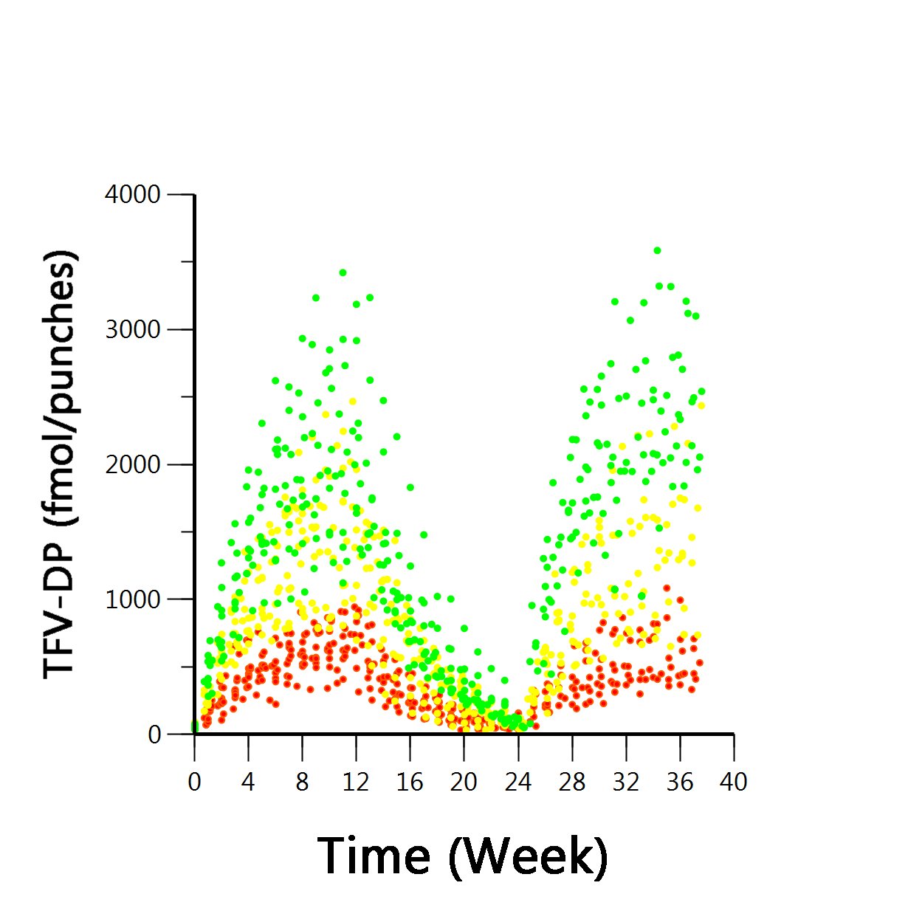
HIV PrEP: Similar Dynamic Range Achievable with TAF
1st dosing regimen
2nd dosing regimen
Washout
HIV-uninfected adults (n=38) received TAF/FTC under DOT
(NCT02962739, PI: Anderson)
100%
7 doses/wk
TFV-DP (fmol/2 x 7 mm punches)
67%
4.7 doses/wk
33%
2.3 doses/wk
Time (weeks)
Yager J, et al. CROI 2019. Seattle, WA.
Notes:
More recently, our lab conducted a study with TAF/FTC applying a similar design of varying adherence patterns to examine the PK of TFV-DP in DBS – these are interim data presented at CROI this past March
Again, you can see a wide dynamic range of concentrations as was seen with TDF, but these concentrations can be separated out according to adherence level
So a similar table will ultimately be developed for TAF/FTC as well
These data will directly complement the DISCOVER study

Slide 11
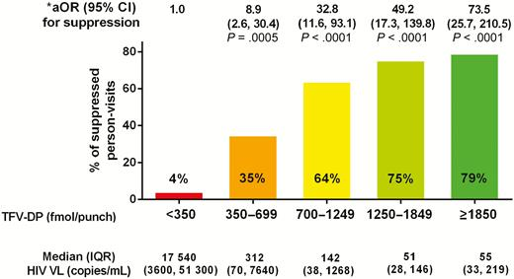
HIV Treatment: Association with Virologic Suppression
Cohort of ~800 PLWH on TDF-based therapy
(NCT02012621,
PI: Castillo-Mancilla)
Higher TFV-DP associated with higher odds of virologic suppression
FTC-TP also predictive of suppression
Association was stronger than self-report
8.5 (95% CI 2.3–30.9; P = .0012) for 100% vs. <28.5% adherence
Castillo-Mancilla JR, et al. Clin Infect Dis. 2019 Apr 8;68(8): 1335-1342.
Frasca K, et al. J Antimicrob Chemother. 2019 Jan 18 [Epub ahead of print].
Notes:
DBS assessments are also applicable to HIV treatment
These data are from a large cohort study of ~800 participants conducted by Dr. Jose Castillo-Mancilla where DBS samples were collected from PLWH on TDF-based therapy
The y-axis indicates % of suppressed person-visits, and the x-axis is categorized according to various adherence thresholds
Adjusted odd ratios are included along the top row, and median (IQR) VL are included along the bottom row
Higher concentrations of TFV-DP were associated with higher odds of virologic suppression, and thus was shown after adjusting for several participant-level characteristics
In the highest category, the odds of viral suppression was 73.5 in comparison to those with DBS <350 fmol/punch
These associations were stronger than self-reported adherence among this same group of individuals

Slide 12
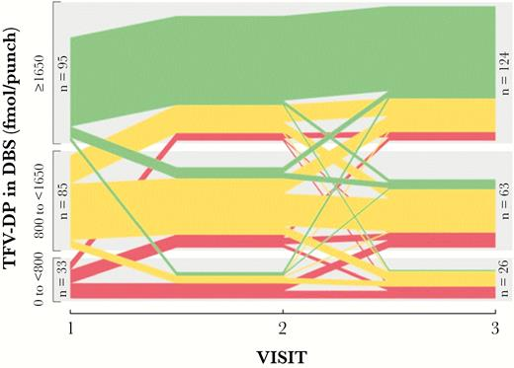
HIV Treatment: Predictive of Future Virologic Suppression
451 PLWH on TDF-based therapy with 3 longitudinal visits over 48 weeks
2.1-fold higher odds vs. ≥1650 fmol/punch
TFV-DP predictive of future viremia, regardless of suppression at current visit
4.7-fold higher odds vs. ≥1650 fmol/punch
Morrow M, et al. J Infect Dis. 2019 Apr 3. pii: jiz144.
Notes:
Took these analyses further within the same cohort, and looked at trends in adherence longitudinally over 48 weeks according to adherence thresholds
Green indicates >1650 fmol/punch, yellow indicates 800 to <1650 fmol/punch, and red indicates <800 fmol/punch
Performed a logistic prediction model and TFV-DP was also predictive of future viremia,
And this held true regardless of whether the participant was suppressed at the current visit

Slide 13
HCV Treatment: Adherence to Sofosbuvir-Based Therapy
P=0.0003
622
(397, 976)
547
(349, 859)
424
(332, 540)
SOF plasma t_{1/2} ~0.4 hours
007-TP DBS t_{1/2} ~4 days
39 persons (237 observations)
with HIV/HCV on LDV/SOF
(NCT02573376, PI: Kiser)
Real-time adherence monitoring with Wisepill® or video-based DOT
007-TP fmol/7 mm punch
P=0.02
Adherence (# doses taken/prescribed)
Rower JE, et al. Antimicrob Agents Chemother. 2015 Dec;59(12):7671-9.
Jimmerson LC, et al. 19th International Workshop on Clinical Pharmacology of Antiviral Therapy [abstract #O_2]. May 2018.
Notes:
These assessments can also be applied to HCV treatment – this study is being lead by Dr. Jennifer Kiser, and is examining the pharmacology of ledipasvir/sofosbuvir (Harvoni) in drug users with HCV infection
Sofosbuvir is an NS5b inhibitor, and similarly to TFV and FTC, the parent sofosbuvir form has a short half-life in plasma, but the active moiety 007-TP has a longer half-life of ~4 days in RBCs
Adherence was monitored in this population using DOT or Wisepill devices, and DBS results into three categories chosen based on where the majority of data fell
Numbers represent geometric mean with a 95% confidence interval calculated from a mixed model accounting for repeated measures and winsorizing values to account for BLQ data.
Those with greater than 75% adherence had significantly higher 007-TP concentrations compared to both the other ADH groups p=0.002.

Slide 14
Future Opportunities
Notes:
Though there are several applications where DBS assessments are useful, there are still several lines of research to pursue

Slide 15
Optimizing DBS Assessments
Personalized estimates
  Demographic and clinical factors^{1,2,3}
  Pharmacogenetics
  Metabolomics⁴
Expansion to other NRTIs
  TAF in PLWH⁵ → R01 recently awarded (PI: Castillo-Mancilla)
  ABC and 3TC in PLWH → ADR Seed Grant (PI: Brooks)
Point-of-care testing and feedback on clinical utility
¹Castillo-Mancilla JR, et al. Clin Infect Dis. 2019 Apr 8;68(8): 1335-1342. ²Jimmerson LC, et al. 19th International Workshop on Clinical Pharmacology of Antiviral Therapy [abstract #O_2]. May 2018. ³Anderson PL, et al. 2018. AAC. (PMID 29038282). ⁴Ibrahim ME, et al. Antiviral PK Workshop 2018. Baltimore, MD.⁵Castillo-Mancilla JR, et al. CROI 2017. Seattle, WA.

Slide 16
Beyond Adherence & Efficacy
Non-HIV related comorbidities
  ~40% higher TFV-DP in PLWH engaged in mental health care vs. those not engaged in care¹
Safety outcomes
  Higher TFV-DP associated with greater endothelial activation, immune activation and inflammation in PLWH²
  TFV-DP not associated with adverse pregnancy outcomes in PROMISE study³
Drug-drug interactions
  Combination of TDF and sofosbuvir results in ~17-fold higher TFV-DP in DBS⁴
¹Coyle RP, et al. AIDS Behav. 2019 Feb 23 [Epub ahead of print]. ²Castillo-Mancilla JR, et al. CROI 2019. Seattle, WA.
³Aizire J, et al. 10th International Workshop on HIV Pediatrics. June 2018. Amsterdam, Netherlands.
³MacBrayne CE, et al. J Antimicrob Chemother. 2018 Aug 1;73(8):2112-2119.
Notes:
DBS utility not limited to adherence/efficacy alone – there are other applications that have recently been presented/published, and this is an area that deserves further investigation

Slide 17
Children & Adolescents
Currently no data on DBS in children, limited data in adolescents, but working on this
IMPAACT 2019: HIV treatment with dispersible and immediate-release DTG/ABC/3TC in children <12 years of age
  DOT lead-in and DBS/PBMC collections
PrEP with TDF/FTC
  ~50% adolescent MSM (age 15-17 years) took >4 doses/wk based on DBS¹
  Transgender adolescents (age 15-24 years) on cross-sex hormone therapy (still enrolling)
¹Hosek SG, et al. JAMA Pediatr. 2017 Nov 1;171(11):1063-1071.

Slide 18
Pregnant & Postpartum Women
Currently no benchmarks, but active area of research
HIV PrEP
  TFV-DP in DBS ~30% lower in pregnant women on PrEP vs. non-pregnant women
  IMPAACT 2009 (fully enrolled): pregnant and non-pregnant women receiving TDF/FTC under DOT → will establish needed benchmarks
HIV treatment
  PROMISE (1077HS): median TFV-DP concentrations ~700 fmol/punch with TDF/FTC + LPV/r
  IMPAACT 2026 (in development): will measure TFV-DP with TAF in PBMCs and DBS during 2nd/3rd trimester and postpartum
Pyra M, et al. AIDS. 32(13):1891–1898, Aug 2018.
Aizire J, et al. 10th International Workshop on HIV Pediatrics. June 2018. Amsterdam, Netherlands.

Slide 19
Conclusions
DBS assessments are critical to understanding cumulative and recent dosing patterns with antiviral medications
Applicability in assessing adherence, efficacy, and other treatment-related outcomes (safety, drug interactions)
Still several opportunities for research in this area

Slide 20




Acknowledgements
Colorado Antiviral Pharmacology Laboratory
Jennifer J. Kiser
Peter L. Anderson
Jose R. Castillo-Mancilla
Lane R. Bushman
Jia-Hua Zheng
Becky Kerr
Lucas Ellison
Martin Williams
Bethany Johnson
David Nerguizian
Laura Roon
Joe Gomez
Jenna Yager
Mustafa Ibrahim
Cricket McHugh
Ryan Huntley
Ryan Coyle
(and past members)
Funding Support
R01 DA040499 (JJK), R01 AI122298 (PLA), K23 AI104315 (JRC-M), R01 AI45453 (JRC-M)

Slide 21
Questions?
Thank you!

Slide 22
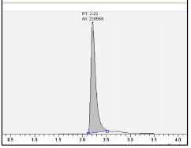
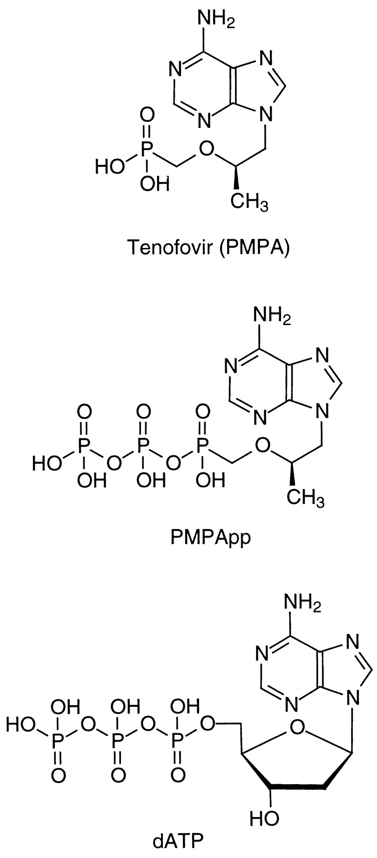
Quantifying NRTIs in DBS
Cell lysis in 70% MeOH
LC-MS/MS
Whole blood
(venipuncture or finger-stick)
25µL spot, 3mm punch
Strong Anion Exchange SPE
Reverse Phase SPE
KCl gradients
Desaltation &
Concentration
TFV-DP
Phosphatase
TFV
Stable labeled TFV
Molar equivalent
Same process for other NRTIs
Slide adapted from Anderson PL (ACTG 2018).
Bushman LR, et al. J Pharm Biomed Anal 2011;56:390–401.
Zheng JH, et al. J Pharm Biomed Anal 2016;122:16-20.
Notes:
This is the general schema for how we quantify intracellular NRTIs (in this example, tenofovir-diphosphate (TFV-DP)) from red blood cells using dried blood spots (DBS)
The DBS cards and punch sizes are on the left
We then perform a series of steps to isolate and purify the phosphorylated NRTI moieties (specialized, labor-intensive process), and then analyze this using LC-MS/MS analysis.
The resulting NRTI concentration is then interpreted for average adherence (doses per week or present/not present).

Slide 23
Analytical Considerations with DBS
Compared RBC vs. DBS from same blood draw – highly correlated, less variability in punch
Cannot create exact QCs
  Clinical DBS replicates used for precision (low and high concentrations)
  Acceptance criteria: CV ≤15%, test condition within ±15% of control
Examined several factors during method development
  Punch location, spot volume (10-50 uL), multiple-punch extraction (up to 3 punches), hematocrit 35-50%, fingerstick vs. venipuncture
Temperature stability
  Room temperature: 5 days
  4˚C: ~3 months
  -20˚C: up to 5 years
Zheng. J Pharm Biomed Anal. 2016 Apr 15;122:16-20. Castillo-Mancilla. AHRH 2012.
Anderson, et al. 2018. AAC. (PMID 29038282).

Slide 24
Precision: Clinical Replicates
Table 1. Precision Assessments | TFV-DP
Inter-Assay and Intra-Assay | fmol/punch
Concentration range (n=5 levels) | 110 to 757
within run (25 triplicates) (%CV) | ≤ 10.5%
between runs (5 levels with n=15 replicates) (%CV) | ≤ 11.6%
Precision of Inter-Cards
inter and Intra-assay (card a and b) (15 triplicates) (%CV) | ≤ 8.5%
% Diff ( card a vs. card b) | ± 9%
Note: % extraction cannot be determined, but extraction is precise
Thus, labs would need to cross-validate methods to use same interpretations
Slide adapted from Anderson PL (ACTG 2018).
Notes:
The triplicate punches provided within-day extraction precision, and the punches on different days (n=5) provided inter-day extraction precision.

