Slide 1
Our voice IS important!
U=U and how one CAB, my UCLA CAB made a difference.
Jayda Arrington, UCLA CAB
June 10, 2019

Slide 2
Who are we? UCLA FAN and C4F CAB
In 2014 our IMPAACT CAB merged with our Ryan White Part D HRSA CAB.
We Are Diverse Group made up of:
Youth, Aging, Care Givers, Partners, Families, Women, Men and Transgender,
Affected by and living with HIV/AIDS, Spanish and English speaking and Patients Community Members.
Core group of 7 or 8, roster of 12, opening it up to include more clinic patients, especially youth and Spanish speakers

Slide 3
What do we do? UCLA FAN and C4F CAB
Meet regularly
Working towards monthly meetings, currently, quarterly to every other month
Challenges -Space, child watch, attendance, coordination
Expectations:
RSVP
Arrive on time
Take minutes or co-chair the meeting
“Attend” on IMPAACT ICAB quarterly call
Attend the LA County Commission on HIV/AIDS meeting
Attend ALL CAB meetings unless there is an extenuating circumstance
Agenda items cover:
IMPAACT Studies
Quality Improvement and DATA review
Education Session
CAB feedback

Slide 4
Where do we meet? UCLA FAN and C4F CAB
Meet regularly
Meet at UCLA and we try to meet in the same meeting room
UCLA is a maze, reply on point and shoot method to locate the room. Members are able to find the room by following the photos on their phone. Before using this method we had to always stop the meeting to go and “find” members.
Child-watch happens in a room adjacent to the meeting space so parents are able to feel comfortable attending the meeting, knowing that their children are right next door.

Slide 5
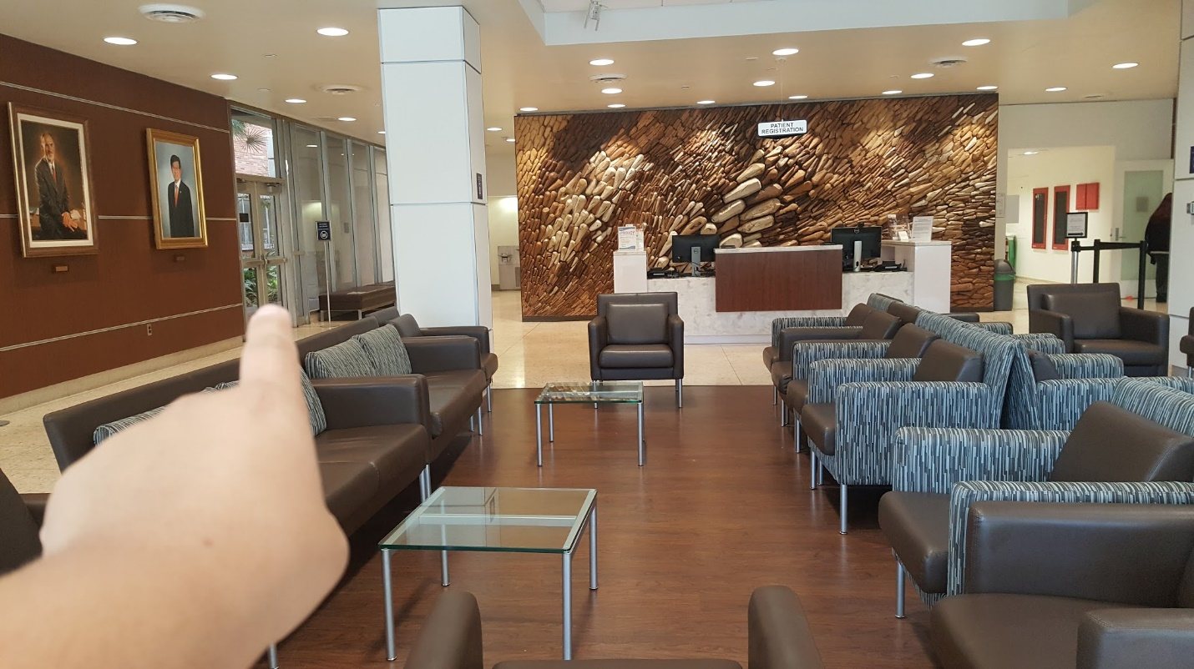
From Dental Clinic Lobby From the lobby, find the glass doors on your left.

Slide 6
Close up...

Slide 7
Go through the doors. You will then see this set of glass doors directly outside...

Slide 8
Go through the doors and make the first right...

Slide 9
Go down this hallway...

Slide 10
Go through these double doors...

Slide 11
Keep going past the “C” elevators on your left.

Slide 12
Keep going...

Slide 13
Keep going...

Slide 14
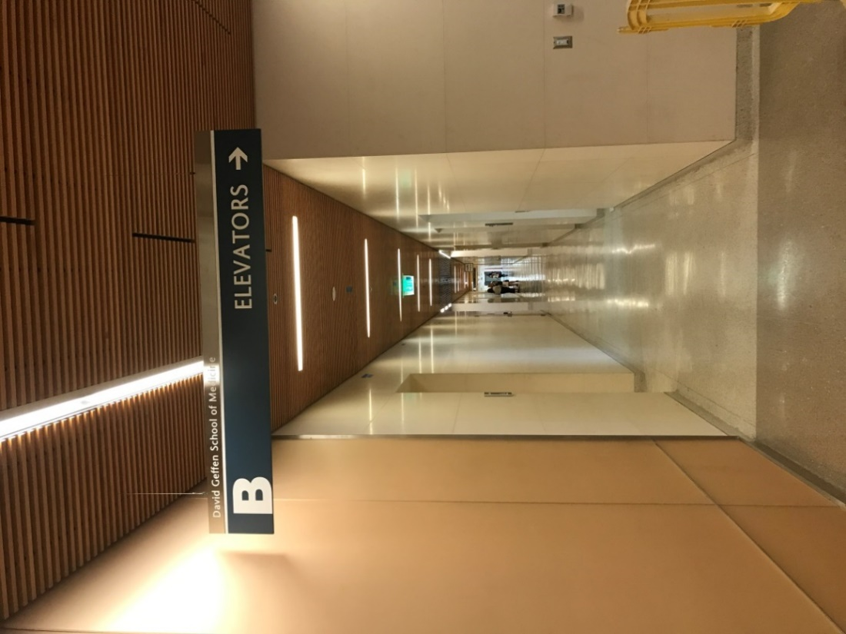
Go past the “B” elevators on your right

Slide 15
Go past the “A” elevators and make the first right.

Slide 16
Brentwood 16-154 will be the second door on your right.

Slide 17
How are we supported? UCLA FAN and C4F CAB
Incentives
Childcare and childcare incentive.
Transportation Assistance.
Lunch, including special requests such as vegan.
Gift Cards – gas and groceries.
Parking available because of CAB member input and request.
Educational updates and/or trainings at every meeting.
Access to and information about conferences and community events.
Networking with each other and other CABs in LA County.
Training to better ourselves.
Access to staff and Clinic Dr/P.I. to share input and to ask questions.

Slide 18
Other ways we are supported UCLA FAN and C4F CAB
Dedicated site staff
Reminder calls and/or emails
Assistance with reviewing the agenda
Dr. Deville:
Attends every CAB meeting and updates us on studies, asks for our input and answers all question.s
Maritza:
Translates all documents into Spanish and works with the Spanish speaking clients.
Shellye:
Coordinates meetings and meets before and debriefs afterwards with the meeting Chairperson and anyone else who requests it.
Natalie:
UCLA Family AIDS Network Director provides administrative support and attends our meetings.

Slide 19
How are we supported? Staff time and Support
Staff brings items to the table and requests our input for not only Care 4 Family and UCLA Family AIDS Network items, but invites other entities access to this CAB, when consumer expertise and input is requested.
The UCLA Center for HIV Identification, Prevention and Treatment Services (CHIPTS) is one of the programs that approached our CAB requesting input on a U=U card.
Next you will see examples of the original card that brought to us and the finished product that went to print AFTER we provided input.

Slide 20
The card on left is the card they thought was good and the card on the left is the reimagined card, after we provided input.

Slide 21
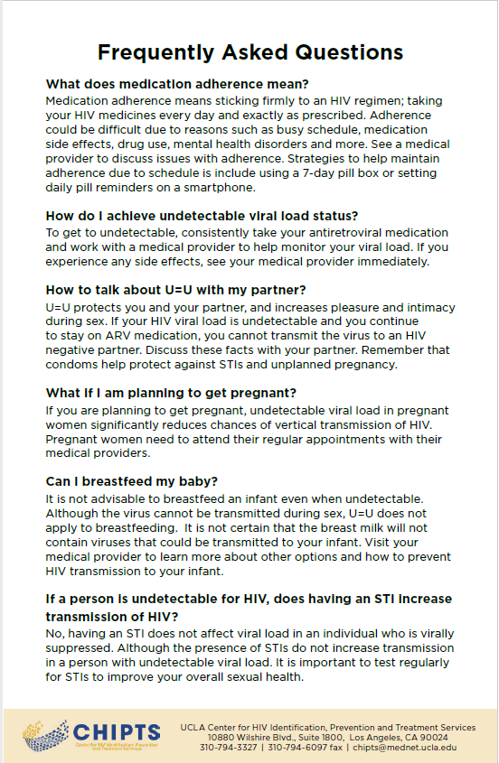
The backside of the card on left is the card they thought was good and the backside of the card on the left is the reimagined card, after we provided input.

Slide 25
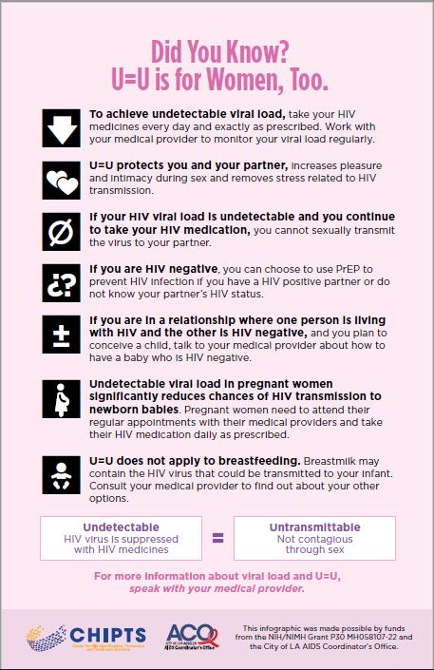

Slide 26
Steal shamelessly, share senselessly Editable Information for the U=U Card
Here is the link for the English cards on the CHIPTS website: http://chipts.ucla.edu
http://chipts.ucla.edu/features/community-advisory-board-creates-uu-for-women-infographic/
It can be edited via Adobe Acrobat or any software that can edit a PDF.
Please feel free to use it and make it your own!
Add your logo or contact information.
The Spanish version should be completed soon and that link will be emailed as well as soon as it has been made available to us.

Slide 27
Thank you and please feel free to contact me or our ICAB liaison if you have any questions.
Jayda Arrington
jaydaarrington@yahoo.com
Shellye D. Jones, MSW, LCSW Clinical Supervisor - UCLAFAN Department of Pediatrics Care 4 Families, Pediatric Infectious Disease 10833 Le Conte Ave, BH 312 MDCC Los Angeles, CA 90095 (310) 794-5635 UCLAFAN (310)825-9175 Fax SDJones@mednet.ucla.edu

