Slide 1
Informed Consent and Assent
ICAB Session at IMPAACT Annual Meeting
10 June 2019

Slide 2
Session Overview
Ethical framework
Definitions
Regulatory requirements
Application in IMPAACT studies
Practical exercises

Slide 3
Resources
US Code of Federal Regulations
45 CRF 46, Protection of Human Subjects
21 CFR 50, Protection of Human Subjects
https://www.ecfr.gov/
US Office for Human Research Protections
https://www.hhs.gov/ohrp/
International Conference on Harmonisation Good Clinical Practice Guideline
Step 4.8, Informed Consent of Trial Subjects
https://www.ich.org/
ClinRegs
online database of country-specific clinical research regulatory information
https://clinregs.niaid.nih.gov/
Notes:
Also mention institutional and local IRB/EC policies, procedures, templates, and other resources

Slide 4
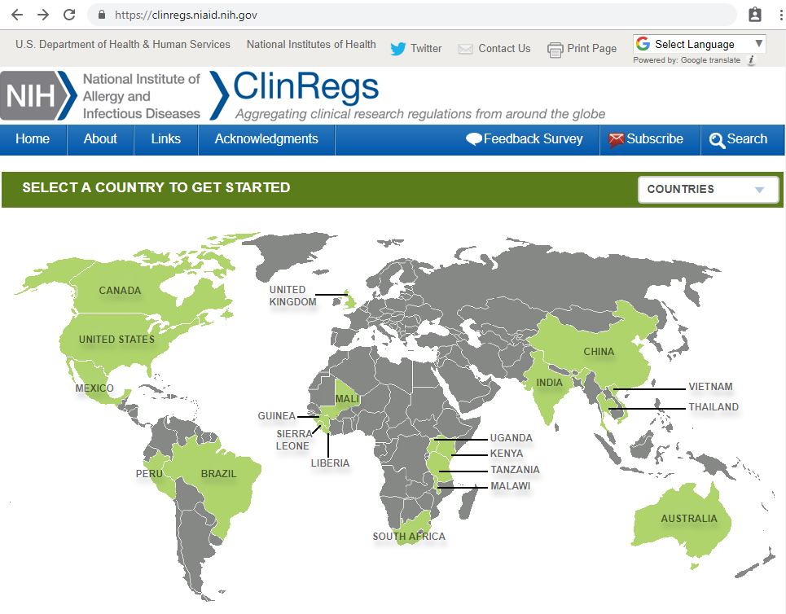

Slide 5
Terminology
What is informed consent?

Slide 6
Informed Consent
The process by which a patient learns about and understands the purpose, benefits, and potential risks of a medical or surgical intervention, including clinical trials, and then agrees to receive the treatment or participate in the trial.
medicinenet.com

Slide 7
Informed Consent
A voluntary agreement to participate in research. It is not merely a form that is signed but is a process in which the participant has an understanding of the research and its risks.
USC Office for the Protection of Research Subjects
https://oprs.usc.edu/
Notes:
Sometimes health care workers refer to an consent form as an “informed consent.” This is not quite accurate. Informed consent is the process and actions that take place as a person learns about and thinks about participation in research before you agreeing to it. Signatures on the form are taken to be evidence that this process took place, but the informed consent form cannot substitute for an adequate process.

Slide 8
Informed Consent
Why must informed consent be obtained?

Slide 9
Informed Consent
Why must informed consent be obtained?
Informed consent is rooted in the ethical principle of respect for persons
Individuals as autonomous agents
Individuals with diminished autonomy are entitled to increased protection

Slide 10
General Requirements for Informed Consent (1)
45 CFR 46.116
Before involving a human participant in research covered by this policy, an investigator shall obtain the legally effective informed consent of the participant or the participant's legally authorized representative.

Slide 11
General Requirements for Informed Consent (2)
45 CFR 46.116
An investigator shall seek informed consent only under circumstances that provide the prospective participant or the legally authorized representative sufficient opportunity to discuss and consider whether or not to participate and that minimize the possibility of coercion or undue influence.

Slide 12
General Requirements for Informed Consent (3)
45 CFR 46.116
The information that is given to the participant or the legally authorized representative shall be in language understandable to the participant or the legally authorized representative.

Slide 13
General Requirements for Informed Consent (4)
45 CFR 46.116
The prospective participant or the legally authorized representative must be provided with the information that a reasonable person would want to have in order to make an informed decision about whether to participate, and an opportunity to discuss that information.

Slide 14
Informed Consent
A process by which an individual voluntarily expresses his or her willingness to participate in research, after having been informed and understood all aspects of the research that are relevant to his or her decision.

Slide 15
Required Elements of Informed Consent
Basic
Additional

Slide 16
Basic Elements of Informed Consent (1)
45 CFR 46.116
A statement that the study involves research, an explanation of the purposes of the research and the expected duration of participation, a description of the procedures to be followed, and identification of any procedures that are experimental

Slide 17
Basic Elements of Informed Consent (2)
45 CFR 46.116
A description of any reasonably foreseeable risks or discomforts to the participant

Slide 18
Basic Elements of Informed Consent (3)
45 CFR 46.116
A description of any benefits to the participant or to others that may reasonably be expected from the research

Slide 19
Basic Elements of Informed Consent (4)
45 CFR 46.116
A disclosure of appropriate alternative procedures or courses of treatment, if any, that might be advantageous to the participant

Slide 20
Basic Elements of Informed Consent (5)
45 CFR 46.116
A statement describing the extent, if any, to which confidentiality of records identifying the participant will be maintained

Slide 21
Basic Elements of Informed Consent (6)
45 CFR 46.116
For research involving more than minimal risk, an explanation as to whether any compensation and an explanation as to whether any medical treatments are available if injury occurs and, if so, what they consist of, or where further information may be obtained

Slide 22
Basic Elements of Informed Consent (7)
45 CFR 46.116
An explanation of whom to contact for answers to pertinent questions about the research and research participants' rights, and whom to contact in the event of a research-related injury to the participant

Slide 23
Basic Elements of Informed Consent (8)
45 CFR 46.116
A statement that participation is voluntary, refusal to participate will involve no penalty or loss of benefits to which the participant is otherwise entitled, and the participant may discontinue participation at any time without penalty or loss of benefits to which the participant is otherwise entitled

Slide 24
Basic Elements of Informed Consent (9)
45 CFR 46.116
One of the following
A statement that identifiers might be removed from the identifiable private information or identifiable biospecimens and that, after such removal, the information or biospecimens could be used for future research studies or distributed to another investigator for future research studies without additional informed consent from the participant or the legally authorized representative, if this might be a possibility
A statement that the participant's information or biospecimens collected as part of the research, even if identifiers are removed, will not be used or distributed for future research studies

Slide 25
Additional Elements of Informed Consent (1)
45 CFR 46.116
A statement that the particular treatment or procedure may involve risks to the participant (or to the embryo or fetus, if the participant is or may become pregnant) that are currently unforeseeable

Slide 26
Additional Elements of Informed Consent (2)
45 CFR 46.116
Anticipated circumstances under which participation may be terminated by the investigator without regard to the participant's or the legally authorized representative's consent

Slide 27
Additional Elements of Informed Consent (3)
45 CFR 46.116
Any additional costs to the participant that may result from participation in the research

Slide 28
Additional Elements of Informed Consent (4)
45 CFR 46.116
The consequences of a participant's decision to withdraw from the research and procedures for orderly termination of participation by the participant

Slide 29
Additional Elements of Informed Consent (5)
45 CFR 46.116
A statement that significant new findings developed during the course of the research that may relate to the participant's willingness to continue participation will be provided to the participant

Slide 30
Additional Elements of Informed Consent (6)
45 CFR 46.116
The approximate number of participants involved in the study

Slide 31
Additional Elements of Informed Consent (7)
45 CFR 46.116
A statement that the participant's biospecimens (even if identifiers are removed) may be used for commercial profit and whether the participant will or will not share in this commercial profit

Slide 32
Additional Elements of Informed Consent (8)
45 CFR 46.116
A statement regarding whether clinically relevant research results, including individual research results, will be disclosed to participants, and if so, under what conditions

Slide 33
Additional Elements of Informed Consent (9)
45 CFR 46.116
For research involving biospecimens, whether the research will (if known) or might include whole genome sequencing (i.e., sequencing of a human germline or somatic specimen with the intent to generate the genome or exome sequence of that specimen)

Slide 34
Presentation of Information
45 CFR 46.116
Informed consent must begin with a concise and focused presentation of the key information that is most likely to assist a prospective participant or legally authorized representative in understanding the reasons why one might or might not want to participate in the research.
This part of the informed consent form must be organized and presented in a way that facilitates comprehension.

Slide 35
Presentation of Information
45 CFR 46.116
Informed consent as a whole must present information in sufficient detail relating to the research, and must be organized and presented in a way that does not merely provide lists of isolated facts, but rather facilitates the prospective participant's or legally authorized representative's understanding of the reasons why one might or might not want to participate

Slide 36
Terminology
What is assent?

Slide 37
Assent
45 CFR 46.408
Affirmative agreement to participate in research
Notes:
(b) Assent means a child's affirmative agreement to participate in research. Mere failure to object should not, absent affirmative agreement, be construed as assent.
(c) Permission means the agreement of parent(s) or guardian to the participation of their child or ward in research.
(d) Parent means a child's biological or adoptive parent.
(e) Guardian means an individual who is authorized under applicable State or local law to consent on behalf of a child to general medical care.

Slide 38
Assent
When a potential research participant cannot legally provide informed consent for research, consent must be obtained from a parent, guardian, or legally authorized representative
Assent should also be obtained from the participant when applicable

Slide 39
Child Assent
45 CFR 46.408
The IRB shall determine that adequate provisions are made for soliciting the assent of the children, when in the judgment of the IRB the children are capable of providing assent

Slide 40
Child Assent
45 CFR 46.408
The IRB shall determine that adequate provisions are made for soliciting the assent of the children, when in the judgment of the IRB the children are capable of providing assent
In determining whether children are capable of assenting, the IRB shall take into account the ages, maturity, and psychological state of the children involved
Notes:
Youngest age of assent is typically 7 years; IRB decides.
Also consider disclosure issues; for example, does child know his or her HIV status?

Slide 41
Child Assent
45 CFR 46.408
The IRB shall determine that adequate provisions are made for soliciting the assent of the children, when in the judgment of the IRB the children are capable of providing assent
In determining whether children are capable of assenting, the IRB shall take into account the ages, maturity, and psychological state of the children involved
When the IRB determines that assent is required, it shall also determine whether and how assent must be documented.
Notes:
Assent forms should use simple terminology written at an appropriate reading level – often for the youngest participant in the study age range – or multiple forms may be developed for different age groups.

Slide 42
Application in IMPAACT Studies

Slide 43
Application in IMPAACT Studies
Human Subjects Protection section in each protocol
IRB/EC review and approval
Vulnerable participants
Informed consent
Potential benefits
Potential risks
Reimbursement/compensation
Privacy and confidentiality
Communicable disease reporting
Management of incidental findings

Slide 44
Application in IMPAACT Studies
Sample informed consent form included in each protocol
For participants who can provide independent informed consent
For parents/guardians of participants who cannot roved independent informed consent
Sample assent form also included when applicable

Slide 45
Application in IMPAACT Studies
IMPAACT Protocol Teams are responsible for developing these forms and ensuring:
All regulatory requirements are met
All information that a reasonable person would want to have is included
All information is understandable

Slide 46
Application in IMPAACT Studies
IMPAACT Protocol Teams are responsible for developing these forms and ensuring:
All regulatory requirements are met
All information that a reasonable person would want to have is included
All information is understandable

Slide 47
Application in IMPAACT Studies
IMPAACT study sites must adapt the sample forms from the protocols following all applicable regulations and IRB/EC requirements
Following all applicable regulations and IRB/EC requirements
Incorporating site-specific procedures and contact details
Translating into all applicable local languages

Slide 48
Application in IMPAACT Studies
IMPAACT study sites must adapt the sample forms from the protocols following all applicable regulations and IRB/EC requirements
Following all applicable regulations and IRB/EC requirements
Incorporating site-specific procedures and contact details
Translating into all applicable local languages

Slide 49
ICAB members can provide input to Protocol Teams as part of protocol document reviews
ICAB and local CAB members can provide input to study site staff as part of development of site-specific forms

Slide 50
Let’s work together …

Slide 51
Let’s work together …
Refer to handout with IMPAACT 2019 study schema on pages 1-2

Slide 52
IMPAACT 2019
This study is testing fixed dose combination ABC/DTG/3TC tablets in children less than 12 years of age
Children who weigh 25 kg or more will take solid formulation Triumeq tablets (approved in the US for adults and children who weigh at least 40 kg)
Children who weigh less than 25 kg will take dispersible tablets
The three drugs in the combined tablets have each been tested for children in prior studies; this is the first study of the combined tablets in younger children

Slide 53
The regulations require informed consent forms to include an explanation of the purposes of the research
Think about a parent whose child might take part in this study, how would you explain the purpose of the study in the informed consent form?
Write down some of the terms and sentences you would use …

Slide 54
Now think about a 9 year old child who might take part in this study
How would you explain the purpose of the study in the assent form?
Write down some of the terms and sentences you would use …

Slide 55
IMPAACT 2019
Some children in this study will have intensive PK evaluations at the Week 1 study visit
The Week 1 study visit is described on pages 5-7 of the handout
Children who have intensive PK evaluations will take their ABC/DTG/3TC tablets at the study site and then have blood drawn 8 times over the next 24 hours
These children will also have “directly observed dosing” on each day leading up to the Week 1 study visit (see page 4 of the handout)

Slide 56
The regulations require informed consent forms to include a description of the procedures to be followed
Let us consider the informed consent form: see page 8 of the handout
What are your thoughts on this wording?
What are your suggestions for improvement?

Slide 57
Let us now consider the assent form: see page 9 of the handout
What are your thoughts on this wording?
What are your suggestions for improvement?

Slide 58
What are your questions?

Slide 59
Resources
US Code of Federal Regulations
45 CRF 46, Protection of Human Subjects
21 CFR 50, Protection of Human Subjects
https://www.ecfr.gov/
US Office for Human Research Protections
https://www.hhs.gov/ohrp/
International Conference on Harmonisation Good Clinical Practice Guideline
Step 4.8, Informed Consent of Trial Subjects
https://www.ich.org/
ClinRegs
online database of country-specific clinical research regulatory information
https://clinregs.niaid.nih.gov/

