Slide 1

IMPAACT TB SCIENTIFIC COMMITTEE UPDATE: 2019
Anneke C. Hesseling
Amita gupta
11 June 2019

Slide 2
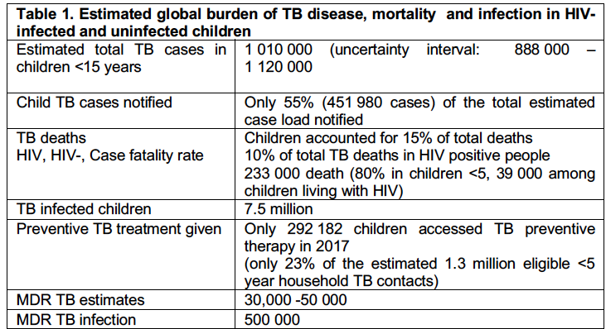

Slide 3
Updated Overall Goals for TB
Evaluate novel approaches for TB prevention, diagnosis and treatment in HIV-infected and uninfected infants, children, adolescents, and pregnant and lactating women that will lead to optimal dosing and regimens, licensing and improved care.

Slide 4
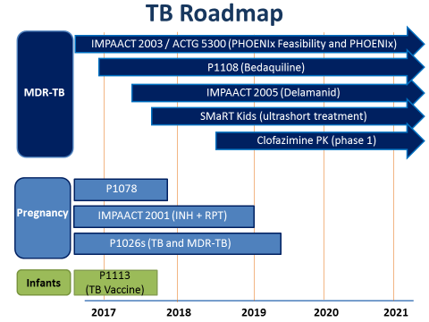

Slide 5
Pretomanid CAP
2026: (DSTB and MDR TB HIV+ & HIV-
Prevention
1 HP CS 5109: children
1 HP 3 HP CS 5021

Slide 6
Strategy
Studies designed with rapid uptake of findings into policy and practice
Phase I/II trials where efficient
Phase III as required
Earlier inclusion of adolescents
Inclusion of pregnant and lactating women
Collaboration with industry
Cross-network collaboration (HVTN, ACTG, TBTC,PADO, GAP-f, other)
Address additional science through nested RFPs/other grants (diagnostics, biomarkers, AMR)

Slide 7
Additional critical cross cutting methods/sciences
Socio-behavioural work core capacity: acceptability, preferences of treatment strategies, measurement of outcomes (e.g. DOOR), adherence
Community engagement
Adolescents and young people
State of the art pharmacometrics to design and analyze PK studies; innovative trial design
TB microbiology expertise
Improved imaging: PTB EPTB
TB vaccines and ACTG/HVTN: immunology, design
Platform opportunities PK for long acting ARVs and DDI protocols: HPTN, ACTG

Slide 8
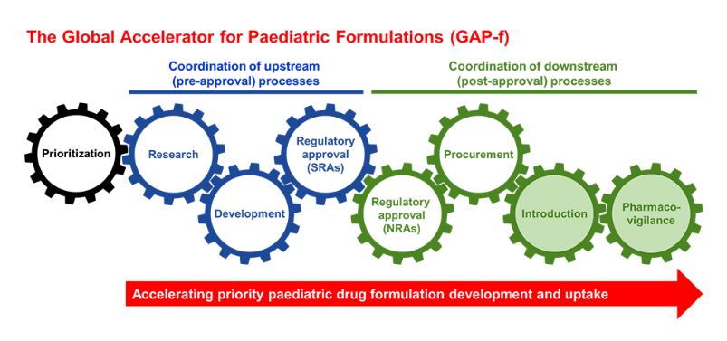
Treatment considerations: children
>75% pulmonary /intrathoracic TB
Wide spectrum of disease
Paucibacillary disease compared to adult pulmonary TB (fewer lung cavities)
Severe and disseminated TB (TBM and miliary TB) especially in young
Treatment outcome in children generally good provided initiated early (paucibacillary)
All treatment data extrapolated from adult studies
Formulations needed to support
appropriate dosing

Slide 9
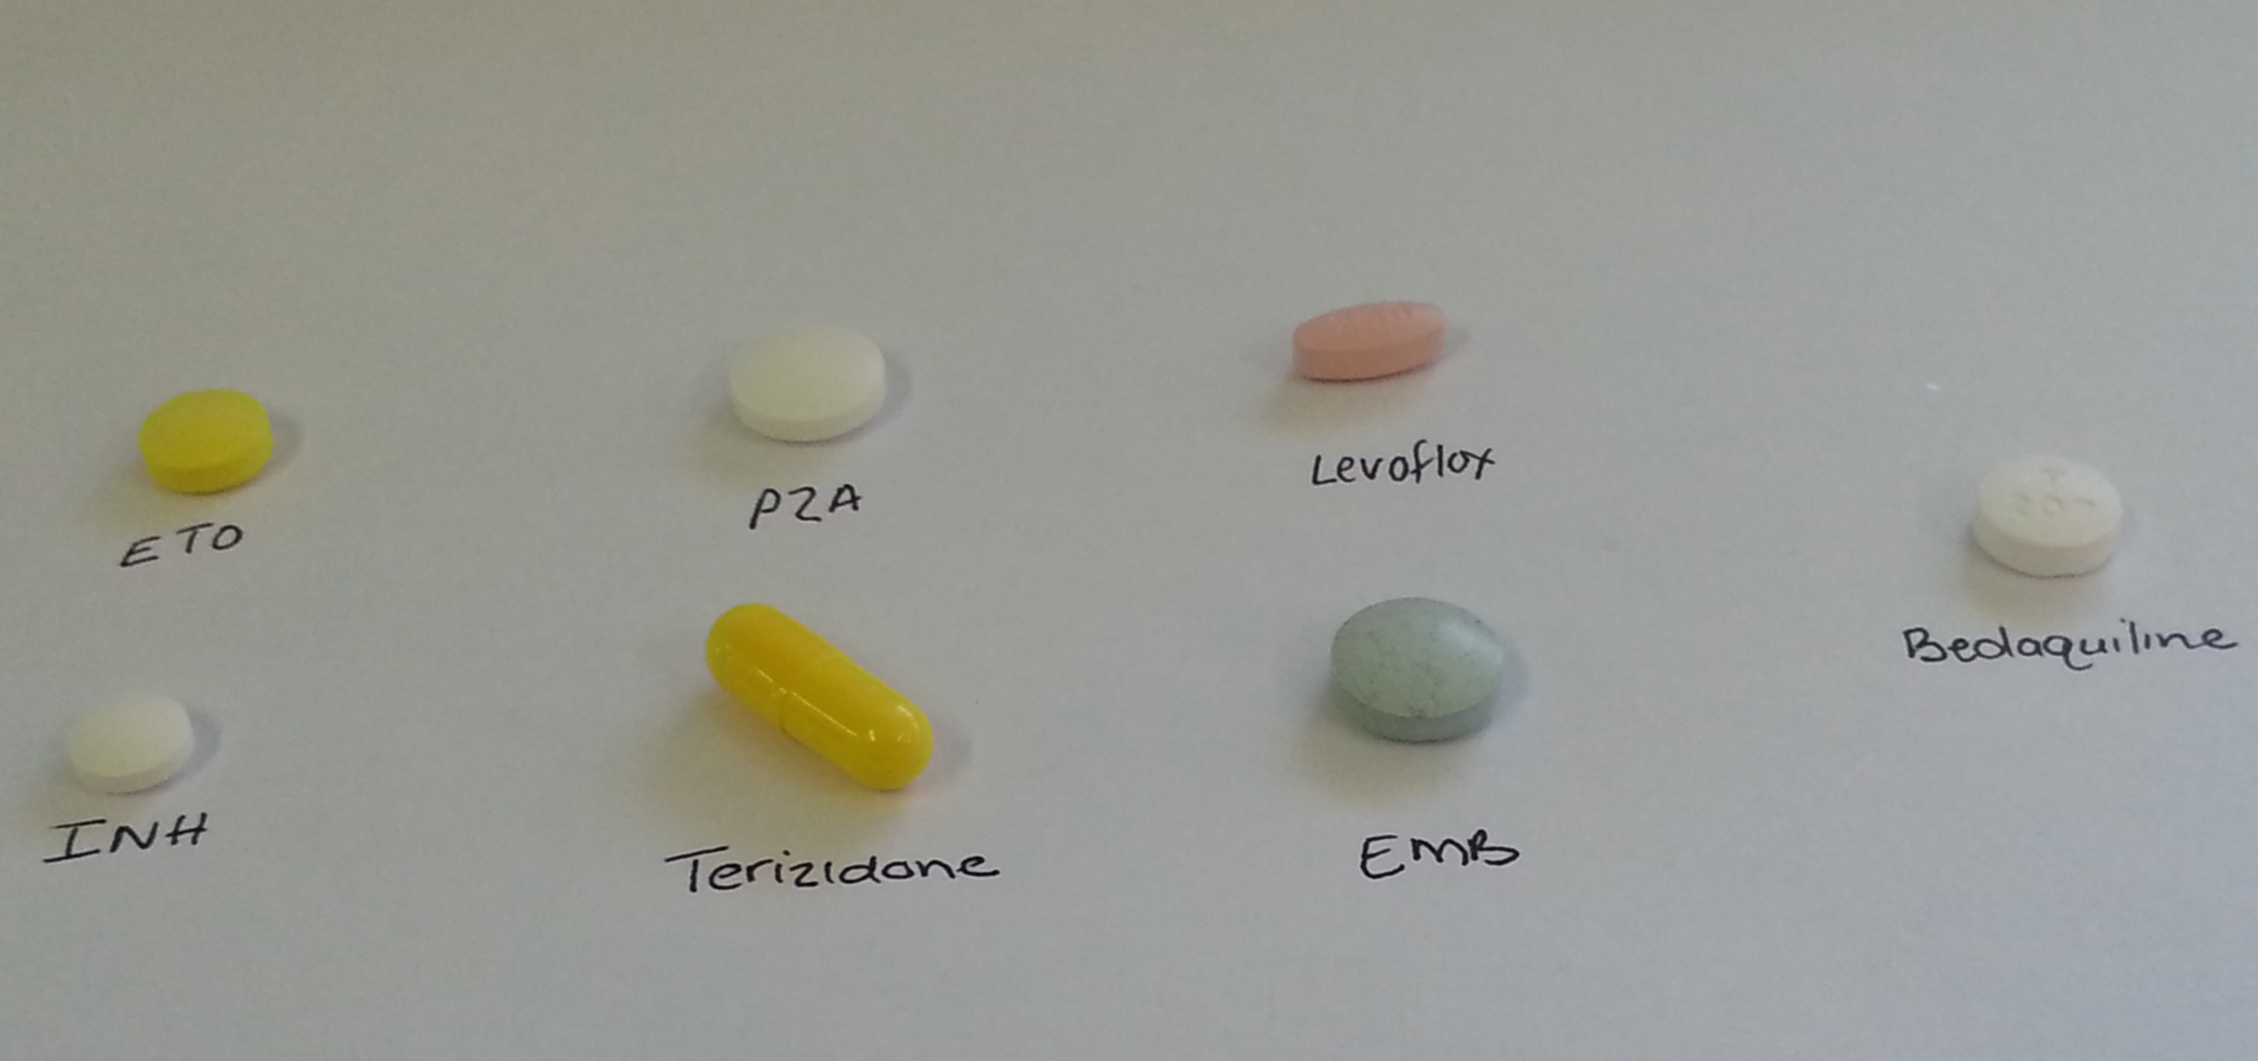
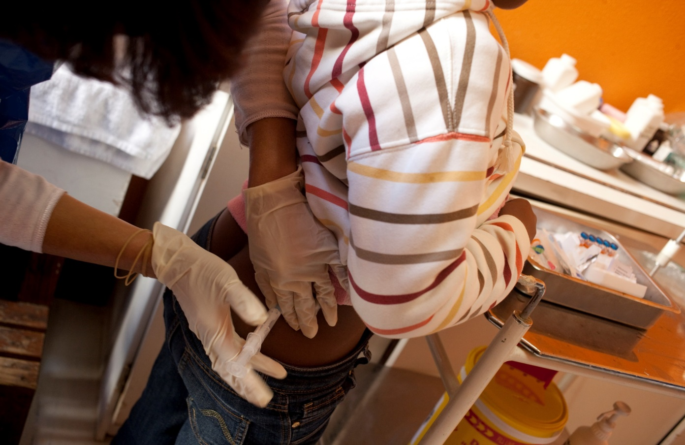
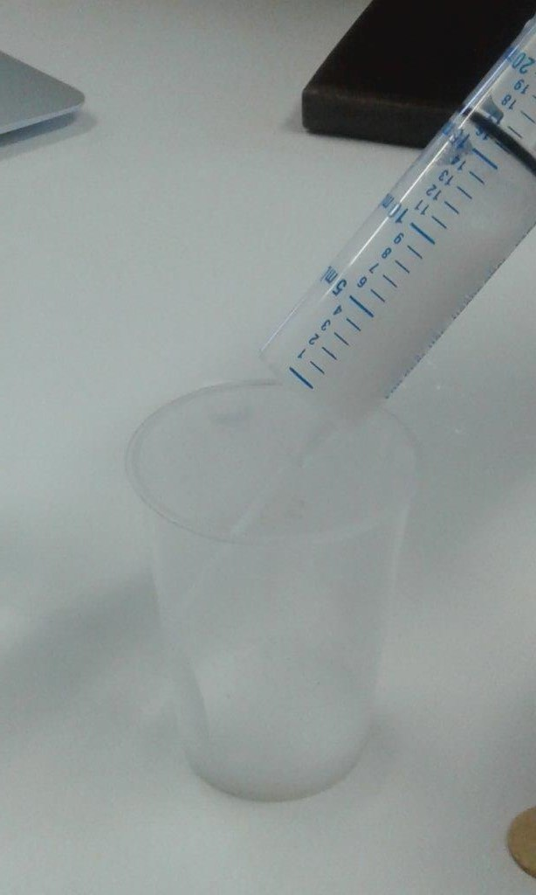
Ofloxacin
200 mg
Levofloxacin
250 mg
Moxifloxacin
400 mg

Slide 10
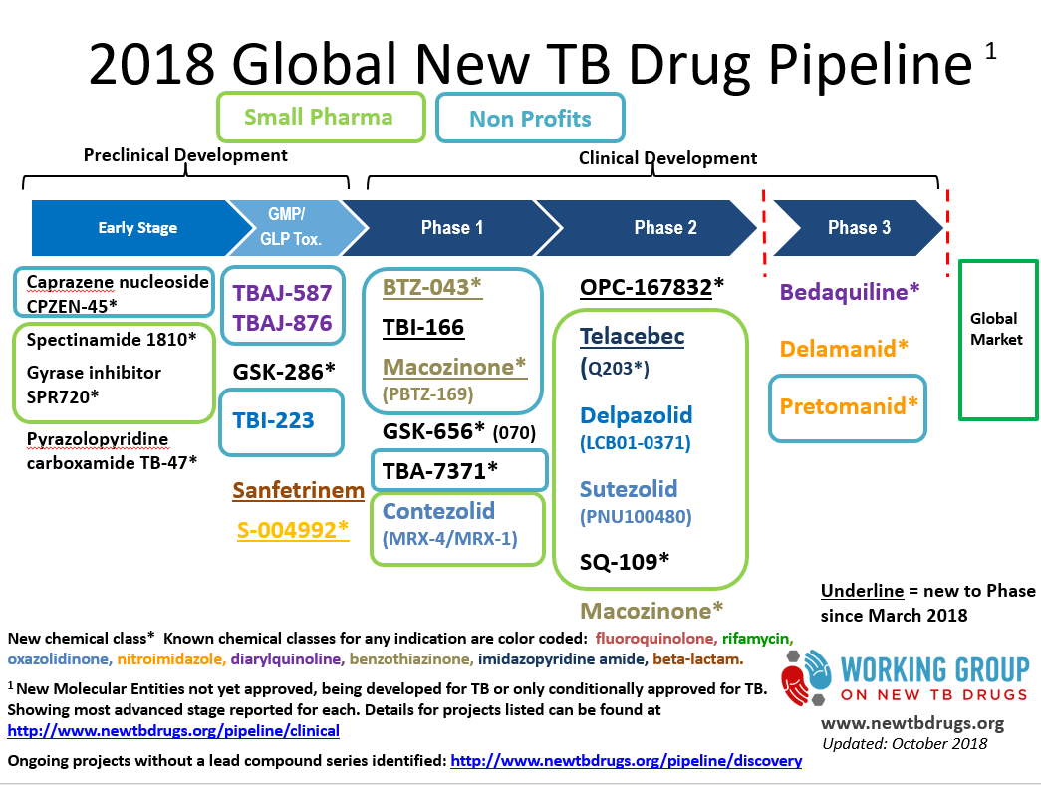

Slide 11
Selected new and existing re-purposed TB drugs for consideration in future IMPAACT trials
Drug class | Producer | Target | Status
Rifamycins Rifapentine* Rifampin* | Sanofi-Aventis | Latent TB Infection TB disease | 1 HP planned (CS 5109) 1 HP vs. 3 HP pregnancy study planned (CS 5021) Treatment shortening of DS-TB: SHINE PLUS
Diaryquinolone Bedaquiline* | Jansen | MDR TB only | P1108 open; P2020
Nitroimidazole Delamanid* Pretomanid* | Otsuka TB Alliance | MDR TB only DS/DR TB | PHOENIX (A5300/I2003) for MDR prevention Pediatric phase I/II planned
Oxazolidinones Sutezolid * Tedizolid * Linezolid phosphate* | TB Alliance Sequellla Prius/Pfizer | MDR TB MDR/DS TB MDR/DS TB/TBM | Pediatric Phase I/II planned (pending adult date) Pediatric Phase I /II planned (pending adult data) Pediatric PK completed
Fluoroquinolones Moxifloxacin Levofloxacin* | Bayer Macleods | DS/DR TB DR prevention | Pediatric PK completed (levofloxacin and moxifloxacin) Phase IIb planned (P2020) TB CHAMP
B-lactams Sanfetrinem. | GSK | DR TB | Pediatric phase I planned based on adult EDCTP data
Clofazimine* | Novartis | DR-TB | Pediatric phase I/II trial planned

Slide 12
PK STUDIES | ONGOING/COMPLETED PAEDIATRIC STUDIES
PK/safety studies Standard first- and second-line drugs-Establishing doses that achieve adult-equivalent exposures | DATiC: PK/safety first-line TB drugs: NICHD R01: McCilleron STEP-TB: New pediatric dispersible formulations of first-line drugs (TBA, Unitaid): 1 FDC Infant PK study: low Rif exposures (TBA/Unitaid): Hesseling/Bekker MDR PK 1: PK, safety second-line drugs in children with/without HIV: levo, moxi, oflox, amik, HD INH, ethio, PAS, cycloserine) completed (NICHD R01) - Hesseling MDR PK 2: Optimizing Levofloxacin, moxifloxacin, linezolid (NICHD Ro1): Garcia-Prats Rifabutin in children, NIRT (terminated; NICHD): Moultrie OptiRIF Kids: high-dose rifampicin PK safety: accrued (TB Alliance/Unitaid): Hesseling: Clofazimine PK
PK/safety studies New drugs Establishing doses that achieve adult-equivalent exposures | Study 35- Rifapentine/isoniazid in HIV+/-children < 12 years of age: TBTC: opens Q3 2019 P1108 and Jansen C211: Bedaquiline in children–BDQ in HIV-uninfected children (Janssen);) 232/233- Delamanid in children- Otsuka (Otsuka) P2005 -injectable-sparing DLM-based regimen in children with and without HIV infection: 2017 (Dooley) P2001: safety and PK of rifapentine in HIV-infected pregnant women P1026S: including new TB drug arms Pretomanid CAP: in development: BDQ and Linezolid (EMA PIP)
HIV/TB DDI studies | DNDi: Ritonavir boosting of LPV/r in TB/HIV: completed NICHD PK: first-line TB drugs with ART: completed P1101: RAL-based ART with standard TB drugs: ongoing
Notes:
Open and planned IMPAACT studies are highlighted in red

Slide 13
IMPAACT P1108
Design: phase I/II multicenter trial
30-day screening window | 2 wks daily BDQ | 22 wks thrice-weekly BDQ | 96 wks follow-up post-BDQ
Sparse PK
Wk 2 intensive PK
Wk 1 sparse PK
Enrollment

Slide 14
Study status
Minimum evaluable: n=54
N=15 enrolled (ages 6-17 years); 3 HIV+
Formal PK criteria met for PK and safety (SMC December 2018)
LOA for dosing submitted to SAHPRA cohorts 1 and 2 (in parallel); new proposed dosing
CTA signed with Janssen
Study on pause: unrelated death, 14 year HIV+ adolescent with advanced AIDS and wasting; weight 24.5 kg; SMC review ongoing

Slide 15
IMPAACT 2005
A Phase I/II Open-label, Single-Arm Study to Evaluate the PK, Safety, and Tolerability of Delamanid in Combination with Optimized Multidrug Background Regimen (OBR) for Multidrug-Resistant Tuberculosis (MDR-TB) in Children with MDR-TB with and without HIV
Anthony Garcia-Prats (garciaprats@exchange.sun.ac.za) --Stellenbosch University
Ethel Weld (eweld@jhmi.edu)-- Johns Hopkins University
Kelly Dooley (kdooley1@jhmi.edu)-- Johns Hopkins University

Slide 16
Objectives
In HIV-infected and HIV-uninfected children treated for MDR-TB with OBR
Primary Objectives
Evaluate the PK of Delamanid (DLM), at doses most likely to achieve exposures similar to those achieved in adults with 100mg twice-daily
Safety of DLM over treatment period (24 weeks)
Secondary Objectives
Effects of HIV co-infection and/or co-treatment, dose, age contributions on PK variability
Acceptability/ tolerability of DLM
Long-term safety (72 weeks following treatment initiation)
TB treatment outcomes
Exploratory Objectives
HIV treatment outcomes ; TB treatment outcomes, safety and tolerability of injectable-sparing, delamanid-containing regimens in the treatment of MDR-TB; PK-QT relationships; longitudinal biomarkers of TB treatment responses in children
N= 36
Notes:
Primary Endpoints
PK: population PK model and simulation results
Safety: Over 24 weeks--Grade 3 or 4 AE, permanent study drug discontinuation due to AE, QTcF > 500 ms
Secondary Endpoints
Covariate effects on population PK model
Grade >2 AE, QTcF > 500 ms, or ∆QTcF >60ms, over 72 weeks
Drug discontinuation for reasons other than toxicity
Acceptability questionnaire responses, by week 24
Bacteriological cure, probable cure, death, treatment failure

Slide 17


Progress
Cohort | Age in Years | DLM Dose
1 | 12 to < 18 | ≥ 40 kg: 100 mg twice daily (adult formulation) 30 to < 40 kg: 50 mg twice daily (adult formulation) 15 to < 30 kg: 25 mg twice daily (peds formulation) < 15 kg: 15 mg twice daily (peds formulation)
2 | 6 to < 12
3 | 3 to < 6
4 | 0 to < 3
Open to Enrollment at 6 sites!
Accrual
Two participants enrolled (BJMC) into Cohort One
  One switched off of a regimen involving an injectable
One potential XDR-TB patient to be screened mid-June
Barriers
Difficulty finding children with MDR-TB who weigh > 40 kg
  With prior OBR MDR-TB regimen duration 2-8 weeks
Cannot open to younger children until protocol amendment containing revised dosing approved (submitted May 16)
Encouraging headway
First Round DAIDS regulatory review complete; making ICF revisions
Goal of getting revised protocol out to sites by July 2019
Notes:
Update on full protocol amendment: The draft protocol amendment was submitted for DAIDS Regulatory Review on 16 May; review comments were received on 23 May 2019. Ops is working to address the comments and will follow-up with the Protocol Chairs and others, as needed, to prepare a response on behalf of the protocol team. Upon resolution of the DAIDS Regulatory Review comments, Ops will submit the protocol for DAIDS Medical Officers Review/Sign-Off. Given current projected timelines, it is anticipated that the protocol will be finalized and distributed to sites for IRB/EC submission in mid- to late July 2019; thereafter, the Protocol Team will work to update study implementation materials to reflect changes implemented in protocol Version 2.0, including the Manual of Procedures, Laboratory Processing Chart, eCRFs, etc.

Slide 18
EFFICACY STUDIES | ONGOING TRIALS
TB prevention Prevention of TB in children (high risk of TB progression) | A5300 PHOENIX: delamanid vs. SD INH for MDR-TB prevention: 2019 TB-CHAMP: Levo vs placebo for MDR-TB prevention: open VQUIN: levo vs. placebo for MDR-TB prevention: open ACTG5279: one month of rifapentine+isoniazid daily for DS-TB prevention P4v9 Trial: 4 months RIF vs 9 months INH for DS-TB prevention: ongoing TBTC 37: RPT 6 weeks vs. local SOC (RIF 4 mo or RPT/INH q week x 3 mo): planned P1078: IPT in HIV-infected pregnant women 1 HP in HIV+/- kids CS 5109 1 HP vs/ 3 HP in pregnant women: CS 5021
DS-TB disease Reduce mortality, improve neurocognitive dysfunction | TBM-KIDS: High-dose RIF +/- Levo for children with TBM (NICHD Ro1 - Dooley SURE Kids: Gibb
Non-severe DS-TB Reduce treatment duration for children with non-severe disease | SHINE: 4 vs. 6 months standard TB Rx (new FDCs, nested PK): open label (MRC CTU; Gibb) N=1200 (accrual completed) IMPAACT priority
MDR-TB disease | SMART-KIDS: P2020 (phase 2)
Notes:
MDR-TB efficacy IS NOT YET BEING ADDRESSED AND WHICH ARE A PRIOIRTY FOR IMPAACT WITH GLOBAL PARTNERS ; IN addition to P1108 and 2005, key other PK questions need to be addressed including clof PK< DLM/BDQ cp-treatment and are planned as IMPAACT CAPS for submission Q3. this along with data from onging Ro1 MDR PK studies will support implementation of an MDR-TB treatment shortening regimen in kds which would be all oral, effective safe and programmatically feasible to implement (e.g. once daily, no injectable, child friendly formulations) Children with MDR-TB have excellent TB cure rates compared to adults; the issue is long and toxic regimens. Strong focus on MDR_TB kids with HIV+ infection required since they tend to haver poorrer outcomes, have more severe TB and are more manourished. Data from IPD in almost 1000 kids just done for MDR-TB guideline review which confrism the cape twon data

Slide 19
IMPAACT 2020 (SMaRT Kids)
Design: Phase 2 multi-centre trial
Eligibility
  Children 0 to <15 years of age;
  Probable or confirmed pulmonary or extrapulmonary MDR/RMR-TB/Rif-R, and MDR-TB with FQN-res
  HIV-infected and uninfected
Assignment to 1 of 2 arms based on FQN-susc
  Arm 1 – FQN-Susc – 26 weeks BDQ-DLM-Levo, 8 weeks Lzd
  Arm 2 – FQN-Res – 26 weeks BDQ-DLM-CFZ, 8 weeks Lzd
Objectives – 1º - Safety; 2º - outcomes, PK, others
N=163

Slide 20
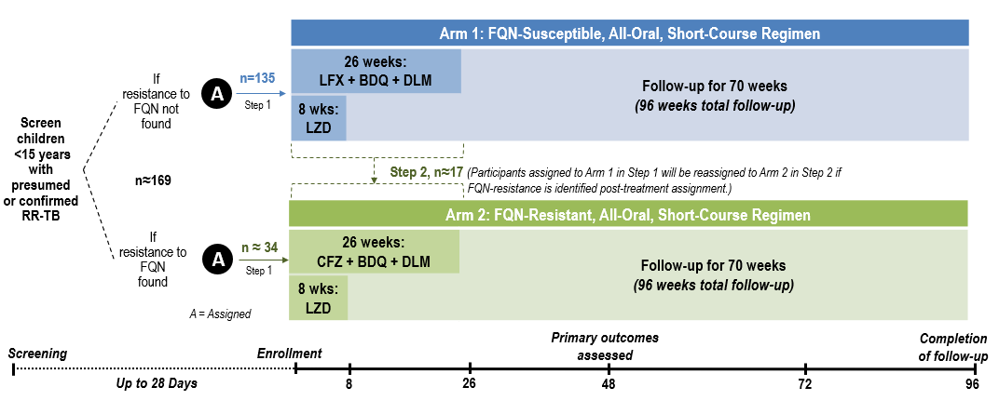
IMPAACT 2020: Study schema

Slide 21
Primary Objectives
Among infants, children, and adolescents with confirmed or probable RR-TB without resistance to FQNs, to:
Characterize the safety and tolerability of an all-oral, short-course regimen through Week 48
Secondary Objectives
Among infants, children, and adolescents with confirmed or probable RR-TB without resistance to FQNs, to:
Characterize treatment outcomes of an all-oral, short-course regimen through:
  Week 48 and Week 72
Among all infants, children, and adolescents who received applicable drugs, to:
Characterize the pharmacokinetics of CFZ, LFX, LZD, BDQ, and DLM through Week 8
Characterize the pharmacokinetics of antiretrovirals among HIV-infected participants through Week 8
Among all infants, children, and adolescents, to:
Characterize the cardiac safety of co-treatment with BDQ and DLM through Week 26
Among infants, children, and adolescents with confirmed or probable RR-TB with resistance to FQNs, to:
Characterize the safety and tolerability of an all-oral, short-course regimen through Week 48
Characterize treatment outcomes of an all-oral, short-course regimen through:
  Week 48 and Week 72

Slide 22
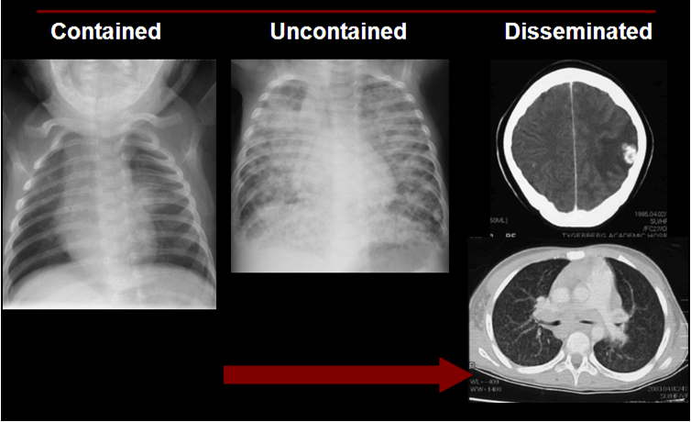
DS-TB | Gaps for children | Priority studies
 | Optimal treatment for TB meningitis (levofloxacin, high dose rifampin) Rifampicin and rifapentine dose optimization (severe disease not addressed in SHINE, treatment shortening): OptiRif Kids Treatment shortening: non-severe and severe disease Build on adult phase IIb/III trials (TBTC Study 31, TB Alliance) Innovative design and outcome assessment Informed by drug optimization studies and site of disease PK Moving to treatment of pan susceptible disease in future | PK and outcome (TBM Kids; NICHD; Dooley) : opened Q2 2017 ; SURE KIDS Priority: building on SHINE, rifampin dose optimization. Daily RFPT (CS 5109) SHINE+: Priority – complementing SHINE and Optirif Kids
Notes:
DS_TB: long-term priority
In red: not yet being addressed and opportunities for IMPAACT
SHINE will address non-severe PTB but important to address treatment shortening with new FDCs in children with complicated and severe forms of TB – at least 40% of the disease burden in children < 5 years of age; would need to assess optimization rif doses before SHINE+ - which could build on SHINE, and link with existing trial sites – some are already IMPAACT sites – e.g. Pune, Cpae Town

Slide 23
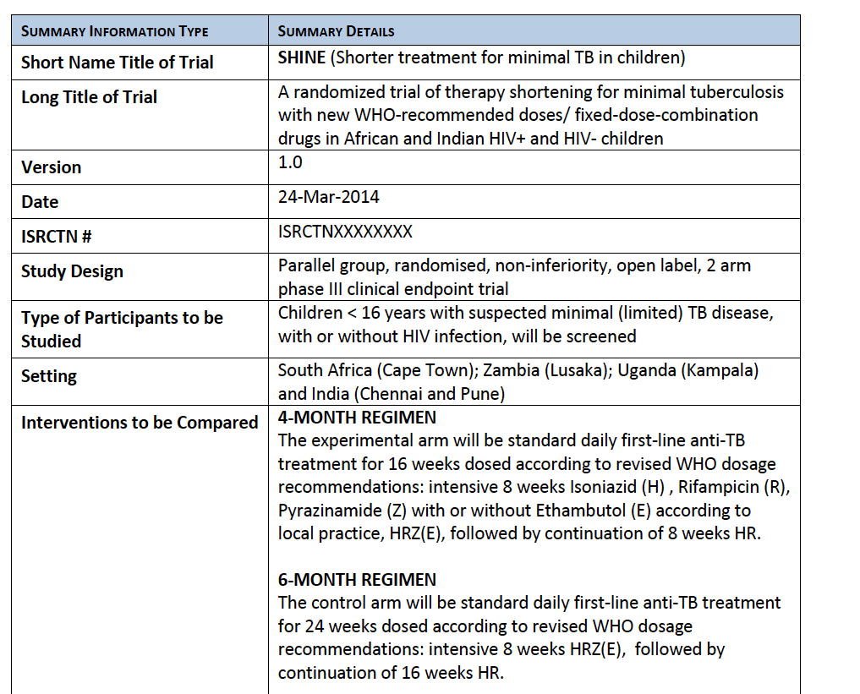

Slide 24
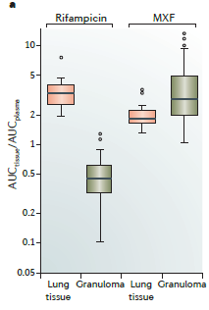
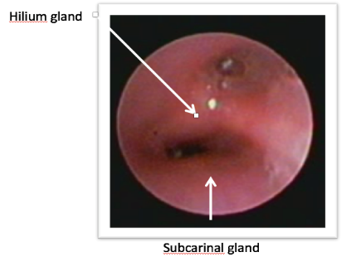
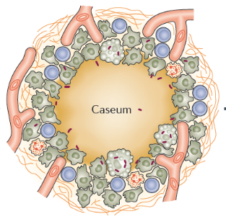
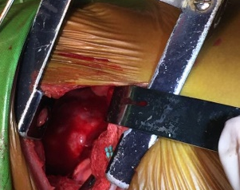
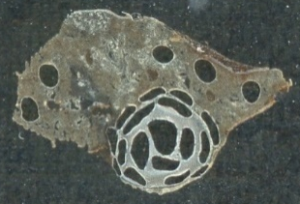
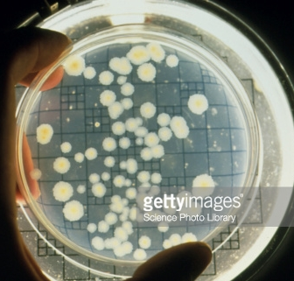
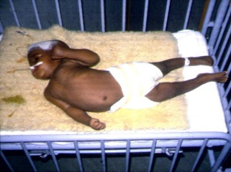
Knowledge needed re site of disease PK
Role of additional imaging
MALDI MS imaging
100%
Homogenize
Extract
LC/MS/MS
Quantify
0%
Laser capture microdissection
PK
LC/MS/MS
Quantify
PD
Drug activity in caseum
Courtesy. V Dartois

Slide 25
Treatment of persons exposed to MDR TB: data limited
Author | Country | Population | Regimen | HIV | Rx vs No Rx
Bamrah | Micronesia | 108 Adults and Children | FQ alone FQ +EMB FQ+ETH | None | 0/93 vs 3/15 0% vs 20% RR 0.02
Denholm | Australia | 49 Contacts | FQ alone FQ+EMB PZA+EMB INH or RIF | None | 0/11 vs 2/38 0% vs 5% RR 0.83
Schaaf | South Africa | 78 Children <5yrs | INH/PZA/EMB or ETH | None | 2/14 vs 13/64 5% vs 20% RR 0.20
Trieu | USA | 199 Adults | FQ | 70% | 0/30 vs 0/166
Adler-Shohet | USA | 31 Children | FQ+PZA | Unknown | 0/26 vs 0/5
Williams | UK | 12 Children | Various 2 drugs | None | 0/8 vs 0/4
Garcia-Prats | South Africa | 31 Children | FQ+EMB+INH | None | 0/21 vs 0/10
Marks CID 2017;
WHO, Latent TB Infection Guidelines, 2018

Slide 26
27 international sites; joint IMPAACT/ACTG

Slide 27
PHOENIx
Design: Multi-center, cluster-randomized, superiority trial comparing 26 weeks of daily delaminid vs INH
  Cluster = eligible high risk contacts from same HH
Sites: 27 ACTG and/or IMPAACT sites in high MDR TB burden countries
Population:
  Index case: adult PTB with confirmed INH/rifampin resistance
  High-risk household contact:
    HIV-infected,
    Child <5 years of age
    LTBI+ (Quantferon Plus or TST)
Sample Size: 2158 Index cases and 3452 high risk HHCs
Follow-up: 96 weeks

Slide 28
PHOENIx Objectives
Primary: Among HIV-infected and child, adolescent, and adult household (HH) contacts of MDR TB patients at high risk of developing TB, to compare:
Efficacy of DLM vs. INH for preventing confirmed or probable active TB
Safety of DLM vs. INH for the treatment of presumed LTBI with MDR TB
Secondary: To compare DLM vs INH with respect to:
Efficacy and safety by High-risk group (HIV+, children, LTBI+)
Efficacy in preventing
  Confirmed MDR TB
  All-cause mortality
  Confirmed or probable TB and all-cause mortality
PK of DLM in children and adults
Adherence
Cost-effectiveness
Biomarkers of progression to TB

Slide 29
PHOENIx is rising!
Version 2 released to sites September 25, 2018
First site activated in Brazil June 7, 2019
Refresher trainings planned IMPAACT June 12 and ACTG June 18, 2019

Slide 30
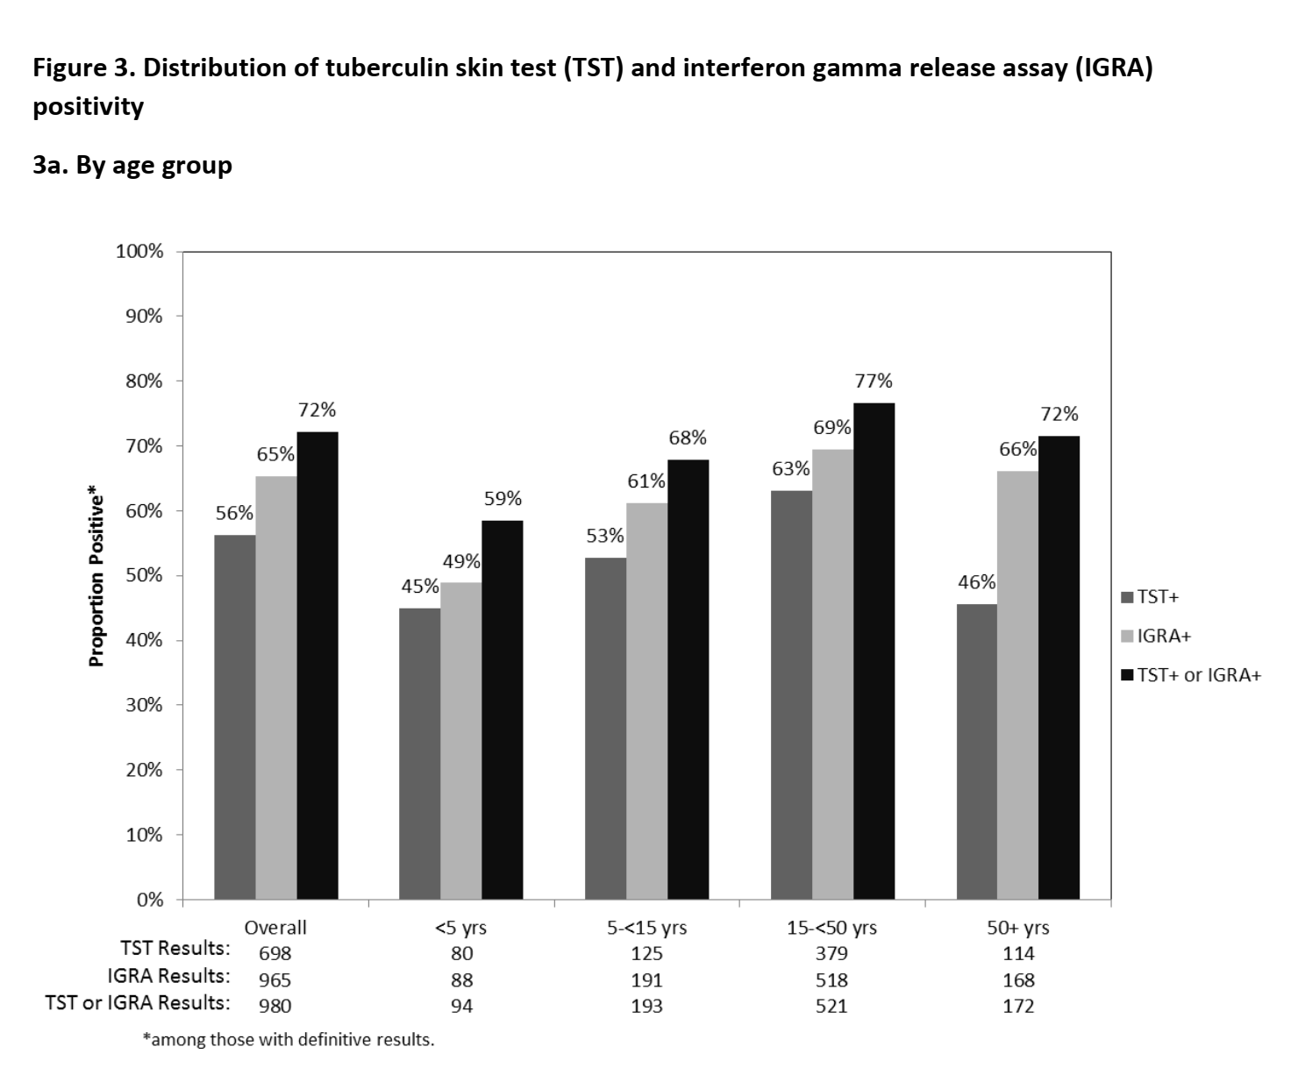
PHOENIx Feasibility Study
TB infection by TST and IGRA by age groups

Slide 31
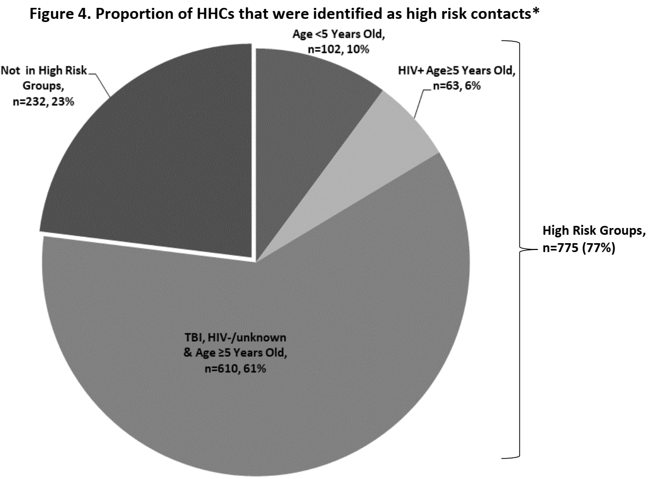
PHOENIx Feasibility Study
Proportion of HHCs that are high risk

Slide 32
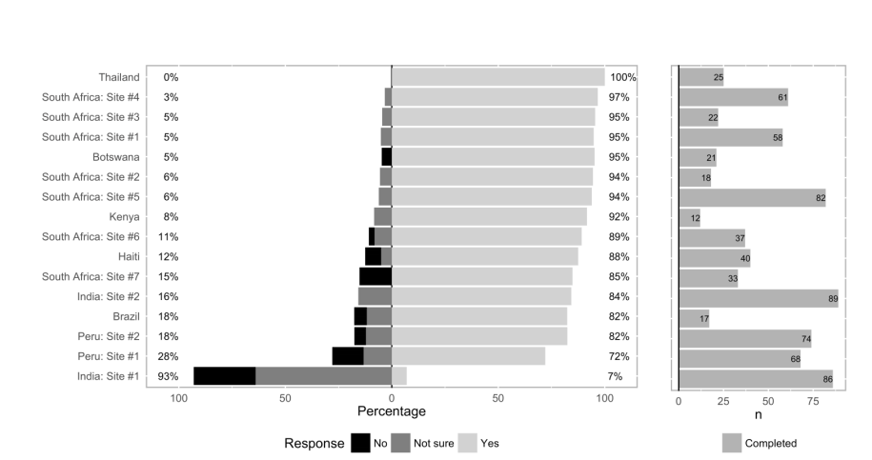
PHOENIx Feasibility Study
Willingness to take MDR TB preventive therapy

Slide 33
Pregnancy and vaccine studies

Slide 34
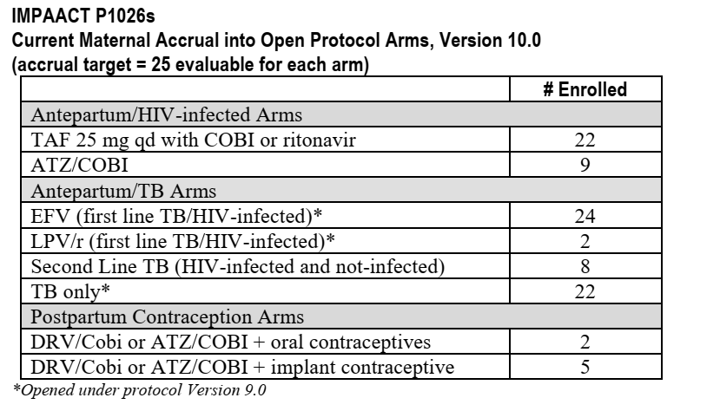
IMPAACT P1026s

Slide 35
IMPAACT P1078
Primary paper. “Isoniazid Preventive Therapy in HIV-Infected Pregnant and Postpartum Women” Accepted NEJM 2019
Impact of maternal isoniazid preventive therapy (IPT) timing on acquisition of infant TB infection (TBI) in the IMPAACT P1078/TB APPRISE trial
  Union 2018 Oral presentation, manuscript draft in preparation
Pharmacokinetics of isoniazid preventive therapy among HIV-infected pregnant women in high tuberculosis incidence settings
  Kamunkwala Gausi et al CROI March 2019 and PAGE conference July 2019 poster, Manuscript draft prepared
Impact of isoniazid and pregnancy on efavirenz pharmacokinetics in women living with HIV
  Kamunkwala Gausi et al IAS 2019 poster, Manuscript draft prepared
Effects of Pregnancy and Isoniazid Preventive Therapy on M. tuberculosis Interferon Gamma Response Assays in Women with HIV
  Adriana Weinberg et al, ID week abstract. Manuscript draft prepared
Analyses of
Adverse pregnancy outcomes (Gerhard Theron);
Hepatotoxicity (A Gupta);
risks and benefits DOOR/RADAR (Grace Montipiedra);
NWCS 626/RO1 awarded on maternal-infant immunology (Savita Pahwa);
Maternal immunology and IPT responses grant submission (Adriana Weinberg)

Slide 36
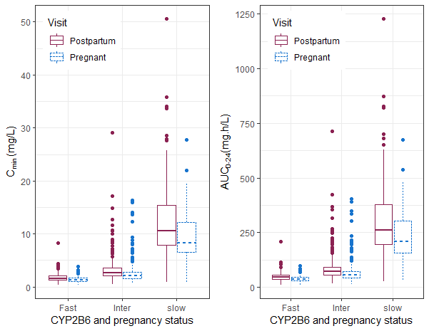
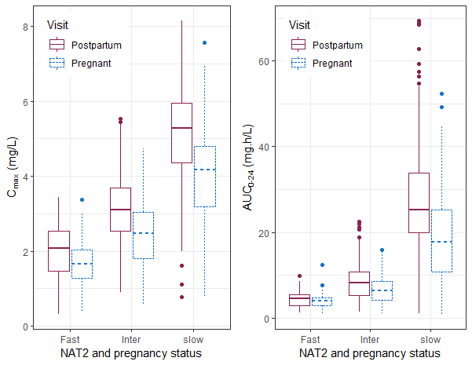
IMPAACT P1078
PK data
Efavirenz Cmin and AUC by NAT2 genotype and pregnancy
Isoniazid C_{max} and AUC by NAT2 genotype and pregnancy
Gausi et al CROI 2019 and IAS 2019

Slide 37
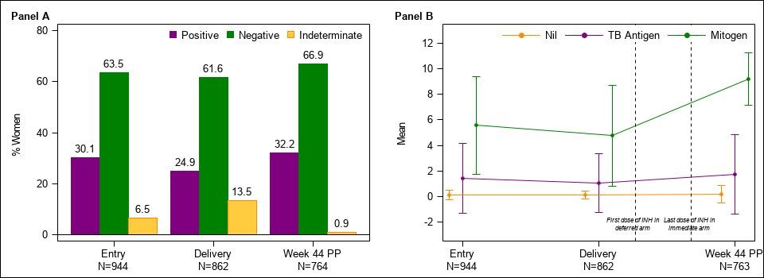
IMPAACT P1078
IGRA by pregnancy stage
Weinberg A et al, Manuscript in preparation

Slide 38
IMPAACT P1078: Prevalence of Infant TB infection at Week 44 by Study Arm
Timing of Maternal IPT did not affect infant TBI acquisition
Gupta et al Union 2018

Slide 39
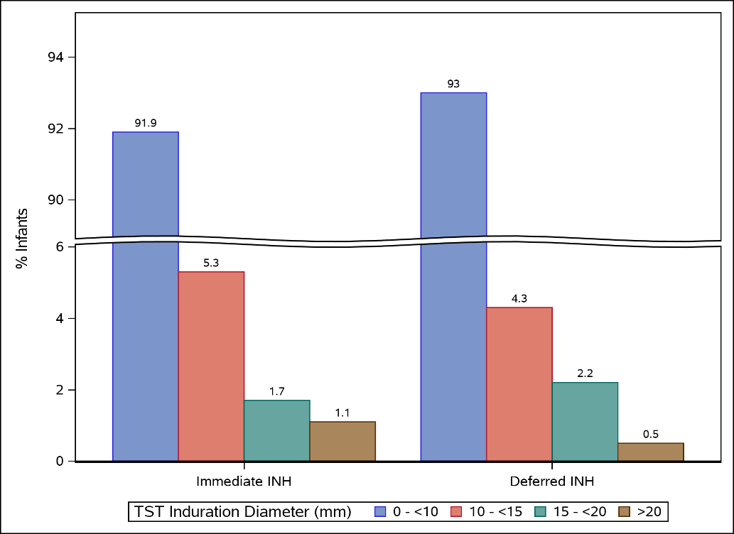
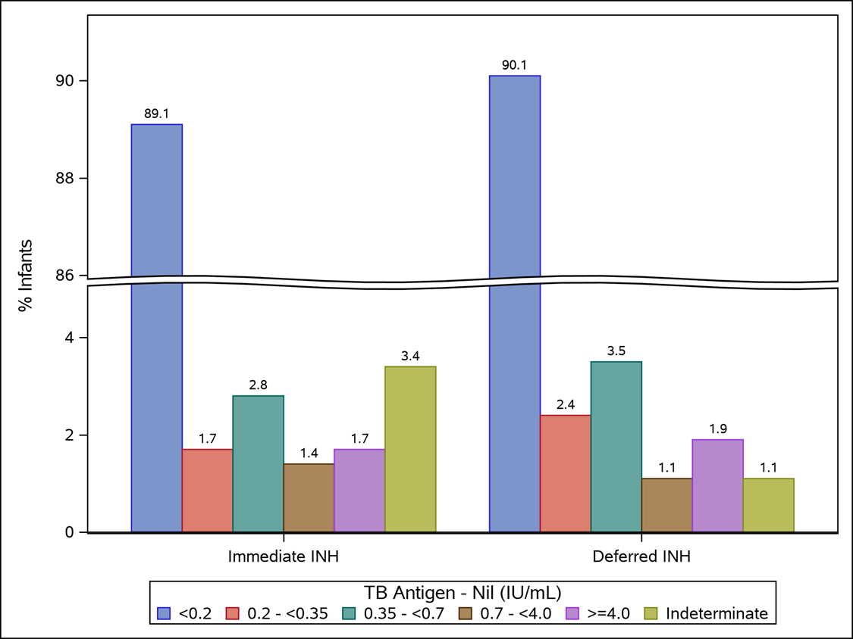
P1078 Infant TB infection by maternal IPT arm
TST Quantitative Results
by Maternal IPT arm
QFT-GIT Quantitative Results by Maternal IPT arm
Infant TBI differed across sites and by type of TBI test used
Small proportion have QFT-GIT at 4.0 IU or higher
Agreement between infant TST and IGRA was poor: Kappa=0.1

Slide 40
IMPAACT 2001
A Phase I/II Trial of the Pharmacokinetics, Tolerability, and Safety of Once-Weekly Rifapentine and Isoniazid in HIV-1-infected and HIV-1-uninfected Pregnant and Postpartum Women with Latent Tuberculosis Infection
Jyoti S. Mathad (Protocol Chair)
Rationale:
  Pregnant/postpartum women have a high risk of developing active TB.
  Recently, results from P1078 raise concerns about safety of 6H in pregnancy
  The regimen of 3 months of weekly INH + RPT (3HP) has improved completion rates and decreased hepatotoxicity in all populations, including HIV-infected and children
Objective: To provide data needed to extend use of 3HP to pregnant women
  Determine the impact of pregnancy on RPT PK
  To estimate the incidence of serious adverse events (SAEs) in maternal-infant pairs

Slide 41

P2001 Updates
6 sites: US, Haiti, Kenya, Malawi, Thailand, Zimbabwe
50 participants enrolled
Interim results: No dose change needed for RPT in 2nd or 3rd trimester of pregnancy*
    Need additional analysis of full HIV+ cohort
Event | Date
Study Closure | May 15, 2019
Study Data Closure | August 7, 2019
Raw analysis of PK samples (maternal/cord) | Start: June/July 2019 End: August 2019
Raw analysis of breastmilk PK | Pending approvals
PK modeling | September 2019
Core analysis to study chair | October 2019
Draft manuscript | January 2020

Slide 42
Selected Novel TB Vaccine Candidates *priority
Type | Product | Sponsor
Mucosal delivery | BCG | Gates
Recombinant live | VPM 1002 | Max Planck, VPM, Serum Institute
Viral recombinant | CMV
Recombinant protein | M72+AS01 H56:IC31 ID93+GLASE | GSK, Aeras SSI, Aeras IDRI, Wellcome Trust
Whole cell, inactivated | DAR 901 M. vaccae MIP RUTI | Aeras NIH, Immodulon ICMR, India

Slide 43
IMPAACT P1113: with HVTN and AERAS
Chair: Avy Violari
Vaccine: HyVac 4/AERAS‐404,+IC31
  Dose escalation study, given after BCG vaccine novel antigen and novel adjuvant
  HIV unexposed
Primary objective:
  Evaluation of safety of vaccine when given as part of primary EPI schedule
Secondary objective:
  Evaluation of immunogenicity of study vaccine
Exploratory objective:
  Immunogenicity interactions with EPI vaccines

Slide 44
Design
Group | Dose (H4mcg/IC31nmol) | # of doses | Age at vaccination | Vaccine /placebo | N
1 | 5/100 | 1 | 6mo | 20/5 | 25
2 | 5/500 | 1 | 6mo | 20/5 | 25
2a | 5/500 | 2 | 18wk, 24 wk | 40/10 | 50
3 | 5/500 | 3 | 10/14/38w | 30/10 | 40
4 | 15/500 | 3 | 10/14/38w | 30/10 | 40
5 | 50/500 | 3 | 10/14/38w | 30/10 | 40
Total |  |  |  | 170/50 | 220
Status: enrolled; safety data meets formal criteria, immunogenicity data pending

Slide 45
HVTN/ACTG/IMPAACT TB vaccine cross-network working group
Lisa Cranmer, Jyothi Rengarajan, Cheryl Day, Amita Gupta, Anneke Hesseling (IMPAACT).
  Discuss TB vaccine landscape and opportunities for TB vaccine collaborations in the DAIDS funded networks
  HVTN focused on POI
  ACTG on adult therapeutic vaccines and possibly POD
  IMPAACT on POD/ therapeutic
TB vaccine concepts and ideas welcome

Slide 46
Diagnostics and biomarkers
Support nested diagnostics, biomarker studies
Support expansion of site and TB lab capacity
Use IMPAACT, ITBSL and other lab platforms
Work with other investigators: serum, urine biomarkers, omics. antibodies
Evaluate novel commercial molecular tests, DST methods, WGS (nested)
Ideal cohorts through planned protocols: SMART-Kids, P1108, PHOENIX, diagnostic studies: prognostic markers, treatment response and diagnostic markers
Vaccine trials and TB prevention efficacy trials: correlates of risk/protection

Slide 47
Milestones
P1078: completed
P2oo1: completed
P1113: completed
Opened to accrual: P1108, P2005, PHOENIX
IMPAACT 2020: Version 1 .0 June 2019
IMPAACT 2026: new TB arms
3 new CAPs: 1 HP children (CS 5109), 1 HP vs. 3 HP pregnancy (CS 5021): Pta (in development)
IMPAACT TB trials symposium: Union 2018, 2019
TB PADO 1 (February 2019)
TB vaccines Working Group (cross-network)

Slide 48
Mentored investigator graduates
Adrie Bekker: P1106, 2026S
Jyothi Mathad: P2001
Vidya Mave: SHINE TB, PHOENIx
Anthony Garcia-Prats: P2005, 2020
Elin Svensson: P1108, P2005, P2020, PHOENIx

Slide 49

New mentored investigators
Ethel Weld: JHU
Yael Hirch-Moverman: CU
Sylvia La Course: UW
Lisa Cranmer: Emory
Jeff Tornheim: JHU
Mandar Paradkar: BJMC-JHU CRS
Pauline Howell: Sizwe
Christy Beneri: Stonybrook
Jennifer Hughes: SU
Nicole Salazar-Austin: JHU
Louvina van der Laan: SU
Graeme Hoddinott: SU
Jana Winckler: SU
Notes:
3 protocols

Slide 50
Publications
Swindells S. Resource utilization for multidrug-resistant tuberculosis household contact investigations (A5300/I2003). Int J Tuberc Lung Dis. 2018 Sep 1;22(9):1016-1022. doi: 10.5588/ijtld.18.0163. PubMed PMID: 30092866.
Gupta A,: ACTG 5300/IMPAACT I2003 PHOENIx Feasibility study team. Feasibility of Identifying Household Contacts of Rifampin- and Multidrug-Resistant Tuberculosis Cases at High Risk of Progression to Tuberculosis Disease. Clin Infect Dis. 2019 Mar 28. pii: ciz235. doi: 10.1093/cid/ciz235. PubMed PMID: 30942853.
Suryavanshi N. A5300/I2003 Study Team. Willingness to Take Multidrug-Resistant Tuberculosis (MDR-TB) Preventive Therapy among Adult and Adolescent Household Contacts of MDR-TB Index Cases: An International Multi-Site Cross-Sectional Study. Clin Infect Dis. 2019 Mar 28. pii: ciz254. doi: 10.1093/cid/ciz254. [Epub ahead of print] PubMed PMID: 30919881.
Opollo VS. HIV testing uptake among the household contacts of multidrug-resistant tuberculosis index cases in eight countries. Int J Tuberc Lung Dis. 2018 Dec 1;22(12):1443-1449. doi: 10.5588/ijtld.18.0108. PubMed PMID: 30606316; PubMed Central PMCID: PMC6364692
Svensson EM. Relative bioavailability of bedaquiline tablets suspended in water: Impli- cations for dosing in children. Br J Clin Pharmacol. 2018 Jun 27. doi: 10.1111/bcp.13696. [Epub ahead of print] PubMed PMID:29952141.
Thuboy B. The determination of capreomycin in human plasma by LC-MS/MS using ion-pairing chromatography and solid-phase extraction. Biomed Chromatogr. 2018 May 3:e4269. doi:10.1002/bmc.4269. [Epub ahead of print] PubMed PMID: 29726023.
Hoddinott G. Community engagement for paediatric MDR-TB clinical trials: principles to support ethical trial implementation. Int J Tuberc Lung Dis. 2018 May 1;22(5):40-45. doi: 10.5588/ijtld.17.0356. PubMed PMID: 29665952.
Seddon JA, Conducting efficacy trials in children with MDR-TB: what is the rationale and how should they be done? Int J Tuberc Lung Dis. 2018 May 1;22(5):24-33. doi:10.5588/ijtld.17.0359. PubMed PMID:29665950.
Garcia-Prats AJ, Current status of pharmacokinetic and safety studies of multidrug-resistant tuberculosis treatment in children. Int J Tuberc Lung Dis. 2018 May 1;22(5):15-23. doi: 10.5588/ijtld.17.0355. PubMed PMID:29665949.
Gupta A, Highes MA, Garcia-Prats Hesseling AC. Plos Med in press: Inclusion of key populations in clinical trials of new antituberculosis treatments
Gupta A et al. NEJM IMPAACT P1078
Notes:
ACH to complete

