Slide 1
UZCHS_CRTC IMPAACT Community Advisory Board
TB awareness in communities_11 June 2019

Slide 2
Background
UZCHS_CRTC Community Advisory Board was established in 2000
IMPAACT CAB was later formed in 2007
It comprised of 11 members form diverse communities
Community Liaison officer is responsible for supporting the CAB activities
The PIs also is present during the meetings and during CAB formation
Stakeholders within the communities the communities represented by CAB were sensitized of the introduced cadre

Slide 3
Concerns
INH adverse reactions – not much information (outside research)
Poverty
Diagnostics – non-availability of diagnostic machines or broken down machines
No vitamin supplements supplied
Little information on chronic conditions that elevate the risk of TB infection, e. g. diabetes mellitus
Advocacy and funding for TB prevention and treatment seems not to be prioritised

Slide 4
Limited range of TB regimens make TB treatment a big burden
Drug-drug interactions result in fewer options for PLHIV
Need more research on TB treatment formulations for children and adolescents, as we find them being given adult formulations
The intensive support that used to be given when TB was introduced is no longer being offered
There is need for support groups for people with TB so as to deal with the high levels of stigma and discrimination

Slide 5
Women bear the brunt of the burden in the community regarding religious and cultural/ traditional practices that hinder access to medical assistance.
Some churches bar their members from going to clinics for medical treatment.
However, the members do not live in isolation when outside church services, hence they can continue to spread TB when there is no correct treatment.
Women, as carers in the home of those who are ill with TB, are at risk of acquiring the infection.

Slide 6
Women who believe in medical treatment, and are in religious sects who deny it, often have to seek medical treatment behind the backs of their spouses and religious leaders
This results in difficulties for women in terms of adherence as they also try to conceal the medicines
This can also result in many cases of TB in the community remaining undetected
The burden is multiplied several times over when the woman is disabled, or where she has to care for someone with TB who is also disabled.

Slide 7
TB and Disability
Many times poverty is an integral part of this combination
Access to health facilities is hampered by mobility difficulties as well as lack of money for bus fares
Adherence may be hampered by inadequate nutrition as the person with disability may be unable to fend for themselves
The pill burden may be too much to bear, particularly where the disability is mental.
People with disabilities face several layers stigma and discrimination – disability, poverty, TB infection, HIV infection, etc

Slide 8
TB studies in Zimbabwean Sites
IMPAACT P1078 (Finished)
IMPAACT 2001 (Finished)
PHOENIX study (Currently ongoing under ACTG)
A5264
A5263
A5288
A5279
A5225

Slide 9
Raising awareness within the communities
Activity
In your groups (2mins) discuss how you are raising awareness on currently going studies at your sites.

Slide 10
Raising Awareness Continues
CAB raises managed to raise awareness on on-going studies during:
  Stakeholders Meetings
  National AIDS council Gala’s
  Radio Shows
  Through local newspapers
  Community gatherings
  Sports Tournaments.
  ICASA

Slide 11
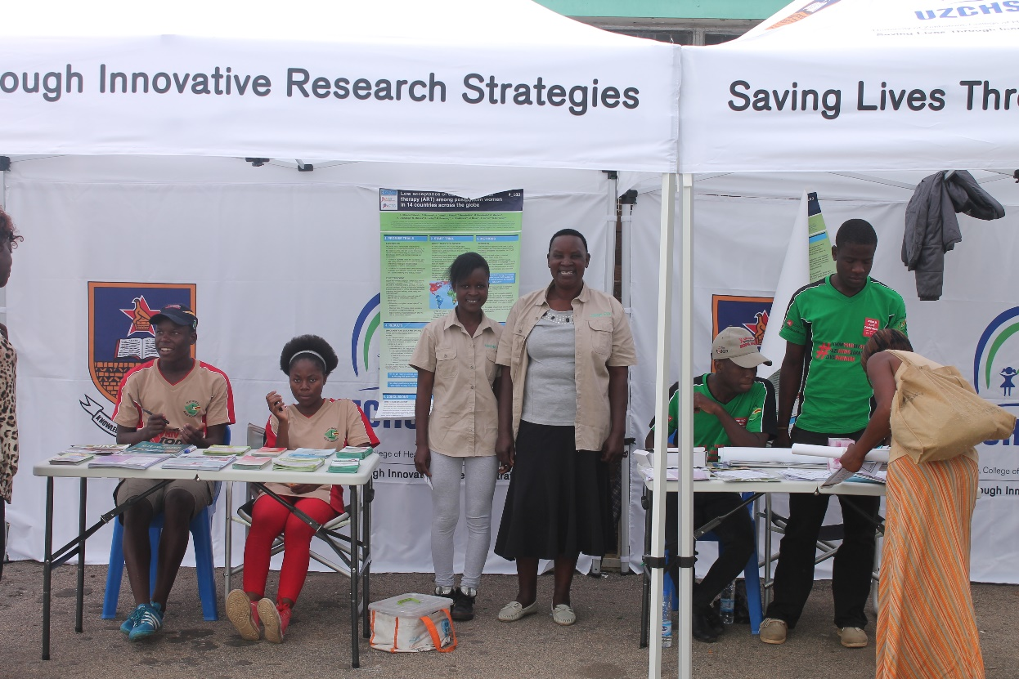
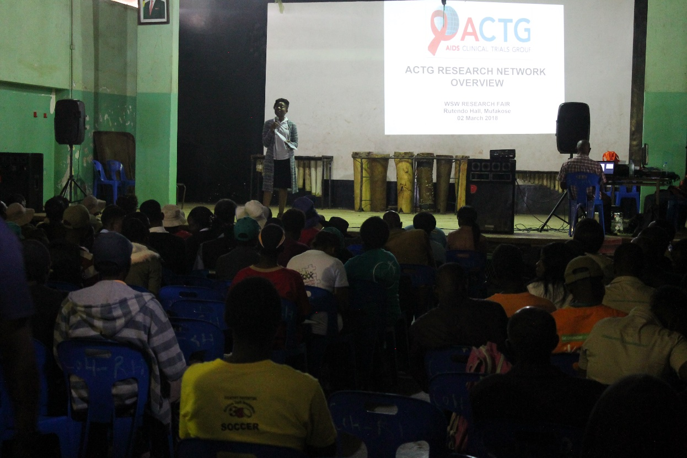
CAB raising awareness

Slide 12
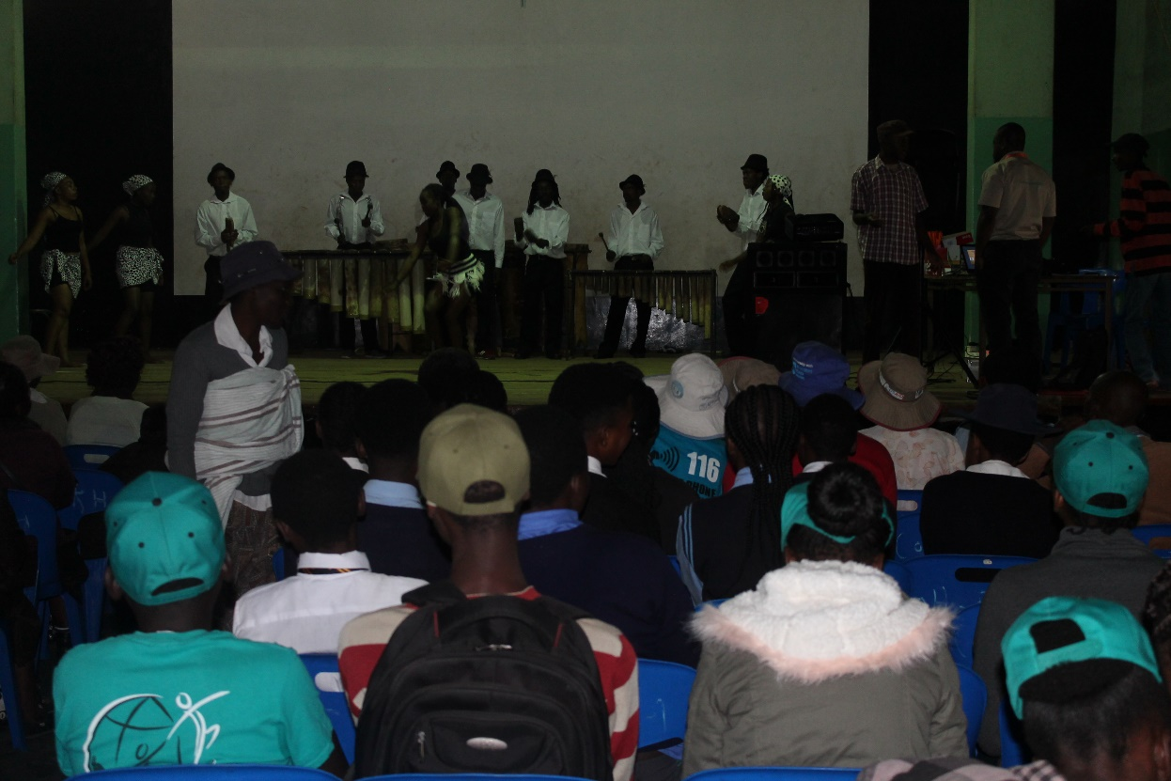
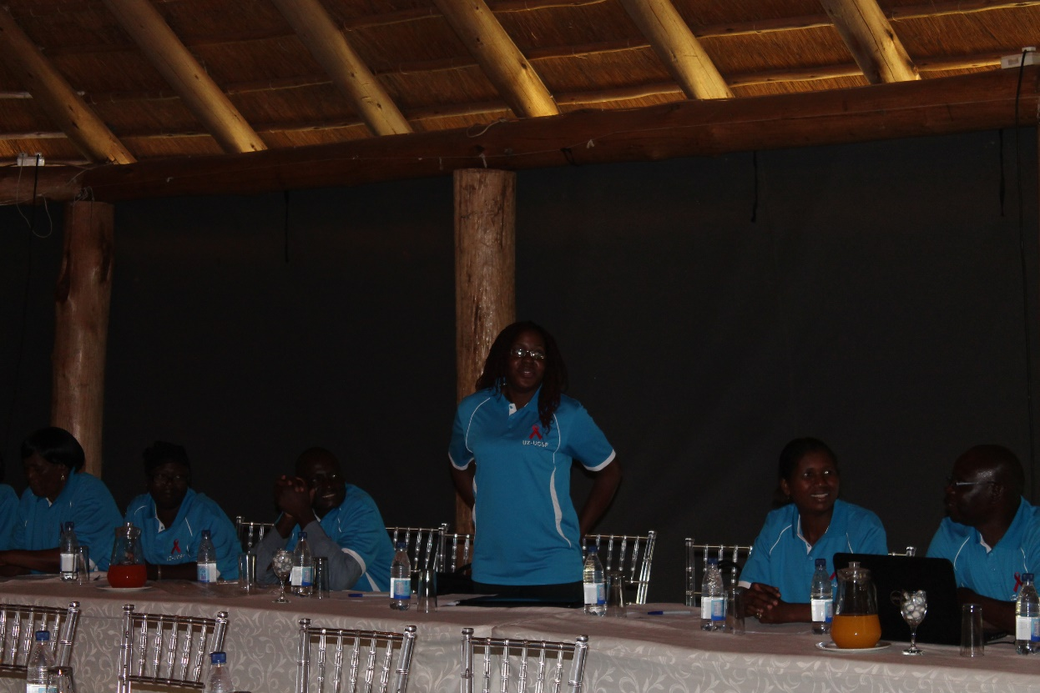
Raising Awareness continued

Slide 13

Conclusion
It is important to involve Community representation of diverse community members so that when raising awareness becomes easier (e.g Youth , People with disability)
It is important to collaborate with other partners so that you have more platforms to raise awareness on on-going studies
Raising awareness by CAB is very important for study enrollment and retention as community/participants can familiarize/associate themselves with CAB.

