Slide 1




IMPAACT HIV Cure Scientific Committee Update
Deborah Persaud, MD
Chair, HIV Cure Scientific Committee
June 11th, 2019

Slide 2

IMPAACT Leadership: Sharon Nachman and James McIntyre
IMPAACT HIV Cure Scientific Committee Members
Deborah Persaud (Chair) and Ellen Chadwick (Vice-Chair)
Committee Members
Jintanat Ananworanich
William Borkowsky
Yvonne Bryson
Mark Cotton
Katherine Luzuriaga
Betsy McFarland
Steve Spector
Thor Wagner
Dan Barouch
Ann Chahroudi
Community Advisory Board Representatives
Steven Mphonda
Committee Specialists
Anne Coletti and Charlotte Perlowski
NICHD:Rohan Hazra, Eric Lorenzo
NIAID:Patrick-Jean Phillipe, Sarah Read, Judi Miller and Ellen DeCarlo
NIMH:Pim Brouwers
Biostatisticians:Camlin Tierney, Bryan Nelson, Jane Lindsey, Meredith Warshaw
IMPAACT SLG Liason:John Sleasman
Clinical Trials Team
Parents, Children and Youth

Slide 3
Specific CAB Requests
Update of HIV Cure Scientific Committee activities
  ongoing studies (P1115, P2008, and P2015)
Definitions of “Functional” cure
Information on the ‘London” Patient
Future Directions

Slide 4
Overarching Goal IMPAACT HIV Cure Scientific Committee (2012-Present)
Identify novel therapeutic strategies that will lead to ART-free remission and cure in pediatric populations (neonates to young adults)

Slide 5
June 2019
Chun TW, Eisinger RW, and Fauci AS. JAMA 2019
“Recognized short-term and uncertain long-term toxicity of antiretroviral drugs”
Commonly experienced feeling of “pill fatigue,”
Stigma associated with taking daily ART
Costs associated with lifelong ART
Altogether, provide strong motivation to pursue such a goal”
Chun TW, Eisinger RW, and Fauci AS. JAMA 2019
(Published online June 6, 2019)(R

Slide 6
ART-Free HIV Remission
On-ART
Off-ART
Plasma HIV-1 RNA (copies/mL)
Detection limit
20 copies/mL

Slide 7
HIV Reservoirs preclude ART-Free HIV Remission and Cure
On-ART
Off-ART
Plasma HIV-1 RNA (copies/mL)
Detection limit
20 copies/mL
Stochastic
Reactivation
Time (Years)
Resting Memory CD4+ T cells
Activated
CD4+ T cells
Virus production

Slide 8
Pathways towards ART-Free Remission
“Cure”: Eradication of the replication-competent HIV reservoir
“Sustained virologic remission”: Control of plasma viral rebound in the absence of ART without eradication of the replication-competent HIV reservoir
Chun TW, Eisinger RW, and Fauci AS. JAMA 2019
(Published online June 6, 2019)(R
Notes:
wo pathways currently are being pursued to achieve a sus- tained ART-free HIV remission: (1) eradication of the rep- lication-competent HIV reservoir, which is classically re- ferred to as a “cure” and (2) control of plasma viral rebound without eradication of HIin the absence of ART, which is referred to as “sustained virologic remission.”

Slide 9
HIV Remission in Perinatal Infection:
“Mississippi Baby” (2013)
ART
No ART
ART
16,750 c/ml; 10,564 c/ml
27 months of control of plasma viral rebound in the absence of ART
Persaud, Gay, Luzuriaga et al 2013 NEJM

Slide 10
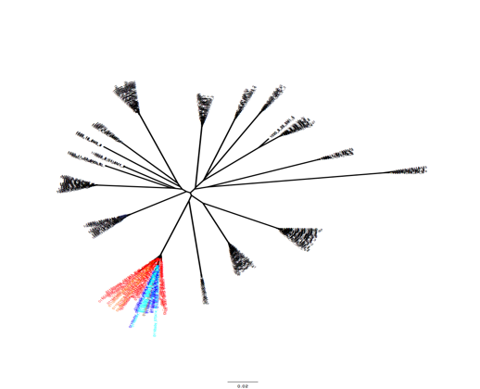
Viremic Relapse in the
“Mississippi Baby” (2015)
Remission
ART
No ART
ART
19,182 c/ml
16,750 c/ml; 10,564 c/ml
Persaud, Gay, Luzuriaga et al 2013 NEJM; Luzuriaga, Gay, Persaud et al 2015 NEJM

Slide 11
Case#2: HIV Remission in Perinatal Infection
“French Teenager”-(2016)
Intervention: Early ART of perinatal infection
Identified at 18.8 years of age while off ART for 11.5 years
1/100 of the early-treated children in the ANRS EPH C010 Pediatric Cohort
ART at 3 months of age for intrapartum HIV infection
Family discontinued ART at 5.8-6.8 years of age
11.5 years off ART with undetectable HIV RNA but detectable HIV DNA (2.2 log 10 copies/million PBMCs
“Weak” HIV-specific CD8+ T cells; no protective HLA genotype identified
Frange P et al. Lancet HIV 2016
Notes:
Subtype H
18.6 years of age identified
Stopped ART at 5.8-6.8 years of age
Not in utero infected-intrapartum infected– not sure if breastfed

Slide 12
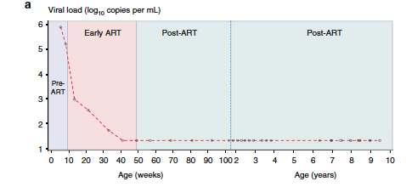
Case#3: ART-Free Remission in a Perinatally
HIV-Infected Child: “South African Child” (2017)
Intervention: Early ART of perinatal infection
ART at 8.7 weeks of age- Time-limited for 40 weeks
No rebound off ART for 8.5 years
Prevalence: 1/227(0.4%) in CHER Trial
Violari A et al Nature Communications 2019
Notes:
ART AT 8.7 weeks OF AGE
ART for 40 weeks
8.5 years remission
Non breast fed
boy

Slide 13
Perinatal HIV Remission Cases (2013-2019)
Patient Profiles | “Mississippi baby” (2013) | “French Adolescent” (2017) | “South African boy” (2019) | Australian Woman (2017)
Strategy | Very Early ART (30 hrs of life) | Early ART ( 3 mos of age) | Early ART (2 mos of age) | ART at 4.9 yrs
ART Duration | 18 mos | 5.8-6.8 yrs | 40 wks | 15.5 yrs
Age at Remission Diagnosis | 23 mos | 18.6 yrs | 9.5 yrs | 25 yrs
Duration of Remission | 27.6 months | >12 yrs | 8.5 yrs | 2 yrs
Prevalence | na | 1/100 (1%) | 1/227 (0.4%) | na
Pre-ART VL (c/mL) | 19,182 | 2.17 x 10⁶ | >750,000 (39 days) 151,000 (60 days) | Not available
Sex | F | F | M | F
HIV-DNA concentrations (Log₁₀ copies per 10⁶ PBMCs) | Nondetectable <0.43 | Detectable 2.2 | Detectable 0.69 | Detectable 0.9
Low-level Viremia | Absent | Detectable | Detectable (<20) | Detectable
HIV Serostatus | Seronegative | Seropositive | Seropositive | Not reported
Cellular Response | Nondetectable | “Weak” | Strong NK cell response | Not reported
Inducible Reservoir | Nondetectable | Detectable | Nondetectable | Detectable cell-associated transcripts
HIV Subtype | B | H | C | B

Slide 14
Strategy #1: Very early and Early Treatment of Perinatal HIV Infection to Achieve ART-Free Remission
(IMPAACT P1115 and P2008)

Slide 15
Overarching Goal of HIV Remission and Cure Therapeutics
Latent reservoir size
(Mean of 1 IUPM)
Latent
Reservoir size
(Mean of 0.001 IUPM)
Hill AM et al. PNAS 2014; Hill AM et al. PLoS PATH. 2016

Slide 16

P1115-Ongoing Prospective Phase I/II
Proof-of-Concept Study of Very Early ART to Achieve
ART-free HIV Remission in Infants
Step 1 | Initiation of ART within 48 hours of life for high-risk infants
Step 2 | Continued ART with confirmed HIV-1 infection with monitoring to determine eligibility for ART cessation between 2 -4 yrs of age
Step 3 | ART cessation with close monitoring for viral rebound if antibody negative and no HIV infected cells detected
Step 4 | ART re-initiation for infants who experience viral rebound
Primary Objective:
To assess HIV remission among in utero –infected neonates who initiate very early therapy within 48 hours of birth
HIV remission: Case Definition
No confirmed plasma HIV RNA ≥ limit of detection of the viral load assay through 48 weeks of stopping ART
clincialtrials.gov NCT02140255
Notes:
48 clinical trials sites in 13 countries
IMPAACT P1115 (clincialtrials.gov NCT02140255) is an ongoing prospective phase I/II proof-of-concept study of very early ART of in-utero infected infants to achieve ART-free HIV remission.

Slide 17
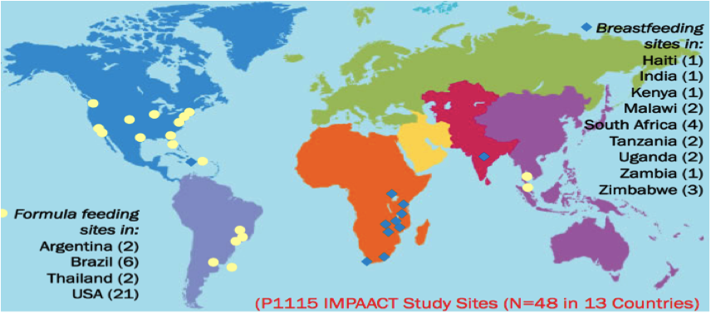
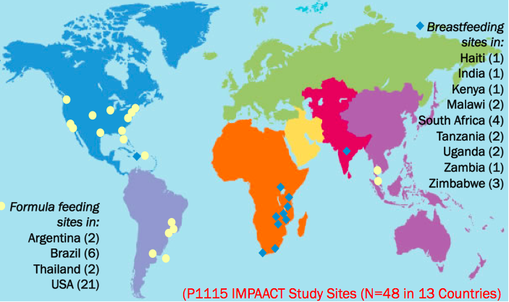
P1115 (Version 1.0)-
440 Mother-Infant Pairs Enrolled in the Prospective Cohort from 11 Countries (2015-2017)
11 countries enrolled directly into Step 1 (Brazil, Haiti, Kenya, Malawi, South Africa, Tanzania, Thailand, USA, Uganda, Zambia and Zimbabwe);
5 countries enrolled directly into Step 2 (Brazil, South Africa, USA, Tanzania and Uganda)
Presented at CROI 2019: VIROLOGIC RESPONSE TO VERY EARLY ART IN NEONATES WITH IN UTERO HIV: IMPAACT P1115: (Poster #0799)
Protocol Co-Chairs: Ellen G. Chadwick, Yvonne Bryson
Clinical Trials Specialist: Anne Coletti
Statisticians: Camlin Tierney and Bryan Nelson
Clinical Site Team Investigators

Slide 18
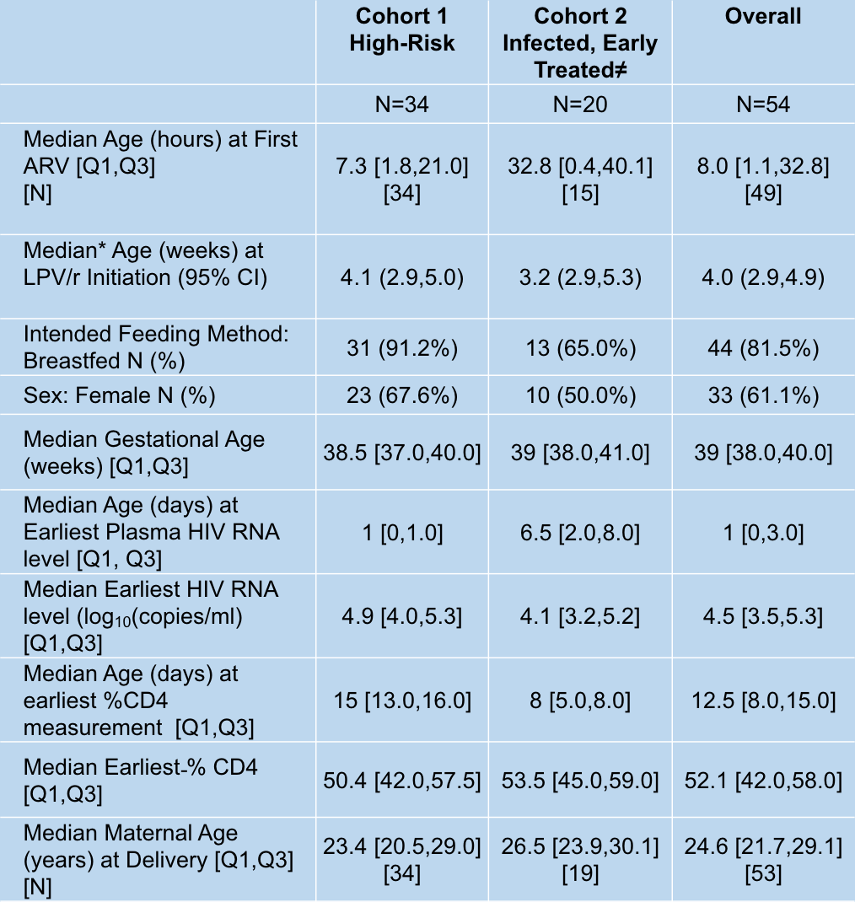

Slide 19
Virologic Failure Definitions
VL ≥200 copies/mL at Week 24
Confirmed VL≥ limit of detection (LOD, target not detected) at later visits
Only infants with confirmed viral load <200 copies/mL from study weeks 24 to 48 and with no confirmed detectable viremia from 48 weeks onward are maintained on study.
CROI 2019: IMPAACT P1115: Poster #0799

Slide 20
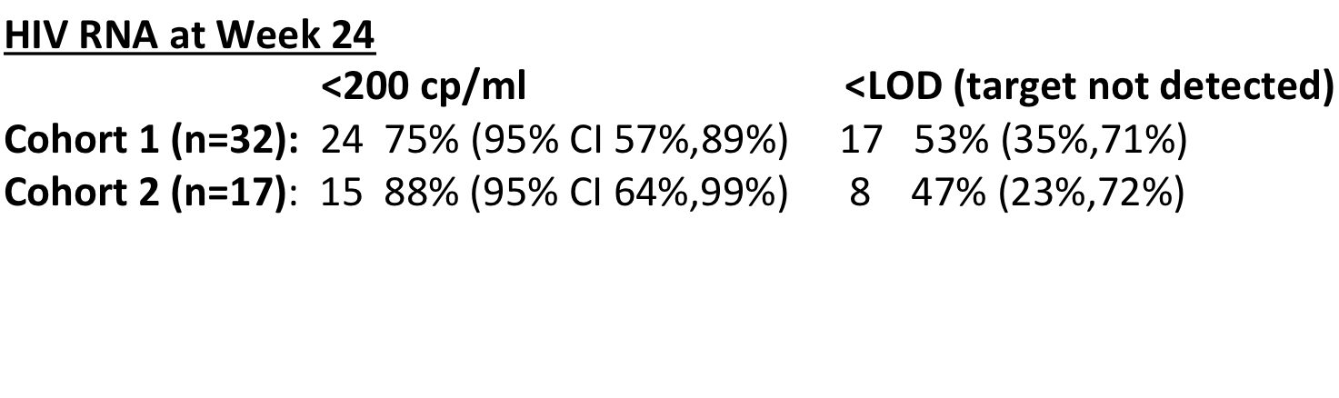
Rates of Virologic Suppression to <200 copies/mL by Week 24 of Study
CROI 2019: IMPAACT P1115: Poster #0799

Slide 21
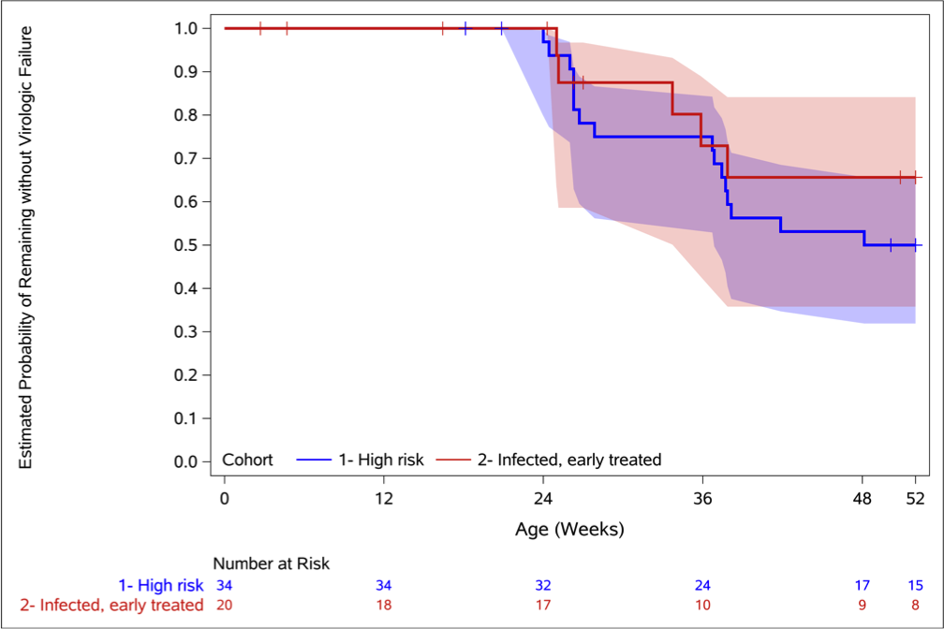
Probability of Remaining Free of Virologic Failure
Virologic Failure (VF) by 52 Weeks:
Cohort 1 16 VF 0.50 (95% CI: 0.32,0.66)
Cohort 2 5 VF 0.66 (95% CI: 0.36,0.84)
Notes:
VF survival probabilities were estimated by Kaplan-Meier* method with 95% confidence intervals
Antibody status- 5/8 and 4/5 at 84 weeks antibody negative by standard elisa used for clinical management

Slide 22

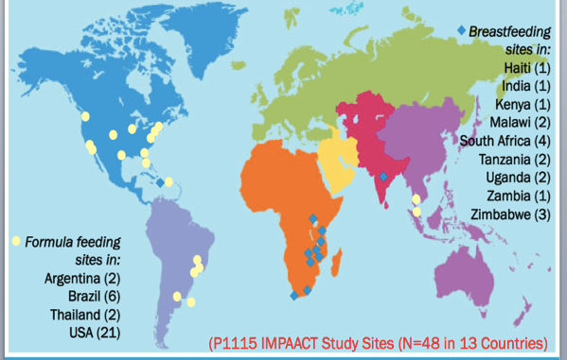
IMPAACT P1115
(Version 2.0-Status-At Sites)
Cohort 1- 445 mother infant-pairs prospectively enrolled
Raltegravir+ nevirapine –based ART or
Raltegravir+ nevirapine –based ART + VRCO1 within 48 hours of life (to enroll 45 infected infants)
Cohort 2 : Enrolled within 10 days of life but have
received very early combination ARV outside the trial
48 clinical trials sites in 13 countries
Notes:
48 clinical trials sites in 13 countries
INFANT
STUDY REGIMENS Three early intensive therapy regimens will be assessed:
Regimen 1L: Two nucleoside reverse transcriptase inhibitors PLUS nevirapine PLUS lopinavir/ritonavir (2 NRTIs + NVP + LPV/r)
Regimen 2R: Two nucleoside reverse transcriptase inhibitors PLUS nevirapine PLUS raltegravir (2 NRTIs + NVP + RAL)
Regimen 2RV: Two nucleoside reverse transcriptase inhibitors PLUS nevirapine PLUS raltegravir PLUS VRC01 monoclonal antibody (2 NRTIs + NVP + RAL + VRC01)

Slide 23

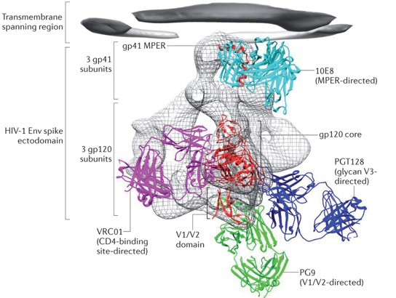
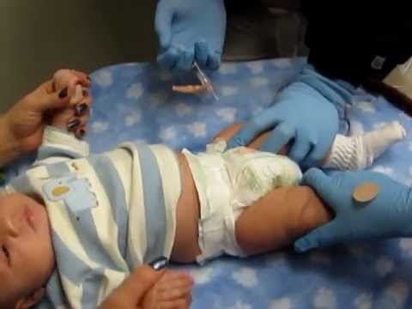
IMPAACT 2008
Phase I/II Multisite, Randomized, Controlled Study of Monoclonal Antibody VRC01 with Combination Antiviral Therapy to Promote Clearance of HIV-1-Infected Cells in Infants
Kwong PD et al. Nature Reviews/Immunology 2013
Hypothesis: Long acting antibody injectables may promote faster clearance of HIV-infected cells, enabling early virologic control and restrict HIV reservoirs
Protocol Chairs: Betsy McFarland (University of Colorado) and William Borkowsky (NYU); Collaboration with the Vaccine Research Center at the NIH (Rick Koup; Lucio Gama, Julie Ledgerwood and John Mascola and Barney Graham )

Slide 24
Study Design, Study Population and Study Regimen
Study Design: Two-arm randomized (1:1) to VRC01 or no VRC01, open label study
Study Population: HIV infected infants age 72 hours -<12wks of age
Study Regimen: VRCO1 regimen started within 14 days of initiating ART; four doses ( 0, 2, 6, 10 weeks)
Accrual and duration: 34 infected infants per arm accrued over approximately 12 months; 48 weeks of follow up

Slide 25
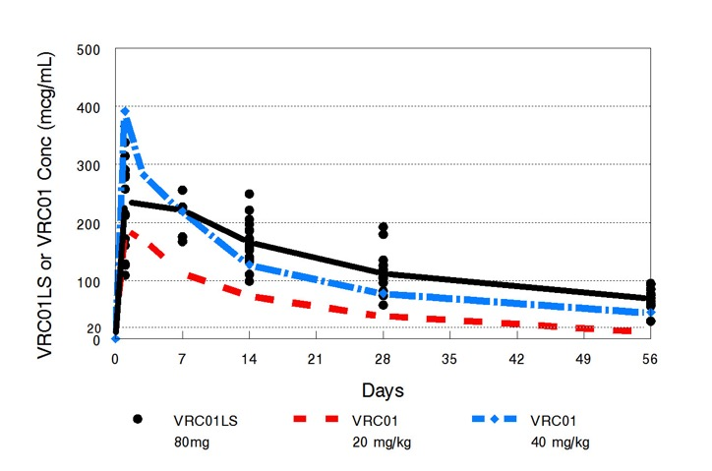



IMPAACT P1112: Safety & Pharmacokinetics of Monoclonal Antibodies VRC01 and VRC01LS in
HIV-Exposed Newborns
C Cunningham, E McFarland, E Capparelli, P Muresan, C Perlowski, L Morrison, P Morgan, B Smith, J Mascola, B Graham, and the IMPAACT P1112 Team;
Slide Courtesy of E. McFarland; CROI 2019 Abstract #45
Single SC doses of VRCO1 at birth (N=27) or VRC01LS (N=10), or repeated doses of VRC01 (N=13) or VRCO1-LS (N=11) over the period of breastfeeding are well tolerated
A birth dose of 40 mg/kg SC, followed by monthly doses of 20 mg/kg SC of VRCO1 result in levels consistently above 50 mcg/mL
VRC01LS has favorable PK in infants; T1/2 =59+8 days
(T_{1/2}: 71 + 18 days) in healthy adults¹
*
VRC01LS vs. VRC01 40mg/kg p < 0.002
*
*
¹Gaudinski et al. Plos Med; 2018
HIVR4P 2018 Oral Presentation, Madrid, October 2018
CROI 2019, Oral Presentation, Seattle, March 5, 2019
Notes:
T_{1/2}: 71 + 18 days_adults
The increase in the half life can be observed in this plot of plasma concentrations vs. days. The red and blue lines are VRC01 levels when given as a single dose at 20mg/kg and 40mg/kg, respectively. The black line is VRC01LS given at fixed dose of 80mg which equated to 20-32 mg/kg. The mean level of VRC01LS significantly exceeds the level for the 40mg/kg dose of VRC01 at 4 and 8 weeks.
VRCO1-27 INFANTS (THREE COHORTS- 13 20 MG/KG; 14 40 MG/KG; ; 14 ADDITIONAL MONTHLY DOSE OF 20 MG/KG-BF-
Vrco1-ls-cohort 1- 10, cohprt 2 11 (BF) SECOND DOSE AT 12 WEEKS

Slide 26
Outcome Measures (P2008)
Primary
Safety: Grade 3 or higher adverse events
Virology: Change in HIV-infected cell concentrations at Week 14 compared with week 0
Secondary
PK of VRC01 in infants initiating ART
Additional Objectives: Effect on reservoir size

Slide 27

Current Status (P2008)
18 sites planned:
11 activated
7 in approval process
Country | Site | Number screened | Number enrolled
Botswana | Gaborone CRS | 4 | 2
Brazil | Hosp. dos Servidores Rio de Janeiro | 2 | 1
 | Hosp. Geral De Nova Igqaucu | 4 | 3
Malawi | Malawi CRS | 2 | 2
 | Blantyre CRS | 28 | 17
Zimbabwe | Harare Family Care CRS | 5 | 3
Total |  | 45 | 28
40 doses VRCO1 given
Summary: Courtesy of Betsy McFarland, MD

Slide 28
IMPAACT 2008 TEAM
VRC Collaborators
Lucio Gama, Ph.D
Alison Taylor
Julie Ledgerwood, D.O.
Richard Koup, M.D.
Clinical Research Sites
Study Participants

Slide 29
Knowledge to be Gained (P2008)
Effect of passive immunity on HIV reservoirs in perinatal infection
Would addition of bNAbs to ART lead to faster clearance of viremia, and smaller HIV reservoirs in perinatal HIV infection?
Does the addition of bNAbs to early ART enhance HIV-specific immune effector function in perinatal infection?
Study provides a framework for combination antibody treatment towards ART-free remission in acute infection in pediatric populations, including in adolescents

Slide 30
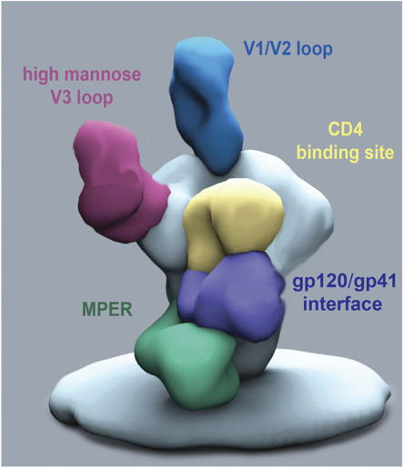
HIV Therapeutics with Combinations of Broadly Neutralizing Antibodies: Rapidly Evolving Field in Adult Infections
Gama L and Koup RA. Annual Review of Medicine Oct. 2017

Slide 31
Shifting the HIV Treatment Paradigm
Present
Future
Life-long ART suppression
HIV Remission
(years off ART
without detectable viremia)
HIV Cure
(Lifetime of no ART)

Slide 32
Undefined HIV Reservoirs

Slide 34
P2015

Slide 35
P2015

Slide 36
P2015

Slide 37
The “London Patient”-18 Months of ART-Free Remission after BMT with CCR5 delta 32 homozygous cells for Hodgkins Lymphoma

Slide 39
In-Development
Long-term follow up study of P1115 and P2008 study participants (CAP 546)
Therapeutic vaccines in perinatally infected adolescents
Combination broadly neutralizing antibodies in infants (P2008-version 2)

Slide 41
Shifting the HIV Treatment Paradigm
Present
Future
Life-long ART suppression
HIV Remission
(years off ART
without detectable viremia)
HIV Cure
(Lifetime of no ART)

Slide 42
IMPAACT Leadership: Sharon Nachman and James McIntyre
IMPAACT HIV Cure Scientific Committee Members
Deborah Persaud (Chair) and Ellen Chadwick (Vice-Chair)
Committee Members
Jintanat Ananworanich
William Borkowsky
Yvonne Bryson
Mark Cotton
Katherine Luzuriaga
Betsy McFarland
Steve Spector
Thor Wagner
Dan Barouch
Ann Chahroudi
Community Advisory Board Representatives
Steven Mphonda
Committee Specialists
Anne Coletti and Charlotte Perlowski
NICHD:Rohan Hazra, Eric Lorenzo
NIAID:Patrick-Jean Phillipe, Sarah Read, Judi Miller and Ellen DeCarlo
NIMH:Pim Brouwers
Biostatisticians:Camlin Tierney, Bryan Nelson, Jane Lindsey, Meredith Warshaw
IMPAACT SLG Liason:John Sleasman
Clinical Trials Team
Parents, Children and Youth

