Slide 1
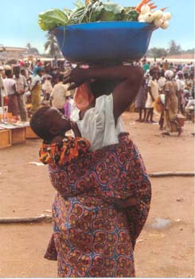
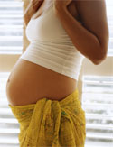


What we have learned from the PROMISE 1077 Trials
PROMISE (P1077) - Promoting Maternal-Infant Survival Everywhere
IMPAACT’s Master Strategy Perinatal Protocol
Chair – Mary Glenn Fowler, MD (US)
Co-Chairs – Pat Flynn, MD (US)
James McIntyre, MD (South Africa)
Tsungai Chipato, MD (Zimbabwe), Judy Currier (US)

Slide 2
Background: Primary PROMISE Research Questions Among HIV+ women with high CD4 counts who did not meet treatment criteria at the time of the trial
Antepartum: Will use of maternal ART be more efficacious and as safe as other proven regimens for PMTCT (ZDV along with sdNVP and TRV tail)?
Postpartum, during breastfeeding: Will use of maternal ART be more efficacious and as safe as infant NVP prophylaxis when used to prevent transmission during breastfeeding?
Maternal Health: Will continuation of maternal ART after the risk period for MTCT is over, be associated with reduced risk of AIDS or death? AND have no increased risk of toxicities when compared to discontinuing maternal ART?

Slide 3
Time Frame, Numbers Recruited into
PROMISE related Trials
PROMISE was conducted from 2011-2016
1077 HS: 1612 HIV+ pregnant women at 52 sites in US and internationally where ART was SOC and formula feeding was safe, affordable and recommended
1077 BF: 3245 HIV+ pregnant women at 14 sites in E. and Southern Africa, & India where Breastfeeding and ZDV + sd NVP were SOC
1077FF: 284 pregnant women at 3 sites in S. Africa and India where ZDV + sd NVP were SOC among women who met AFASS and chose FF

Slide 4
1077 Trials: Three PROMISE Randomizations
Antepartum Labor/ Postpartum Maternal Health
(14 wks-term) Delivery (for duration of BF) (after risk of infant transmission is ended)
0.56% mART vs 1.87% ZDV 0. 5% ART vs 0.6% iNVP HR 0.68 (95% CI 0.19-2.40)
infant uninfected at birth
(Version 2.0)
R
a
n
d
o
m
i
z
e
R
a
n
d
o
m
i
z
e
Triple ARV
Prophylaxis
Continue
Triple ARV Regimen
R
a
n
d
o
m
i
z
e
Triple ARV
Prophylaxis
Triple
ARV
Prophylaxis
Mother
Stop
All ARVs
ZDV
ZDV +
sdNVP+
TRV
Infant NVP
Prophylaxis
Breastfeeding Version
Formula Feeding Version
Breastfeeding Version
Breastfeeding Version
Formula Feeding Version
HAART Standard
Notes:
PROMISE is a complex protocol with three randomizations: The antepartum component during pregnancy, the post partum component during breastfeeding and the Maternal Health component following breastfeeding

Slide 5
What did we learn from the PROMISE
Antepartum Component Findings?
Triple maternal ARV (ART) regimens in pregnancy resulted in lower rates of HIV transmission to infants (0.56%) compared to zidovudine plus single dose nevirapine (1.8%).
The TDF/FTC and ZDV/3TC ART regimens were significantly associated with higher risk of moderate but not severe adverse pregnancy outcomes including increased risk of:
  Preterm birth (21% vs 13%) & low birth weight (23% vs12%) which is being followed up to assess their 12 and 24 month infant mortality and HIV-free survival.
  Increased maternal chemistry grade 2+ toxicities (primary hepatic)
There was an increased risk of VPTD and early infant deaths in the TDF-FTC ART arm compared to the 3TC-ZDV ART arm.
5

Slide 6
What did we learn from PROMISE about maternal HIV Drug Resistance (DR) and Transmission?
Maternal DR at infant diagnosis was associated with MTCT during breastfeeding but not with in utero/peripartum transmission.
After adjusting for maternal HIV RNA load, DR was still significantly associated with increased risk of MTCT (15.8% vs 7.6%) .
Infant DR emerged over time – possibly due to prolonged exposure to maternal ARV or iNVP prophylaxis or due to ART failure in the infant
Poster presented at CROI 2019-- Boyce, Frenkel
See upcoming Resistance presentation at Thursday Prevention Scientific Committee meeting by Dr. Boyce for further details

Slide 7
Frequency of Maternal HIV Drug Resistance
at Time of Infant Diagnosis

Slide 8
Comparison of Maternal HIV Plasma Viral Load
at Time of Infant Diagnosis

Slide 9
What did we learn from the PROMISE Postpartum component findings comparing maternal ART to infant NVP during BF?
Both maternal antiretroviral therapy (0.5%) and daily infant nevirapine prophylaxis (0.6%) were similar and safe.
Both regimens were associated with very low postpartum perinatal transmission rates during extended breastfeeding and high infant survival rates >97%.

Slide 10
In PROMISE What effects did Maternal ART have on infant Growth & Development?

Slide 11
Among infants with VPTD, Were Early Infant Deaths related to intracellular Tenofovir Drug Concentrations?
TFV-DP intracellular levels in DBS samples were not significantly different between cases and controls at 4 and 8 weeks post-ART initiation, respectively, and were not associated with individual or composite adverse pregnancy outcomes.
These findings, based on data from a limited sample size, suggest that in-utero exposure to TDF-DP concentrations, as measured in DBS, was not significantly associated with the adverse pregnancy outcomes VPTD/ early infant deaths in the PROMISE trial
The higher rates of VPTD/early infant deaths among women on TRV ART compared to ZDV/3TC ART remain unexplained.
Maternal Prolactin/progesterone levels are being evaluated.

Slide 12
Does TDF- FTC ART adversely effect pediatric
Growth or Neurodevelopment?
The post partum PROMISE 1084s substudy found that infants born to mothers randomized to maternal TDF ART during breastfeeding had
  No significant differences in mean LAZ at 26 weeks or other time points BUT
  Significantly increased risk of stunting (<--2 SD below WHO mean for AGE (HAZ) Z- scores at 26 weeks compared to infants on iNVP OR 1.28 (1.05, 1.57) p=.017
  Details to be presented by Dr. Jim Aizire at the Prevention Scientific Committee June 13th
A PROMISE co-enrollment R01 study (Fowler, Boivin) in Malawi and Uganda that compared growth of PROMISE HIV exposed Uninfected participants to Unexposed children found that HIV exposed Uninfected PROMISE Children were
  at significantly increased risk of stunting by 24 months compared to SES/gender matched children born to HIV negative mothers (Azire et al).
  Adjusted RR stunting Uganda for HEU children was aRR 1.7 (95% CI 1.2-2.4)
  Adjusted RR stunting Malawi HEU children was aRR 1.3 (95% CI 1.1-1.7)
  However HEU children had NO increased risk of lower cognitive scores by age 48-60 months with ARV exposures antepartum or post partum (Boivin et al, in press Lancet HIV)

Slide 13
Boivin/Fowler ND grant: Risk of stunting for HEU PROMISE Children in Malawi and Uganda versus HUU children
Jim Azire et al, IAS 2017
Risk of stunting (LAZ < -2 SD)
P=0.341

Slide 14
Boivin et al, IAS 2018
Malawi - Mullen Scales of Early Learning Cognitive Composite Standard Score
Uganda - Mullen Scales of Early Learning Cognitive Composite Standard Score
48 Months
48 Months
Level of Ante- Partum and Post-Partum ARV Exposure – Treatment Arms | N | Mullen Cognitive Composite Standardized Score
 |  | Mean | Std Dev
Triple ARV+Infant NVP | 44 | 76.84 | 12.13
Triple ARV+Maternal triple ARV | 36 | 83.03 | 12.65
ZDV+Infant NVP | 34 | 81.71 | 11.56
ZDV+Maternal triple ARV | 37 | 81.35 | 11.74
Unexposed controls | 191 | 82.32 | 12.99
Level of Ante- Partum and Post-Partum ARV Exposure – Treatment Arms | N | Mullen Cognitive Composite Standardized Scores
 |  | Mean | Std Dev
Triple ARV+Infant NVP | 42 | 84.62 | 15.01
Triple ARV+Maternal triple ARV | 52 | 87.73 | 16.13
ZDV+Infant NVP | 39 | 87.72 | 14.39
ZDV+Maternal triple ARV | 36 | 80.94 | 14.11
Unexposed controls | 179 | 85.73 | 15.29

Slide 15
WHAT IMPACT DID MATERNAL ART HAVE ON MOTHERS’ HEALTH DURING FOLLOW UP IN PROMISE?

Slide 16
PROMISE 1084s: Were there effects of postpartum Maternal ART have on Maternal Bone Density?
Post partum Maternal TDF based ART was associated with significantly Hip and Lumbar-Sacral spine bone mineral density compared to women randomized to no ART whose infants received infant NVP during Breastfeeding.
Stranix et al. IAS 2016

Slide 17
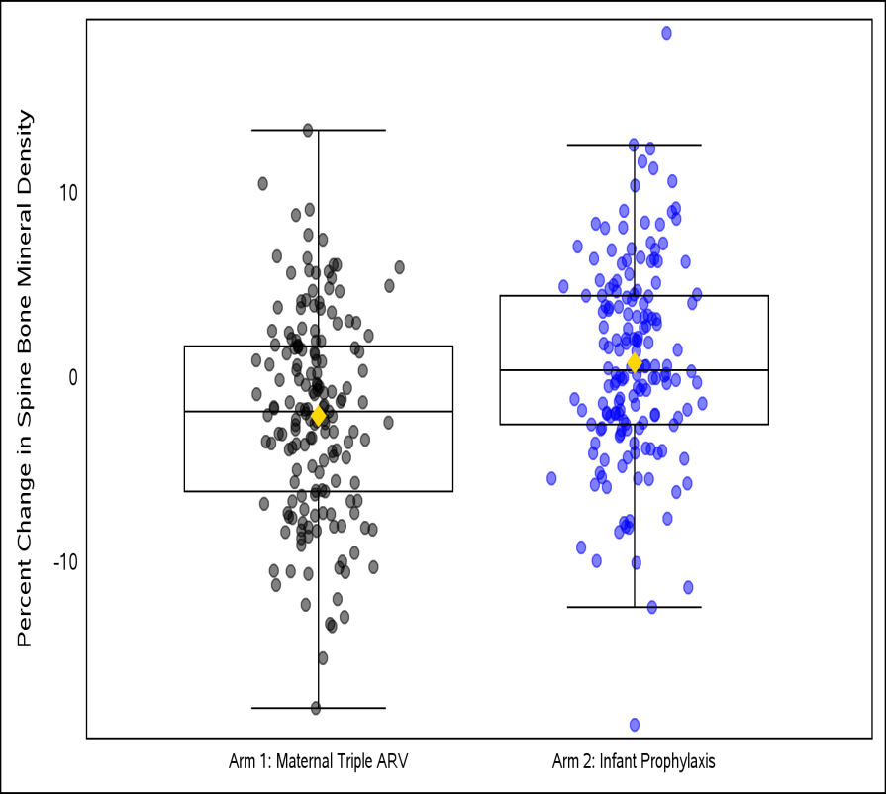
1084s TDF ART versus Lumbar spine BMD % decline week 1 to 74 greater in maternal ART study arm
Mean difference of -2.86%
(-4.03, -1.70)
(p-value <0.001)
Maternal Triple ART
N=169
No maternal ART
N=168
-2.05% (-2.88, -1.22) | Mean % change (95% Confidence Interval ) | +0.81% (-0.01, +1.64)
Notes:
For the primary outcome of percent change in lumbar spine BMD, the Maternal Triple ARV arm had significantly lower mean (95% confidence interval) percent change to Week 74 of -2.05 (-2.88, -1.22) percent compared to mean of 0.81 (-0.01, 1.64) percent in the Infant Prophylaxis arm, for a mean difference of -2.86 (-4.03, -1.70) percent (p-value <0.001).

Slide 18
What did we learn from the PROMISE Maternal Health Component on the Benefits or Risks of Continuing ART after the period of risk of MTCT is over?
During PROMISE Follow up, Risk of Progression to AIDS or death events was extremely low
There were no significant differences between continuing or discontinuing maternal ART in either 1077HS (Hoffman et al, Clinical trials, 2018) or the 1077 BF/1077FF Maternal Health component
There was however an significantly increased risk of progression to WHO clinical grade 2-3 events in 1077HS and similar trend in 1077BF/1077FF
In subsequent pregnancies, when conception occurred while mothers were on ART, there was increased risk for adverse pregnancy outcomes including abortions and still births. Similar to finding from several programs in other African settings.

Slide 19
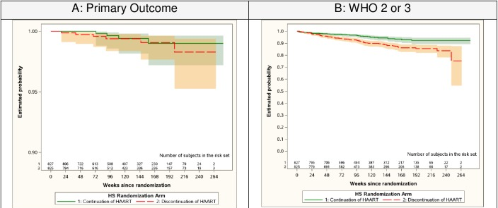
PROMISE 1077HS FOUND NO SIGNIFICANT DFFERENCES IN PROGRESSION TO AIDS OR DEATH FOR WOMEN RANDOMIZED TO STOP OR CONTINUE ART AFTER RISK FOR PMTCT WAS OVER
Event rate lower than expected
Hazard ratio 0.68 ( 95% CI 0.19, 2.40)
Hazard ratio 0.48 (95% CI 0.33, 0.70)
Occurrence of AIDS-defining illness, serious non-AIDS defining cardiovascular, renal or hepatic event or death
Occurrence of unexplained weight loss, zoster, recurrent RTIs or oral ulcerations, targeted rashes, chronic diarrhea, oral candidiasis, pulmonary TB, etc

Slide 20
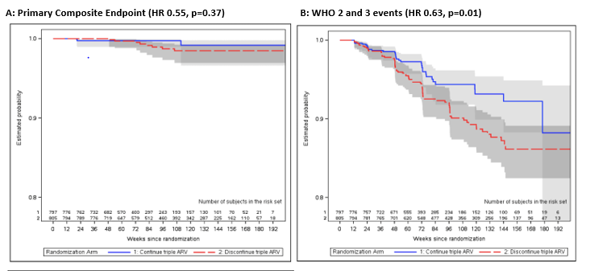
PROMISE 1077BF/FF found Similar Findings Among Women in Low-Income Countries (1077 FF/BF): NO significant differences in Risk of AIDS or Death for continuing or stopping ART

Slide 21
Does maternal ART exposure at conception increase risk of Adverse Pregnancy Outcomes? 1077HS and 1077BF post hoc analyses of subsequent pregnancy outcomes
Adverse Pregnancy outcomes 1077HS and 1077BF MH component
Summary of Relative Risks and Hazard Ratios 1077HS and 1077BF MH
In 1077HS, When spontaneous abortions and stillbirths were combined, there was a significant difference in events, with 33/140 (23.6%) in the CTART arm versus 15/126 (11.9%) in the DCART arm
(relative risk[RR], 2.0 [95% confidence interval {CI}, 1.1–3.5]; P = .02). (R Hoffman, et al, CID 2019)
In 1077BF, similar results were seen: The intent to treat analyses showed significantly increased low birth weight in the Maternal Health continue ART group. See Presentation at Thursday Prevention SC by Theron et al for details

Slide 22
Overall Conclusions: We learned and are continuing to learn a lot from PROMISE!
Maternal ART is highly efficacious in reducing risk of MTCT with rate of <1% during antepartum, Labor/delivery and Breastfeeding
Maternal ART is also associated with some adverse effects including increased risk of moderate adverse pregnancy outcomes
Both maternal ART and infant NVP are similarly efficacious in reducing risk of transmission to <1% during BF
Maternal resistance mutations are associated with increased risk of transmission during BF
We found no differences for women randomized to continue or stop ART after the risk of MTCT was over in terms of maternal AIDS or death events; but there was less risk of progression to WHO clinical state 2-3 with ART continuation
TDF-FTC ART post partum was associated with significantly lower BMD at 74 weeks than mothers not randomized to ART post delivery

Slide 23
PROMISE Related Publications Pub or Accepted
Fowler MG, Qin M, Fiscus SA, Currier JS, Flynn PM, et al for the IMPAACT 1077BF/1077FF PROMISE study team. Benefits and risks of Antiretroviral Therapy for Perinatal HIV Prevention. New England Journal of Medicine, 2016. 375(18): p. 1726-1737. PMC5214343.
(Shepherd JA, Sommer MJ, Fan B, et al. Advanced Analysis Techniques Improve Infant Bone and Body Composition Measures by Dual-Energy X-Ray Absorptiometry. The Journal of Pediatrics. Feb 2017;181:248-253.e243. PMC5274603
Currier JS, Britto P, Hoffman RM, Brummel S, et al. Randomized trial of stopping or continuing ART among postpartum women with pre-ART CD4 ≥ 400 cells/mm³. PLoS One. 2017 May 10;12(5):e0176009. PMC5425014
Flynn PM, Taha TE, Cababasay M, et al Prevention of HIV-1 transmission through breastfeeding: efficacy and safety of maternal antiretroviral therapy versus infant nevirapine prophylaxis for duration of breastfeeding …l. JAIDS. 11 Dec 2017. ePub ahead of print. 2018 Apr 1;77(4):383-392. PMC5825265.
Hoffman RM, Brummel SS, Britto P, Pilotto JH,. Klingman KL, Currier JS; 1077HS PROMISE Team. Adverse Pregnancy Outcomes Among Women who Conceive on Antiretroviral Therapy. Clin Infect Dis. 1 Jun 2018. ePub ahead of print. Jan 2019;68(2):273-9. PMC6321847.
Hoffman R et al. Maternal health outcomes among HIV-infected breastfeeding women with high CD4 count: results of a treatment strategy trial. Accepted to HIV Clinical Trials in October 2018. (PROMISE tracking number, MH-1)
Boivin M et al. Developmental effects of antepartum and postpartum ARV exposure for Ugandan and Malawian PROMISE HIV-exposed versus unexposed children at age 12, 24, 48, and 60 months. Accepted Lancet HIV in March 2019. (PROMISE tracking number, CO-5-a)
Murnane P et al. Tenofovir concentrations in hair strongly predict virologic suppression in breastfeeding women. Accepted to AIDS in March 2019.
Sebikari D et al. Risk Factors for Low Birth Weight (LBW) and Preterm Delivery (PTD) in the IMPAACT PROMISE-1077BF Randomized Trial. Accepted to JAIDS in March 2019.
Also PROMOTE PEPFAR COHORT—Taha/Fowler And three related R01 grants:
ND, Growth and Development: Boivin/Fowler
Maternal DXA Repeat Pregnancy: Fowler
Brain Computer Games-- Boivin

Slide 24
Pending PROMISE Analyses and Further Research Needed
Antepartum Component: Further basic research on the biologic basis for the increased risk of adverse pregnancy outcomes with ART
Assess the role of breast milk viral load and resistant mutations in breastmilk in relation to infants who became infected
Follow up of 12 and 24 month overall and HIV free survival including for preterm and low birth weigh infants
Further research to better understand growth findings related to stunting among HIV Exposed but Uninfected children
Assessment of later school performance among HEU children
Follow up of Maternal Bone Health including Maternal Bone Mineral Density decreases after cessation of breastfeeding and impact of repeat pregnancy among HIV + mothers on lifetime ART

Slide 25
Thank you for your attention and we welcome your help with future PROMISE Analyses!

Slide 26
Acknowledgements: The PROMISE team gratefully acknowledges the support of
All the mothers and infants who participated in the 1077 PROMISE trials
The Co Chairs and Component leaders, Site IoRs and the staff at the PROMISE sites
The IMPAACT Central Lab, SDAC, FSTRF, and FHI360 staff
IMPAACT Leadership
The pharmaceutical companies: AbbVie, Gilead, Boehinger Ingelheim, Bristol Meyer Squibb, Merck, GlaxoSmithKline/ViiV Healthcare
The National Institutes of Health: NIAID, NICHD, NIMH

