Slide 1
Broadly Neutralizing Antibodies to Reduce Vertical HIV Transmission: Safety and PK of VRC01, VRC01LS, and VRC07-523LS
Coleen Cunningham, MD
Presenting on behalf of the IMPAACT P1112 team and collaborators from research sites and VRC

Slide 2
Vertical transmission of HIV
Maternal and infant ART has resulted in considerable progress to reduce transmission.
However, an estimated 180,000 children were newly infected in 2017; 90% in Africa¹.
Factors contributing to transmission include:
  Women not diagnosed during pregnancy
  Incomplete ART adherence during pregnancy or
  while breastfeeding
  Drug resistant virus
  Women acquiring HIV while breastfeeding
To eliminate transmission to infants, additional strategies are needed.
1. http://www.unaids.org/en/resources/documents/2018/core-epidemiology-slides
Notes:
As you all know, antiretroviral therapy is remarkably effective in preventing perinatal HIV transmission to infants, providing protection during both pregnancy and breastfeeding. And yet, there were still an estimated 180,000 children with newly acquired HIV in 2017, mostly living in sub-Saharan Africa and the vast majority due to vertical transmission.
The factors that contribute to ongoing transmission to infants include– women who are not diagnosed in pregnancy, incomplete adherence to treatment, drug resistant virus, and acquisition of HIV late in pregnancy or during breastfeeding, both resulting in high rates of transmission to their infants, who would not be receiving ART since their risk is not identified. To achieve the goal of elimination of perinatal HIV, we need additional strategies, ideally an treatment that can be given at birth, is long acting and not reliant on adherence, and could be administered to all infants in regions with high seroprevalence and high rates of incident infections.

Slide 3
Passive immunization is a potential strategy to interrupt transmission
Hepatitis B perinatal transmission prevented with HBIG.
HIV-1 specific broadly neutralizing monoclonal antibody protection in non-human primates (NHP).
  Prevention from SHIV transmission via rectal challenge in adults and juvenile NHP¹
  Prevention from SHIV transmission via oral challenge in infant NHP²
AMP study (HVTN/HPTN) Phase 2b study of VRC01 for HIV prevention adults
  Enrolled and in follow-up
1. Pegu A et al. Sci Transl Med 2014: 6; 243ra288
2. Hessell AJ et al. Nat Med 2016: 22;362-368
Notes:
One such alternative strategy would be passive immunization. A successful example of this approach is the use of HBIG to interrupt mother-to-child transmission of Hepatitis B. Even from very early in the HIV epidemic, the concept of using passively administered HIV antibodies for prevention of HIV has been considered. These ideas were thwarted due to the limited potency and breadth of polyclonal and early generation monoclonal antibodies. However, newer technologies have allowed the identification and production of monoclonal antibodies with excellent potency and breadth in the last several years. These antibodies, so called bNAbs, have excellent neutralizing activity. Many of these bNAbs have demonstrated protection from SHIV transmission via rectal and vaginal inoculation in adult non-human primate as well as prevention of SHIV transmission via oral challenge in infant macaques.
One of these bNAbs is currently being studied in AMP, a phase 2b study of VRC01 administered every 8 weeks to adults at high risk of HIV acquisition. This study is fully enrolled and follow-up is ongoing.

Slide 4
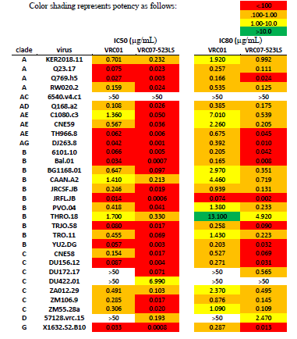
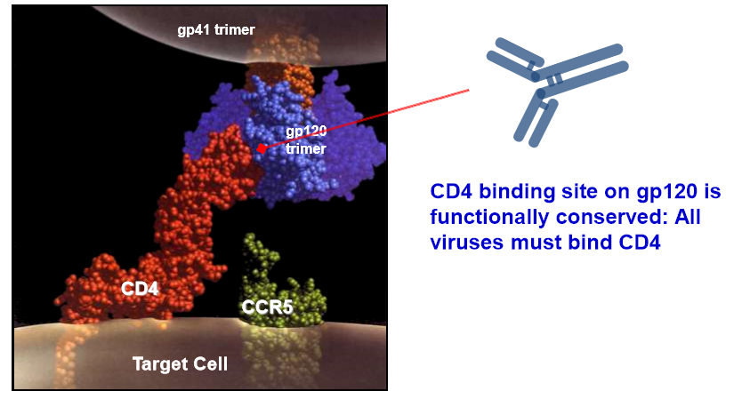
VRC01 and
VRC07-523LS:
Broadly neutralizing anti-CD4 binding site monoclonal antibodies
gp120
CD4 binding site on gp120 is functionally conserved: All viruses must bind CD4
Notes:
VRC01 which is a bNAb that recognizes the CD4 binding site on the HIV envelope. VRC01 is capable of neutralizing 85-90% of circulating HIV isolates.
VRC07-523 also binds to the CD4 binding site and is more potent, in general with about a 10-fold increase in potency compared to VRC01

Slide 5
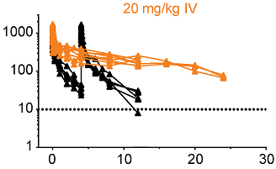
VRC01LS: Increased affinity for neonatal
Fc-receptor increases mAb half-life
Two amino acid substitutions (M428L/N434S) in the Fc domain result in increased affinity for the neonatal Fc-receptor at low pH and recirculation of functional IgG.
In adults, this results in a dramatic increase in half-life.
These changes also result in prolonged protection in NHP.
VRC01
VRC01LS
Serum concentration (mcg/mL)
Time (weeks)
Ko et al, Nature, 514(7524) 2014
Guadinski et al, PLoS Med, 2018
Notes:
The half life of an agent determines the frequency and dose that are needed to achieve a target serum concentration. Longer half life will be allow for less frequent administration. In adult studies, VRC01 has a half-life of 15 days. In order to increase the half-life of this antibody, VRC01LS was developed by inserting two amino acid substitutions into FC segment of the antibody – this mutation increases the affinity for the neonatal Fc-receptor which results in a higher fraction of the antibody being returned to circulation after uptake by endosomes. In adults, this change is associated with a 4-fold increase in the serum half-life over VRC01. You can see the orange line for VRC01LS has substantially higher serum concentrations after a single dose compared to two doses of VRC01.

Slide 6
IMPAACT P1112: Study Overview
Open label, dose-escalating, phase I study of safety and pharmacokinetics of single and multiple subcutaneous (SC) doses starting at birth
VRC01LS (VRC-HIVMAB-080-00-AB)
VRC01 (VRC-HIVMAB-060-00-AB)
Dose group 4
Cohort 1 (non-breastfed, N=10)
  Birth dose weight bands
    Wt <4.5 kg: 80mg
    Wt > 4.5 kg: 100mg
Cohort 2 (breastfed, N=11)
  Birth dose weight bands
    Wt <4.5 kg: 80mg
    Wt > 4.5 kg: 100mg
  Week 12 dose : 100mg
Dose group 1 (N=13, non-breastfed)
  Birth dose 20mg/kg
Dose group 2 (N=14, non-breastfed)
  Birth dose 40mg/kg
Dose group 3 (N=13, breastfed)
  Birth dose 40mg/kg
  Monthly dose 20mg/kg
Notes:
This leads us to IMPAACT P1112, a study designed to evaluate the safety and pharmacokinetics of VRC01 and VRC01LS when administered to HIV exposed newborns. We initially evaluated single doses of VRC01 at 20 and 40 mg/kg and then progressed to study repeated doses with 40mg/kg given at birth followed by 20mg/kg monthly. VRC01LS was studied in Dose group 4 including Cohort 1 who were non-breastfed infants receiving a single dose. Cohort 2 were breastfed infants and received a dose at birth and a second dose at 12 weeks if there was ongoing breastfeeding. We used weight banded doses for VRC01LS – so infants with birth weight less than 4.5 kg received 80mg for the initial dose and if their birthweight was over 4.5 kg, 100mg. For the second dose, all cohort 2 infants received a dose of 100mg.

Slide 7


IMPAACT P1112 study schedule
HIV-exposed infants
  ALL infants receive ART to prevent perinatal/breastmilk transmission
  Followed for prolonged period for safety and to determine HIV infection status
  Primary objectives are safety and PK
Follow up schedule varied, depending on cohort
Consent, screen
DAYS
WEEKS
0 1 14 28
8 12 14 16 24 36 48-96
Initial dose before age 3-5d; 4 hour observation
Notes:
Each Cohort had slightly different immunization and follow up schedule, however, all were followed until well after the antibody was no longer detectable. Initial dose was within 72 hours of birth for non-breast fed infants and within 5 days of birth for breastfed infants.

Slide 8
Characteristic |  | Dose Group 1 (20mg/kg) (N=13) | Dose Group 2 (40mg/kg) (N=14) | Dose Group 3 (40/20 monthly) (N=13) | Dose Group 4 Cohort 1 (N=10) | Dose Group 4 Cohort 2 (N=11)
Gender | M | 8 (62%) | 6 (43%) | 8 (62%) | 6 (60%) | 5 (45%)
Race | Black | 6 (46%) | 11 (79%) | 13 (100%) | 8 (80%) | 11 (100%)
 | White | 6 (46%) | 2 (14%) | 0 | 1 (10%) | 0
Infant ART | 3TC, ZDV | 1 (8%) | 0 (0%) | 0 | 0 | 0
 | 3TC, ZDV, NFV | 1 (8%) | 0 (0%) | 0 | 0 | 0
 | 3TC, ZDV, NVP | 2 (15%) | 5 (36%) | 0 | 2 (20%) | 0
 | NVP | 0 | 1 (7%) | 12 (92%) | 2 (20%) | 11 (100%)
 | ZDV | 4 (31%) | 4 (29%) | 0 | 5 (50%) | 0
 | ZDV, NVP | 5 (38%) | 4 (29%) | 1 (8%) | 1 (10%) | 0
Age (days) at Administration | Mean (s.d.) | 1.5 (1.1) | 1.9 (0.9) | 2.7 (1.4) | 2.0 (0.9) | 2.4 (0.8)
 | Median | 2 | 2 | 2 | 2 | 2
 | Min, Max | 0, 3 | 0, 3 | 1, 5 | 0, 3 | 1, 4
Birth Weight (grams) | Mean | 3,185 | 3,134 | 3,055 | 3123 | 2948
 | Median | 3,045 | 3,160 | 2,860 | 2,865 | 2,920
 | Min, Max | 2,330, 4,675 | 2,609, 3,580 | 2,330, 4,320 | 2,535, 4,045 | 2,500, 3,545
Enrollment site | S. Africa and Zimbabwe | 1 (8%) | 5 (36%) | 13 (100%) | 3 (30%) | 11 (100%)
 | United States | 12 (92%) | 9 (64%) | 0 | 7 (70%) | 0
Notes:
Baseline characteristics. Just want to point out a couple items. The breastfed cohorts (Dose group 3 and dose group 4, cohort 2) were enrolled entirely in Africa. African infants were more likely to receive NVP alone, compared with US infants who were more likely to receive combination therapy or ZDV alone.

Slide 9
Dose Group 1 and 2 PK: 100% of infants receiving 40 mg/kg were above 50 mcg/ml at day 28; and average was still above 10 mcg/ml at day 112.

Slide 10
Infants receiving multiple doses (dose group 3) remained over 50 mcg/mL almost all the time.

Slide 11
Infants receiving VRC01LS (Dose Group 4) achieved significantly higher levels at day 28 and later time points.
*
VRC01LS vs. VRC01 40mg/kg p < 0.002
*
*
Notes:
The increase in the half life can be observed in this plot of plasma concentrations vs. days. The red and blue lines are VRC01 levels when given as a single dose at 20mg/kg and 40mg/kg, respectively. The black line is VRC01LS given at fixed dose of 80mg which equated to 20-32 mg/kg. The mean level of VRC01LS significantly exceeds the level for the 40mg/kg dose of VRC01 at 4 and 8 weeks.
Half life of VRC01LS is approximately 60 days!

Slide 12
Infants receiving VRC01LS (Dose Group 4) maintain lower levels at later time points compared to the modeled adult values.
Notes:
If the target trough level before redosing is the same in adults and infants, then the infants would be anticipated to need a repeat dose after a shorter interval. Some of this is due to growth of the infant, especially in the first several months of life, but there may be other maturational changes in bNAb metabolism and redistribution that also will impact PK. Still don’t have long enough follow up data to report on a final half-life.

Slide 13
VRC01 and VRC01LS Safety
Frequent local reactions, generally mild and resolved rapidly
No serious adverse events attributed to study drug
No infants HIV-infected

Slide 14
In conclusion
VRC01 and VRC01LS are well tolerated.
VRC01 and VRC01LS can be administered at birth and subsequent time points to achieve desired levels.
Broadly neutralizing antibodies are feasible as an additional strategy to prevent perinatal transmission of HIV in infants at increased risk.
Next steps:
  VRC07-523LS enrolling- increased potency & breadth
  (IMPAACT P1112)
  Studies of bNAb as adjunct to ART for neonatal HIV prevention and early treatment
  (IMPAACT 2008; IMPAACT P1115)
Notes:
In conclusion, VRC01LS administered subcutaneously was well tolerated by infants. The half-life is such that dosing at birth and then 1-2 times more during the first year of life, a typical duration for breastfeeding, could achieve plasma levels that are potentially protective. Next steps include examining newer agents that have increased potency and breadth. One of these is VRC07-523LS which is being studied in P1112 and has just started enrollment. Studies of that will examine the effect of bNAbs as an adjunct to antiretrovirals for prevention and early treatment could provide an important additional strategy to achieve elimination of perinatal HIV.

Slide 15



Acknowledgements -Thanks to:
The International Maternal Pediatric Adolescent AIDS
Clinical Trials Network
Sites
FAMCRU Cape Town
Harare Family Care
Bronx-Lebanon Hospital, NY
Univ California, LA
Emory University
University of Puerto Rico
Jacobi Med. Ctr. , NY
Johns Hopkins University
San Juan City Hospital
South Florida, Ft Lauderdale
Texas Children’s Hosp.
University of Colorado
University of Florida
Thanks to:
The parents
and infants
for participating
The P1112 Team
Coleen Cunningham
Elizabeth McFarland
Edmund Capparelli
Petronella Muresan
Elizabeth Smith
Charlotte Perlowski
Leavitt Morrison
Patricia Morgan
Adrian McDermott
Rohan Hazra
Thanks to: Vaccine Research Center: Barney Graham, John Mascola, Julie Ledgerwood for slides and data
Notes:
As with every clinical trial, this work was contributed to by a large and terrific group of dedicated team members – at least 20 individuals. All of them made important contributions. I would to specifically acknowledge Edmund Capparelli for the PK analysis, Ella Muresan for safety data and statistical analysis, and Coleen Cunningham for leading the protocol team. We also thank the Vaccine Research Center for providing the antibody and the assays for the PK analysis as well as slides and data for this talk. We thank the dedicated sites for rapid accrual and excellent study adherence and the parents and infants who volunteered for this study and all that entailed. Thank you!

Slide 16
Extra slides

Slide 17
Dose Group 4: Local Reactions
Local reactions were common, especially with the first dose; almost all mild and resolved within hours
 | Cohort 1: dose 1 (n=10) | Cohort 2: dose 1 (n=11) | Cohort 2: dose 2 (n=10)
Volume per site, mean (min/max) | 0.8 mL (0.8/0.8) | 0.6 mL (0.4/0.8)* | 0.6 mL (0.3/1.0)*
% of children with any reaction^ | 50% | 82% | 20%
Grade mean (min/max)& | 1 (1/1) | 1 (1/1) | 2 (2/2)
Resolution by 1 hr | 60% | 89% | 0%
Resolution by 24 hr | 100% | 100% | 100%
* Some infants received dose split across two injection sites
^ Erythema 9-55%; edema 10-45%, induration 0-20%, bruising: 1 infant
& Reaction size: most 1-2 cm; maximum 3.5 cm
Notes:
As might be expected, local reactions in the first minutes after the subcutaneous slow push injection were common. 50% of cohort 1 and 82% of cohort 2 having some type of local reaction for the 1st dose. For the 2nd dose, only 20% had a reaction.
The most common reaction was erythema, followed by edema, and then induration. The grades, which are based on size of reaction, were all grade for the 1st injection. The two reactions after the 2nd dose were grade 2. Most of the reactions had resolved by one hour and all of the reactions were fully resolved by 24 hours. The typical reaction was 1-2 cm; the largest reaction was 3.5 cm.

