Slide 1
Treatment Studies in the Pipeline
IMPAACT HIV Treatment Scientific Committee Update
IMPAACT Community and Science
Theodore Ruel MD
11 June 2019

Slide 2
Proposals and Protocols in Development
Study | Title
IMPAACT 2026 | Pharmacokinetic Properties of Antiretroviral, Anti-Tuberculosis, Contraceptive and Related Drugs During Pregnancy and Postpartum
IMPAACT 2023 | A Phase I Trial to Evaluate the Safety and Pharmacokinetics of Dolutegravir in Neonates Exposed to HIV-1 Infection
IMPAACT 2022 | Phase II Study of the Virologic Efficacy and Feasibility of Long-Acting Injectable Antiretroviral Medications in Non-Adherent Youth with HIV
CS 5022 | Phase I/II Trial of the Pharmacokinetics, Safety and Efficacy of an age-appropriate formulation of Doravirine in HIV-infected children ages 4 weeks to 11 years
CAP 538 | Open label, multicenter, single arm study to evaluate the pharmacokinetics, safety, tolerability, and antiviral efficacy of switching to dual therapy dolutegravir (DTG) plus rilpivirine (RPV) fixed dose combination (FDC), in antiretroviral therapy (ART) experienced, HIV-1 infected children from 6 to less than 18 Years of age who are virologically suppressed on their current anti-retroviral (ARV) regimen
Notes:
Speaker’s Notes: there are currently three proposals within the Treatment research area in protocol development and one capsule and one concept sheet in process

Slide 3
IMPAACT 2026 PK of ARVs, Anti-TB Meds, and Hormonal Contraceptives During Pregnancy and Postpartum
Phase IV prospective PK study of selected ARVs, anti-TB medications, and hormonal contraceptives
Participants: pregnant and postpartum women and their infants
Follow-on to P1026s
Anticipate Version 1.0 by September 2019

Slide 4
IMPAACT 2026 - Components
1
2
3
Pregnant WLHIV on ARVs and no TB drugs, and their infants
BIC
DOR
TAF (intracellular)
WLHIV and HIV-uninfected women who received Long-action/Extended-release ARVs during Pregnancy, and their infants
CAB LA
Pregnant WLHIV on ARVs and First-Line TB Treatment, and their infants
First-line TB drugs (INH, RIF, RFB, EMB, PZA, MFX) and:
DTG
ATZ/r or DRV/r
LPV/r
4
5
6
Pregnant WLHIV and HIV-uninfected Women on Second-Line TB Treatment, and their infants
LFX, CFZ, LZD, BDQ, DLM, or MFX and at least one other second-line drug
Postpartum WLHIV on ARVs and Hormonal Contraceptives
DTG and ethinyl estradiol
DTG and etonogestrel implant
Postpartum WLHIV and HIV-uninfected Women Breastfeeding and on ARVs and/or TB treatment, and their infants
2 or more 1st-line TB drugs
1 or more 2nd-line TB drugs
ATZ/r
DRV/r
LPV/r
DTG
TAF
DOR
BIC
BIC=bictegravir; DOR=doravirine; TAF=tenofovir alafenamide fumarate; CAB LA=cabotegravir long-acting;
INH=isoniazid; RIF=rifampin; RFB=rifabutin; EMB=ethambutol; PZA=pyrazinamide; MFX=moxifloxacin; DTG=dolutegravir; ATZ/r=atazanavir/ritonavir; DRV/r=darunavir/ritonavir; LPV/r=lopinavir/ritonavir; LFX=levofloxacin; CFZ=clofazimine; LZD=linezolid; BDQ=bedaquiline; DLM=delamanid

Slide 5
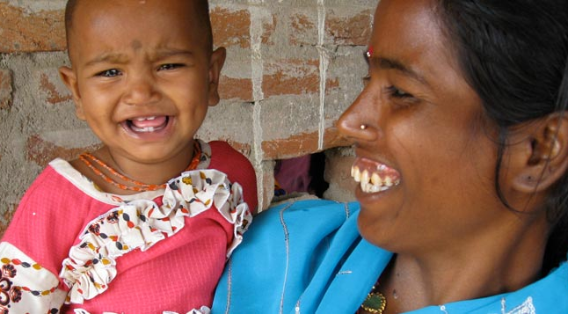
IMPAACT 2023 Safety and PK of DTG in HIV Exposed Neonates at Risk of HIV Infection
Aim: dosing for DTG during the first six weeks of life
Design: Phase I dose-finding study of DTG added to standard ARV prophylaxis to prevent perinatal transmission in infants exposed to HIV-1 infection
Participants: full term infants born to mothers with HIV-1
Enrollment: 2 sequential cohorts, stratified by infant in utero exposure to maternal DTG
Cohort 1: Two single doses of DTG one week apart.
Cohort 2: Long term oral dosing of DTG starting within 72 hours of birth and continued for 6 weeks of life.
Anticipate Version 1.0 by December 2019

Slide 6
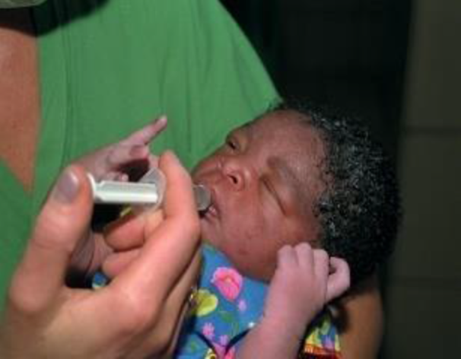
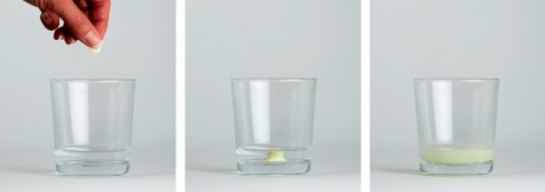
Dolutegravir Formulations
ViiV Healthcare has contracted with Quotient Sciences to produce a liquid solution for this study
DTG 5 mg dispersible tablets will be available if this dose is determined to be appropriate for some infants included in the study

Slide 7
IMPAACT 2022 Feasibility and Acceptability of Long-Acting Injectables in Non-Adherent Youth Infected with HIV
Phase II study of PK, effectiveness, feasibility, and acceptability of long-acting injectable CAB + RPV
Participants: non-adherent adolescents age 13 to 25 years
Follows on IMPAACT 2017 (MCOHA), Phase I/II in suppressed 12 to 18 yo
Further protocol development pending interim results from IMPAACT 2017

Slide 8
CAP 547 PK, Safety and Efficacy of Doravirine in HIV-infected children ages 4 weeks to < 12 years
Phase I/II PK, Safety and Efficacy dose finding study in children
Participants: > 4 weeks to < 12 years
Follow on IMPAACT 2014 which includes adolescents 12- 18 yrs
Undergoing IMPAACT leadership review in June 2019

Slide 9
CS 5022 Switching to dual therapy DTG + RPV in ART-experienced Children with HIV infection
Phase I/II PK, safety, tolerability, and antiviral efficacy of SWITCH to DTG + RPV FDC
Participants: 6 to < 18 years virologically suppressed on current regimen
Undergoing IMPAACT leadership review in June 2019

Slide 10
One Study Pending
Study | Title | Status | Population
IMPAACT 2019 | Phase I/II study of the pharmacokinetics, safety, and tolerability of dolutegravir/lamivudine/abacavir (Triumeq®) in HIV-1-infected children less than 12 years of age | Open to accrual expected in January 2020 | HIV-infected infants and children (<12 years of age)

Slide 11
Eight Studies Currently Enrolling
Study | Title | Status | Population
IMPAACT 2017 (MOCHA) | Phase I/II Study of the Safety, Acceptability, Tolerability, and Pharmacokinetics of Oral and Long-Acting Injectable Cabotegravir and Long-Acting Injectable Rilpivirine in Virologically Suppressed HIV-Infected Children and Adolescents | 6 of 155 (4%) | Adolescents living with HIV
IMPAACT 2014 | Phase I/II Trial of the Pharmacokinetics, Safety and Efficacy of Doravirine (MK-1439) and Doravirine/ Lamivudine/ Tenofovir Disoproxil Fumarate (MK-1439A) in HIV-1-infected Children and Adolescents | 10 of 65 (15%) | Children living with HIV (12 to <18 years of age)
IMPAACT 2007 | Phase I Safety & Pharmacokinetics of Maraviroc in HIV-1-Exposed Neonates at Risk of Acquiring HIV-1 Infection | 37 of 72 (51%) | Neonates exposed to HIV perinatally
P1106 | Pharmacokinetic Characteristics of Antiretrovirals and Tuberculosis Medicines in Low Birth Weight Infants | 121 of 158 (77%) | Low birth weight and normal birth weight infants

Slide 12
Eight Studies Currently Enrolling (cont.)
Study | Title | Status | Population
P1026s (V10) | Pharmacokinetic Properties of Antiretroviral and Related Drugs During Pregnancy and Postpartum | 93 of 225 (41%) | Pregnant and postpartum women and their infants
P1093 | Phase I/II, Multi-Center, Open-Label Pharmacokinetic, Safety, Tolerability and Antiviral Activity of Dolutegravir, a Novel Integrase Inhibitor, in Combination Regimens in HIV-1 Infected Infants, Children and Adolescents | 162 of 300 (54%) | HIV-infected infants, children, and adolescents (4 weeks to <18 years of age)
P1101 | Phase I/II Dose-finding, Safety, Tolerance and Pharmacokinetics Study of a Raltegravir-containing Antiretroviral Therapy (ART) regimen in HIV-infected and TB co-infected children ≥ 2 years to < 12 years of age | 40 of 108 (37%) | HIV-infected and TB co-infected children (2 to <12 years of age)

Slide 13
New versions or arms for existing Protocols
Study | Title | Status | Population
P1110 | A Phase I Trial to Evaluate the Safety and Pharmacokinetics of Raltegravir in HIV-1-Exposed Neonates at Risk of Acquiring HIV-1 Infection Version 3: Preterm low birth weight infants | In development | Neonates exposed to HIV perinatally
P1106 | Pharmacokinetic Characteristics of Antiretrovirals and Tuberculosis Medicines in Low Birth Weight Infants Version 2: New arm for NVP at treatment doses | In development | Low birth weight infants

Slide 14
IMPAACT P1106 PK Characteristics of ARVs and anti-TB Meds in LBW infants
Phase IV prospective PK study of selected ARVs and anti-TB medications in low birth weight infants
121 of 158 (77%) infants enrolled, with accrual completed in two arms and continuing in two arms
Preparing protocol Version 2.0 to add an arm evaluating NVP for HIV treatment among LBW infants
Anticipate Version 2.0 by late 2019

Slide 15
Upcoming studies and populations
Study | Title | HIV Status | Ages | Status
IMPAACT 2017 (MOCHA) | Phase I/II Safety, Acceptability, Tolerability, and Pharmacokinetics of Oral and Long-Acting Injectable Cabotegravir and Long-Acting Injectable Rilpivirine in Virologically Suppressed HIV-Infected Children and Adolescents | 6 of 155 (4%) | Adolescents living with HIV
IMPAACT 2014 | Phase I/II Trial of the Pharmacokinetics, Safety and Efficacy of Doravirine (MK-1439) and Doravirine/ Lamivudine/ Tenofovir Disoproxil Fumarate (MK-1439A) in HIV-1-infected Children and Adolescents | 10 of 65 (15%) | Children living with HIV (12 to <18 years of age)
IMPAACT 2007 | Phase I Safety & Pharmacokinetics of Maraviroc in HIV-1-Exposed Neonates at Risk of Acquiring HIV-1 Infection | 37 of 72 (51%) | Neonates exposed to HIV perinatally
P1106 | Pharmacokinetic Characteristics of Antiretrovirals and Tuberculosis Medicines in Low Birth Weight Infants | 121 of 158 (77%) | Low birth weight and normal birth weight infants

Slide 16
Two Studies Recently Closed to Accrual
Study | Title | Status | Population
IMPAACT 2010 (VESTED) | Phase III Study of the Virologic Efficacy and Safety of Dolutegravir-Containing versus Efavirenz-Containing Antiretroviral Therapy Regimens in HIV-1-Infected Pregnant Women and their Infants | Closed to accrual (February 2019) Closed to follow-up expected in September 2020 | Pregnant women with HIV and their infants
P1090 | A Phase II/III Open-Label Trial to Evaluate the Safety, Tolerability, PK & Antiviral Activity of Etravirine in Antiretroviral Treatment-Experienced HIV-1 Infected Infants and Children, ≥2 Months to <6 Years | Closed to Accrual (October 2017) Closed to follow-up expected in July 2023 | Children living with HIV (2 months to <6 years of age)

Slide 17
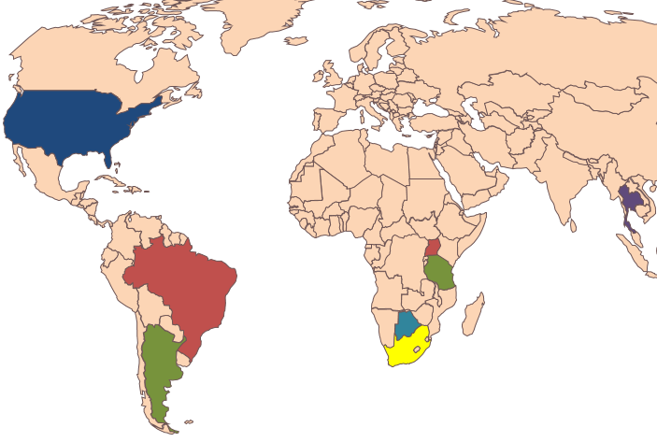
Study Highlight: P1026s PK Properties of ARVs during Pregnancy
As of 5 June 2019, 1022 mothers and 524 infants enrolled
27 completed pregnancy arms for 18 ARVs, including tenofovir alafenamide, darunavir, rilpivirine, maraviroc, dolutegravir and elvitegravir
Presented 43 abstracts and published 28 manuscripts
Treatment Research Agenda

Slide 18
Study Highlight: P1026s Contributions to Perinatal HHS Guidelines
30 ARV drugs in the current published HHS perinatal guidelines – PK data from P1026s cited for 20 (67%)
97 PK in pregnancy studies cited in perinatal guidelines for all ARVs – P1026s responsible for 32 (33%)
P1026s data are the only cited source of PK data from studies in pregnant women for 2 drugs (maraviroc and tenofovir alafenamide)
Class | P1026s Citations/Total # of PK studies in Pregnancy* Citations | Percent of Data from P1026s
NRTI | 4/20 | 20%
NNRTI | 5/12 | 42%
PI | 14/49 | 29%
INSTI | 3/8 | 38%
Entry/Fusion | 1/1 | 100%
PK Enhancers | 5/7 | 71%
*Excludes case reports
Notes:
Updated as of 5 June 2019
Another note: P1026s is often the first to present or publish PK data (as can be seen with the higher percentages & lower total number of studies in the newer ARV categories.

Slide 19
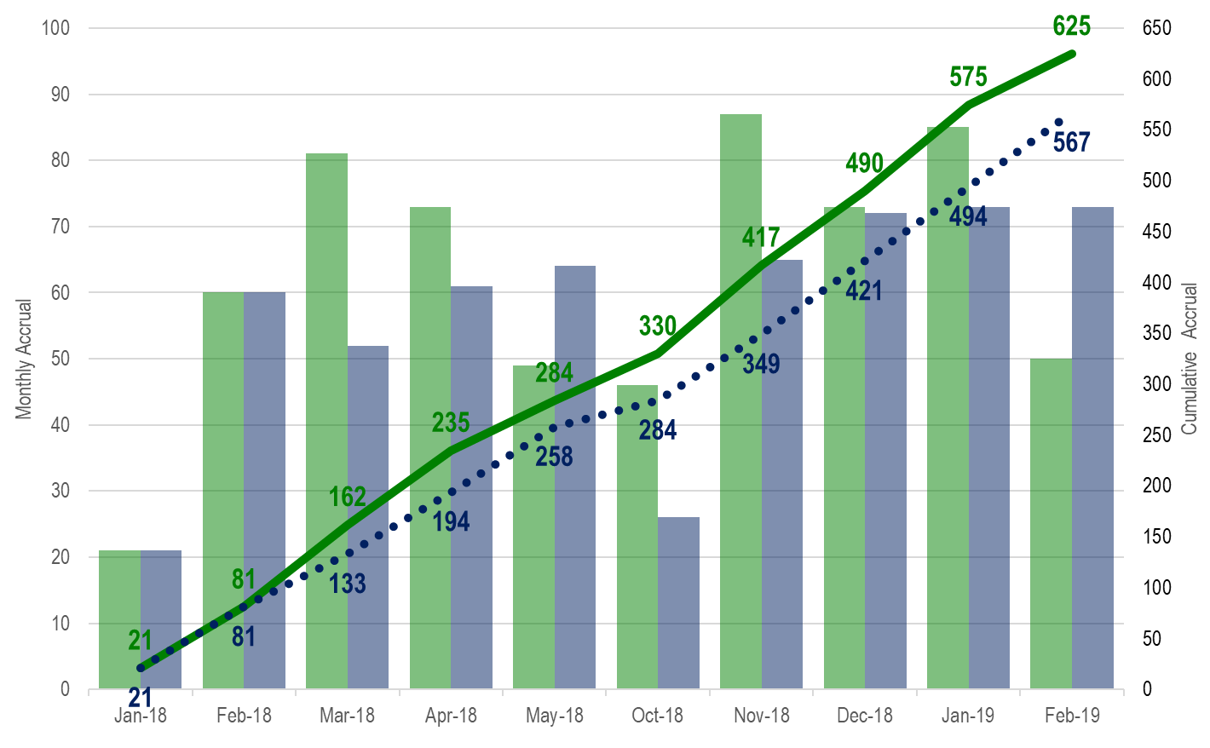
Study Highlight: IMPAACT 2010 Efficacy & Safety of DTG-Containing vs. EFV-containing ART Regimens in HIV-Infected Pregnant Women & Their Infants
Phase III study among HIV-infected pregnant women and their infants
22 sites enrolled in Botswana, Brazil, India, South Africa, Tanzania, Thailand, Uganda, the United States, and Zimbabwe
643 pairs
Treatment Research Agenda

Slide 20
Future Directions

Slide 21
Long acting agents in neonates?
Do we move ahead with study of Injectable cabotegravir in neonates?
Rilpivirine? Worth it given cold chain limitations?
What about the antibody VRCO1 LS? For prophylaxis or treatment …
What about for patches for neonates?
Notes:
We are making great progress on develop of many oral agents for neonates, what is best future role for long acting agents.

Slide 22
What are key management challenges in neonates?
What is the best approach to breastfeeding infants, who may go in and out of exposure to viremia?
Is there a feasible way to study clinical outcomes of prohylaxis?
Notes:
We are making great progress on develop of many oral agents for neonates, what is best future role for long acting agents.

Slide 23
Children ages 2 to 13 years ?
What will be best approach to newborns who fail RAL?
DTG at increased dosing (which we need to figure out)?
Can we improve on outcomes (toxicity, feasibility of long term adherence) for suppressed children?
Will DTG/3TC have a role for suppressed
Do we see a role for CAB/RPV in this age range?
With DTG as first line, what are best 2nd and 3rd line options?
Efficacy trial for failing participants with DRV/r?
Might there be a role for LA agents as second line? Could switch “early” so that those failing for adherence/oral medications swtich prior to DTG/INSTI resistance

Slide 24
Adolescents
What is the role for long actin injectable CAB/RPV in adolescents?
2017 (Mocha) – Phase I/II in suppressed 12 to 18 yo
2022 – Phase II PK/F/A in non-adherent youth 13 to <25 yo
Is there a need for comparative efficacy study in adolescents?

Slide 25
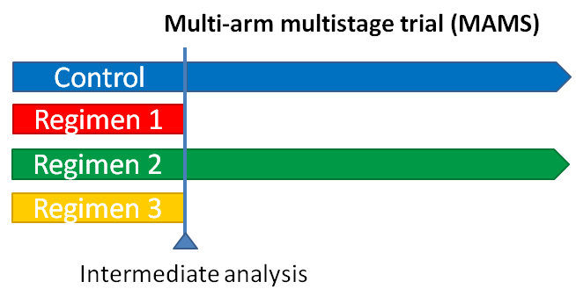
New approaches – Multi-arm, multistage (MAMS)?
Adaptive methods and allow for the comparison of multiple agents to a single control group.
Planned interim analyses allow unpromising arms to be dropped and new arms added while preserving the integrity of the trial.
Shorten the drug development process without compromising safety and efficacy by increasing the power for identify best clinical benefit of the drug product under investigation.
Could serve as a master protocol to examine the efficacy new ARV’s in children and pregnant women
MAMS designs have been used to evaluate cancer treatments in adults, allow elements of Phase II trials like dose exploration determination to be combined with phase III trials examining efficacy.

Slide 26
Future PK methods
What novel techniques can we use to improve our understanding of the variability in PK/PD?
We currently incorporate targeted studies of known genetic markers
What is the potential for metabolomics to characterize drug clearance at different ages?
Should be including gut microbial studies?
Intestinal microbiota have direct effects on the bioavailability, toxicity and efficacy of drugs
Beyond increasing our understanding of PK variability, which of these could play a clinical role in predict/tailoring drug dosing? E.g. premature infants

Slide 27
Questions? Suggestions?

Slide 28
THANK YOU
NIH Representatives
Renee Browning
Rohan Hazra
Judi Miller
Teri Greenfied
Committee Members
Ted Ruel
Linda Barlow-Mosha
Brookie Best
Carolyn Bolton
Edmund Capparelli
Diana Clarke
Lee Fairlie
Liz Lowenthal
Mark Mirochnick
Jorge Pinto
Andy Wiznia
Leadership and Operations Center
Katie McCarthy
Sharon Nachman
SDMC Representatives
Kathryn Gray
Pearl Samson
Bobbie Graham
Community Advisory Board Representative
Yuitiang Durier

