Slide 1
Treatment Studies in the Pipeline
IMPAACT HIV Treatment Scientific Committee Meeting
Annual Meeting
11 June 2019

Slide 2
Eight Studies Currently Enrolling
Study | Title | Status | Population
IMPAACT 2017 (MOCHA) | Phase I/II Study of the Safety, Acceptability, Tolerability, and Pharmacokinetics of Oral and Long-Acting Injectable Cabotegravir and Long-Acting Injectable Rilpivirine in Virologically Suppressed HIV-Infected Children and Adolescents | 6 of 155 (4%) | Adolescents living with HIV
IMPAACT 2014 | Phase I/II Trial of the Pharmacokinetics, Safety and Efficacy of Doravirine (MK-1439) and Doravirine/ Lamivudine/ Tenofovir Disoproxil Fumarate (MK-1439A) in HIV-1-infected Children and Adolescents | 10 of 65 (15%) | Children living with HIV (12 to <18 years of age)
IMPAACT 2007 | Phase I Safety & Pharmacokinetics of Maraviroc in HIV-1-Exposed Neonates at Risk of Acquiring HIV-1 Infection | 37 of 72 (51%) | Neonates exposed to HIV perinatally
P1106 | Pharmacokinetic Characteristics of Antiretrovirals and Tuberculosis Medicines in Low Birth Weight Infants | 121 of 158 (77%) | Low birth weight and normal birth weight infants

Slide 3
Eight Studies Currently Enrolling (cont.)
Study | Title | Status | Population
P1026s (V10) | Pharmacokinetic Properties of Antiretroviral and Related Drugs During Pregnancy and Postpartum | 93 of 225 (41%) | Pregnant and postpartum women and their infants
P1093 | Phase I/II, Multi-Center, Open-Label Pharmacokinetic, Safety, Tolerability and Antiviral Activity of Dolutegravir, a Novel Integrase Inhibitor, in Combination Regimens in HIV-1 Infected Infants, Children and Adolescents | 162 of 300 (54%) | HIV-infected infants, children, and adolescents (4 weeks to <18 years of age)
P1101 | Phase I/II Dose-finding, Safety, Tolerance and Pharmacokinetics Study of a Raltegravir-containing Antiretroviral Therapy (ART) regimen in HIV-infected and TB co-infected children ≥ 2 years to < 12 years of age | 40 of 108 (37%) | HIV-infected and TB co-infected children (2 to <12 years of age)

Slide 4
New versions or arms for existing Protocols
Study | Title | Status | Population
P1110 | A Phase I Trial to Evaluate the Safety and Pharmacokinetics of Raltegravir in HIV-1-Exposed Neonates at Risk of Acquiring HIV-1 Infection Version 3: Preterm low birth weight infants | In development | Neonates exposed to HIV perinatally
P1106 | Pharmacokinetic Characteristics of Antiretrovirals and Tuberculosis Medicines in Low Birth Weight Infants New arm for NVP at treatment doses | In development | Low birth weight infants

Slide 5
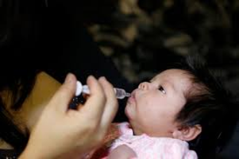
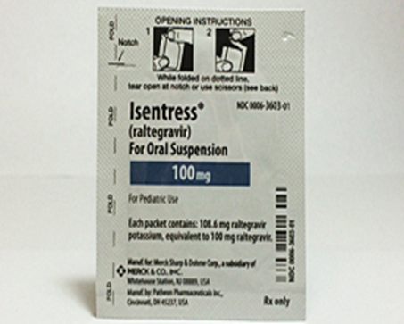
IMPAACT P1110: A Phase I Trial to Evaluate the Safety and Pharmacokinetics of Raltegravir in HIV-1-Exposed Neonates at Risk of Acquiring HIV-1 Infection
Cohorts 1 and 2: fifty-two mother-infant pairs were enrolled with 50 full-term infants evaluable (closed to accrual)
Cohort 3: Stratified by infant weight at birth
2000-2500 g and < 2000 g
Cohort 4: Stratified by infant weight at birth
2000-2500 g and < 2000 g

Slide 6
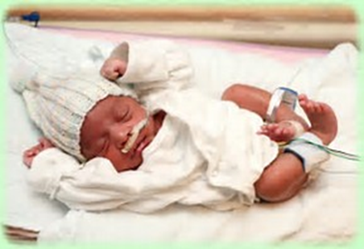
P1110 Version 3: Preterm low birth weight infants
Cohort 3:
Regimen: Single doses of RAL oral granules at 3 time points:
Day 0-4; 5 Days after first dose; and Day 28-35 after birth
Evaluation for safety and PK exposure targets
Cohort 4:
Objective: Dosing for RAL in first 6 weeks of life for preterm low birth weight infants
Initial dose based on data from cohort 3 and modeling (data generated from IMPAACT P1066, P1097, and P1110 Cohorts 1, 2, and 3).

Slide 7
IMPAACT P1106 PK Characteristics of ARVs and anti-TB Meds in LBW infants
Phase IV prospective PK study of selected ARVs and anti-TB medications in low birth weight infants
121 of 158 (77%) infants enrolled, with accrual completed in two arms and continuing in two arms
Preparing protocol Version 2.0 to add an arm evaluating NVP for HIV treatment among LBW infants (< 2500 g)
Anticipate Version 2.0 by late 2019

Slide 8
Population pharmacokinetics of NVP in preterm infants and prediction of doses needed for treatment
Combining PK data from IMPAACT P1106 and P1115
Therapeutic target
Notes:
To present combined PK data from 2 IMPAACT studies
- P1106 (NVP prophylaxis in premature infants and
- P1115 (NVP treatment in 34-37 weeks infants)
to simulate predicted NVP doses for treatment
11th International Workshop on HIV Pediatrics – Mexico 2019

Slide 9
Two Studies Recently Closed to Accrual
Study | Title | Status | Population
IMPAACT 2010 (VESTED) | Phase III Study of the Virologic Efficacy and Safety of Dolutegravir-Containing versus Efavirenz-Containing Antiretroviral Therapy Regimens in HIV-1-Infected Pregnant Women and their Infants | Closed to accrual (February 2019) Closed to follow-up expected in September 2020 | Pregnant women with HIV and their infants
P1090 | A Phase II/III Open-Label Trial to Evaluate the Safety, Tolerability, PK & Antiviral Activity of Etravirine in Antiretroviral Treatment-Experienced HIV-1 Infected Infants and Children, ≥2 Months to <6 Years | Closed to Accrual (October 2017) Closed to follow-up expected in July 2023 | Children living with HIV (2 months to <6 years of age)

Slide 10
Proposals and Protocols in Development
Study | Title
IMPAACT 2026 | Pharmacokinetic Properties of Antiretroviral, Anti-Tuberculosis, Contraceptive and Related Drugs During Pregnancy and Postpartum
IMPAACT 2023 | A Phase I Trial to Evaluate the Safety and Pharmacokinetics of Dolutegravir in Neonates Exposed to HIV-1 Infection
IMPAACT 2022 | Phase II Study of the Virologic Efficacy and Feasibility of Long-Acting Injectable Antiretroviral Medications in Non-Adherent Youth with HIV
CAP 547 | Phase I/II Trial of the Pharmacokinetics, Safety and Efficacy of an age-appropriate formulation of Doravirine in HIV-infected children ages 4 weeks to 11 years
CAP 538 | Open label, multicenter, single arm study to evaluate the pharmacokinetics, safety, tolerability, and antiviral efficacy of switching to dual therapy dolutegravir (DTG) plus rilpivirine (RPV) fixed dose combination (FDC), in antiretroviral therapy (ART) experienced, HIV-1 infected children from 6 to less than 18 Years of age who are virologically suppressed on their current anti-retroviral (ARV) regimen
Notes:
Speaker’s Notes: there are currently three proposals within the Treatment research area in protocol development and two capsules in process

Slide 11
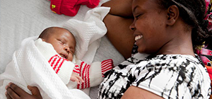
IMPAACT 2026 PK of ARVs, Anti-TB Meds, and Hormonal Contraceptives During Pregnancy and Postpartum
Phase IV prospective PK study of selected ARVs, anti-TB medications, and hormonal contraceptives
Participants: pregnant and postpartum women and their infants
Follow-on to P1026s
Anticipate Version 1.0 by September 2019

Slide 12
IMPAACT 2026 - Components
1
2
3
Pregnant WLHIV on ARVs and no TB drugs, and their infants
BIC
DOR
TAF (intracellular)
WLHIV and HIV-uninfected women who received Long-action/Extended-release ARVs during Pregnancy, and their infants
CAB LA
Pregnant WLHIV on ARVs and First-Line TB Treatment, and their infants
First-line TB drugs (INH, RIF, RFB, EMB, PZA, MFX) and:
DTG
ATZ/r or DRV/r
LPV/r
4
5
6
Pregnant WLHIV and HIV-uninfected Women on Second-Line TB Treatment, and their infants
LFX, CFZ, LZD, BDQ, DLM, or MFX and at least one other second-line drug
Postpartum WLHIV on ARVs and Hormonal Contraceptives
DTG and ethinyl estradiol
DTG and etonogestrel implant
Postpartum WLHIV and HIV-uninfected Women Breastfeeding and on ARVs and/or TB treatment, and their infants
2 or more 1st-line TB drugs
1 or more 2nd-line TB drugs
ATZ/r
DRV/r
LPV/r
DTG
TAF
DOR
BIC
BIC=bictegravir; DOR=doravirine; TAF=tenofovir alafenamide fumarate; CAB LA=cabotegravir long-acting;
INH=isoniazid; RIF=rifampin; RFB=rifabutin; EMB=ethambutol; PZA=pyrazinamide; MFX=moxifloxacin; DTG=dolutegravir; ATZ/r=atazanavir/ritonavir; DRV/r=darunavir/ritonavir; LPV/r=lopinavir/ritonavir; LFX=levofloxacin; CFZ=clofazimine; LZD=linezolid; BDQ=bedaquiline; DLM=delamanid

Slide 13
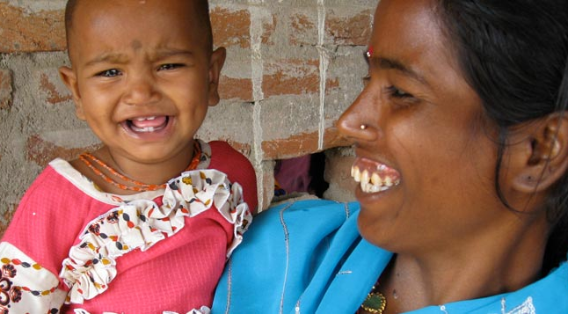
IMPAACT 2023 Safety and PK of DTG in HIV Exposed Neonates at Risk of HIV Infection
Aim: dosing for DTG during the first six weeks of life
Design: Phase I dose-finding study of DTG added to standard ARV prophylaxis to prevent perinatal transmission in infants exposed to HIV-1 infection
Participants: full term infants born to mothers with HIV-1 (breast and formula feeding)
Enrollment: 2 sequential cohorts, stratified by infant in utero exposure to maternal DTG
Cohort 1: Two single doses of DTG one week apart.
Cohort 2: Long term oral dosing of DTG starting within 72 hours of birth and continued for 6 weeks of life.
Anticipate Version 1.0 by December 2019

Slide 14
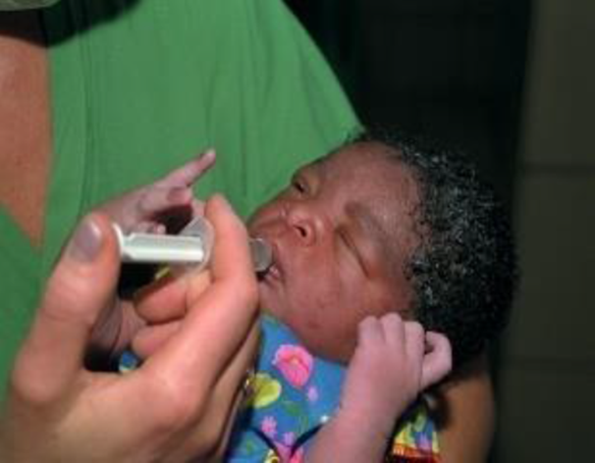
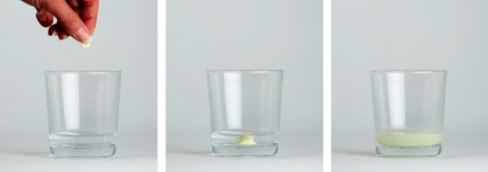
Dolutegravir Formulations
ViiV Healthcare has contracted with Quotient Sciences to produce a liquid solution for this study
DTG 5 mg dispersible tablets will be available if this dose is determined to be appropriate for some infants included in the study

Slide 15
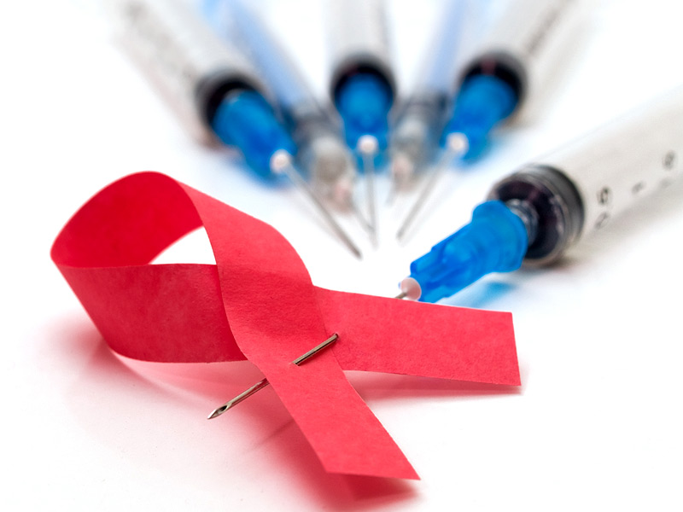
IMPAACT 2022 Feasibility and Acceptability of Long-Acting Injectables in Non-Adherent Youth Infected with HIV
Phase II study of PK, effectiveness, feasibility, and acceptability of long-acting injectable CAB + RPV
Participants: non-adherent adolescents age 13 to 25 years
Follows on IMPAACT 2017 (Mocha), Phase I/II in suppressed 12 to 18 yo
Further protocol development pending interim results from IMPAACT 2017

Slide 16
CAP 547 PK, Safety and Efficacy of Doravirine in HIV-infected children ages 4 weeks to < 12 years
Phase I/II PK, Safety and Efficacy dose finding study in children
Participants: > 4 weeks to < 12 years
Follow on IMPAACT 2014 which includes adolescents 12- 18 yrs
Undergoing IMPAACT leadership review in June 2019

Slide 17
CAP 538 Switching to dual therapy DTG + RPV in ART-experienced Children with HIV infection
Phase I/II PK, safety, tolerability, and antiviral efficacy of SWITCH to DTG + RPV FDC
Participants: 6 to < 18 years virologically suppressed on current regimen
Undergoing IMPAACT leadership review in June 2019

Slide 18
One Study Pending
Study | Title | Status | Population
IMPAACT 2019 | Phase I/II study of the pharmacokinetics, safety, and tolerability of dolutegravir/lamivudine/abacavir (Triumeq®) in HIV-1-infected children less than 12 years of age | Open to accrual expected in January 2020 | HIV-infected infants and children (<12 years of age)

