Slide 1
Prevention Scientific Committee
International Community Advisory Board
11 June 2019
Lynda Stranix-Chibanda and Sybil Hosek

Slide 2
Outline
Focal populations
Key priorities
IMPAACT P1112 study update
IMPAACT 2009 study update

Slide 3
Focal populations
Pregnant and breastfeeding mothers and their infants

Slide 4
Key priorities for mothers with HIV infection
Optimise current ARV-based strategy to prevent vertical HIV transmission
Immune strategies for ‘getting to zero’

Slide 5
Priority for mothers with HIV
Optimise current ARV-based strategy to prevent vertical HIV transmission
Life long ART recommended in global guidelines
Improve outcomes
Implementation challenges in coverage, retention, adherence
Improve ARVs
Less side effects/safer
Better control of viral load
Less risk of developing resistance
Cheaper
PROMISE data
Treatment SC

Slide 6
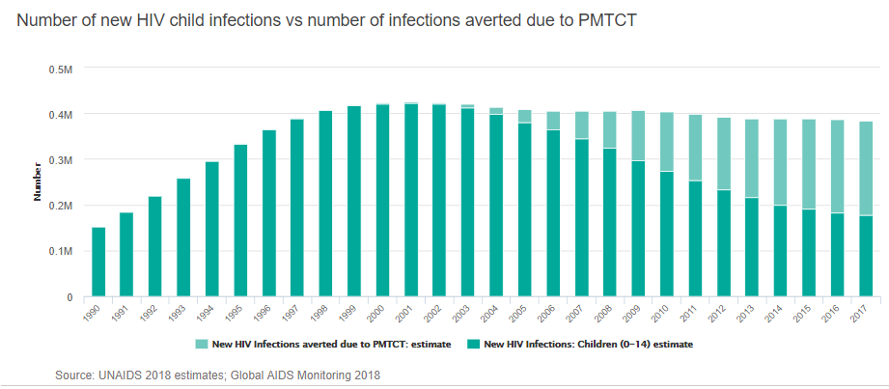
Priority for mothers with HIV
Virtual elimination of paediatric HIV is possible
Continuing the current strategy won’t get us to zero → need to add something new to ART

Slide 7
Priority for mothers with HIV
Immune strategies for ‘getting to zero’
Passive immunity from broadly neutralising antibodies (bnAbs)
P1112
Cost-effectiveness

Slide 8
Key priority for mothers without HIV infection
Primary prevention during pregnancy and lactation

Slide 9
Priority for mothers without HIV
Primary prevention during pregnancy and lactation
A time of heightened risk
Oral PrEP recommended in most guidelines
Less effective in youth
2009

Slide 10
Any questions so far?

Slide 11
IMPAACT P1112 Update
Passive immunity
Protocol Overview
Study status
Next steps

Slide 12
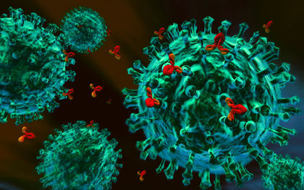
Passive Immunity
Administer pre-formed antibodies
Immediate levels of antibodies detectable
Only lasts as long as the antibodies last
In use for Rabies, Hepatitis B, Varicella Zoster
Photo by: cglightNing

Slide 13
IMPAACT P1112
Safety & Pharmacokinetics of Monoclonal Antibody VRC01LS in HIV-Exposed Newborns
Phase I study of safety and pharmacokinetics of single and multiple subcutaneous (SC) doses starting at birth
ALL infants receive ART to prevent perinatal/ breastmilk HIV transmission
Followed on study 96 weeks
Primary objectives are safety and PK

Slide 14
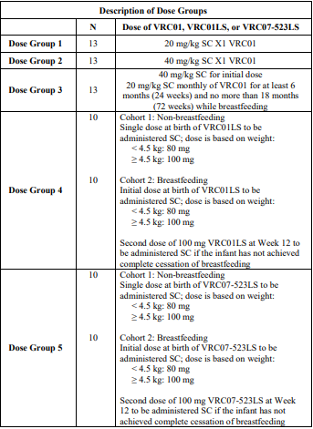
Different study groups
Different products
Different doses
Different infant feeding

Slide 15
What happens on study?

Slide 16
Group 4 status
Enrollment between Jan 2017-Feb 2018
All infants (N=21) received 1st dose; 10 infants received 2nd dose
No Grade 3 or 4 adverse events related to VRC01LS
Local reactions were common, especially with the first dose; almost all mild and resolved within hours
No infants stopped study treatment due to adverse events
Ongoing follow-up (N=18) through Feb 2020
3 infants discontinued at 2, 4 weeks & 22 weeks

Slide 17
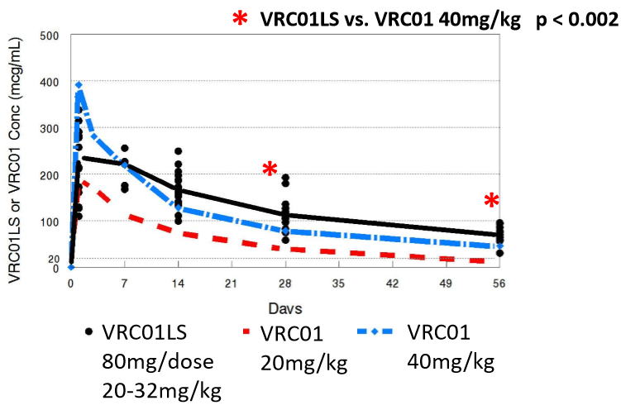
Different PK with different doses & products

Slide 18
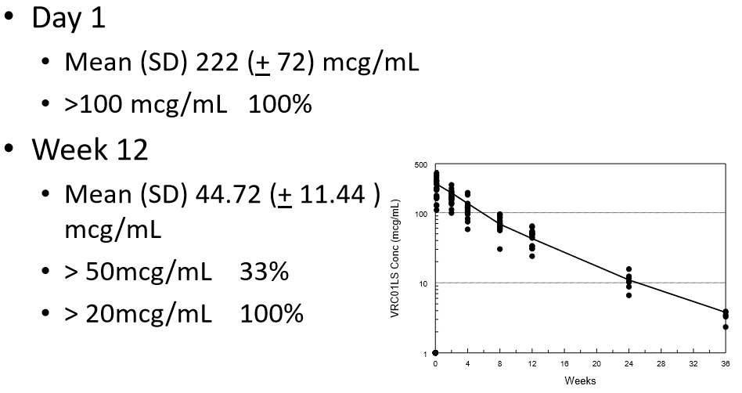
VRC01LS Infant PK

Slide 19
P1112 conclusions so far
VRC01LS is well tolerated
VRC01LS can be administered at birth and 1-2 times per year to achieve desired levels
Broadly neutralizing antibodies are feasible as an additional strategy to prevent mother-to-child transmission of HIV in infants at increased risk of HIV transmission
Next steps: – New agents VRC07-523LS - increased potency & breadth

Slide 20
Any questions so far?

Slide 21
IMPAACT 2009 Update
Pre-exposure prophylaxis
Protocol Overview
Study status
Next steps

Slide 22
What is PrEP?
PrEP means Pre-Exposure Prophylaxis, and it’s the use of anti-HIV medications to keep HIV negative people from becoming infected. PrEP is approved by the FDA and has been shown to be safe and effective at preventing HIV infection

Slide 23
IMPAACT 2009
Pharmacokinetics, Feasibility, Acceptability, and Safety of Oral Pre-Exposure Prophylaxis for Primary HIV Prevention during Pregnancy and Postpartum in Adolescents and Young Women and their Infants
A 2-part observational trial in HIV-uninfected adolescent and young women who are offered oral PrEP while pregnant and breastfeeding
PK Component
PrEP Comparison Component

Slide 24
Study Design
PK Component – 40 mother-infant pairs
Establish plasma drug concentrations associated with optimal dosing of oral PrEP during pregnancy and postpartum
Findings will guide interpretation of drug levels observed in pregnant women
Notes:
PKS – The PK Component is a lead-in phase for 40 mother-infant pairs to establish plasma drug concentrations associated with optimal dosing of oral PrEP during pregnancy and postpartum. Findings will guide interpretation of drug levels observed in pregnant women and lead to the opening of the PrEP Comparison Component, which is an observational parallel cohort study to follow women who choose to start PrEP in pregnancy or not through 6 months postpartum, documenting their adherence experiences and safety outcomes for the women and breastfeeding infants. [KEY]

Slide 25
Study Design
PrEP Comparison Component
Follow women who choose to start PrEP in pregnancy (~200 pairs) or not (~100 pairs) through 6 months postpartum
PrEP adherence
DBS drug levels (based on PK component)
Maternal adverse events
Renal and hepatic function, bone health
Adverse pregnancy outcomes
Abortion, stillbirth, preterm delivery, SGA
Infant safety
Death, adverse events, bone health, renal function, growth
Notes:
PKS – The PK Component is a lead-in phase for 40 mother-infant pairs to establish plasma drug concentrations associated with optimal dosing of oral PrEP during pregnancy and postpartum. Findings will guide interpretation of drug levels observed in pregnant women and lead to the opening of the PrEP Comparison Component, which is an observational parallel cohort study to follow women who choose to start PrEP in pregnancy or not through 6 months postpartum, documenting their adherence experiences and safety outcomes for the women and breastfeeding infants. [KEY]

Slide 26
Study Sites
Kampala, Uganda: Baylor CRS & Makerere University - JHU CRS
Blantyre, Malawi (JHU)
Harare, Zimbabwe: Harare Family Care, Saint Mary’s & Seke North CRSs
Johannesburg, South Africa: Shandukani WRHI
Mother and Child by
Colleen Madamombe
Notes:
PKS – The study is being done at 5 CTUs in 4 countries in SSA – Uganda, Malawi, Zimbabwe and South Africa. [KEY]

Slide 27
PK Comparison Component Status
Enrolled March-June 2019
20 pairs in each group
Group 1: Enrolled 14 – 24 wks gestation
Group 2: Enrolled 6 – 12 wks after delivery
Monitor and document PrEP administration daily, for 12 weeks
In-person (clinic or home)
Real-time video call
DBS specimens collected weekly for PK testing
Notes:
PKS – The PK Component began enrolling participants in March 2019, targeting 40 mother-infant pairs enrolled either at 14-24 weeks of gestation or postpartum within 6-12 weeks after delivery. Study staff monitor and document PrEP administration daily, for 12 weeks either in person at the clinic or at home, or through a real-time video call. Dried blood spot specimens are collected weekly for PK testing. [KEY]

Slide 28
PK Comparison Component Status
Retention – 100%
Adherence to DOTS – 99.87%
2 doses not directly observed so far
Exceptional commitment from participants, site staff, community and protocol team

Slide 29
What will we learn?
At this time of particular risk for new HIV infection in young women, 2009 will help us understand more about:
PK in pregnancy
Adherence to PrEP in young women
Safety information to inform the risk:benefit ratio of oral PrEP

Slide 30
Any further questions?

