Slide 1
Good Documentation Practices
2019
Sheryl Zwerski, D.N.P.
Director
Prevention Sciences Program
Division of AIDS

Slide 2
Goal for Today’s Meeting
Summarize lessons learned from recent regulatory inspections surrounding documentation
Provide examples of inadequate documentation
Provide high level summary of goals and impact
Conduct an open question and answer session to address network-specific concerns

Slide 3
Why Document?
ICH E6 R2, Good Clinical Practice, Section 8 Essential Documents
To individually and collectively enable evaluation of the conduct of a trial and the quality of the data produced.
The documentation has to tell the story of the study to someone who was not involved and has little to no knowledge of the history.
“If it isn’t documented, it didn’t happen.”
?

Slide 4
Goal and Impact of Gaps in Documentation
Are you confident we could clearly reconstruct every step in the life cycle of a trial?
If not, then regulatory agencies are put in a very difficult position - being responsible for deciding whether to approve products that could impact millions of people without adequate evidence to base their decision on.

Slide 5
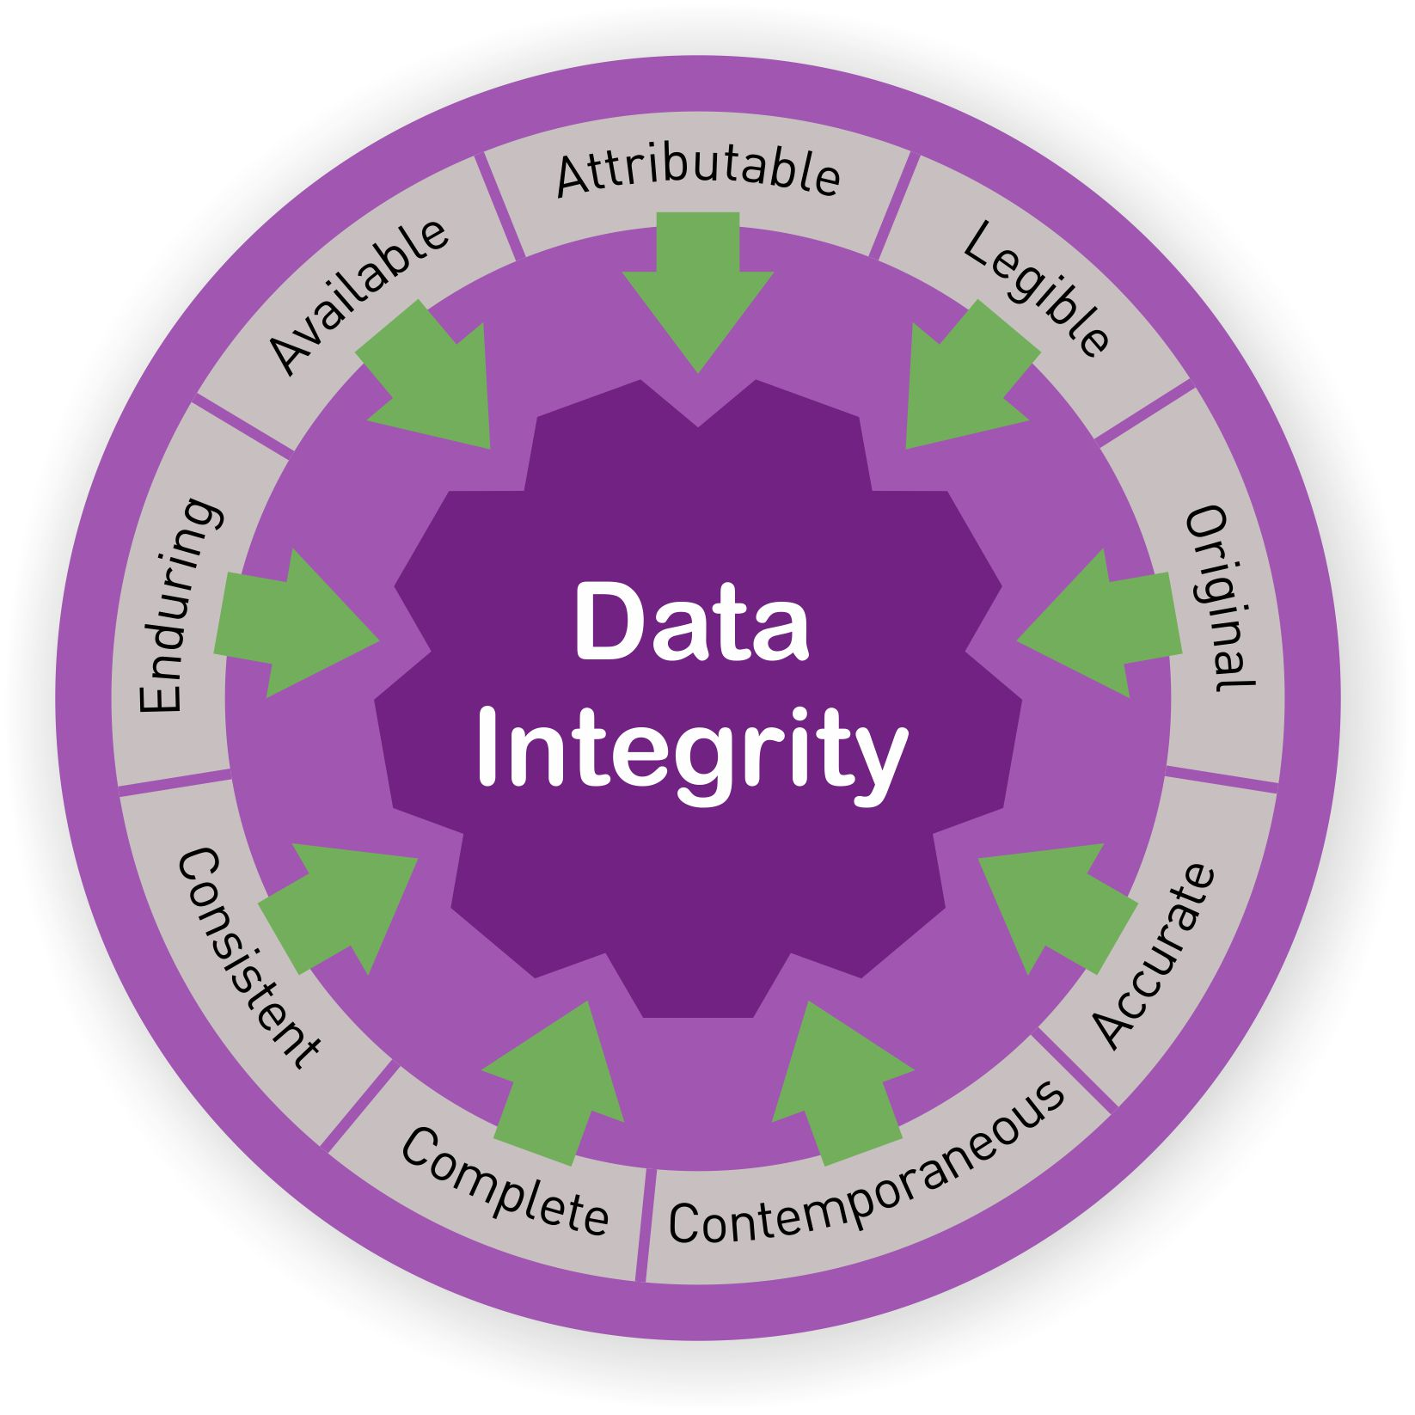
Principles of GDP
GDP is the method for recording, correcting, and managing data, documents, and records to ensure the reliability and integrity of information and data throughout all aspects of a clinical trial.
A
ttributable
L
egible
C
ontemporaneous
O
riginal
A
ccurate
C
omplete

Slide 6
Examples of Inadequate Documentation
Curricula Vitae are not signed and are provided in MS-Word format
Training documentation incomplete

Slide 7
Maintaining Complete and Accurate Records of Staff Qualifications and Training Throughout the Study
Documentation of trainings must be complete for all staff from study start and updated as required during the course of the study.
Group trainings should be documented on a sign-off sheet that includes:
Session Purpose/Title
Session Date
Session Presenter
Signature of Attendees
CVs should be signed and dated, and the originals saved in a non-editable format.
CVs and training documentation should be kept in an organized fashion in secure file storage.

Slide 8
Examples of Inadequate Documentation
Protocol documents exist in multiple versions and dates to denote both the Sponsor-approved version and the IRB/EC approved version
Implementation of changes to study without amendment or Letter of Amendment (LOA) documented and/or reviewed by appropriate personnel
Study Specific Procedures or Manual of Operations with incorrect versions and dates

Slide 9
Ensuring Documentation and Sponsor Approval Prior to Implementation of any Study Conduct Changes
The DAIDS Guidance for Determining the Appropriate Use of Full Version Protocol Amendments, Letters of Amendment, and Clarification Memos during the Lifecycle of a DAIDS-Approved Protocols was developed to assist Protocol Teams, DAIDS Staff, and other Stakeholders in choosing the appropriate method for clarifying or making changes to DAIDS approved protocols.
The Sponsor (i.e., DAIDS) should be involved in, and provide approval for, any and all decisions to deviate from, or make changes to the protocol, except where necessary to eliminate immediate hazard(s) to trial participants.
Study changes cannot be implemented prior to DAIDS and IRB/EC approval.

Slide 10
Examples of Inadequate Documentation
Dissemination of study decisions verbally
Lack of documentation of who was involved in decision making and rationale for the decision
Lack of documentation of attendees for open/closed meetings

Slide 11
Documenting Decisions Made During Meetings/Calls
At minimum, effective meeting minutes should include:
Meeting Title/Subject, Date, Time, and Location
Name and Affiliation of Required Attendees
Note Absentees
Agenda Items
Decisions Made by Participants
Rationale for Decision
Action Items, Responsible Party, and Timeline/Status
Name of Person Preparing the Meeting Summary
Participants should have an opportunity to review the minutes and provide feedback.
Group Charters should be developed for any group reviewing data and making decisions.
Documentation of decisions is also important for informal groups/calls.

Slide 12
Steps taken by DAIDS to meet GDP
DAIDS has developed internal policies on Good Documentation Practices and Version control
GDP Webinars have been conducted by DAIDS
Calls with teams conducting registrational trials

Slide 13
Resources
 | Resource Title | Version | DAIDS Policy Number
1. | ICH Guideline for Good Clinical Practice | E6(R2) | N/A
2. | DAIDS Policy: Requirements for Essential Documents at Clinical Research Sites Conducting DAIDS Funded and/or Sponsored Clinical Trials | 2.0 | DWD-POL-RA-03.00
3. | DAIDS Policy: Requirements for Source Documentation in DAIDS Funded and/or Sponsored Clinical Trials | 2.0 | DWD-POL-CL-04.00
4. | DAIDS Policy: Requirements for Manual of Operational Procedurals | 2.0 | DWD-POL-CL-05.00
5. | DAIDS Policy: Storage and Retention of Clinical Research Records | 1.0 | DWD-POL-CL-006.02
6. | DAIDS Policy: Delegation of Duties Log Policy | 1.0 | POL-A15-OPC-002.00
7. | DAIDS Guidance for Determining the Appropriate Use of Full Protocol Amendments, Letters of Amendment, and Clarification Memos during the Lifecycle of a DAIDS-Approved Protocol | 3.0 | N/A
Division of AIDS Clinical Research Policies and Standard Procedures Documents

Slide 14
Closing the Gaps – Together
In order for the research we foster to have an impact, we must meet good documentation practice standards.
DAIDS and the networks have made significant progress in closing gaps; we have to continue refinement of our processes and standards
Closing these gaps together demonstrates our commitment to good science which ultimately improves health in the US and across the world
The dedication, passion and commitment to excellence across all the Networks is unquestionably our greatest asset in this shared endeavor.

Slide 15
Open Question and Answer Session

