Slide 1
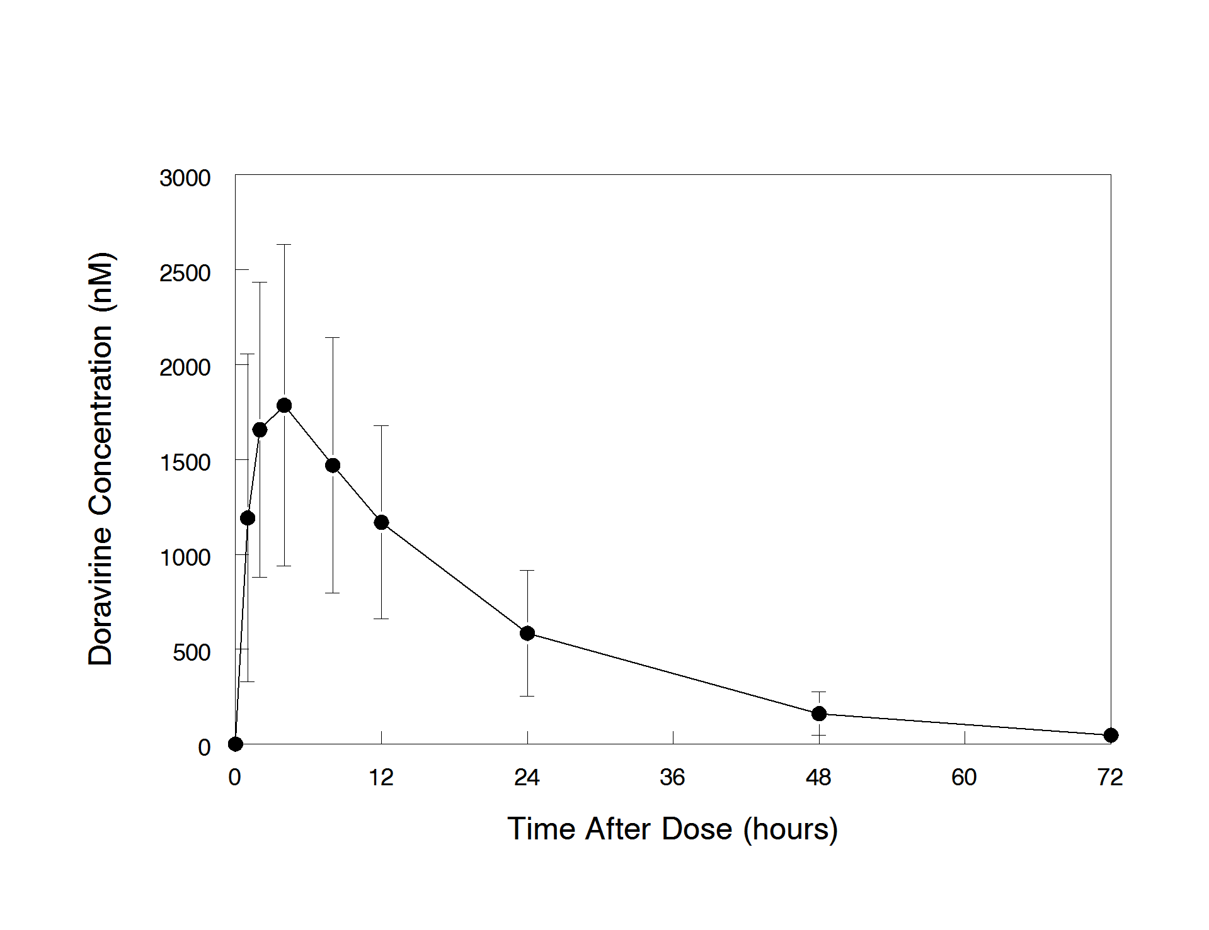
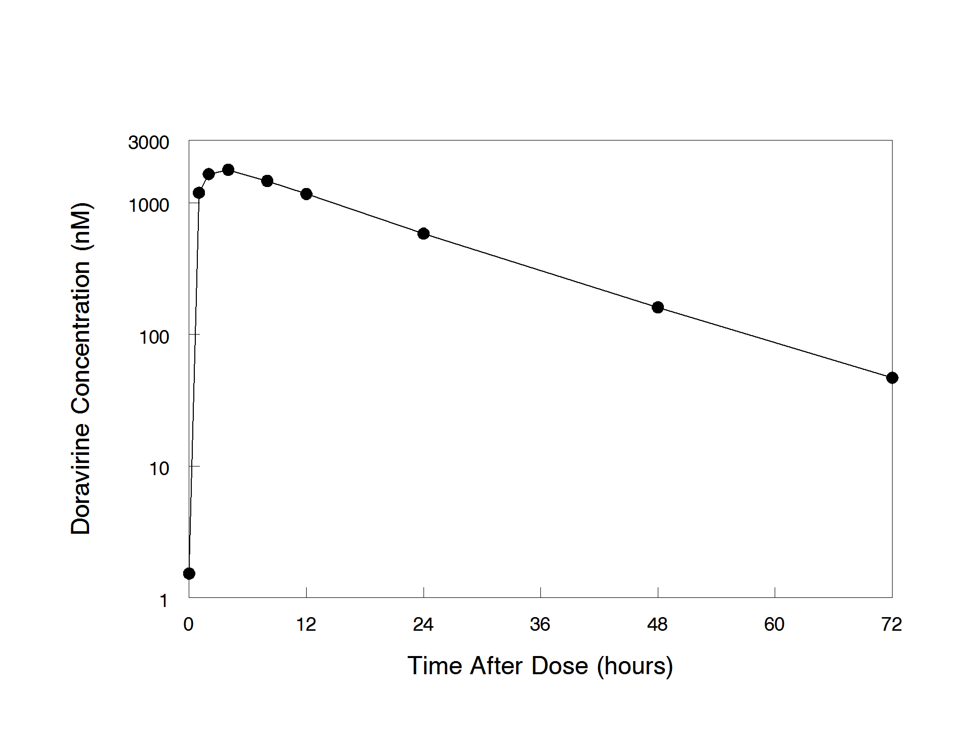
39
Pharmacokinetics, Safety and Tolerability of Doravirine in Adolescents with HIV-1
Brookie Best¹, Kelly Yee², Mona Farhad³, Carmelita Alvero³, Patricia Morgan⁴, Katie McCarthy⁴, Hedy Teppler², Sushma Kumar², Nicole Tobin⁵, Elizabeth McFarland⁶, Ellen Townley⁷, Ann J. Melvin⁸ for the IMPAACT 2014 team.
¹ University of California, San Diego; ² Merck & Co., Inc., Kenilworth, NJ, USA; ³ Harvard T.H. Chan School of Public Health; ⁴ IMPAACT; ⁵ University of California, Los Angeles; ⁶ University of Colorado School of Medicine; ⁷ DAIDS/NIAID/NIH; ⁸ University of Washington, Seattle Children’s Research Institute
BACKGROUND and METHODS
CONCLUSIONS
Doravirine is a novel nonnucleoside reverse transcriptase inhibitor (NNRTI) active against both wild type virus and the most common NNRTI-resistant variants, recently approved for treatment of HIV-1 infection in antiretroviral-naïve adults with HIV-1. Results are presented for IMPAACT 2014 Cohort 1 which investigated the pharmacokinetics (PK) and safety of a single dose of 100mg in adolescents.
Participants:
Adolescents infected with HIV-1 between the ages of 12 and 18
Weight ≥ 35 kg
Virologically suppressed for at least 3 months on an ART regimen of dolutegravir or raltegravir plus 2 NRTIs
Study Procedures:
Participants were given a single dose of 100mg of doravirine
Plasma samples for doravirine levels were drawn pre-dose, 1, 2, 4, 8, 12, 24, 48 and 72 hours post-dose
Safety follow-up visit at 2 weeks
Analysis:
Single dose AUC_{(0-∞)}, C_{max}, C₂₄, T_{max}, and apparent terminal t_{1/2} were reported. The pharmacokinetics of doravirine are linear over a large dose range and with repeated dosing, therefore single-dose data can be used to accurately predict steady-state pharmacokinetics. Steady state AUC₍₀₋₂₄₎ is equivalent to single dose AUC_{(0-∞)}. Individual steady state C₂₄ and C_{max} were projected from individual single dose plasma concentration-time profiles using the non-parametric superposition function in WinNonLin v6.3.
100 mg doravirine dosing in adolescents met the prespecified targets for AUC_{(0-∞)} and C_{24,ss,pred}
The doravirine geometric mean value of the single-dose AUC_{(0-∞)} for these 9 participants is 34.8 μM∙h
Target value for this study was a geometric mean AUC_{(0-∞)} that does not exceed the AUC_{0-24h} at steady-state in adults associated with taking 200 mg daily; 64.8 μM∙h
The geometric mean predicted steady-state trough concentrations (C_{24,ss,pred}) in these 9 participants is 690 nM
Target value for this study was a geometric mean predicted C_{24,ss,pred} that exceeds 560 nM (the lower bound for doravirine based on Phase 3 adult studies)
RESULTS
Results are available from 9 youth enrolled into Cohort 1
Table 1: Participant demographics
Figure 1: Arithmetic mean (SD) Plasma Concentration Profiles of Doravirine following administration of single 100 mg oral doses to adolescents Panel A: Linear Scale, Panel B: Semi-log Scale
ID | Age (yrs) | Gender | Race | Weight (kg) | CD4 (cells/mm³)
1 | 16 | M | BLACK | 68.9 | 900
2 | 16 | F | WHITE | 90.8 | 760
3 | 13 | M | BLACK | 51.5 | 790
4 | 16 | F | BLACK | 47.1 | 647
5 | 13 | M | BLACK | 45.8 | 1137
6 | 15 | M | BLACK | 62.8 | 689
7 | 13 | M | WHITE | 48.7 | 1006
8 | 15 | M | BLACK | 47.1 | 449
9 | 12 | M | BLACK | 40.3 | 716
A
Table 2: Summary Pharmacokinetic Parameter Values for Doravirine Following Administration of Single Oral Doses to Adolescents
 | Min | Median | Max | Geomean | CV% Geomean
AUC_{(0-∞)}† (μM∙h) | 20.0 | 31.3 | 73.6 | 34.8 | 43.2
C_{24,ss,pred} (nM) | 335 | 630 | 1720 | 690 | 65.8
C₂₄ Accum. Ratio | 1.2 | 1.4 | 1.6 | 1.3 | 11.7
C_{max,ss,pred} (μM) | 2.08 | 2.70 | 5.11 | 2.76 | 28.2
C_{max} Accum. Ratio | 1.2 | 1.3 | 1.6 | 1.3 | 10.5
T_{max} (h) | 1.00 | 3.78 | 7.75 | -- | --
t_{1/2} (h) | 7.82 | 12.2 | 16.0 | 11.8 | 25.0
Cl/F (L/h) | 3.19 | 7.49 | 11.7 | 6.75 | 43.2
V_{z}/F (L) | 65.8 | 111 | 198 | 115 | 32.5
B
TWO WEEK SAFETY and TOLERABILITY
There were no clinically significant adverse events
One participant had grade 1 diarrhea on the day of study entry: assessed as not related to doravirine
† Steady state AUC₍₀₋₂₄₎ is equivalent to single dose AUC_{(0-∞)}
Acknowledgements
The authors wish to acknowledge the full IMPAACT 2014 team, NIAID, NICHD, MSD, the IMPAACT 2014 sites and staff, and the IMPAACT 2014 participants
Overall support for the International Maternal Pediatric Adolescent AIDS Clinical Trials Network (IMPAACT) was provided by the National Institute of Allergy and Infectious Diseases (NIAID) with co-funding from the Eunice Kennedy Shriver National Institute of Child Health and Human Development (NICHD) and the National Institute of Mental Health (NIMH), all components of the National Institutes of Health (NIH), under Award Numbers UM1AI068632 (IMPAACT LOC), UM1AI068616 (IMPAACT SDMC) and UM1AI106716 (IMPAACT LC), and by NICHD contract number HHSN275201800001I. The content is solely the responsibility of the authors and does not necessarily represent the official views of the NIH.
11th International Workshop on HIV & Pediatrics Mexico City, Mexico, July 19, 2019.
Poster Number: 39

