Slide 1

TENOFOVIR ALAFENAMIDE PHARMACOKINETICS
WITH AND WITHOUT COBICISTAT IN PREGNANCY
Jeremiah D. Momper¹, Brookie Best¹, Jiajia Wang², Alice Stek³, Tim R. Cressey⁴, Sandra Burchett⁵, Regis Kreitchmann⁶, David E. Shapiro², Elizabeth Smith⁷, Nahida Chakhtoura⁸, Edmund V. Capparelli¹, Mark Mirochnick⁹, for the IMPAACT P1026s Protocol Team
Skaggs School of Pharmacy and Pharmaceutical Sciences, University of California, San Diego, CA, USA¹, Harvard T.H. Chan School of Public Health, Center for Biostatistics in AIDS Research, Boston, MA, USA², University of Southern California School of Medicine, Los Angeles, CA, USA³, Chiang Mai University, Chiang Mai, Thailand⁴, Boston Children's Hospital, Boston, MA, USA⁵, Irmandade da Santa Casa de Misericordia de Porto Alegre, Porto Alegre, Brazil⁶, National Institute of Allergy and Infectious Diseases, Bethesda, MD, USA⁷, Maternal and Pediatric Infectious Disease Branch, Eunice Kennedy Shriver National Institute of Child Health and Human Development (NICHD), Bethesda, MD, USA⁸, Boston University School of Medicine, Boston, MA, USA⁹

Slide 2
Background
Tenofovir alafenamide (TAF), a prodrug of the nucleotide reverse transcriptase inhibitor tenofovir (TFV), has enhanced stability in plasma and an improved safety profile compared to tenofovir disoproxil fumarate (TDF)
TAF is most commonly administered as part of a fixed-dose combination either with or without the pharmacokinetic (PK) booster cobicistat (COBI)
COBI inhibits transporters involved in the bioavailability of TAF (P-glycoprotein, BCRP, OATP1B1/3) and co-administration of TAF with COBI results in higher TAF exposure
During pregnancy, physiological changes cause decreased exposure to many antiretrovirals; however, the PK of TAF has not been studied in pregnant women

Slide 3
Objectives
To characterize the pharmacokinetics of TAF during pregnancy and postpartum when administered as:
  25 mg without COBI
  or
  10 mg with 150 mg COBI
To evaluate the safety of TAF in pregnancy
To determine the transplacental passage of TAF from maternal to fetal circulation

Slide 4
Methods
P1026s is an ongoing, non-randomized, multi-center phase-IV prospective study of antiretroviral PK and safety in HIV-infected pregnant women
Pregnant women were eligible to enroll in the P1026s TAF arms if they were receiving as part of clinical care:
  TAF 25 mg without boosting (TAF/FTC/RPV 25/200/25 mg, Odefsey®)
  or
  TAF 10 mg with COBI boosting (TAF/FTC/EVG/COBI 10/200/150/150 mg Genvoya®)
All medications were prescribed by the participants’ clinicians, who also managed any toxicities and adverse events

Slide 5
Methods
Intensive steady-state PK profiles (predose and 1, 2, 4, 6, 8, 12 and 24 hours postdose sampling) were obtained at steady state during the 2nd trimester, 3rd trimester, and 6-12 weeks postpartum
Maternal plasma and cord blood samples were collected at delivery
TAF plasma concentrations were measured by a validated LC-MS/MS method with a quantitation limit of 3.9 ng/mL
PK parameters were calculated using NONMEM
A two-tailed Wilcoxon signed rank test (α = 0.10) was used for paired within-subject comparisons
For protocol management purposes, target TAF exposure was assessed relative to the 10th percentile value in non-pregnant adults

Slide 6
Results: Clinical Characteristics
Maternal Demographics | Median (Range) or N (%)
 | TAF 25 mg (n=31) | TAF/COBI 10/150 mg (n=27)
Age at Delivery (years) | 29.5 (18.1 – 45.8) | 34.0 (19.1 – 38.8)
Weight at Delivery (kg) | 85.0 (59.4 – 154.2) | 87.5 (66.0 – 152.7)
Race/Ethnicity: White Non-Hispanic Black Non-Hispanic Hispanic (regardless of race) Asian, Pacific Islander | 3 (10%) 18 (58%) 10 (32%) 0 (0%) | 4 (15%) 8 (30%) 14 (52%) 1 (4%)
Country: United States | 31 (100%) | 27 (100%)
2nd Trimester
Gestational Age (wk) at sampling | 23.4 (21.1 – 27.4) | 24.9 (20.4 – 27.1)
HIV-1 RNA ≤ 50 copies/mL | 13/15 (87%) | 13/18 (72%)
3rd Trimester
Gestational Age (wk) at sampling | 33.3 (30.0 – 37.6) | 33.0 (30.0 – 36.4)
HIV-1 RNA ≤ 50 copies/mL | 24/27 (89%) | 24/27 (89%)
Postpartum
Weeks After Delivery at sampling | 9.9 (6.0 – 14.4) | 8.5 (4.4 – 20.6)
HIV-1 RNA ≤ 50 copies/mL | 22/25 (88%) | 22/24 (92%)
Pregnancy Outcomes
Gestational Age (weeks) | 38.9 (36.0 – 40.9) | 38.6 (27.1 – 41.3)
Birth Weight (grams) | 3084 (2100 – 4102) | 3035 (1835 – 4170)

Slide 7
TAF median plasma concentration versus time profiles
2T=2nd trimester; 3T=3rd trimester; PP=postpartum

Slide 8
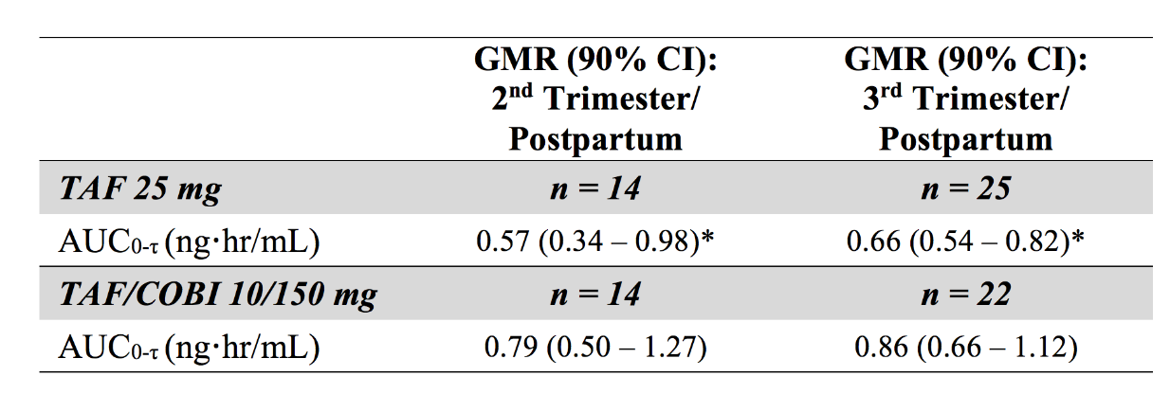
TAF Plasma AUC during pregnancy and postpartum
The shaded area displays the 5th to 95th percentile AUC in the E/C/F/TAF FDC (Genvoya®) reference population
Data presented as median with interquartile range. The median for each sampling period is denoted in the boxes
With TAF 25 mg, exposure was lower during pregnancy compared to postpartum, but this difference was driven by a higher than anticipated AUC postpartum
Proportion of subjects exceeding the TAF target AUC (10th percentile non-pregnant adults) ranged from 84%-96% without differences during pregnancy and postpartum

Slide 9
Maternal Safety
Reported maternal Grade 3 or 4 adverse events
Event | # Participants | Relatedness
Anemia | 7 | Not related
Preterm delivery | 4 | Not related
Hypertension | 3 | Not related
Chorioamnionitis | 1 | Not related
Uterine rupture | 1 | Not related
Severe postpartum pre-eclampsia | 1 | Not related
Calcific tendonitis of shoulder | 1 | Not related
Pyelonephritis | 1 | Not related
Nausea and vomiting | 1 | Not related
Low bicarbonate, low calcium | 1 | Not related
One grade 2 maternal adverse event (Probable Hepatic Steatosis) was considered possibly related

Slide 10
Infant Outcomes
Infant HIV Infection Status: 46 (79%) uninfected; 8 (14%) indeterminate; 4 (7%) pending
TAF was below the limit of quantitation (3.95 ng/mL) in all 15 cord blood samples tested to date
Reported birth abnormalities:
Abnormalities | Gest Age TAF begun | Relatedness
Left Congenital Pseudoarthrosis Clavicle Right Duplicated Renal Collecting System | 25 5/7 weeks | Possibly related Not related
Renal Cyst | Prior to conception | Possibly related
Patent Foramen Ovale Pulmonary Artery Stenosis | 15 2/7 weeks | Not related
Ventricular Septal Defect | 7 0/7 weeks | Not related
Ventricular Septal Defect | 18 2/7 weeks | Not related
Ear Skin Tags/Cauliflower Ear | 14 6/7 weeks | Not related
Supernumerary digit (Ulnar Postaxial Polydactyly) | 5 3/7 weeks | Normal variant
CMV Infection | 20 3/7 weeks | Not related
Left Brachial Plexus Injury | 10 6/7 weeks | Not related

Slide 11
Conclusions
Plasma TAF exposures during pregnancy and postpartum were within the range of those typically observed in non-pregnant adults
TAF was safe and well tolerated by mothers and babies in this small sample
Analysis of all maternal delivery samples, cord blood samples and infant washout samples is not yet complete but no transplacental passage of TAF was observed in cord blood samples assayed to date
Additional safety and outcome data from larger numbers of pregnant women receiving TAF and their infants are needed

Slide 12
Acknowledgements
We wish to thank the women and infants who participated in the protocol, the staff of the participating IMPAACT sites and the entire P1026s protocol team
Supported in part by a grant from Gilead Sciences
Overall support for the International Maternal Pediatric Adolescent AIDS Clinical Trials Network (IMPAACT) was provided by the National Institute of Allergy and Infectious Diseases (NIAID) with co-funding from the Eunice Kennedy Shriver National Institute of Child Health and Human Development (NICHD) and the National Institute of Mental Health (NIMH), all components of the National Institutes of Health (NIH), under Award Numbers UM1AI068632 (IMPAACT LOC), UM1AI068616 (IMPAACT SDMC) and UM1AI106716 (IMPAACT LC), and by NICHD contract number HHSN275201800001I. The content is solely the responsibility of the authors and does not necessarily represent the official views of the NIH

