Slide 1

Alendronate improves bone mineral density in HIV-infected children and adolescents
IMPAACT P1076
Denise L. Jacobson, Jane C. Lindsey, Hans Spiegel, Rohan Hazra, George Siberry, for the IMPAACT P1076 Study Team

Slide 2
Team members have no conflicts of interest to disclose.

Slide 3
Background and Significance
Puberty is a time of rapid bone mineral accrual. Within the five years surrounding peak height velocity in adolescence, 39% of adult total body bone mineral content is accrued.
Detriments in bone accrual during this critical period could lead to lower peak bone mass which increases the risk of osteoporosis later in life.
Several factors may contribute to poor bone accrual including inflammation, poor linear growth and weight gain, malabsorption, medications, endocrinopathies, low vitamin D concentrations, etc.

Slide 4
Background and Significance
HIV-infected children/youth have lower bone mineral density (BMD) than their HIV-uninfected peers, which may be more pronounced in boys.
While the bisphosphonate alendronate has been shown to increase BMD or slow down loss of bone in adults with osteopenia or osteoporosis, it has not been extensively studied in HIV-infected children and adolescents.

Slide 5
IMPAACT P1076
Randomized, placebo-controlled, double-blind, crossover study
Assess safety and efficacy of 48/96 weeks of once-weekly alendronate in HIV-infected children and adolescents

Slide 6
Key Inclusion/Exclusion Criteria
Inclusion:
Age 11 - < 25 years
Acquired HIV before puberty
On same ART ≥12 weeks (or not on ART ≥ 12 weeks)
Lumbar spine (LS) BMD z-score < -1.5 OR history of a fragility fracture within 12 months of study entry
If on tenofovir disoproxil fumarate (tenofovir) or medroxyprogesterone, on ≥ 6 months
Exclusion:
25-hydroxy vitamin D (25-OHD) concentrations < 10 ng/mL in combination with elevated intact parathyroid hormone (PTH) above upper limit of normal for local laboratory
Recruited at sites in the US (including Puerto Rico) and Brazil

Slide 7
Treatment Sequences
A/A
A/P
P/A
Weeks 0 48 96 144
Alendronate (A)
Placebo (P)
Follow-up (no treatment)
Participants randomized equally to three groups (N=51 total)
A/A – Alendronate treatment for 96 weeks
A/P – Alendronate treatment 48 weeks followed by placebo for 48 weeks
P/A – Placebo for 48 weeks followed by alendronate for 48 weeks
DXA scans were performed at 0, 24, 48, 72, 96 and 144 weeks

Slide 8
Presentation of Week 48
A/A
A/P
P/A
A
P
Weeks 0 24 48
A/A and A/P groups combined for week 48 analysis
  Modified intent-to-treat analysis only including those who started study treatment

Slide 9
Treatment
Alendronate treatment - Once weekly alendronate tablet
  70 mg if > 30kg or 35 mg if ≤ 30 kg
Placebo – Once weekly placebo tablet
All participants throughout follow-up
Calcium carbonate (600 mg) and vitamin D (400 IU)
  Once daily if 25-OH-vitamin D levels ≥20 ng/mL
  Twice daily if 25-OH-vitamin D levels <20 ng/mL
Weight-bearing exercise – Asked to perform 60 minutes daily

Slide 10
Primary Safety Outcome Measures and Analysis
  Proportion (95%CI) of participants experiencing new:
  Grade >3 hematology or chemistry laboratory values, signs or symptoms*
  Cases of jaw osteonecrosis (JON), atrial fibrillation or non-healing fractures
  *Division of AIDS Table for Grading Severity of Adult and Pediatric
  Adverse Events, Dec 2004

Slide 11
Primary and Secondary Efficacy Outcome Measures and Analysis
Outcome measures
Primary:
  % change in lumbar spine (LS) BMD (g/cm²)
Secondary:
  Change in LS BMD z-score*
  % change in whole body (WB) BMD (g/cm²)
  Change in WB BMD z-score*
  Unadjusted analysis
  Mean (95% CI) week 0 to 48
*z-scores for age, sex and race

Slide 12
Effect modification
  Evaluate if effect of alendronate varies across levels of factors at week 0 (effect modification)
    Age, Tanner stage, bone age
    Ethnicity
    Tenofovir use
    Vitamin D concentrations, nadir CD4 count, BMD
Fit individual slopes (average change in outcome over one year including weeks 0, 24, 48)
Linear regression to test effect modification term: treatment group*covariate

Slide 13
Screened N=75
Not enrolled N=23*
LS BMD z-score > -1.5: 11 Dental issues: 7
Change ARVs/Depo: 2 Non-adherence ARVs: 1
Problems with labs: 2 Anemia: 1
HIV-RNA > 10,000 cp/mL: 1 Recent surgery: 1
Co-enrollment not allowed :1
Randomized N=52
Alendronate N=34 (A/A: 17, A/P:17)
Started trt N=32
Did not start trt (N=2)
Entry LS BMD z-score > -1.5: N=2
Placebo N=18
Started trt: (N=18)
Completed 48 weeks on study trt: (N=31)
Completed 48 weeks but off study trt: (N=1)
Adherence issues: (N=1)
Completed 48 weeks on study trt: (N= 18)
49/50 who started treatment completed at least 48 weeks of study

Slide 14
Characteristics at Entry
Characteristic |  | Alendronate (N=32) | Placebo (N=18)
Sex | Male | 21 (66%) | 13 (72%)
Race/ethnicity | White Non-Hispanic | 6 (19%) | 1 (6%)
 | Black Non-Hispanic | 6 (19%) | 1 (6%)
 | Hispanic (Any Race) | 20 (63%) | 16 (89%)
Age (years) | Median (Min, Max) | 16.1 (11.1, 23.4) | 16.3 (11.2, 22.4)
Tanner stage | 1-2 | 6 (19%) | 4 (22%)
 | 3 | 6 (19%) | 2 (11%)
 | 4-5 | 20 (62%) | 12 (67%)
Smoker at entry | Yes | 2 (6%) | 1 (6%)
CDC stage/cat | A/B | 3 (9%) | 9 (50%)
 | C | 29 (91%) | 9 (50%)
CD4 count (cells/mm³) | Median (Q1, Q3) | 693 (543, 777) | 876 (599, 1,152)
HIV-1 RNA | <400 copies/mL | 26 (81%) | 15 (83%)

Slide 15
Characteristics at Entry
Characteristic | Alendronate (N=32) | Placebo (N=18)
On tenofovir | 14 (44%) | 9 (50%)
Perinatally HIV-infected* | 31 (97%) | 18 (100%)
 | Median (Q1, Q3)
LS BMD (g/m²) | 0.7 (0.6, 0.8) | 0.7 (0.6, 0.8)
LS BMD Z-score | -2.4 (-3.1, -1.9) | -2.5 (-3.6, -2.0)
WB BMD with head (g/m²) | 0.9 (0.8, 1.0) | 0.9 (0.8, 0.9)
WB BMD with head Z-score | -2.6 (-3.3, -1.9) | -2.5 (-3.9, -1.7)
* 1 child infected through cross-contaminated breastmilk

Slide 16
Primary Safety Events
No cases of jaw osteonecrosis, atrial fibrillation or non-healing fractures
All grade 3 and not related to treatment
Group | ID | Week | Description
Alendronate | 1 | 4 | Abdominal pain
 | 2 | 24 | Total bilirubin
 | 3 | 48 | Total bilirubin
 | 4 | 48 | Platelets
 | 5 | 48 | Phosphorus/Phosphate
Placebo | 6 | 24 | Difficulty swallowing
 |  |  | Midline chest pain
 |  |  | Pain swallowing
 |  |  | Weight loss (disseminated)
 | 7 | 47 | Total bilirubin

Slide 17
Number of Participants Experiencing
At Least One Safety Event
Toxicities | Trt | Participants with events | Total | Had event |  | Alendronate - placebo
 |  |  |  | % | (95% CI)
 |  |  |  |  |  | % | (95% CI)
Primary safety events | A | 5 | 32 | 15.6 | (5.3, 32.8) | 4.5 | (-24.2, 33.0)
 | P | 2 | 18 | 11.1 | (1.4, 34.7)
New events >grade 2 | A | 15 | 32 | 46.9 | (29.1, 65.3) | 8.0 | (-21.2, 35.9)
 | P | 7 | 18 | 38.9 | (17.3, 64.3)
All Fisher’s exact p-values > 0.77

Slide 18
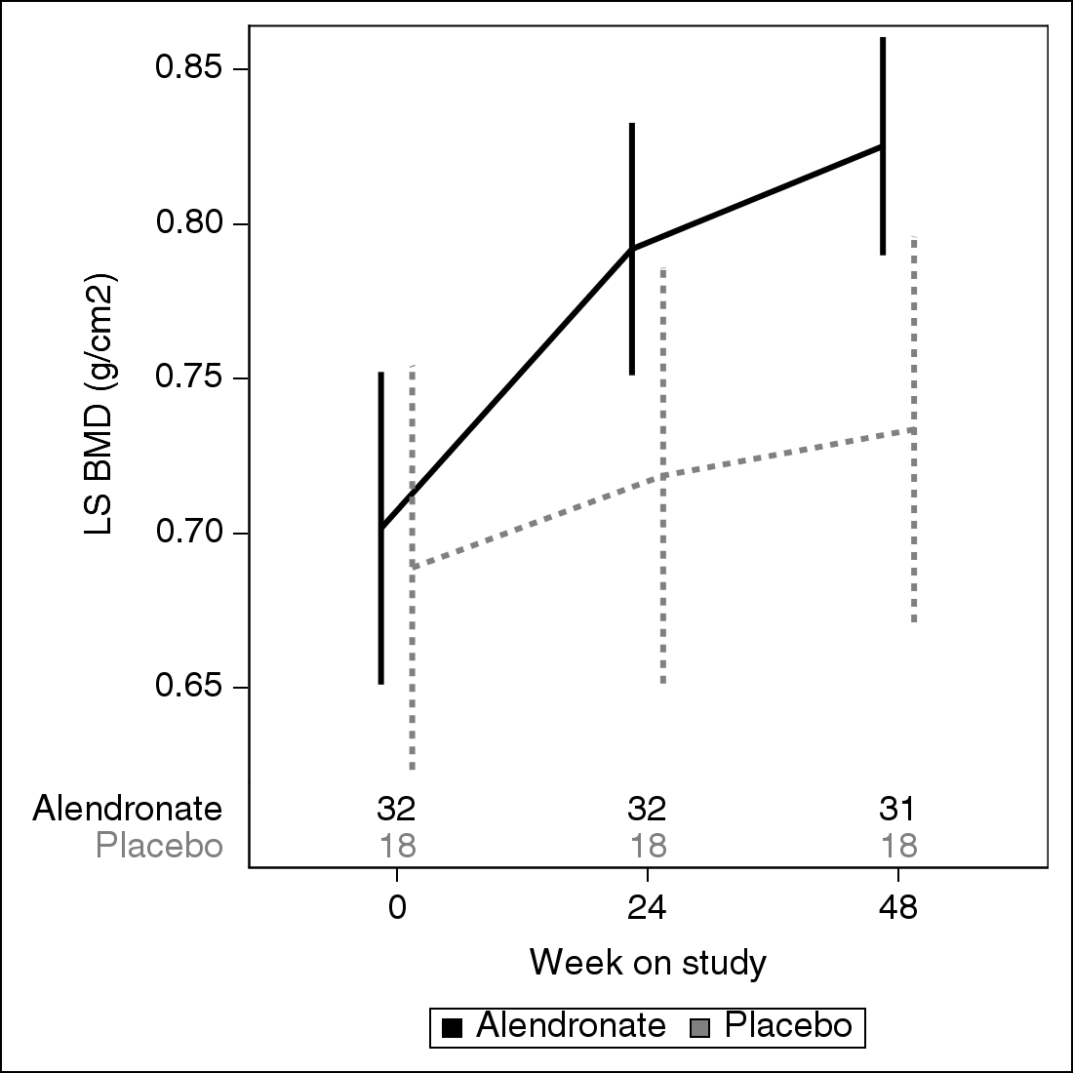
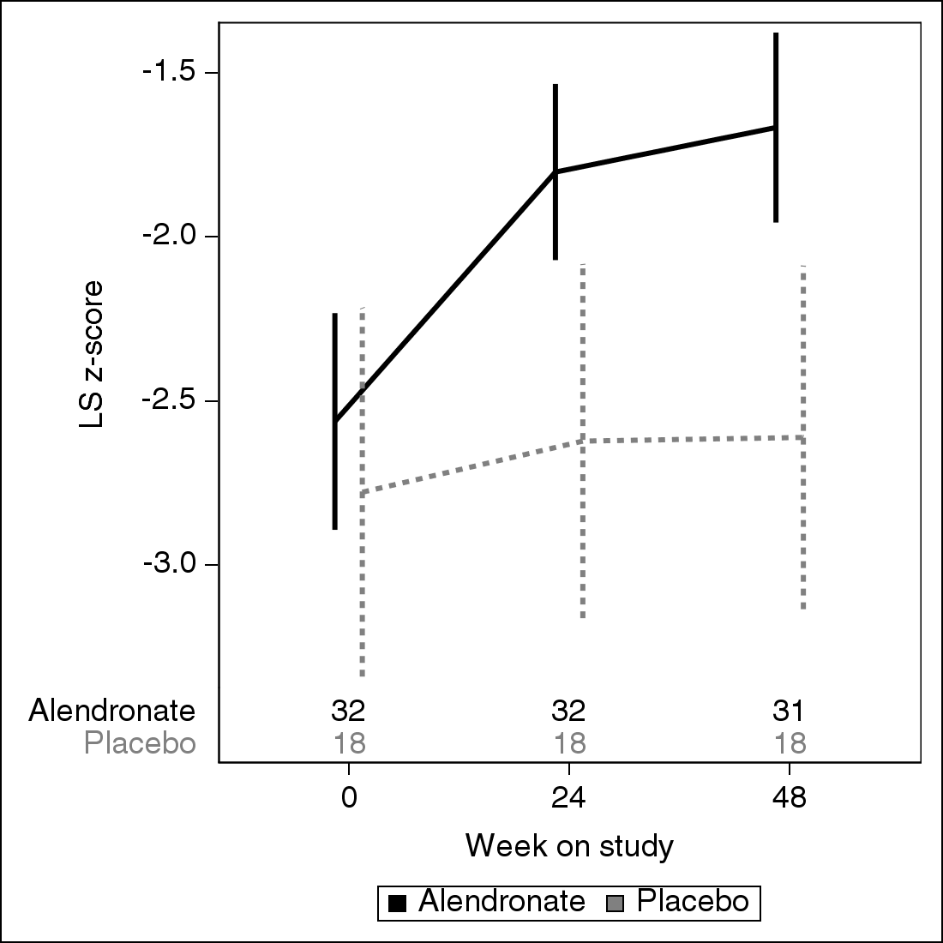
LS Outcomes:
Mean (95% CI)
LS BMD
LS BMD z-score

Slide 19
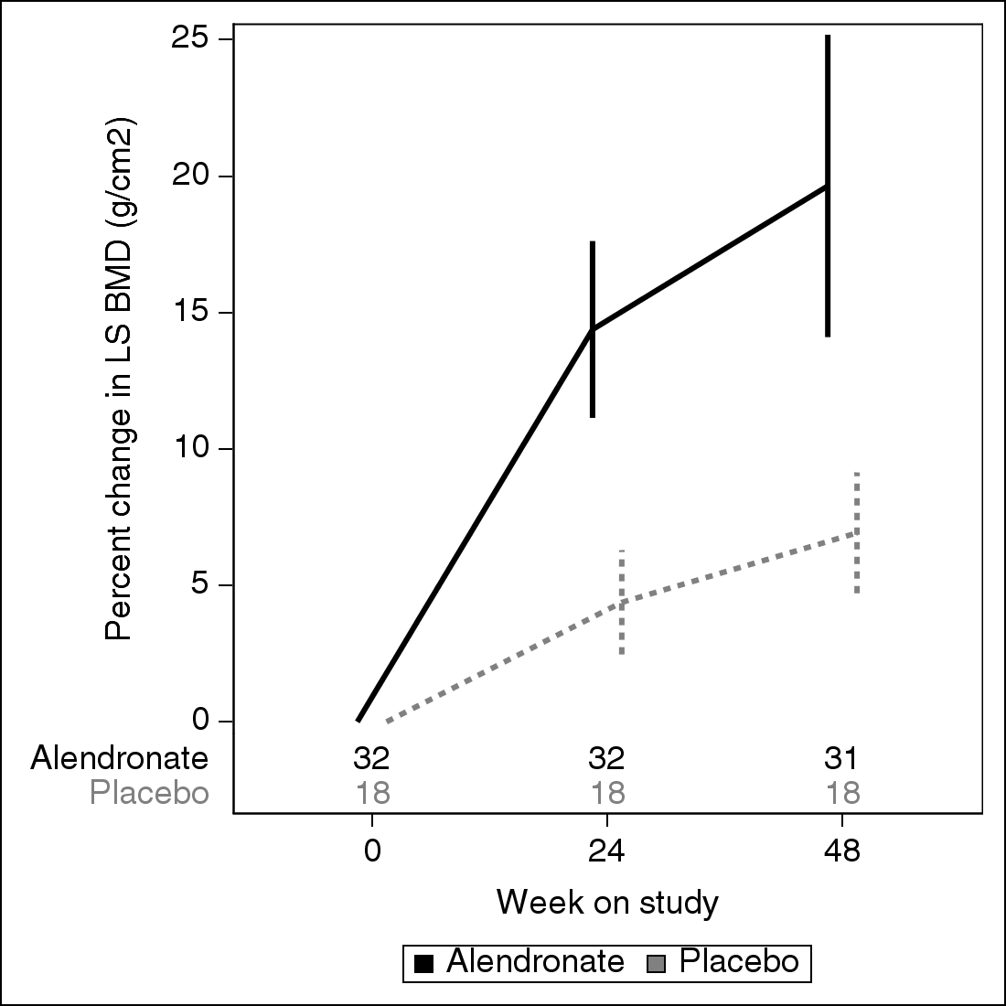
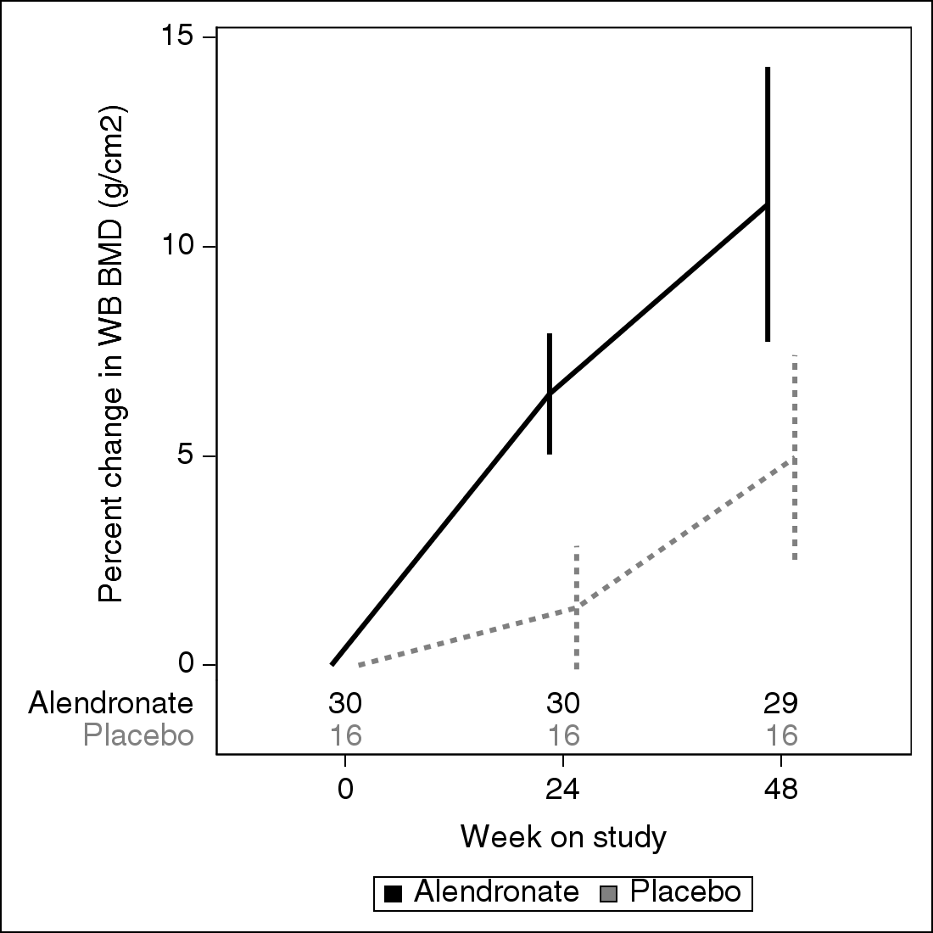
Percent Change in BMD Outcomes From Week 0: Mean (95% CI)
% change LS BMD
12.7 (6.8, 18.6), P < 0.001*
% change WB BMD
6.1 (2.1, 10.0), P=0.004*
*T-test

Slide 20
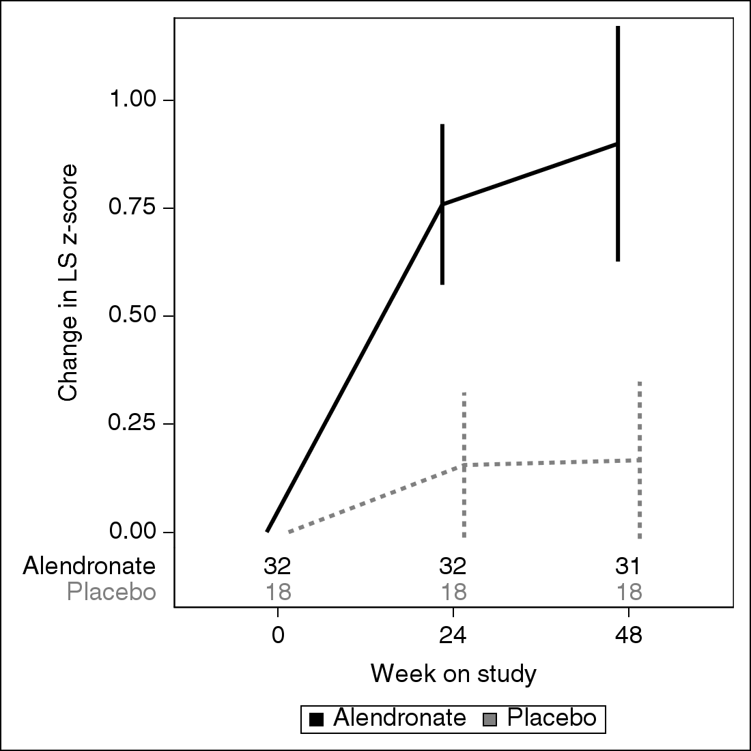
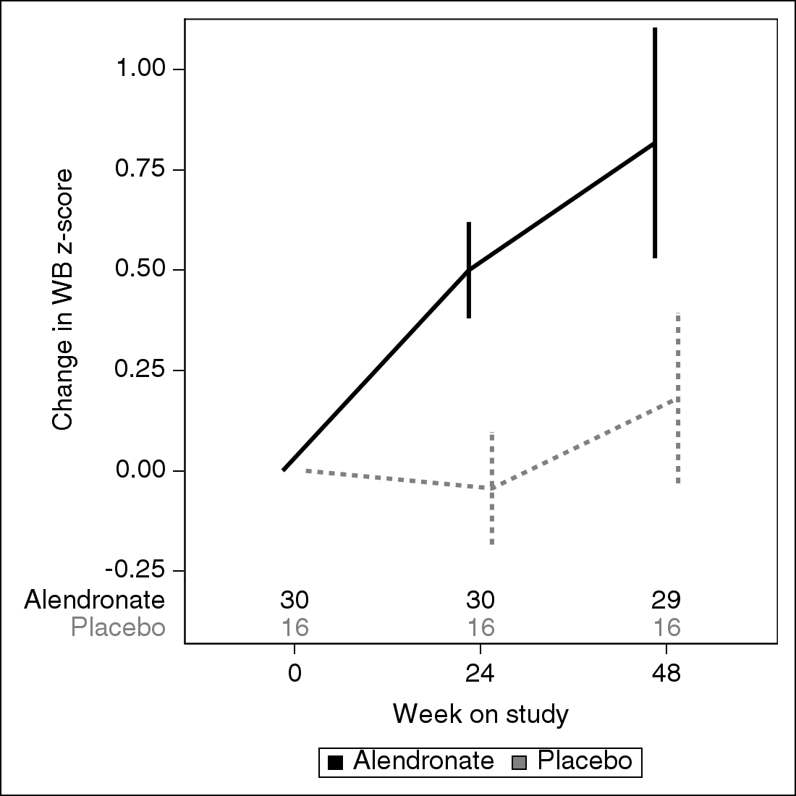
Changes in Z-score Outcomes From Week 0: Mean (95% CI)
Change LS BMD z-score
0.73 (0.41, 1.05), P <0.001*
Change WB BMD z-score
0.64 (0.29, 0.98), P <0.001*
*T-test

Slide 21
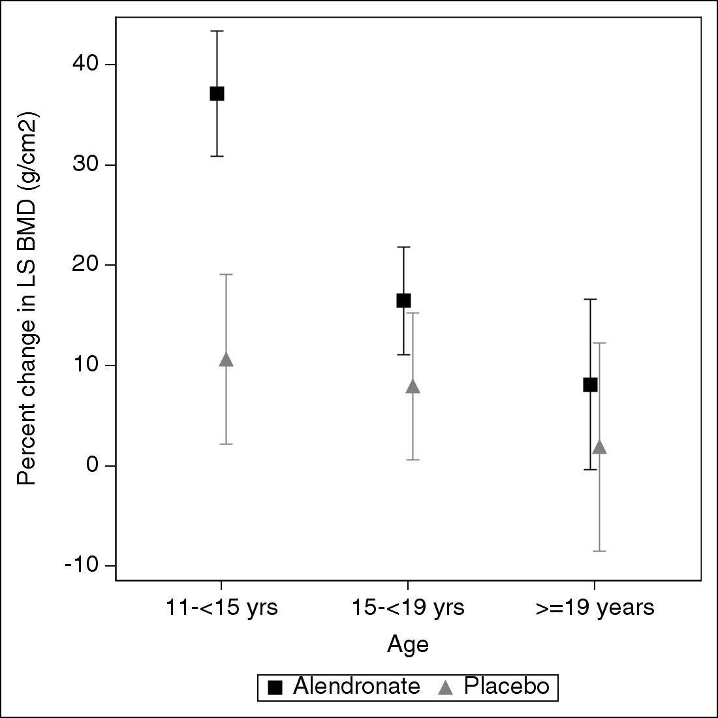
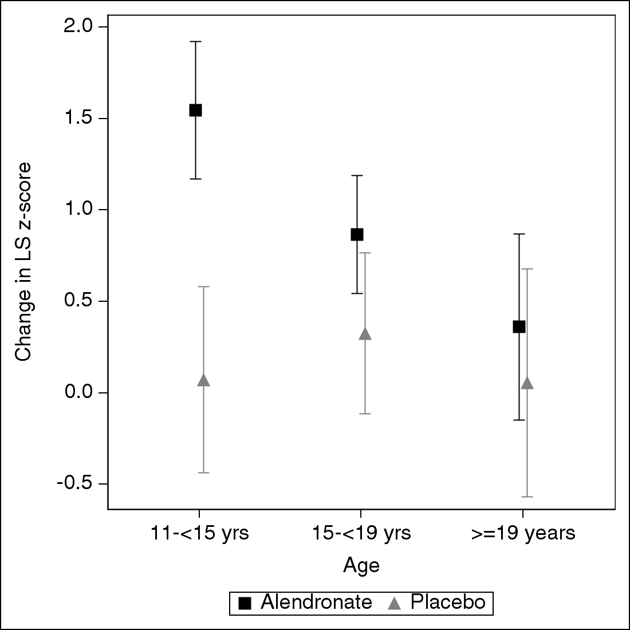
Alendronate Had a Larger Effect on LS Outcomes in Younger Children*
% change LS BMD
Change LS z-score
P=0.02*
P=0.038*
*P-value for effect modification
Trends were similar by Tanner stage and bone age, and for whole body

Slide 22
Conclusions
No indications of safety issues with alendronate in HIV-infected youth treated for 48 weeks
Significantly greater improvements in BMD and BMD z-scores on alendronate
  compared to vitamin D/calcium/exercise alone
  in less mature (age, Tanner, bone age) participants
Mean z-scores at week 0 and 48 weeks
A: -2.6 to -1.7 P: -2.8 to -2.6
Impact on fractures and peak bone mass unknown
Limitations include a small sample size

Slide 23
Durability of Alendronate treatment
Does an additional 48 weeks of alendronate
further improve BMD?
How long is efficacy maintained after stopping alendronate?
A/A
A/P
P/A
Weeks 0 48 96 144
Alendronate (A)
Placebo (P)
Follow-up (no treatment)

Slide 24
IMPAACT P1076 Protocol Team
George Siberry
Bret Rudy
Patrick Jean-Phillipe
Paul Sato
Hans Spiegel
Rohan Hazra
Kimberly Hudgens
Kathy George
Lynette Purdue
William Meyer
Francesa Aweeka
Janice Hodge
Adriane Hernandez
Aaron Atlas
Christopher Hensel
Stephen Spector
Grace McComsey
Jane Benson
Yvonne De Souza
Catherine Gordon
Dan Colosi
Fred Ferguson
Jessica Pagano-Therrien
Dorothy Shaw
Eric Stets
Arthur Santora
Study sites
Brazil:
  Federal University Minas Gerais
  University of Sao Paulo
US:
  UCLA Medical Center
  Chicago Children’s
  University of Miami
  South Florida
  San Juan City Hospital
  Johns Hopkins University
  St Jude
  U Mass Medical School

Slide 25
Thank you
IMPAACT P1076 participants and guardians
Overall support for the International Maternal Pediatric Adolescent AIDS Clinical Trials Network (IMPAACT) was provided by the National Institute of Allergy and Infectious Diseases (NIAID) with co-funding from the Eunice Kennedy Shriver National Institute of Child Health and Human Development (NICHD) and the National Institute of Mental Health (NIMH), all components of the National Institutes of Health (NIH), under Award Numbers UM1AI068632 (IMPAACT LOC), UM1AI068616 (IMPAACT SDMC) and UM1AI106716 (IMPAACT LC), and by NICHD contract number HHSN275201800001I. The content is solely the responsibility of the authors and does not necessarily represent the official views of the NIH.

Slide 26
References for z-scores
Lumbar spine:
Kelly et al (1990): 3-6 years (white)
Bone Mineral Density in Childhood Study (BMDCS Kalkwarf et al, 2007): females 7-16 years and males 7-17 years (black and non-black)
Kelly et al (2005): > 17 years
Whole Body with head:
NHANES, Kelly et al 2009: 8-85 years (black, white and Hispanic)

