Slide 1


Pharmacokinetic and 4-week safety/efficacy of dolutegravir (S/GSK1349572) dispersible tablets in HIV-infected children aged 4 weeks to <6 years: results from IMPAACT P1093
Theodore Ruel, Edward P. Acosta, Rajendra Singh, Carmelita Alvero, Terry Fenton, Kathleen George, Ellen Townley, Rohan Hazra, Stephanie Popson, Ann M. Buchanan, Cindy Brothers, Cindy Vavro, Andrew Wiznia, and the IMPAACT P1093 Team
International Workshop on HIV Pediatrics - July 20, 2018

Slide 2

BackGround
Dolutegravir (DTG) is a promising agent for children with HIV given its potency, high barrier to resistance, and tolerability.
IMPAACT P1093 is an ongoing phase 1/2 open-label pharmacokinetic (PK), safety, and dose-finding regulatory study of DTG in children
  Film-coated tablets approved for older children in the USA and EU.
  Dispersible tablets (DTG-DT) of 5mg developed for younger children and infants
Here we present the intensive PK and 4-week safety (primary outcomes), as well tolerability and efficacy data for DTG-DT in children ages 4 weeks to < 6 years

Slide 3
P1093 Design – dose determination by age cohorts
Intensive PK plus 4-week safety and tolerability data for
dose selection …
Mini Cohort
n=4
Full Cohort - Stage 1
n=6 more enrolled to achieve 10 total
Full Cohort - Stage II
n= 12 more enrolled to achieve 22 total
Intensive PK sampling
and 4-week safety/efficacy
Sparse PK sampling
and 48-week safety/efficacy
Cohort I: Adolescents ≥12 to <18 years of age (Tablet formulation)
Cohort IIA: Children ≥6 to <12 years of age (Tablet formulation)
Cohort IIB: Children ≥6 to <12 years of age (Granules)
Cohort III - DT: Children ≥2 to <6 years of age (Dispersible Tablet)
Cohort IV - DT: Children ≥6 months to <2 years (Dispersible Tablet)
Cohort V - DT: Infants ≥4 weeks to <6 months (Dispersible Tablet)

Slide 4
Methods – Enrollment*
Inclusion Criteria:
  Within age range of cohort at time of entry
  Antiretroviral Therapy (ART) Status:
    ART-experienced and failing or off ART for ≥ 4 weeks
    ART-naïve or have started ART < 4 weeks prior to entry (if < 2 years old)
  HIV RNA > 1,000 copies/ml
Exclusion Criteria:
  Current or recent (< 4 weeks) co-morbidity or laboratory abnormality
  Weight < 3 kg
  Maternal or participant exposure to integrase inhibitor
  No receipt of Nevirapine in14 days prior to enrollment (as PMTCT or treatment)
* Per Version 4.0 of the protocol

Slide 5
Methods – STAGE I PK and monitoring
Enrollment
4 weeks
Day 5
Day 10
Intensive PK Sampling
Pre-, 1, 2, 3, 4, 6, 8 and 24 hours after witnessed dose in fasted state*
History and examination
Safety Laboratory testing (blood count, electrolytes, liver enzymes)
HIV RNA level
History and examination
Safety Laboratory testing (blood count, electrolytes, liver enzymes)
HIV RNA level
History and examination
Safety Laboratory testing (blood count, electrolytes, liver enzymes)
HIV RNA level
* Instructed to not ingest breastmilk, formula or other high fat food/liquid 2 hours prior and 1 hour after dosing.

Slide 6
Participant Characteristics
 | Cohort V-DT (≥4 wk to <6 mo) | Cohort IV-DT (≥6 mo to <2 yr) | Cohort III-DT (≥2 yr to <6 yr) | Total
 | (N=10) | (N=10) | (N=10) | (N=30)*
Sex
Female | 4 | 6 | 3 | 13 (43%)
Baseline Plasma HIV RNA (copies/mL)
400 to < 5,000 | 3 | 1 | 2 | 6 (20%)
5,000 to <10,000 | 1 | 1 | 1 | 3 (10%)
10,000 to <25,000 | 0 | 1 | 1 | 2 (7%)
25,000 to <50,000 | 0 | 2 | 1 | 3 (10%)
≥ 50,000 | 6 | 5 | 5 | 16 (53%)
Baseline CD4 Cell Count (cells/mm³)
≥500 | 10 | 10 | 10 | 30 (100%)
Baseline CD4 Percent
≤14 | 0 | 1 | 2 | 3 (10%)
>14 to <25 | 5 | 5 | 1 | 11 (37%)
≥25 | 5 | 4 | 7 | 16 (53%)
Number (%) of participants in each subcategory; * 32 enrolled to achieve 30 evaluable.
Countries
Botswana | 3 (10%)
Brazil | 1 (3%)
South Africa | 7 (23%)
Tanzania | 3 10%)
Thailand | 2 (7%)
USA | 2 (7%)
Zimbabwe | 12 (40%

Slide 7
Initial dTG-DT Dosing table
Weight Band (kg) | Dose* (mg) | Dose (mg/kg) for Weight Range
 |  | Lower Weight | Upper Weight
3 to < 6 | 5 | 1.67 | 0.83
6 to <10 | 10 | 1.67 | 1.00
10 to <14 | 15 | 1.50 | 1.07
14 to <20 | 15 | 1.79 | 1.25
20 to <25 | 20 | 1.50 | 1.20
* Once daily

Slide 8
Intensive PK Results for DTG-DT
Cohort (n=10 each)~ | Age (yrs)^ | Dose (mg/kg)^ | AUC_{24h}* (mg x h/L) | C_{24h}* (ng/mL)
≥4 weeks to <6 months (Cohort V) | 0.34 (0.28-0.39) | 1.2 (0.9-1.7) | 61 (44%) | 1,207 (55%)
≥6 months to <2 years (Cohort IV) | 1.2 (0.9-1.9) | 1.2 (1.0-1.4) | 51 (38%) | 711 (60%)
≥2 years to <6 years (Cohort III) | 4.0 (2.1-5.9) | 1.1 (0.8-1.6) | 40 (36%) | 461 (59%)
^ Median (range); * Geometric mean (arithmetic coefficient of variation %) of 24 hour area under the curve (AUC_{24h}) and trough (C_{24h}).
Version 4.0 Target (range) for Geometric Mean:
AUC_{24h} : 46
(37-86)
mg x h/L
C_{24h} : 750
(500-2260) ng/mL
Note: Dispersible Tablets (DT) are 5mg each.

Slide 9
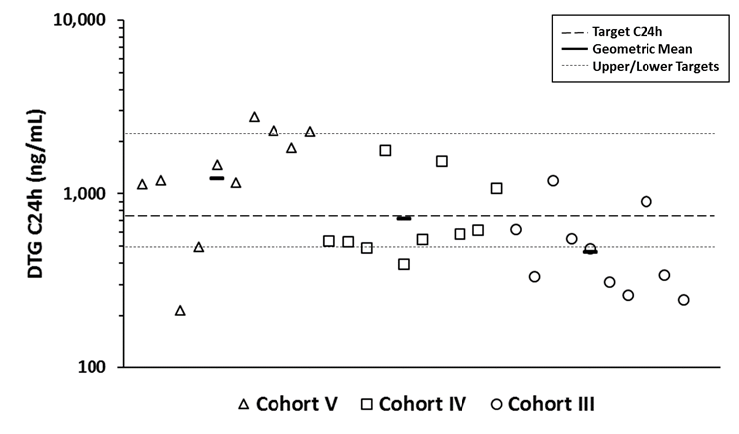
DTg DT : 24 hour trough by cohort
Version 4.0 Target (range) for Geometric Mean:
C_{24h} : 750
(500-2260) ng/mL
Below target range (<500 ng/mL)
(≥4 wk to <6 mo) (≥6 mo to <2 yr) (≥2 yr to <6 yr)

Slide 10
4 week Safety – Grade 3/4 Adverse Events
No Grade 3 or 4 adverse events (AE) attributed to study drug
No study drug discontinuations
Cohort | AE Grade~ | Week | Description | Outcome/explanation
V-DT | 3 | 1 | Low Phosphate | Grade 2 at baseline, then resolved
IV-DT* | 3 | 1 | Low Bicarbonate | Grade 3 at baseline
IV-DT* | 4 | 4 | Low Absolute Neutrophil Count | 253 c/mm³ but normal 2 days later
III-DT | 3 | 1 | Elevated Systolic Blood Pressure | Hypertension noted at baseline, providers suggested anxiety
III-DT | 3 | 1 | Low Bicarbonate | Grade 2 at baseline
~ DAIDS AE Grading Table, Version 1.0, December 2004, Clarification August 2009
* Same participant

Slide 11
Feasibility, Acceptability and Tolerability of DTG DT
Cohort (N=10 participants in each cohort) | Problems with swirling, dispersing or drawing up? | Overall Taste Assessment? | Problems taking?
≥4 wk to <6 mo (V) n=28 assessments | Never: 28 “Infrequent/ sometimes”: 0 | Very good: 9 Fair/Pleasant: 18 Acceptable: 2 Very bad: 0 | No: 28 Yes: 0
≥6 mo to <2 yr (IV) n=32 assessments | Never: 29 “Infrequent/ sometimes”: 3 | Very good: 7 Fair/Pleasant: 15 Acceptable: 8 Very bad: 2 | No: 28 Yes: 4
≥2 yr to <6 yr (III) n= 35 assessments | Never: 34 “Infrequent/ sometimes”: 1 | Very good: 14 Good: 13 Average: 2 Very bad: 5 | No: 33 Yes: 2
* Dispersible tablets were well-tolerated across all ages

Slide 12
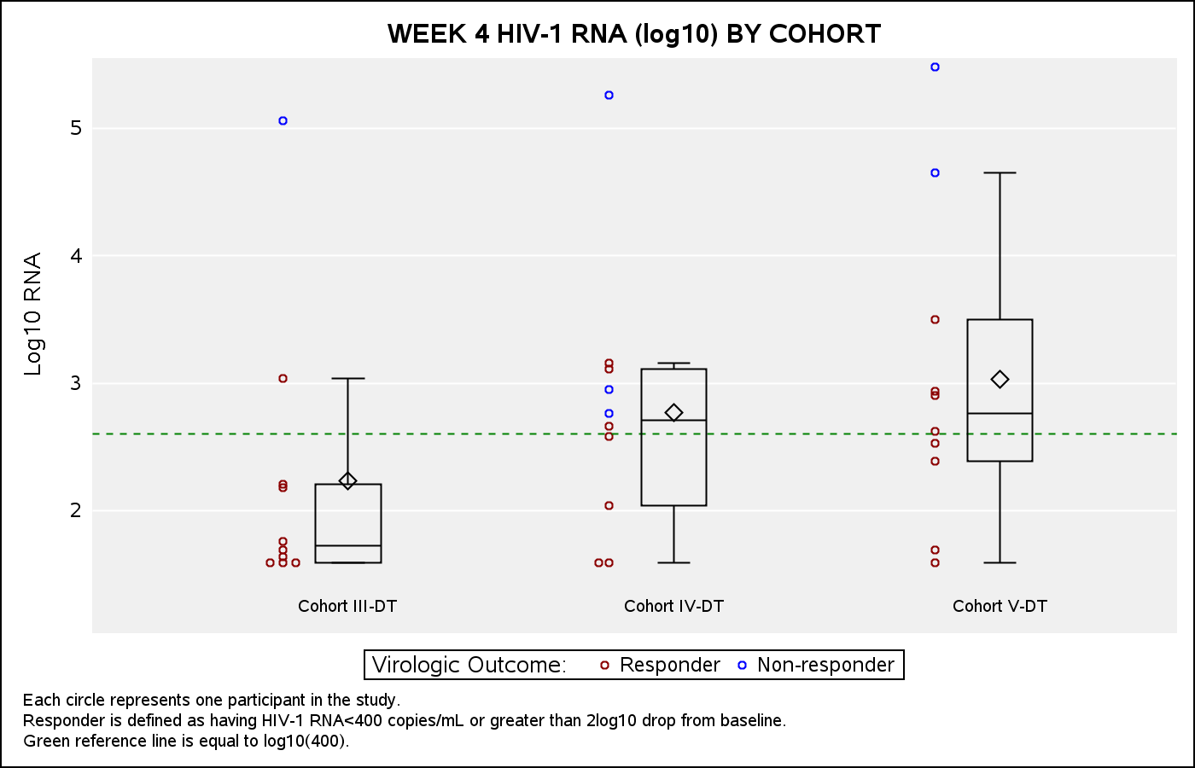
4 week Virological Outcomes
At 4 weeks, 24/30 (80%) attained HIV-1 RNA of <400 copies/ml or a >2 log₁₀ decrease
Background Regimens*
ZDV/3TC | 15
ABC/3TC | 4
LPV/r + ZDV/3TC | 6
LPV/r + ABC/3TC | 3
LPV/r + D4T/3TC | 1
LPV/r + 3TC | 1
LPV/r + TDF | 1
* Optimized to ensure ≥ genotype-documented active agent
Diamond is mean, box is quartiles, whiskers are 1.5x interquartile range.

Slide 13
Key PK findings and Next steps
DTG DT for ages 4 weeks to 6 years
This dosing of DTG-DT resulted in geometric mean AUC_{24h} and C_{24h} generally within target ranges
However children 6 mos to < 6 yrs of age demonstrated moderate inter-subject variability and some low individual C_{24h}
  Higher doses now under study for those ages
Next protocol version allows for additional enrollments to ensure data adequate for WHO weight-band and age-based dosing

Slide 14
CURRENT dtg-DT Dosing TABLE: P1093
Age | Weight Band (kg) | Dose (mg) | Dose Range (mg/kg)
 |  |  | low weight | high weight
≥ 4 weeks to < 6 months of age | 3 to < 6 | 5 | 1.67 | 0.83
 | 6 to < 10 | 10 | 2.50 | 1.50
≥ 6 months of age | 3 to < 6 | 10 | 3.33 | 1.67
 | 6 to < 10 | 15 | 2.50 | 1.50
 | 10 to < 14 | 20 | 2.00 | 1.43
 | 14 to < 20 | 25 | 1.79 | 1.25
 | ≥ 20 | 30 | 1.50
* Due to greater bioavailability, the 30mg dispersible tablet is approximately equivalent to the 50mg film-coated tablets.

Slide 15
Conclusions:
DTG DT for ages 4 weeks to 6 years in P1093
Drug Exposures similar to adults can be achieved with the dispersible tablet formulation of dolutegravir in children aged 4 weeks to 6 years.
The dispersible tablet formulation was well tolerated and easily administered by participants and their families
Week 4 virologic outcomes suggest that DTG-DT plus standard background regimens will provide safe and potent treatment for children with HIV

Slide 16

acknowledgements
P1093 Protocol Team
NICHD/NIAID
ViiV / GSK
Sites and their staff
P1093 participants and their caregivers!
Overall support for the International Maternal Pediatric Adolescent AIDS Clinical Trials Network (IMPAACT) was provided by the National Institute of Allergy and Infectious Diseases (NIAID) with co-funding from the Eunice Kennedy Shriver National Institute of Child Health and Human Development (NICHD) and the National Institute of Mental Health (NIMH), all components of the National Institutes of Health (NIH), under Award Numbers UM1AI068632 (IMPAACT LOC), UM1AI068616 (IMPAACT SDMC) and UM1AI106716 (IMPAACT LC), and by NICHD contract number HHSN275201800001I. The content is solely the responsibility of the authors and does not necessarily represent the official views of the NIH.”

