Slide 1
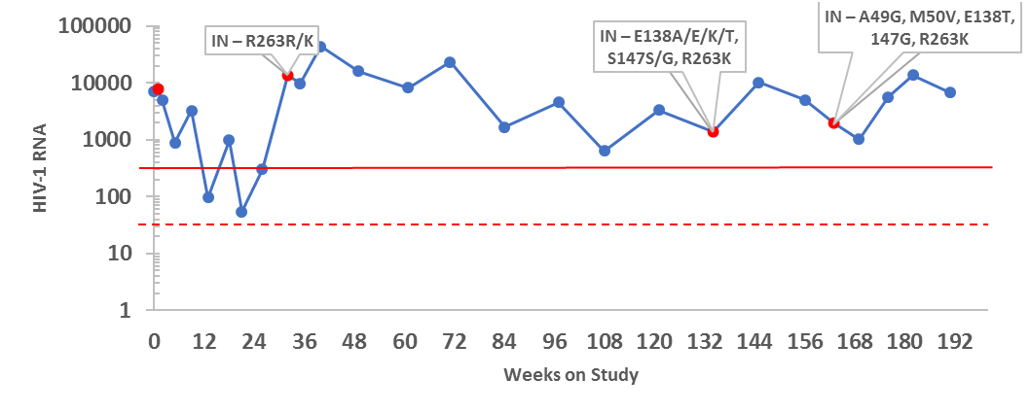
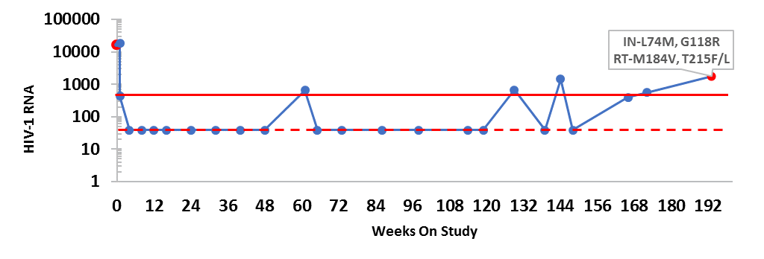
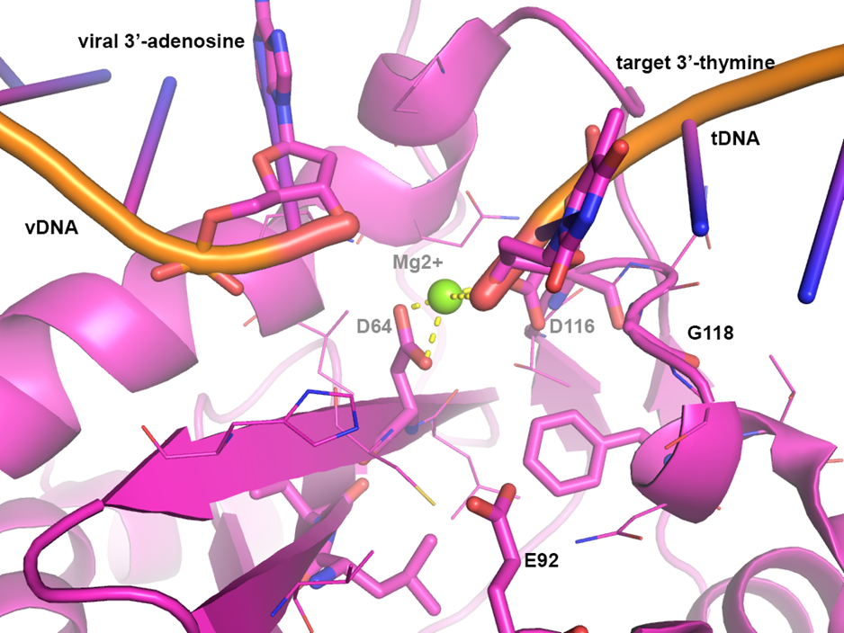
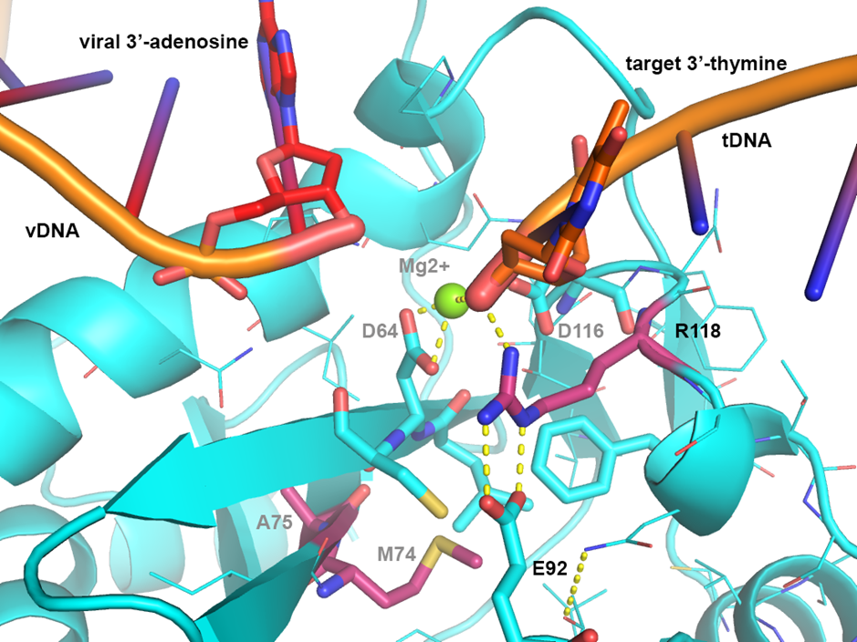
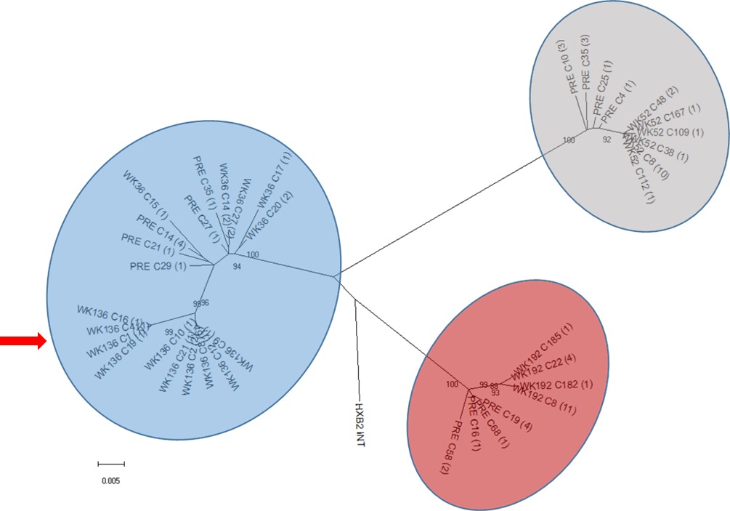
Poster
36
Emergence of resistance in HIV-1 Integrase following dolutegravir (DTG) treatment in 6 to <18 year old participants enrolled in the P1093 study
Cindy Vavro¹, Ted Ruel², Andrew Wiznia³, Carmelita Alvero⁴, Stephanie Popson⁵, Terry Fenton⁴, Rohan Hazra⁶, Ellen Townley⁷, Ann Buchanan¹, and Paul Palumbo⁸
¹ViiV Healthcare, Research Triangle Park, NC, USA, ²University of California San Francisco, San Francisco, CA, USA ³Jacobi Medical Center, Bronx, NY, USA, ⁴Harvard School of Public Health, Boston, MA, USA, ⁵Frontier Science Research Foundation, Inc, Amherst, NY, USA, ⁶NICHD, Bethesda, MD, USA, ⁷NIAID and Ctr: Columbus Technologies and Services Inc, Bethesda, MD, USA, ⁸Dartmouth Medical School, Lebanon, NH, USA
BACKGROUND and METHODS
Background and Objective
IMPAACT P1093 is an ongoing phase I/II, multicenter, open-label pharmacokinetics (PK), safety, dose-finding study of dolutegravir (DTG) plus optimized background regimen (OBR) in children and adolescents in 5 age-defined cohorts: Cohort I (≥12-<18 years), Cohort IIA (≥6-<12 years), Cohort IIB (≥6-<12 years), Cohort III (≥2-<6 years), Cohort IV (≥6 mo-<2 years), and Cohort V (≥4 weeks-<6 mo). The P1093 study duration is 48 weeks followed by a 3 yr safety follow up on DTG (total 192 weeks). P1093 used sequential enrolment of age cohorts starting with adolescents. Cohorts I, IIA, and IIB have completed 48 Weeks on study. Results from Cohorts I and IIA have been used to support DTG tablet dosing down to 6 yrs in several markets.
This presentation provides a characterization of integrase resistance that arose at protocol-defined virologic failure (PDVF) through the instream cut date (30 Sept 2017) for adolescents and children ≥ 6 years
Methods
Virologic failure (VF) for P1093 is defined as confirmed decrease in HIV-1 RNA (VL) of < 1.0 log10 at/after week 12 (unless <400c/mL), or confirmed >400c/mL at/after Week 24, or confirmed >400c/mL after initial confirmed <400c/mL or confirmed >1 log10 increase above VL nadir (nadir =>400c/mL). At confirmed VF, population and clonal integrase (IN) genotypes and phenotypes with integrase (IN) replication capacity (RC) were investigated. In addition, population reverse transcriptase (RT) and protease genotypes were performed. Adherence was assessed by 3-day recall per visit, and through communication with site PI. A phylogenetic analysis of integrase clonal nucleotide sequences was performed to create a Neighbor-Joining tree. Evolutionary distance was determined with Maximum Composite Likelihood: 1000 Bootstrap Replicates. A structural examination of HIV-1 integrase using the HIV-1 Intasome structure was conducted (Passos et al, Science 2017).
RESULTS
P1093 recruited 23 participants each in Cohort I (tablets), and Cohort IIA (tablets) and 15 participants in Cohort IIB (dissolvable granules). Through the cut off for this study, the median time on study for each cohort was as follows. For Cohort I, all completed study or reached week 192; for Cohort IIA, 17/23 completed study and remaining 6 on for a median 168 weeks; and for Cohort IIB, 1/15 completed study and 14/15 on study a median 132 weeks. Virologic failure (VF) rates per cohort were 12/23, 6/23, and 1/15, respectively. Virologic failure was associated with lack of adherence in most cases. For each cohort, genotypic resistance to integrase strand transfer inhibitors (INSTI) was detected in 2/12, 0/6, and 1/1, respectively. Additionally, two of the three participants had RT mutations detected. A patient narrative and HIV-1 RNA course for each is provided below.
FIGURE 1. Subject 1 RNA course on study
FIGURE 2. Subject 2 RNA course on study
FIGURE 3. Subject 3 RNA course on study
Subject 1, a 12 year old adolescent was enrolled to Cohort I with extensive prior ART. This participant received DTG with an OBR of FTC/TDF. Adequate DTG exposure observed through Week 24. Virologic failure was reported at Week 32 after reports of non-compliance, but remained on study through Week 192 with continued viremia and reports of non-compliance.(Vavro, IAS 2015; Abstract TUPEA068).
Subject 2, a 16 year old adolescent enrolled to Cohort I with 14 years of prior ART. This participant received DTG with an OBR of EFV/FTC/TDF. Adequate DTG exposure was observed through Week 24. Virologic failure was met at Week 192. At this study visit the patient reported being off all study meds for 5 mo prior to Week 192
Subject 3, a 7 year old enrolled to Cohort IIB received granular formulation of DTG with an OBR of 3TC/ZDV. Adequate DTG exposure was observed through Week 24. At Week 24 the participant switched to DTG tablet dosing to assist with ARV compliance. The participant met virologic failure at Week 48 after continued non-compliance.
TABLE 1. Clonal Integrase Genotypes and INSTI Fold Change (FC)
FIGURE 5. Intrasome Stucture of HIV-1 Integrase: Structural Effects of G118R
Subject | Study Visit | Clones Tested | IN Linked Substitutions / # of Clones | Median DTG FC | Median EVG FC | Median RAL FC | Median IN RC
1 | Pre | 8 | L74V / 4 clones | 0.97 | 1.28 | 1.10 | 95%
 |  |  | L74I / 1 clone | 0.97 | 1.22 | 0.90 | 29%
 |  |  | L74L / 3 clones | 1.16 | 1.03 | 1.28 | 81%
 | Week 36 | 8 | R263K / 4 clones | 2.0 | 2.3 | 1.37 | 97%
 |  |  | V201I / 3 clones | 1.19 | 1.11 | 1.11 | 92%
 |  |  | V20I V, R263R / 1 clone | 1.26 | 1.31 | 1.15 | 128%
 | Week 136 | 16 | A49G, M50V, V201I, R263K / 12 clones | 4.17 | 3.6 | 1.76 | 49%
 |  |  | A49G, M50V, E138T, S147G, V201I, R263K / 4 clones | 6.33 | 4.83 | 2.22 | 28%
2 | Pre | 8 | WT/8 clones | 0.9 | 1.8 | 1.0 | 87.5
 | Week 192 | 16 | L74M, G118R/15 clones | 22 | 31 | 36 | 5.5
 |  |  | L74M, V75A, G118R / 1 clone | 52 | 76 | >MAX | 0.28
3 | Pre | 8 | V151I/8 clones | 0.9 | 1.1 | 0.8 | 147
 | Week 52 | 16 | V151I, G118R/16 clones | 9.6 | 6.0 | 12.5 | 17.5
Integrase resistance-associated mutations shown in bold Additional IN substitutions of interest shown in italics
Discussion
Longitudinal results from Subject 1 with prolonged viremia, suggest continuing evolution, after the acquisition of the uncommon IN mutation R263K, leads to increases in DTG FC and decreases in IN RC.
The clonal analysis showed IN substitutions, A49G and M50I, were observed at Week 136 and Week 160 but their specific impact on DTG is not well understood.
The impact of the rarely occurring G118R on both DTG FC and decreased integrase RC was modulated by the addition of one (L74M) or two (L74M and A75V) additional IN linked mutations, but not V151I.
Structural analysis of HIV-1 INT suggests R118 sterically restricts access to the active site for inhibitors by forming strong hydrogen bonds with E92 but allows space for substrate binding resulting in reduced INSTI susceptibility and reduced integrase RC.
Addition of L74M/V75A in HIV-1 INT forms a stronger hydrophobic core below the active site pocket that restricts the geometry of the catalytic site; this hydrophobic core is formed by M74, A75, F121, L63, C65, and the side chain of E92 supporting the further decrease in INSTI susceptibility and decrease in IN RC with these additional mutations.
FIGURE 4. Phylogenetic Analysis of Integrase Clonal Nucleotide Sequence
Conclusions
In P1093 the incidence of protocol-defined virologic failure was higher for adolescents compared to children ≥6-<12 years and for most cases associated with non-adherence to one or more components of the study regimen
At virologic failure, INSTI associated resistance was detected in few participants
R263K seen in Subject 1, resulted in moderate DTG FC and lower IN RC when additional IN mutations were present
G118R seen in Subjects 2 and 3, resulted in increased DTG FC and much lower IN RC The degree of increased DTG FC and decreased IN RC was impacted by specific additional single or multiple IN secondary mutations with G118R.
Phylogenetic Analysis Summary
A common ancestry for each of the clonal clusters/subject is displayed by colored circles.
More diversity at Baseline versus virologic failure was consistent with under drug pressure.
For Subject 1, at Week 136, 4 clones harboring A49G, M50V, E138T, S147G, V201I, R263K cluster together with a bootstrap of 99% showing more evolutionary distance consistent with continued drug pressure (red arrow). These clonal results were confirmed at Week 160.
Acknowledgements
We would like to thank all of the participants in P1093, subjects and their families, investigators and site staff. We would like to thank the IMPAACT P1093 study team and acknowledge the support of ViiV Healthcare. Thanks to Joe Horton for support with phylogenetic analyses and to Eugene Stewart for his HIV-1 integrase structural interpretations of IN resistance.
Overall support for the International Maternal Pediatric Adolescent AIDS Clinical Trials Network (IMPAACT) was provided by the National Institute of Allergy and Infectious Diseases (NIAID) with co-funding from the Eunice Kennedy Shriver National Institute of Child Health and Human Development (NICHD) and the National Institute of Mental Health (NIMH), all components of the National Institutes of Health (NIH), under Award Numbers UM1AI068632 (IMPAACT LOC), UM1AI068616 (IMPAACT SDMC) and UM1AI106716 (IMPAACT LC), and by NICHD contract number HHSN275201800001I. The content is solely the responsibility of the authors and does not necessarily represent the official views of the NIH.
Presented at the 10th Intl. Workshop on HIV Peds Amsterdam, Netherlands; July 20-21, 2018.
Poster Number: 36

