Slide 1
Caregiver depression and child neuropsychological outcomes in an observational study of pediatric HIV carried out in four sub-Saharan countries
Itziar Familiar, Miriam Chernoff, Horacio Ruisenor-Escudero, Barbara Laughton, Celeste Joyce, Lee Fairlie, Mutsa Bwakura-Dangarembizi, Portia Kamthunzi, Linda Barlow, Patrick Jean-Philippe, Bonnie Zimmer, Katie McCarthy, Michael J. Boivin
10th HIV Pediatrics Workshop
Amsterdam, Netherlands

Slide 2
Maternal depression
Depression is one of the most common mental health problems among women
Between 7-20% of women are affected by depression symptoms during pregnancy and for the first year of the child’s life^{1,2}
HIV+ women are more likely to experience depressive symptoms than their non-HIV infected peers (19.4% vs. 4.8%)³
1 Woolhouse et al, BJOG 2014
2 Gavin et al, Obstet Gynecol 2005
3 Morrison et al, Croat Med J, 2011

Slide 3
Maternal depression affects child socio-emotional and cognitive development through the child’s development stages
This phenomenon is largely compounded in the context of HIV/AIDS:
African children are at a particular disadvantage if their care depends on impoverished HIV-infected caregivers, themselves at risk for mental health problems and impaired functioning⁴
Compromised quality of caregiving can compound the already serious neurodevelopmental effects of HIV infection and exposure for these children.
4 Stein, A .et al, Child: Care, Health and Development, 2008
Notes:
The consequences on the child of maternal postpartum depression are not restricted to infancy, but can extend into toddlerhood, pre-school age and even school age. Maternal depression that occurs later influences the development of the school-age child and adolescent.

Slide 4
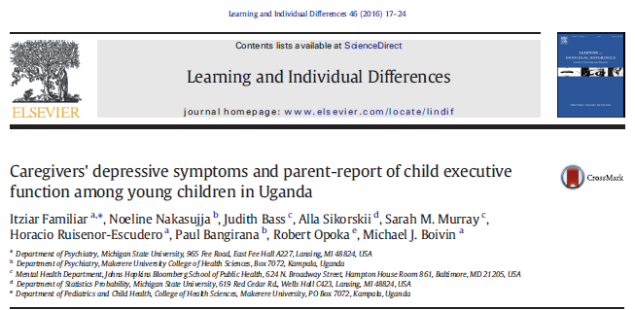
Depression of Ugandan Moms with HIV related to their BRIEF evaluation of their children, especially if HIV infected

Slide 5
Primary Study Aim
To evaluate how depressive symptoms and depression severity in mothers affects their child’s neuropsychological outcomes among three cohorts of African pre-school children from the P1104s study:
perinatally HIV-infected (HIV+)
perinatally exposed HIV-uninfected (HEU)
un-exposed HIV-uninfected children (HUU)
Notes:
Caregiver depression symptoms in low- and middle-income countries (LMIC) have been described mostly for mothers in the antepartum and post-partum periods . Environmental factors frequently encountered in low-income settings and related to HIV disease in the mother such as psychological (depression symptoms), behavioral (e.g. compromised caregiving), and socioeconomic factors can adversely impact neurodevelopment in young children.
AIMS were…

Slide 6
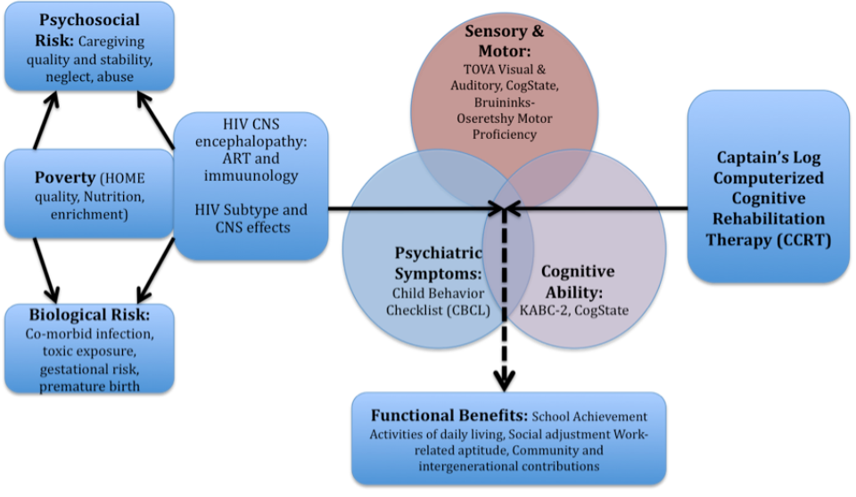
Observational Study Design for P1104s: Neuropsychological domains (center), risk factor domains (Left), HIV exposure groups (right)
Caregiver
Depression
Effects of HIV exposure
HIV+
HEU
HUU
Notes:
Children and their caregivers were invited to participate if they met the following eligibility criteria: (1) perinatally HIV-infected children participating in P1060 Version 5.0 (HIV group), (2) perinatally exposed HIV-uninfected children (HEU) born to HIV+ mothers recruited from the same households, extended families, or neighborhoods/communities as the P1060 participants, and (3) non-exposed HIV-uninfected children (HUU) attending vaccination and outpatient treatment clinics at each of the P1060 study sites. Only HUU children were medically screened for prior hospitalizations that could involve brain injury (e.g., cerebral malaria, meningitis, head trauma) or severe malnutrition, and excluded if they screened positive for any developmental disability. A total of 611 children (246 HIV, 183 HEU, 182 HUU) and their caregivers were enrolled in the P1104s study across the six research sites and evaluated for neuropsychological outcomes 3 times (baseline, 48 and 96 weeks after intake) over a period of 2 years.

Slide 7
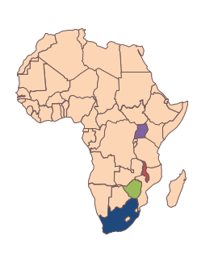
P1060/P1104s Study Sites
Accrual completed on 17 December 2014, with 615 participants enrolled (246 into HIV+ cohort; 185 into HEU cohort; 184 into HU cohort)
MUJHU, Kampala, Uganda n=89 participants (14%)
FAM-CRU, Cape Town, South Africa n=142 participants (23%)
Malawi CRS, Lilongwe, Malawi n=82 participants (13%)
Soweto, Johannesburg, South Africa n=100 participants (16%)
Harare Family Care, Harare, Zimbabwe n=133 participants (22%)
Wits RHI Shandukani Research, Johannesburg, South Africa n=69 participants (11%)

Slide 8
Methods
Participants (n=611 dyads) were primary caregivers and their 5-11 year old child who were HIV+, HEU, or HUU.
Caregivers were assessed for depression symptoms with the Hopkins Symptom Checklist
Low score: 1-1.75
High score: >1.75
3 assessment time points: 0, 48 and 96 weeks after study intake
Cross-sectional and longitudinal linear regression models adjusted for potential confounders
Notes:
All models included cohort, caregiver mood, and the interaction between cohort and caregiver mood
Note: Adjusted models also included site, sex, age at entry, caregiver relationship to child, residential zone, WHO height for age z-score, and socio-economic index

Slide 9
Neuropsychology Assessments

Slide 10
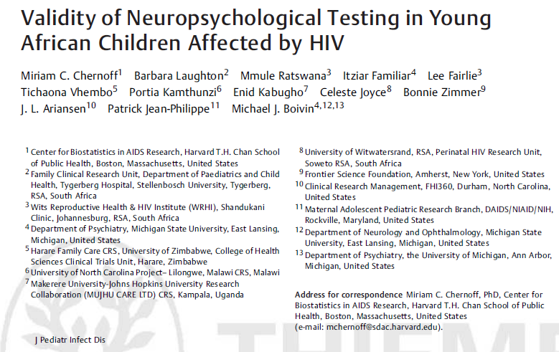

Slide 11
Kampala MUJHU/GHU IMPAACT and PROMISE NeuroDev Testing QA Assessment Center Team (Left to Right: Ssesanga Titus Kisa, Mary Nyakato, Namukooli Jackie Lydia , Agatha Kuteesa, M.J. Boivin

Slide 12
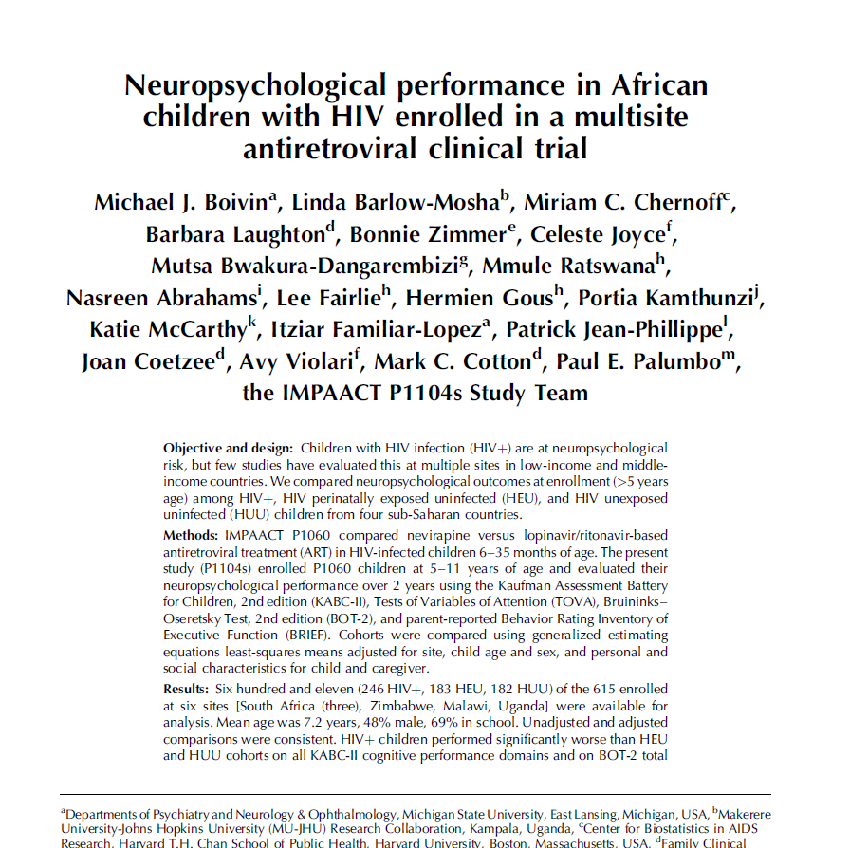
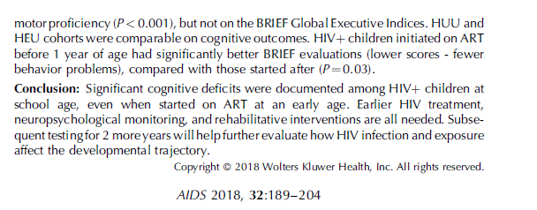
Distal Factors Affecting Neuropsychological Outcomes in Pediatric HIV.
Between-group differences adjusted for site, sex and age at entry, WHO height-for-age Z score, school status, caregiver relation, residential zone, length of time with caregiver, socioeconomic index, MICS disability and MICS development.

Slide 13
Child and caregiver characteristics at study entry, by cohort
 | HIV (N=246) | HEU (N=183) | HUU (N=182) | P-value
Male (%) | 45 | 52 | 46 | 0.35
Black, African (%) | 98 | 96 | 82
Age, years (mean (SD)) | 7.1 (1.2) | 7.3 (1.6) | 7.3 (1.5) | 0.46
Age group |  |  |  | 0.87
< 6 (%) | 17 | 20 | 19
6-7 (%) | 34 | 35 | 35
≥ 7 (%) | 50 | 45 | 46
Biological mother as caregiver (%) | 85 | 99 | 100 | <0.001
Caregiver with HIV (%) | 96 | 99 | 0 | n/a
High caregiver depression level (HSCL >1.75) (%) | 43 | 43 | 40 | 0.79

Slide 14
Biological markers of disease among HIV+ children (N=246)
 | HIV (N=246)
Age at ARV initiation, years (median, interquartile range) | 1.2 (0.7,2.1)
ARV initiated at < 1 year (%) | 44
# years on ARVs prior to entry (median, IQ range) | 5.8 (5.1,6.7)
ARV regimen HAART with PI (%) | 67
WHO disease stage III or IV (%) | 61
CD4 percent ≥ 25% (%) | 97
HIV RNA cp/ml 0-400 (%) | 96
Notes:
For the HIV-infected children, the median age at infection was 1.2 years and they had a median of almost six years on ARVs prior to study entry and 60% were classified at WHO disease stage III or IV

Slide 15
Standardized test scores at study entry, Mean (SD)
 | HIV (N=246) | HEU (N=183) | HUU (N=182) | Total (N=611) | P-value
KABC MPI | 73.2 (10.5) | 79.1 (11.4) | 80.9 (11.7) | 77.3 (11.6) | <0.001
BOT-2 | 48.3 (8.8) | 52.5 (7.6) | 52.6 (7.8) | 50.8 (8.4) | <0.001
BRIEF MI | 52.2 (13.0) | 51.9 (12.1) | 49.8 (10.5) | 51.4 (12.1) | 0.11
BRIEF BRI | 53.1 (13.0) | 51.2 (12.3) | 51.9 (11.2) | 52.2 (12.3) | 0.27
BRIEF GEC | 53.2 (13.3) | 51.5 (12.0) | 50.6 (10.5) | 51.9 (12.2) | 0.09
TOVA ADHD | -0.51 (3.13) | 0.51 (2.63) | 0.28 (2.59) | 0.03 (2.86) | <0.001
TOVA D PRIME | 82.5 (14.0) | 88.3 (12.3) | 87.9 (11.7) | 85.9 (13.1) | <0.001
Notes:
ND tests scores were significantly lower among HIV+ children at study entry (except BRIEF scores)

Slide 16
Associations of caregiver depression with neuropsychological test scores at entry
HSCL Depression score (continuous)
 | Unadjusted |  | Adjusted
Outcome | Slope (SE) | P-value | Slope (SE) | P-value
KABC MPI | -1.30 (0.71) | 0.07 | -0.44 (0.68) | 0.52
BOT-2 | 0.46 (0.51) | 0.37 | -0.57 (0.53) | 0.28
BRIEF MI | 7.29 (0.76) | <0.001 | 7.08 (0.81) | <0.001
BRIEF BRI | 5.12 (0.77) | <0.001 | 6.02 (0.84) | <0.001
BRIEF GEC | 6.66 (0.77) | <0.001 | 6.98 (0.84) | <0.001
TOVA ADHD | 0.23 (0.18) | 0.20 | -0.13 (0.19) | 0.49
TOVA D PRIME | -0.83 (0.80) | 0.30 | 0.73 (0.89) | 0.41
Notes:
In cross sectional analyses (at study entry) BRIEF scores were significantly associated with depression scores (as continuous variable) in the expected direction – a higher depression score was associated with higher BRIEF indices
*Adjusted models included site, sex, age at entry, caregiver relationship to child, residential zone, WHO height for age z-score, and socio-economic index

Slide 17
Association of caregiver depression severity level with neuropsychological test scores at study entry
HSCL Depression level Adjusted means (IC 95%)
Test | Low (0-1.75) (N=351) | High (>1.75) (N=259) | P-value
KABC MPI | 79.2 (77.4,80.9) | 78.7 (76.7, 80.6) | 0.58
BOT-2 | 51.8 (50.3,53.3) | 51.2 (49.7, 52.8) | 0.41
BRIEF MI | 48.9 (46.7,51.1) | 56.0 (53.6,58.5) | <0.001
BRIEF BRI | 49.6 (47.0,52.2) | 55.3 (52.4, 58.1) | <0.001
BRIEF GEC | 49.2 (46.7,51.6) | 55.9 (53.1,58.7) | <0.001
TOVA ADHD | 0.01 (-0.53-0.54) | 0.08 (-0.48,0.65) | 0.76
TOVA D PRIME | 87.5 (85.2,89.8) | 87.0 (84.5, 89.6) | 0.70
Notes:
If we look at the association by depression level using the standard HSCL cut-off value of 1.75, we see a similar picture where only BRIEF scores were associated with a high depression level
All models included cohort, caregiver depression, and the interaction between cohort and depression
Note: Adjusted models also included site, sex, age at entry,
caregiver relationship to child, residential zone, WHO height for age z-score, and socio-economic index
Wald P-values are for tests of main effect of depression level

Slide 18
KABC-II Mental Processing Index means at study entry by caregiver depression level
 | HIV |  | HEU |  | HUU
Depression level | Unadjusted mean (95% CI) | Adjusted mean (95% CI) | Unadjusted mean (95% CI) | Adjusted mean (95% CI) | Unadjusted mean (95% CI) | Adjusted mean (95% CI)
Low (0-1.75) | 74.8 (73.0,76.7) | 76.0 (74.1,77.9) | 79.6 (77.4,81.8) | 80.2 (77.7,82.7) | 80.3 (78.1,82.6) | 81.3 (78.7,83.9)
High (>1.75) | 71.1 (69.3,72.8) | 73.4 (71.2,75.5) | 78.5 (76.1,80.9) | 80.3 (77.5,83.0) | 81.9 (79.3,84.4) | 82.4 (79.6,85.1)
*Adjusted models included site, sex, age at entry, caregiver relationship to child, residential zone, WHO height for age z-score, and socio-economic index
Notes:
In cross sectional analyses (at study entry) the only neuropsychological assessment associated with depressive symptoms by HIV group was the KABC. This table shows that among HIV+ children, the KABC MPI was marginally lower (Wald test p-value for interaction =0.05) with increased caregiver depression symptomatology compared to the non HIV-infected groups where scores were stable.

Slide 19
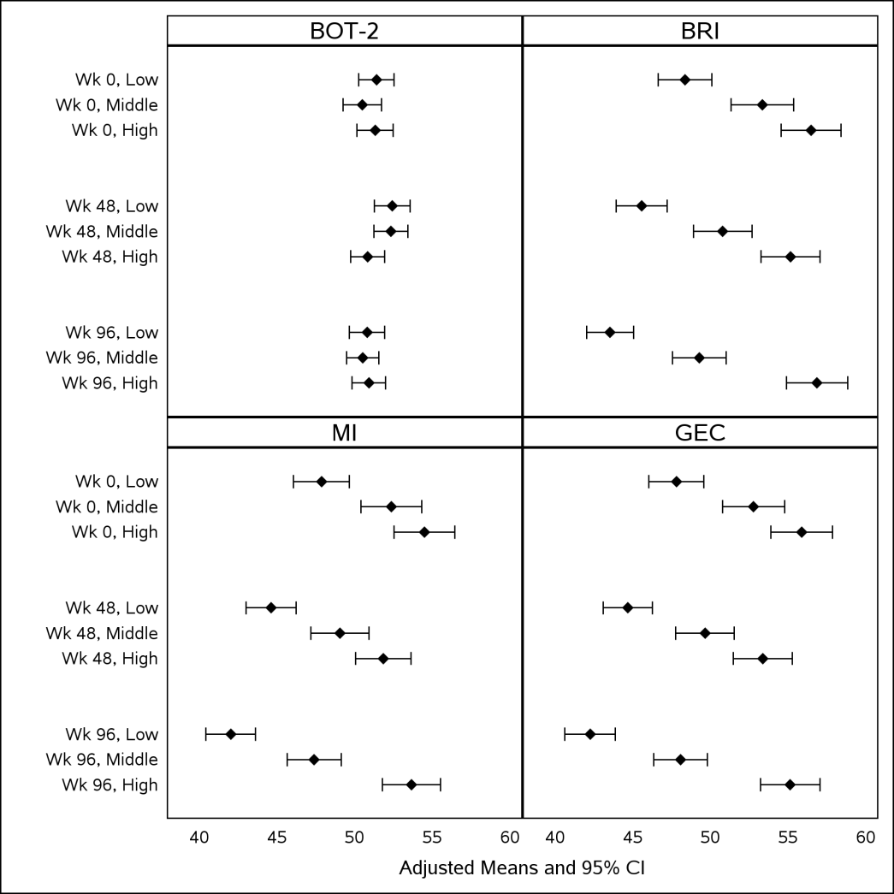
Adjusted means and 95% confidence interval for neuropsychological outcomes over time among school-age children of varying HIV status and caregiver depression level (High >1.75, Low ≤1.75). BOT-2: Total point standard score for Bruininks-Oseretsky Test of Motor Proficiency, BRI: Behavior Regulation Index, MI: Metacognition Index, and GEC: Global Executive Composite standard scores for the Behavior Rating Inventory of Executive Function.

Slide 20
Conclusions
HIV-infected children had lower cognitive performance scores than their non-infected peers
Caregivers with higher levels of depressive symptoms reported more executive function problems in their children, regardless of the child’s HIV status
Caregiver’s depression symptoms may have a more pronounced, negative effect on the neurodevelopment of HIV-infected children

Slide 21
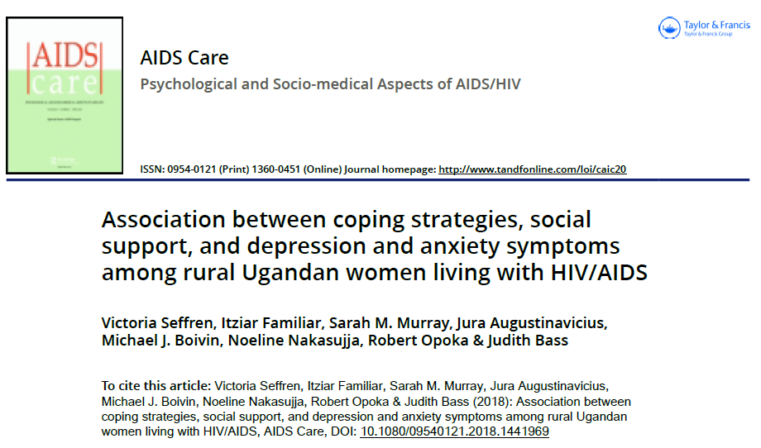

Slide 22
Implications and Questions
Identifying mothers in need of support and addressing their needs could help reduce the burden of early behavioral and cognitive problems in children
The BRIEF assessment is a promising way to systematically assess executive functioning in children in different cultural settings
Possible caregiver reporting bias need to be considered⁶
There is a need to integrate health programs for both children and mothers
For example: PMCT programs for HIV+ women
⁶ Familiar et al, J Learn Ind Diff 2015

Slide 23
Acknowledging the IMPAACT P1104s Study Leadership
Protocol Chair: Michael Boivin, Ph.D., M.P.H.
Study Statistician: Miriam Chernoff, Ph.D.
Data Manager: Bonnie Zimmer, B.S.
NIAID Medical Officer: Patrick Jean-Philippe, M.D.
NICHD Medical Officer: Sonia Lee, Ph.D.
NIMH Medical Officer: Pim Brouwers, Ph.D.
Clinical Trials Specialists: Katie McCarthy, MPH, J.L. Ariansen, MPH
Study Investigators: Paul Palumbo, M.D., Avy Violari, M.D.,
Mark Cotton, M.D., Barbara Laughton, M.D.
Site Representatives: Linda Barlow-Mosha, Nasreen Abrahams, Lee Fairlie, Hermien Gous, Portia Kamthunzi, Mutsa Bwakura-Dangarembizi,
Assessment Center Personnel: Agatha Kuteesa, Ssesanga Titus Triks,
Mariah Namubiru Kateete
SOP development: Mary Nyakato (University of Chester, UK)
Field Representative: Joan Coetzee, C.P.N.
Laboratory Data Coordinator: Brittany White, B.S.

Slide 24
Funding Support - Acknowledgements
Overall support for the International Maternal Pediatric Adolescent AIDS Clinical Trials (IMPAACT) Network was provided by the National Institute of Allergy and Infectious Diseases (NIAID) of the National Institutes of Health (NIH) under award numbers UM1AI068632 (IMPAACT LOC), UM1AI068616 (IMPAACT SDMC), and UM1AI106716 (IMPAACT LC), with co-funding from the Eunice Kennedy Shriver National Institute of Child Health and Human Development (NICHD) and the National Institute of Mental Health (NIMH). The content is solely the responsibility of the authors and does not necessarily represent the official views of the NIH.

Slide 25
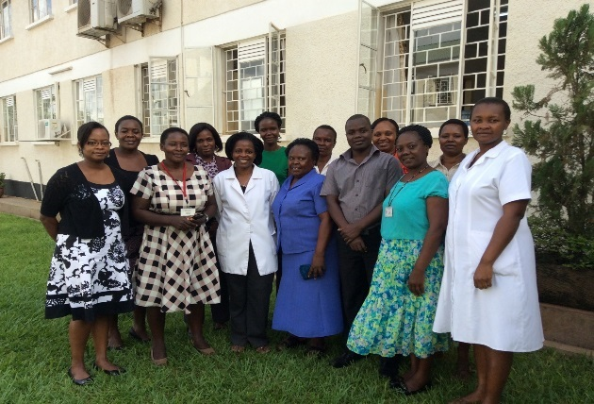
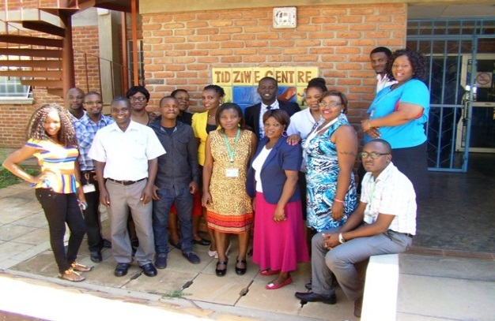
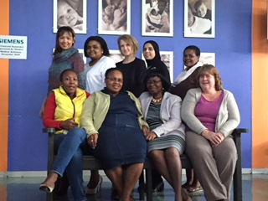
We acknowledge and appreciate the efforts of the study site staff in accomplishing P1104s
MU-JHU, Uganda
UNC Lilongwe, Malawi
PHRU SOWETO, RSA
SHANDUKANI, RSA
FAM-CRU, Cape Town, RSA
HFC, Zimbabwe

Slide 26
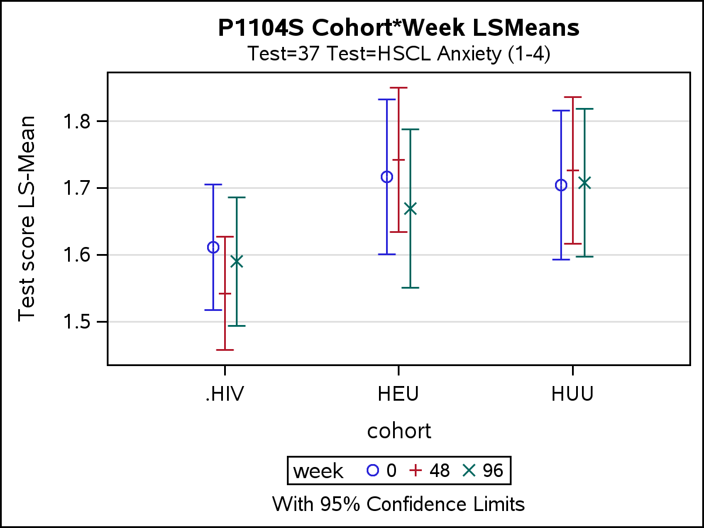
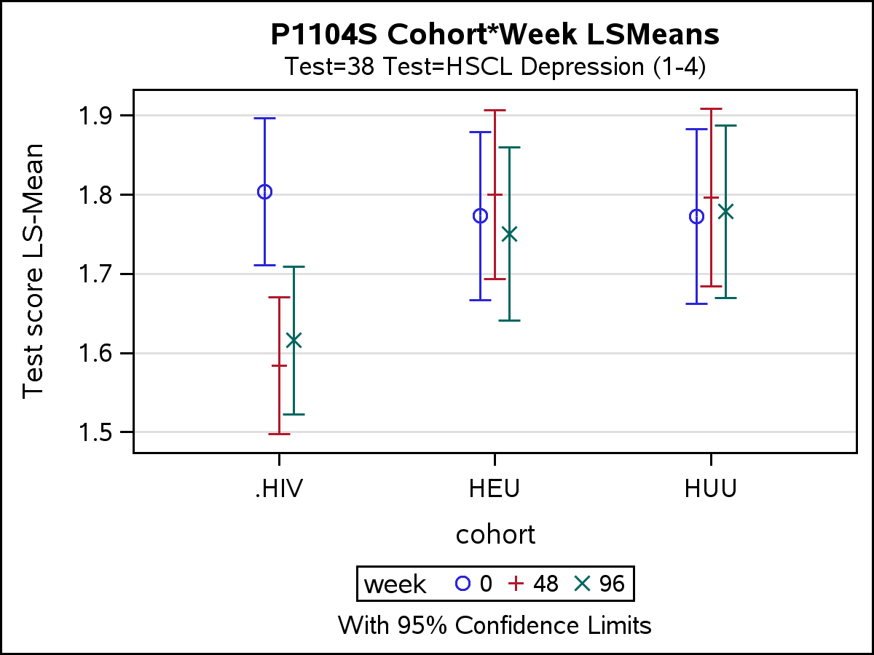
Caregiver Changes in Anxiety and Depression at Baseline, 48, and 96 months

Slide 27
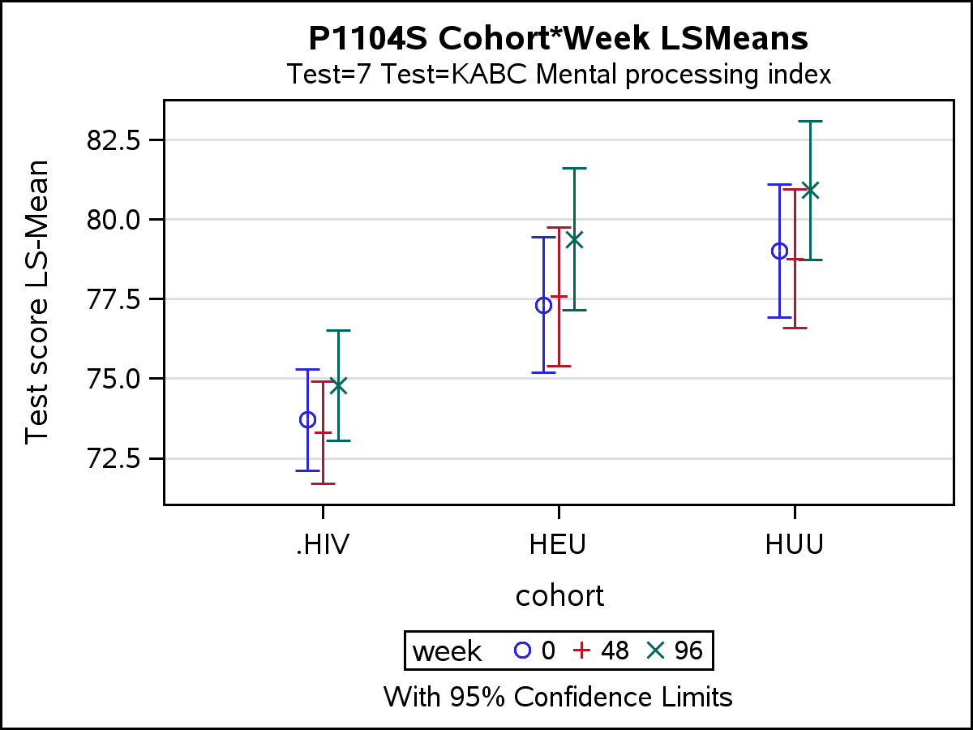
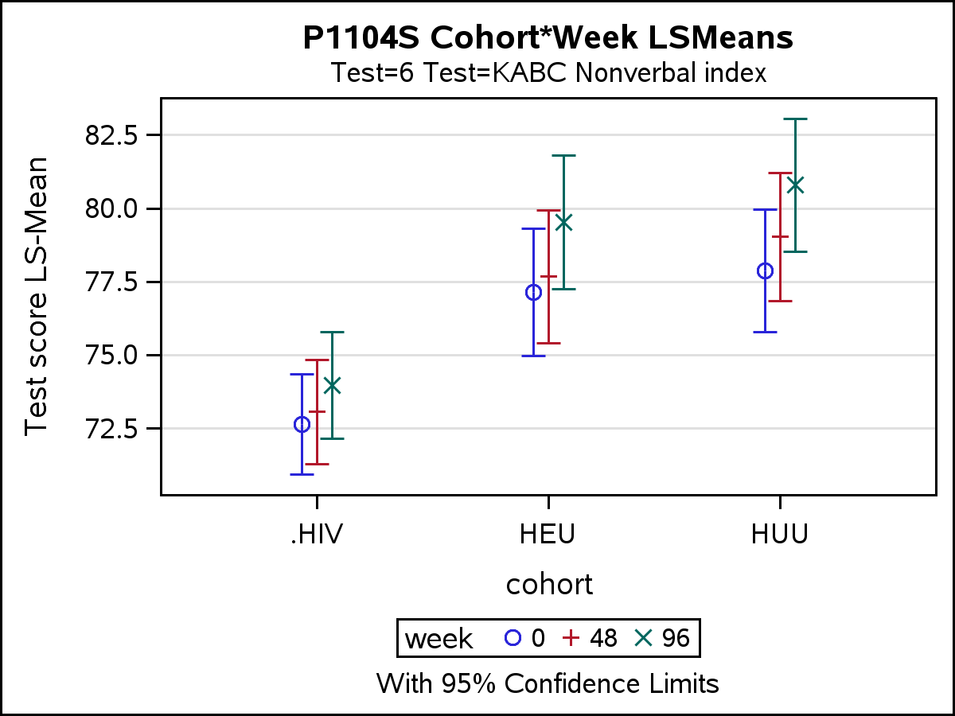
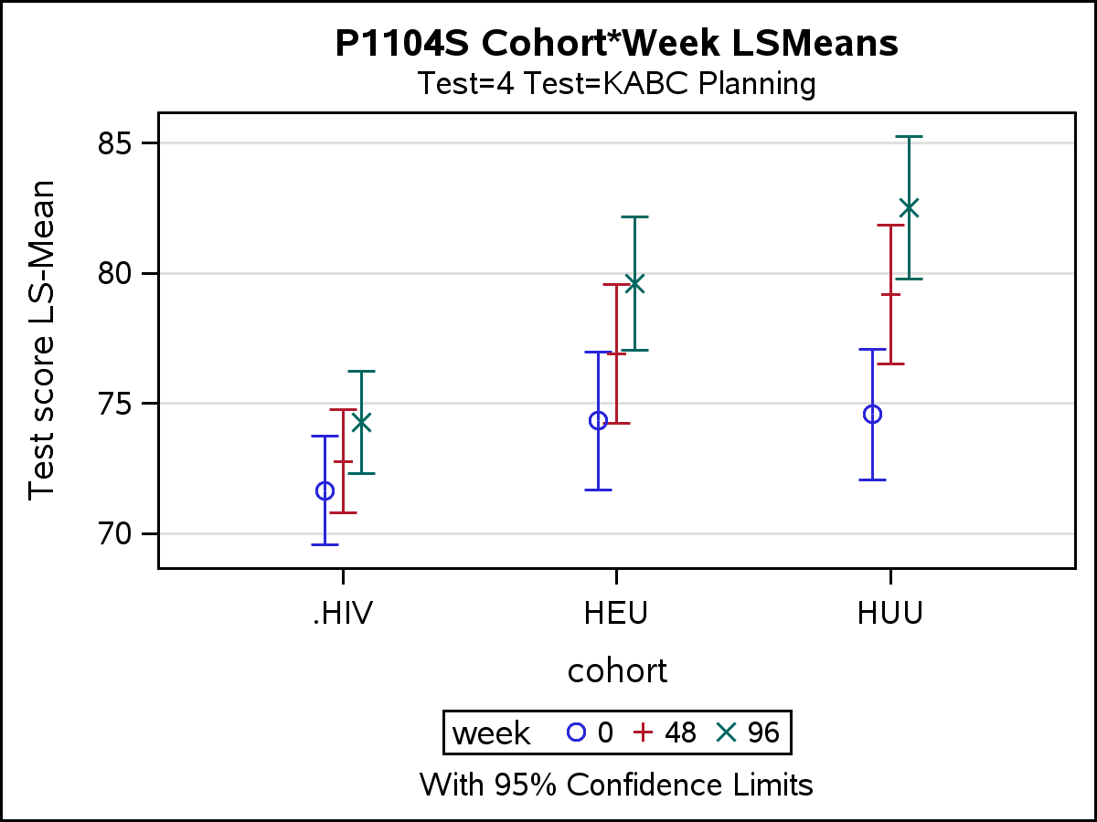
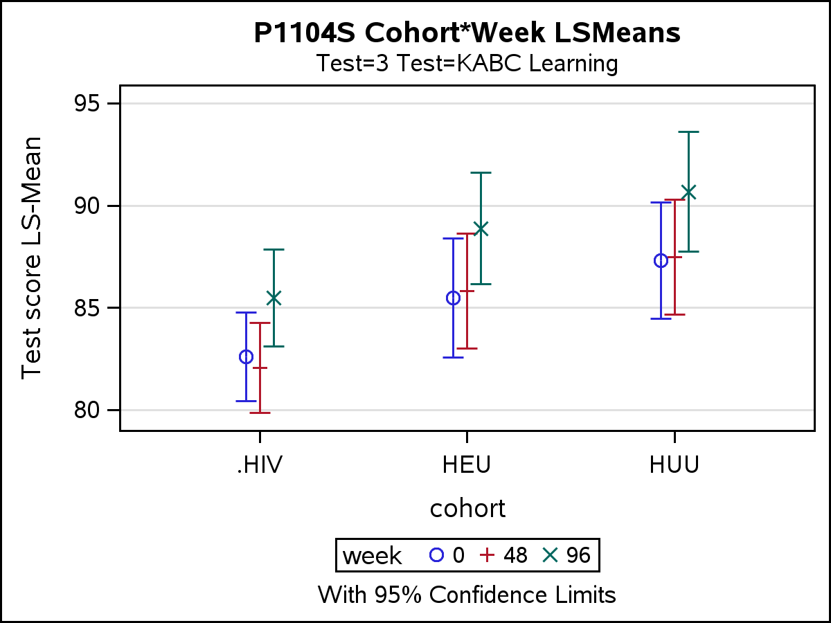

Slide 28
