Slide 1
Association of Maternal Viral Load and CD4 Count with Perinatal HIV-1 Transmission Risk during Breastfeeding in the PROMISE Postpartum Component
10th Workshop on HIV Pediatrics
July 20-21, 2018
Amsterdam, the Netherlands
Patricia M. Flynn, MD, Taha E Taha, MD, Mae Cababasay, MS, Kevin Butler, MS, Mary Glenn Fowler, MD, Lynne M. Mofenson, MD, Maxensia Owor, MD, Susan Fiscus, PhD, Lynda Stranix-Chibanda, MD, Anna Coutsoudis, PhD, Devasena Gnanashanmugam, MD, Nahida Chakhtoura, MD, Katie McCarthy, MPH, Cornelius Mukuzunga, MD, Bonus Makanani, MD, Dhayendre Moodley, PhD, Teacler Nematadzira, MD, Bangani Kusakara, MD, Sandesh Patil, MD, Tichaona Vhembo, MD, Raziya Bobat, MD, Blandina T Mmbaga, MD, Maysseb Masenya, MD, Mandisa Nyati, MD, Gerhard Theron, MD, Helen Mulenga, MD, David E. Shapiro, PhD and the PROMISE Study Team

Slide 2
Disclosures
Dr. Flynn is a paid consultant for Merck and receives royalties from Up to Date.

Slide 3
Background
Increased maternal viral load (MVL) and decreased CD4 cell counts (CD4) have been associated with increased risk of perinatal and postnatal HIV-1 transmission
Women with CD4 ≥350 cells/mm³
Antepartum
(14 wk-term)
Labor & Delivery
Postpartum
(for duration of breastfeeding)
Maternal Health
(after breastfeeding cessation)
R
A
N
D
O
M
I
Z
E
Continue
ART
R
A
N
D
O
M
I
Z
E
ZDV/3TC/LPVr
ZDV-ART
R
A
N
D
O
M
I
Z
E
Maternal TDF/FTC/LPVr
(mART)
Stop ART
TDF/FTC/LPVr
TDF-ART
Infant NVP
(iNVP)
ZDV Alone
ZDV + sdNVP
Late Presenting Mothers

Slide 4
PROMISE – Postpartum Component
Eligible mother-infant (M-I) pairs (maternal CD4 ≥ 350 cells/mm³ or country-specific level and infant HIV-1 NAT negative and > 2 kg) were randomized at 6 – 14 days postpartum to a maternal three-drug ART regimen (TDF/FTC/LPVr preferred, mART) arm or infant nevirapine (iNVP) arm
Infants in the mART arm also received NVP for 6 weeks
Late-presenting women were enrolled during labor or within 6 days of delivery after assuring the mother’s CD4 count met eligibility criteria and infant had a negative HIV-1 NAT
Maternal prophylaxis during breastfeeding (TDF/FTC/LPVr)
Postpartum Component Screening
Randomize
Infant prophylaxis during breastfeeding (NVP)

Slide 5
PROMISE – Postpartum Component
2,431 M-I pairs were randomized at 6-14 days postpartum to mART (n=1,220) or iNVP (n=1,211) at 14 sites in 7 countries
95% of the mothers had been enrolled in the antepartum component (42% ZDV and 53% mART)
Randomized regimens were continued until 18 months postpartum, unless stopped earlier due to cessation of breastfeeding, infant HIV-1 infection, or toxicity

Slide 6
PROMISE – Postpartum Component, Primary Analysis Findings
The primary analysis of the postpartum component has been reported (J Acquir Immune Defic Syndr. 2018 Apr 1;77(4):383-392)
Both regimens were safe and associated with very low postpartum transmission rates (mART , 0.57% and iNVP, 0.58%; hazard ratio [HR] 1.0, 96% repeated confidence interval 0.3-3.1)
Infant HIV-1-free survival was high (97.1%, mART and 97.7%, iNVP, at 24 months)
This planned secondary analysis examines the relationship between MVL and CD4 with HIV-1 transmission during breastfeeding

Slide 7
Methods
Study Evaluations
Maternal Viral Load | Entry (6-14 days postpartum), weeks 6, 14, 26, and 50 postpartum
Maternal CD4 | Entry, weeks 14, 26, 38, 50 postpartum
Infant HIV-1 NAT | Entry (6-14 days postpartum), week 6, every 4 weeks until week 26, then every 12 weeks
Infant infection was defined as a positive HIV-1 NAT at any two post-entry timepoints
The associations of baseline and time-varying MVL (<1000 or ≥1,000 copies/ml) and CD4 (< 500 or ≥ 500 cells/mm³) with transmission risk were assessed using proportional hazards regression models and adjustment for randomization to the mART arm during the antepartum component of PROMISE

Slide 8
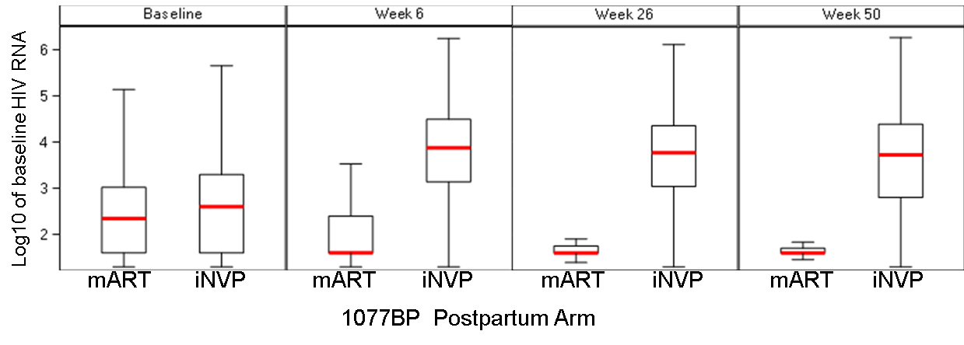
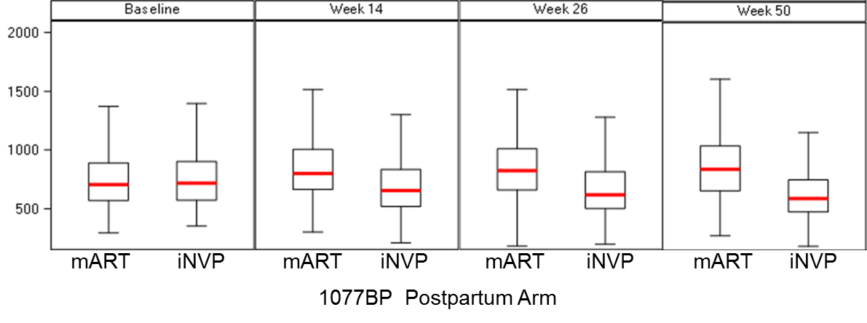
Analysis
For analyses using time-varying MVL and CD4, each treatment arm was analyzed separately because the post-randomization visits showed little overlap between the two arms with respect to MVL and CD4 cell count
Log 10 HIV RNA
CD4 cell/mm³

Slide 9
Results
Baseline MVL and CD4 cell count by Treatment Arm
 | mART n=1,220 | iNVP n=1,211
Baseline Maternal Viral Load
< 1,000 copies/mL | 911 (75%) | 814 (67%)
≥ 1,000 copies/mL | 309 (25%) | 397 (33%)
Baseline CD4 count
< 500 cells/mm³ | 162 (13%) | 170 (14%)
≥ 500 cells/mm³ | 1,058 (87%) | 1,041 (86%)
Baseline MVL (p=0.11) and CD4 cell count (p=0.51) were not significantly associated with infant HIV-1 transmission

Slide 10
Results, continued
Time-varying MVL was significantly associated with infant HIV-1 infection in the mART arm but not in the iNVP arm
Time-varying CD4 was significantly associated with infant HIV-1 infection in the mART arm but not in the iNVP arm
 | Hazards Ratio (95% Confidence Interval)
 | mART | iNVP
Time-varying MVL | 13.96 (3.12-62.45) | 1.04 (0.20-5.39)
Time-varying CD4 | 0.18 (0.03-0.93) | 0.38 (0.08-1.77
Adjusting for whether or not the mother was randomized to the mART arm in the antepartum component of PROMISE component did not change these findings

Slide 11
Results, continued
When both time-varying MVL and time-varying CD4 were in used in the model for infant HIV-1 infection in the mART arm, only MVL remained associated with infant HIV-1 infection (hazard ratio (95% CI): 11.57 (2.45,54.68)) and there was no association with maternal CD4 (hazard ratio (95% CI): 0.34 (0.06,1.88))
Adjusting for whether or not the mother was randomized to the mART arm in the antepartum component of PROMISE did not change these findings

Slide 12
Infant HIV-1 Infections
There were seven infants with HIV-1 infection in each treatment group​
 | mART | iNVP
HIV-1 infections | n=7 | n=7
Median infant age at first positive HIV-1 NAT | 38 weeks (range, 13-50 weeks) | 26 weeks (range, 6-74 weeks)
MVL closest and prior to first positive infant HIV-1 NAT | Not detected – 52,002 copies/mL | 815 – 153,963 copies/mL

Slide 13
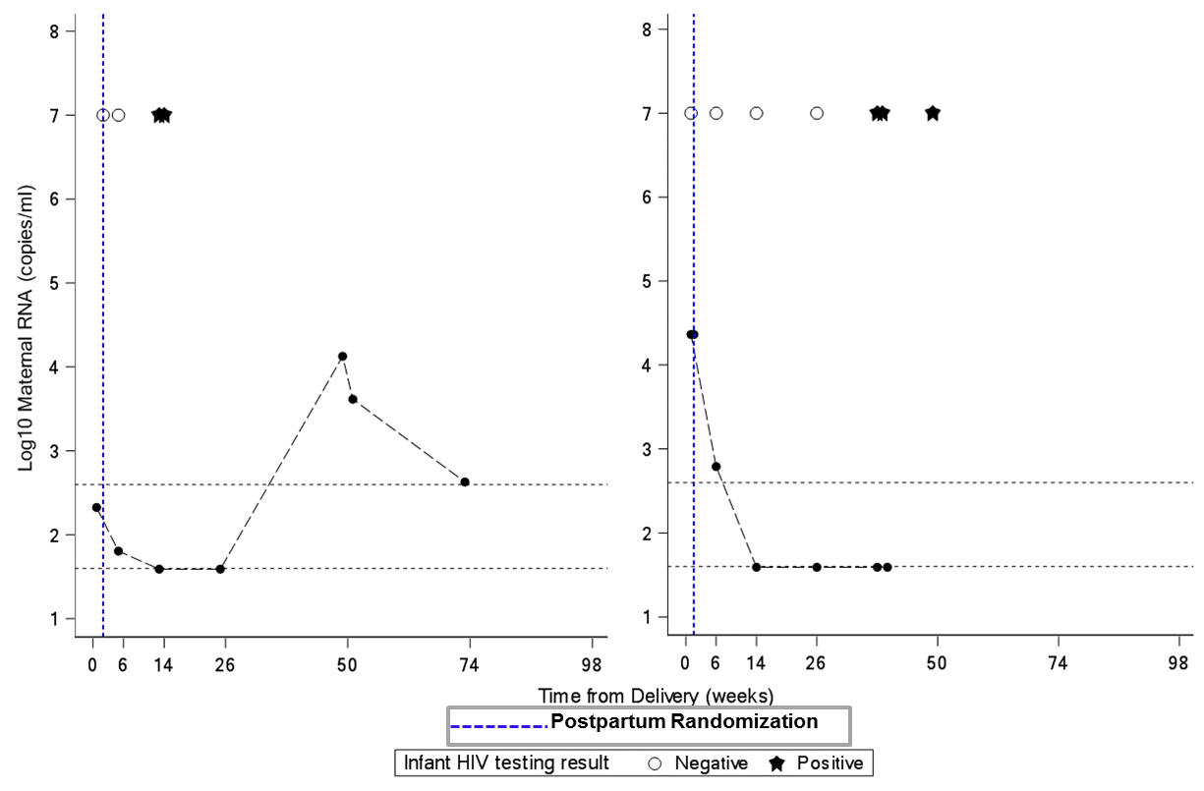
Results, continued
In the mART arm there were two infected infant cases where MVL was undetectable or < 40 copies/mL in assessments prior to first positive infant HIV-1 NAT
13 weeks
38 weeks
< 40 copies/mL
Not detected

Slide 14
Conclusions
In the iNVP arm, time-varying MVL and CD4 were not significantly associated with HIV-1 transmission during breastfeeding. However, in the mART arm, increased MVL and decreased CD4 during breastfeeding were associated with increased risk of infant HIV-1 infection​
Two infant transmissions were observed following periods of MVL that were < 40 copies/mL​
These data emphasize the important role of adherence to mART in controlling MVL and preventing infant HIV-1 infection and suggest that iNVP should be considered in situations with documented poor maternal ART adherence

Slide 15
Acknowledgements
The PROMISE protocol team gratefully acknowledges the dedication and commitment of the more than 3,500 mother-infant pairs without whom this study would not have been possible.​
Sponsors: US National Institutes of Health (K Klingman, R Browning, L Purdue, G Siberry); Protocol Chair and Vice Chairs: J McIntyre, T Chipato; Operations Center: M Allen, A Coletti, K George, M Valentine, V Toone; Statistical and Data Management Center: T Fenton, K Butler, M Qin, C Marr, C Tierney, S Brummel, K Angelidou, M Basar, L Marillo, A Manzella, A Zadzilka; Laboratory Center: A Loftis; CMC: D Bhattacharya, R Hoffman, A Gupta, G Theron, B Chi, P Flynn, J Currier
Sponsors: US National Institutes of Health (K Klingman, R Browning, L Purdue, G Siberry); Protocol Chair and Vice Chairs: J McIntyre, T Chipato; Operations Center: M Allen, A Coletti, K George, M Valentine, V Hardy; Statistical and Data Management Center: T Fenton, K Butler, M Qin, C Marr, C Tierney, S Brummel, K Angelidou, M Basar, L Marillo, A Manzella, A Zadzilka; Laboratory Center: A Loftis; CMC: D Bhattacharya, R Hoffman, A Gupta, G Theron, B Chi, P Flynn, J Currier; Principal Investigators: P Sambarey, B Makanani, M Mallewa, F Martinson, A Violari, L Fairlie, A Coovadia, P Mlay, M Mbewe, B Chi

