Slide 1
Welcome to the webinar!
The session will begin shortly.
Please mute your phone line (*6) to improve sound quality during the session.
Do not place your phone line on hold during the session.

Slide 2
Updated Emergency Unblinding Procedures for IMPAACT 2018
Laura Smith, IMPAACT Chief Data Manager

Slide 3
Reminder: Document this training!
Site IoRs are responsible for ensuring that study staff members are adequately trained to serve their designated site- and study-specific functions.
Per the DAIDS policy on Requirements for Manual of Operational Procedures, all sites must establish and follow a standard operating procedure (SOP) for personnel training and certification documentation.
Site IoRs are responsible for documenting that each study staff member has completed study-specific training corresponding to his or her designated roles and responsibilities. This documentation must be on file at the site and available for inspection/monitoring at any time.

Slide 4
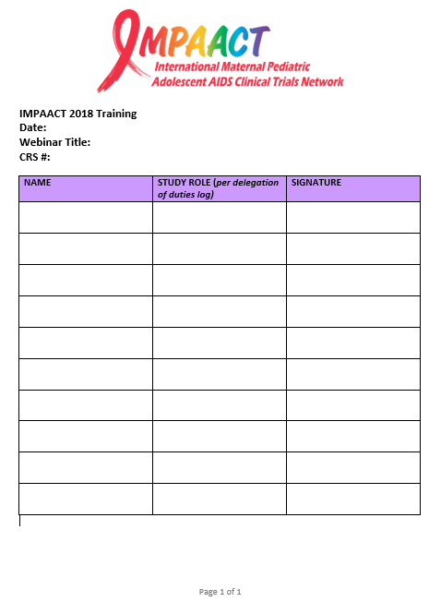
Reminder: Document this training!
The Ops Center will provide an email documenting that the training was conducted.
Sites: you are responsible for documenting individual staff attendance of this webinar.
A sample sign-in log is shown here, but any format consistent with site SOPs may be used.

Slide 5
Overview of Today’s Discussion
Background on unblinding
Key resources
Emergency unblinding updates
Questions

Slide 6
Background
In July 2018, provisions for emergency unblinding were implemented within the IMPAACT network.
The site Investigator of Record (IoR) or designee is now able to obtain a participant’s treatment assignment if needed immediately to guide management of a serious illness or medical emergency occurring in a study participant from the site Pharmacist of Record (PoR) or the Data Management Center (DMC) — independent of the study sponsor or Protocol Team.

Slide 7
Reason For Today’s Training
In July 2018, training on the unblinding procedures occurred for IMPAACT 2018
Explained the steps on contacting the DMC for emergency unblinding
The procedures for emergency unblinding requests have been updated
This training will explain the updated steps for contacting the DMC for emergency unblindings

Slide 8
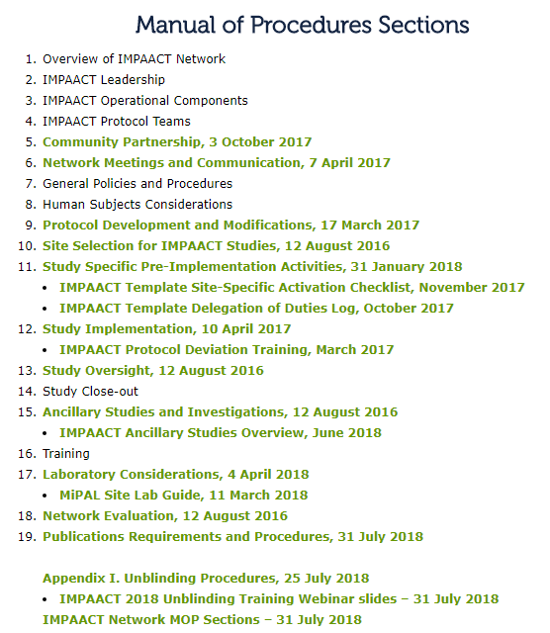
Key Resources
IMPAACT Network Manual of Procedures (MOP), Appendix I: Unblinding Procedures: https://impaactnetwork.org/resources/policies-procedures.htm
Update when MOP is updated

Slide 9
Key Resources
Email the IMPAACT 2018 Protocol Team with any questions: IMPAACT.team2018@fstrf.org

Slide 10
*IMPORTANT NOTES*
The need for emergency unblinding of individual participant treatment assignments is expected to be extremely rare.
Early unblinding of an individual participant’s treatment assignment for non-urgent medical/safety reasons is different than emergency unblinding.

Slide 11
Early Unblinding for Non-Urgent Medical/Safety Reasons
Different than emergency unblinding
Non-urgent, unplanned unblinding prior to full study unblinding
Performed for reasons that are not urgent and would not affect immediate medical management but may affect other aspects of a participant’s medical care/safety
Examples and procedures for early unblinding are included in the IMPAACT Network MOP Appendix I; this training focuses on emergency unblinding updates

Slide 12
Emergency Unblinding
Urgent, unplanned unblinding prior to full study unblinding
Performed to protect participant safety when, as determined by the site Investigator of Record (IoR) or designee, knowing the participant’s treatment assignment would affect immediate medical management of the participant, e.g., for drug identity during an acute reaction.

Slide 13
Emergency Unblinding Roles
Site Investigator of Record (IoR) (or designee)
Site Pharmacist of Record (PoR)
Data Management Center (DMC) User Support

Slide 14
Emergency Unblinding Request: PoR
Site IoR (or designee) sends written request for unblinding to site PoR
Request contains the following information:
Name of caller
IoR
Phone Number
Email Address
Study
Step (if applicable)
Site
Patid
Reason for unblinding
Site PoR provides participant’s treatment assignment directly to requesting IoR or designee in writing

Slide 15
Emergency Unblinding Procedure – Emergency Unblinding Utility
If the PoR is not available, the IoR or designee uses the new Emergency Unblinding Utility
Obtain treatment assignment through the Emergency Unblinding Utility on the DMC Portal (www.frontierscience.org)
Site IoRs listed in CRMS given permission for the portal utility
Designees must request Emergency Unblinding Utility access through DMC User Support
Access provided upon approval by IoR

Slide 16
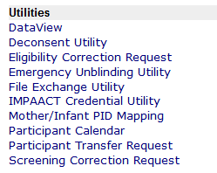
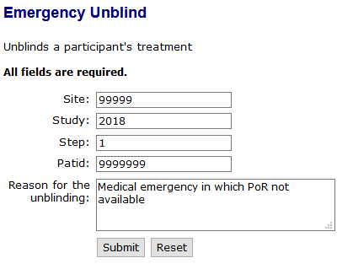
Emergency Unblinding Utility Submission
www.frontierscience.org
NEW

Slide 17
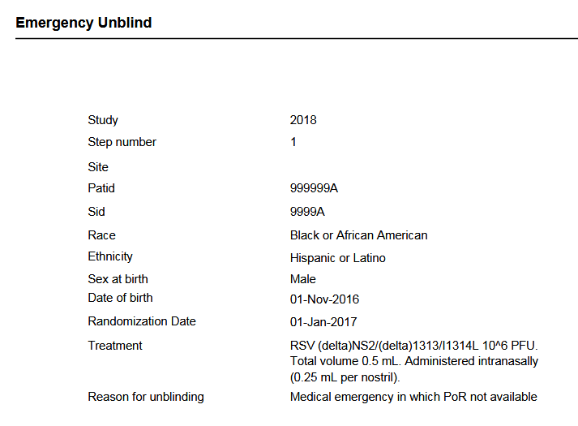
Emergency Unblinding Utility Output
PDF output upon submission

Slide 18
Emergency Unblinding Utility Message
Email message to requester (includes treatment):

Slide 19
Emergency Unblinding Utility Message
Email message to 2018 Core Team (does not include treatment):

Slide 20
Emergency Unblinding Written Request- Written
Site PoR not available AND IoR or designee does not have access to the Emergency Unblinding Utility:
Site IoR (or designee) sends written request for unblinding to DMC User Support
Also alerts DMC User Support via phone
Written request contains the following information:
Name
Phone Number
Email Address
Study
Step (if applicable)
Site
Patid
Reason for unblinding

Slide 21
Emergency Unblinding Written Request- Oral
In An Extreme Medical Emergency
The Site IoR or designee may orally request DMC User Support to unblind the participant prior to providing the written request
The written request must be sent to DMC User Support and the Chief Data Manager within 24 hours of unblinding

Slide 22
Emergency Unblinding: DMC Provision of Treatment Assignment
The DMC will deliver the treatment assignment to the requestor in writing
If it is not possible for the treatment assignment to be delivered to the requester by the DMC in writing, it should be provided orally
The DMC will also provide a written confirmation of the unblinded treatment to the requestor within 24 hours

Slide 23
DMC User Support Contact
User Support 24/7*
Telephone: 716-834-0900, ext. 7301
user.support@fstrf.org
* With the exception of five US holidays

Slide 24
Questions?

