Slide 1



Allopregnanolone for Treatment of PTSD and Comorbid Psychiatric,
Substance Use and Medical Conditions: Important Considerations
Ann M. Rasmusson, MD
*VA National Center for PTSD, Women’s Health Science Division, VA Boston Healthcare System, Boston, MA 02130, U.S.A.
Professor, Department of Psychiatry, Chobanian & Avedisian Boston University School of Medicine, Boston, MA 02118, U.S.A.

Slide 2
Support
VA National Center for PTSD:
Clinical Neuroscience Division (Yale University & VA Connecticut Healthcare System)
Women’s Health Science Division (Boston University & VA Boston Healthcare System)
VA CSR&D Merit Reviews (Rasmusson)
ORWH & NIDA: 1K12DA14038-01
NIMH MH49486 & MH56890
NIMH R21MH31113
VA/DOD INTRuST Clinical Consortium
VA CSR&D CDA-2 (Pineles)
NIMH 1R01MH122867-01 (Rasmusson)

Slide 3
Government, Foundation, Commercial & Academic Disclosures
(past 3 years)
DOD Integrated Product Team for Development of PTSD Therapeutics (Unpaid Consultant)
DOD Adaptive Platform Trial for PTSD - Lead for Biomarker Working Group (Unpaid Consultant)
NIMH 1R01MH122867-01(Rasmusson) 05/01/2020-04/30/2025
“Facilitation of Extinction Retention and Reconsolidation Blockade in PTSD by Intravenous Allopregnanolone”

Slide 4

“ALLO”: Allopregnanolone (Allo) + Pregnanolone (PA)
Equipotent stereoisomeric metabolites of progesterone that positively modulate effects of GABA at GABA_{A} receptors

Slide 5
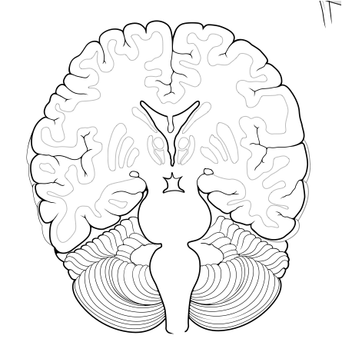
ALLO IS SYNTHESIZED IN
BRAIN, ADRENAL GLANDS, OVARIES & TESTES
Hypothalamus
Hypothalamus
CRF
(+)
STRESS
Pituitary
(+/-)
ACTH
(+)
(+)
DHEA/
Cortisol
ALLO/NPY
Adrenals

Slide 6
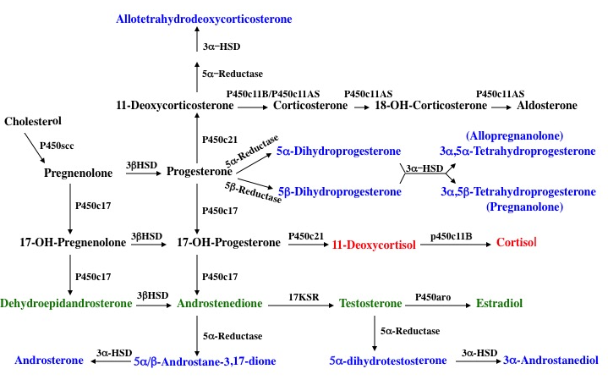
GABAergic Neurosteroid Synthesis Pathways
Adrenals: ACTH
Gonads: LH
Brain: NMDA-R
3ΒHSD3ΒHSD
3ΒHSD3ΒHSD
3ΒHSD
3ΒHSD 3ΒHSD

Slide 7
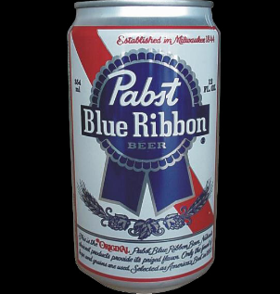
Some Factors that Influence Synthesis of ALLO
Cortisol upregulates
Testosterone upregulates in men
Estradiol upregulates in women
OCT transcription factors bind to NRE may & may reduce constitutive levels
Progesterone, DHEA in both sexes
3α-HSD Gene
NADPH Oxidase
Cagetti E et al., 2004.
STRESS
Finasteride: Propecia & Proscar
NADPH
NADP⁺
5α-Reductase
3α-HSD Enzyme
Progesterone
5α−DHP
Allopregnanolone & Pregnanolone

Slide 8
Prevalence of Posttraumatic Stress Disorder in United States
8.3% of the general U.S. population
11.0% of women and 5.4% of men¹
15-20% of individuals exposed to particularly high-risk trauma
  Combat
  Sexual assault
  Compound community trauma

Slide 9
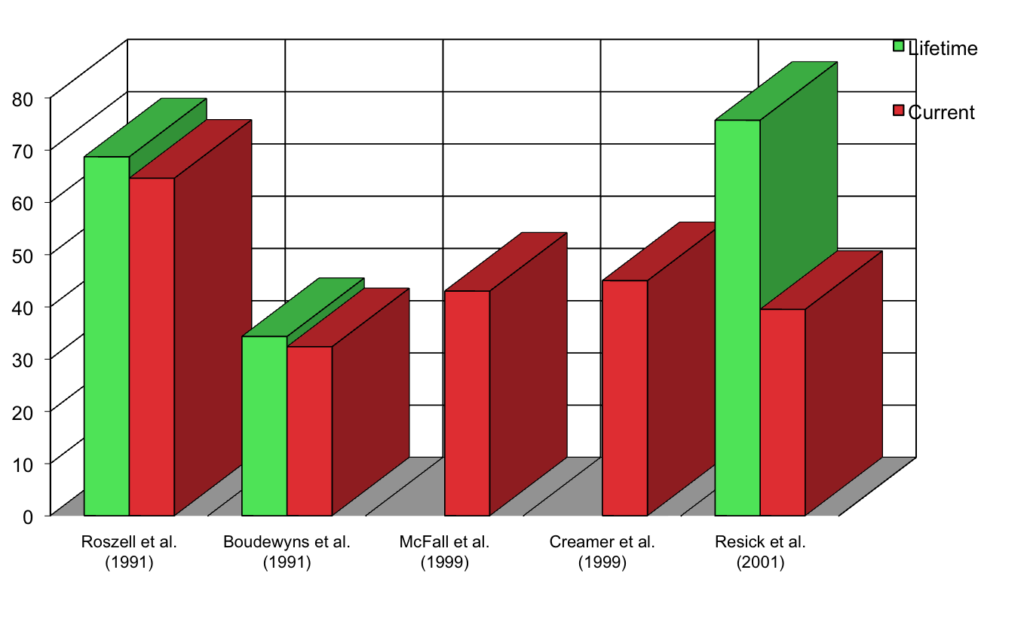
PTSD and Depression Comorbidity
(Treatment Seeking Samples)
Courtesy of Patricia Resick
Notes:
Roszell et al. (1991) - N=116, Mean age=41 +/-3.2 yrs., Vietnam Veterans (Male). DSM-III-R, Mississippi Scale for Combat Related PTSD, Mean age of onset of Sx = 23.5.
Boudewyns et al. (1991) - N=102, treatment-seeking Vietnam Veterans (Male), inpatient. Subset of the Augusta War Trauma Project. DIS “Current” = in past month.
McFall et al. (1999) - N=228, Mean age= 46 +/- 2.5 yrs., Vietnam Veterans, seeking inpatient tx. DSM-III-R, Brief M-PTSD & Standard Clinical Interview(?) “Affective Disorder”, current(?).
Creamer et al. (1999) - N=419, Mean age=50 +/- 3.7 yrs., Australian Vietnam Veterans completing a 12 week hospital-based program(mixed inpatient & outpatient treatment), PCL (PTSD checklist), Questionnaires used to determine PTSD and comorbid conditions.
Resick et al. 290 rape victims. Mean age 32. CPT vs. PE. Current MDD/PTSD

Slide 10
Major Depression without PTSD is
Empty Chi Square Cell After Trauma
No Diagnosis
PTSD Alone
PTSD + Major Depression
Rates of major depressive disorder (MDD) are ~5% prior to trauma. After trauma, rates of MDD increases to ~20%, but almost all of the increase is accounted for by MDD comorbid with PTSD.
Rates of MDD alone after trauma remain at ~5%.

Slide 11
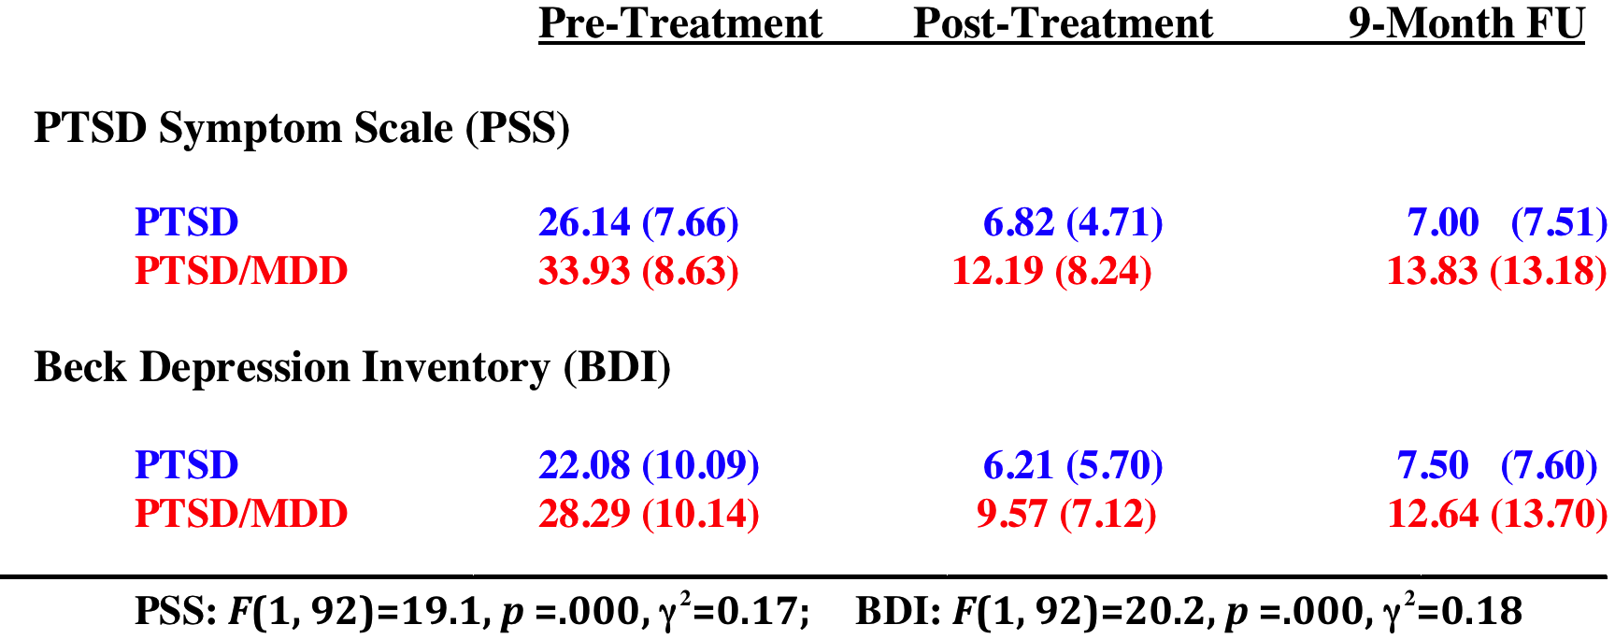
Higher PTSD & Depression Symptoms Before & After Cognitive Processing Therapy (CPT) in Comorbid PTSD/MDD
Nishith et al., 2005

Slide 12
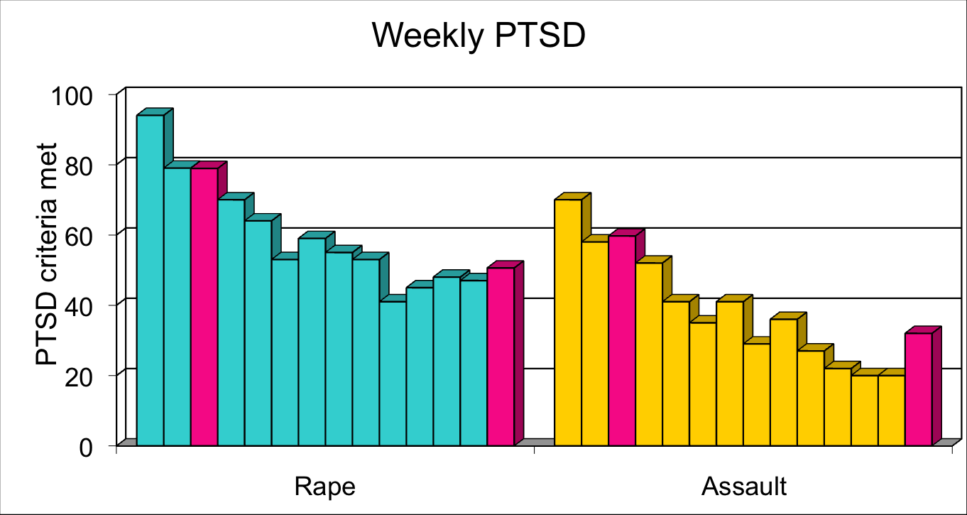
Natural Recovery From PTSD from Trauma is “Normal”
2
12
2
12
= Rothbaum et al
= Resick et al.
= Riggs et al.
Notes:
Here is a prospective study conducted by Edna Foa and her colleagues with sexual assault (teal) and physical assault victims (yellow) who were assessed for symptoms of PTSD weekly from the time of the assault. .
This is the % of women who met the symptom criteria for PTSD at each interval. Notice, that in the most homogeneous event, rape, 94% met all the symptom criteria for PTSD at one week post-crime and that they recover naturally over the three months of the study.
The assault victims, a more heterogeneous group show the same pattern but start at a lower point.
The bars in pink are from a study that Patricia Resick conducted with 200 rape and assault victims inserted at the appropriate intervals. Please note, that the data map onto the other study very closely.

Slide 13
What Gets in the Way of Recovery from PTSD?
Avoidance of Reprocessing and Extinction
Ongoing Psychosocial Stress
Neurobiological Vulnerabilities

Slide 14
CPT Study Outcomes: Civilian
Baseline CAPS Scores 67-76 og
assault survivors

Slide 15
CPT Study Outcomes: Military/Veteran
Baseline CAPS Scores 67-84

Slide 16
What Gets in the Way of Recovery from PTSD?
Avoidance of Reprocessing and Extinction
Ongoing Psychosocial Stress
Neurobiological Vulnerabilities

Slide 17
Serotonin
Dopamine
Glutamate
Neurotransmitters/Receptors
Norepinephrine
Aspartate
Epinephrine
Gamma-amino-butyric acid (GABA)

Slide 18
DA
NE
5HT
Mild to Moderate Stress Normally regulated:
information processing &
sympathetic nervous system,
cardiovascular system,
HPA axis, and
behavioral reactivity
NE
NE
DA
PFC
5HT
5HT
NE
Increased α₁/α₂
Increased DA₁
DA
Increased 5HT_{2A}
BL
CE
NE
A Arnsten et al, 2009
VTA
Raphe
CS
US
CS
LC
Goldstein, Rasmusson, Bunney, Roth: J. Neuroscience, 1996
Arnsten AFT: Nat. Rev. Neurosci., 2009

Slide 19
NE
DA
DA
NE
DA
Extreme Unconditioned Stress
NE
5HT
information processing
Sympathetic nervous activity
HR & BP
HPA axis activity,
Reflexive defensive behavior
(fight, flight, freeze, faint)
DA
NE
NE
5HT
NE
NE
5HT
PFC
5HT
5HT
DA
NE
5HT
Increased α₁/α₂
NE
Increased DA₁
DA
Increased 5HT_{2A}
BL
CE
DA
Associative LTP
NE
5HT
VTA
Raphe
CS
US
CS
LC
Goldstein, Rasmusson, Bunney, Roth: J. Neuroscience, 1996
Arnsten AFT: Nat. Rev. Neurosci., 2009

Slide 20
Optimization/Deterioration of Frontal Lobe Executive Capacities is a Function of Stress /Arousal: Inverted U-Shaped Curve
PFC Function
Sweet Spot
PFC Function
Deterioration
Inhibition of reflexive defense reactions
Critical evaluative thinking & guided behavior
Inhibition of reflexive defense reactions
Critical evaluative thinking & guided behavior
Stress >>>>>>> Arousal

Slide 21
Frontal Lobe/Hippocampal
Reprocessing & Inhibition
imbalance
Amygdalar Reactivity

Slide 22
What regulates the release of monoamines and their persistence in neuronal synapses?

Slide 23
GABA
GABAergic Neuroactive Steroids
Serotonin Reuptake Inhibitors
Neuropeptides
Neuroactive steroids
Transporters & Transporter Blockers
Metabolic Enzymes
Monoamine Receptor
Agonists &Antagonists
Cortisol
Neuropeptide Y (NPY)

Slide 24
Changes in GABA Transmission in Amygdala after Fear Conditioning and GABA Receptor Subtypes in Hippocampus after Stress
Decreased expression of GABA synthesizing enzyme genes
Decreased NE a₁-stimulated GABA release from BLA interneurons
Downregulated gephyrin (protein that anchors synaptic GABA_{A} receptors)
Chronic stress results in suppression of tonic GABAA-receptor mediated currents in lateral amygdala
‘Benzodiazepine-sensitive’ synaptic GABA_{A} receptors (γ2 subunits) downregulated by stress in hippocampus; provide ‘phasic inhibition’.
‘Benzodiazepine-insensitive’ extrasynaptic GABA_{A} receptors (δ subunits) upregulated by stress in hippocampus. Provide ‘tonic inhibition’. Have increased sensitivity to alcohol and GABAergic neurosteroids, which may be downregulated by stress.
Martijena et al., 2002; Braga et al., 2003; Chhatwal et al., 2005; Heldt and Ressler, 2005; Mody and McGuire, 2012; Liu et al, 2014

Slide 25
Allo and PA equipotently facilitate effects of GABA at GABA_{A} receptors (increases neuronal Cl⁻ influx 7-10 times).
Deficient Allo + PA Synthesis Capacity
Rasmusson et al., 2006, 2019 (CSF) Pineles et al., 2018 (plasma)
Pinna & Rasmusson, 2014 (male mice)
Pineles et al., 2020 (females with PTSD)
Increased PTSD Symptom Severity
Impaired Extinction Retention
Shalev et al., 2019
Chronic PTSD

Slide 26
Intense stress
Social isolation
Heavy alcohol use (reduces co-factor NADPH; likely other mechanisms)
Oral contraceptives (combination)
Suppression of HPA axis reactivity: dependent nicotine/opiate use, chronic psychotropics medications: benzodiazepines, antidepressants, neuroleptics
(Zhang et al., 2014; Pibiri et al., 2008; Cagetti et al., 2004; Graham & Milad, 2013; Rasmusson et al., 2003; Rasmusson: preliminary data re: for effects of combined oral contraceptives on adrenal synthesis)
Causes of GABAergic Neurosteroid Synthesis Deficiency
Genetic: many polymorphisms of 5α-reductase gene 1 & 2
Epigenetic: not yet studied
C. Experiential:

Slide 27
Allopregnanolone: Broad Impact
* Anticonvulsant
*Anxiolytic, antidepressant, anti-conflict
*Modulates the intensity of defensive conditioned stress reactions
*Neuroprotective and regenerative: protects against ischemic and blunt trauma-induced
brain injury, reduces apoptosis, supports neurogenesis (e.g., Djebaili et al., 2005; Wang et al., 2005)
*Critical for myelination
*Provides “long-loop” negative feedback to HPA axis
*Reduces pain at spinal and supra-spinal levels; anesthetic
*Increases CD55, which limits complement-mediated neuroinflammation (VanLandingham et al., 2007)
*Inhibits MyD88-dependent inflammatory pathways in macrophages and brain (Balan et al., 2020)
*Inhibits IL-6 & metalloproteinases (MMP-9: limits blood-brain barrier disruption)
*Memory Effects: increases mature excitatory synapses on dendrites in hippocampus;
promotes long-term depression (LTD) and/or long-term potentiation (LTP)
interference; promotes extinction retention; enhances memory during proestrus
* Sedating, decreases latency to non-REM sleep, enhances stage 2 “spindle” sleep
which is also associated with memory consolidation

Slide 28
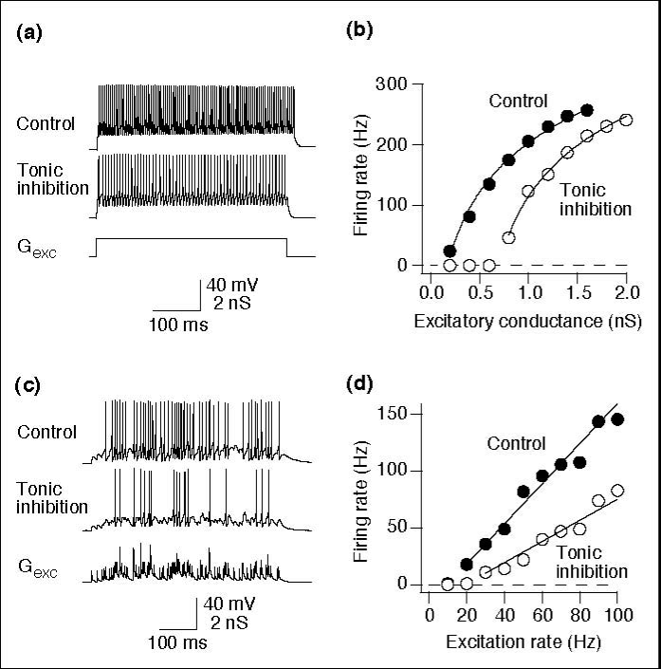
Extrasynaptic GABA_{A} Receptors Reduce Gain in Neuronal
Firing Rate as Neuronal Excitation Increases
Semyanov et al., 2004

Slide 29
Follicular Phase CSF Progesterone, 5α-DHP & (Allo+PA)
FOLLICULAR
PHASE
PROG 5α-DHP Allo+PA PROG 5α-DHP Allo+PA
No PTSD history
PTSD
N=10
N=9
N=10

Slide 30
PTSD allopregnanolone 39% of controls t = -2.77, p < 0.01
FOLLICULAR
PHASE
Fmol per ml
No PTSD history

Slide 31
SPEARMAN CORRELATIONS WITH CFA-DEFINED
PTSD SYMPTOM CLUSTERS (Simms et al., 2002)
 | ALLO | ALLO/DHEA
Re-experiencing Symptoms | -.72 (.03) | -.82 (.007)*

Slide 32
SPEARMAN CORRELATIONS WITH PROFILE OF MOOD STATE SCORES IN ALL PARTICIPANTS (n=19)
 | ALLO | ALLO/DHEA
Anger/Irritation | -.43 (.06) | -.57 (.01)^{t}
Anxiety/Tension | -.46 (.04) | -.50 (.03)
Confusion | -.31 (.20) | -.43 (.07)
Depression/Dejection | -.52 (.02) | -.70 (.0008)*
Fatigue | -.50 (.03) | -.63 (.004)*
Vigor | .23 (.34) | .03 (.90)
Total POMS | -.45 (.05) | -.52 (.02)

Slide 33
GABAergic Neurosteroid Synthesis Pathways
Adrenals: ACTH
Gonads: LH
Brain: NMDA-R
Block in Women
With PTSD
3ΒHSD3ΒHSD
3ΒHSD3ΒHSD
3ΒHSD
3ΒHSD 3ΒHSD

Slide 34
The 5α-DHP/(Allo+PA) Ratio
Current PTSD vs. No PTSD History: p = 0.006 (MW test)
No PTSD history or other current mental health disorder

Slide 35
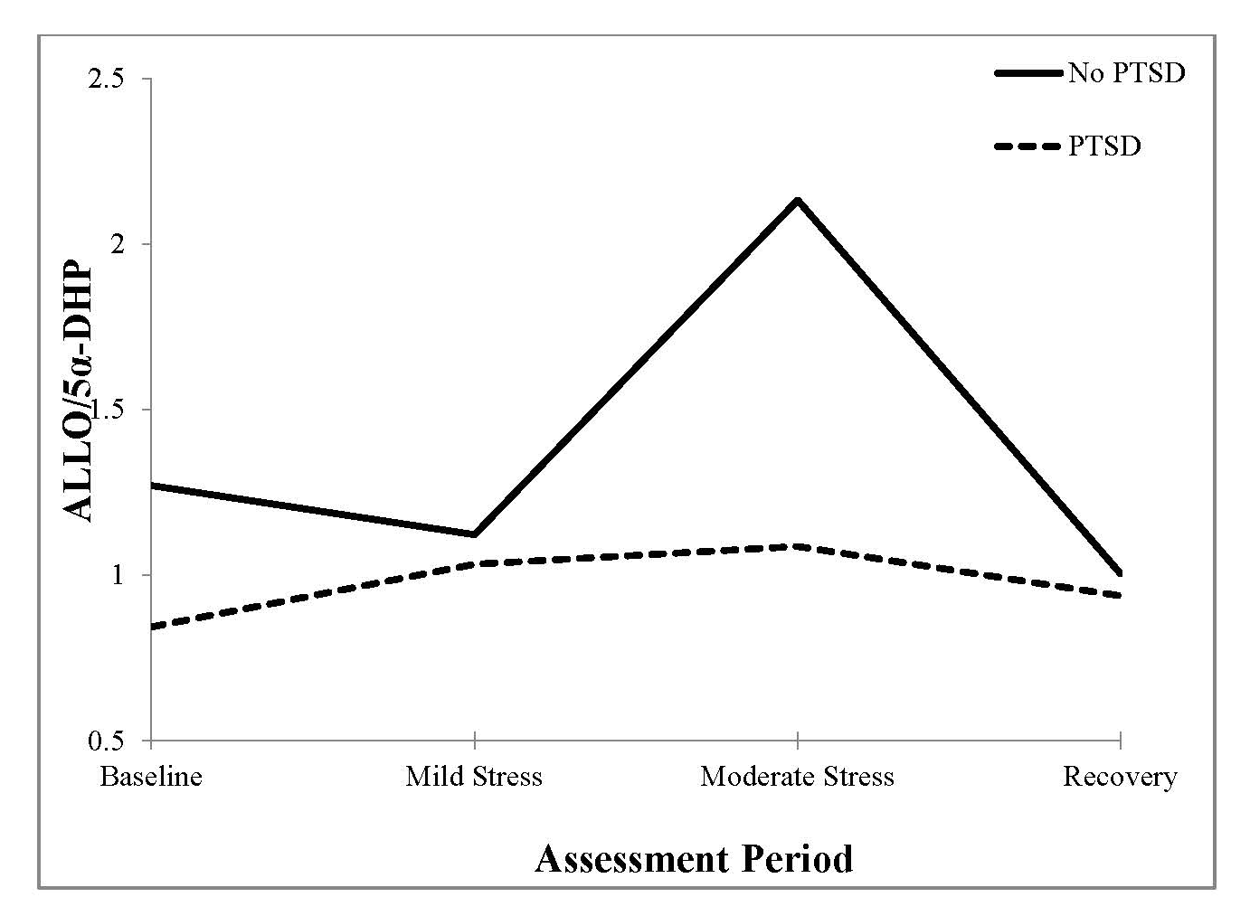
Low Plasma (Allo+PA)/5α-DHP Resting Levels & Reactivity
in Women with PTSD (Pineles et al., 2018)
PTSD: N=15
TC: N=21

Slide 36

Healthy Controls: Effects of Hormonal Contraception
Plasma Allopregnanolone + Pregnanolone (pg/mL)
+ Hormonal Contraception
ACTH
NuvaRing
ONovum
OTCyclen
OCyclen
OTCyclen
OEvraPatch
T-120’ T-90’ T-60’ T -30’ T- 0‘ T+30’ T+60’ T+90’

Slide 37
Allo+PA Correlates Negatively with CAPS Total Symptoms & Simms (2002) CFA-Symptom Clusters in Men
PTSD Symptoms | Spearman Correlation with Allo+PA (pg/mL)
CAPS Total | r = -0.74, p = 0.006
Reexperiencing | r = -0.51, p = 0.09
Active Avoidance | r = -0.27, p = 0.39
Arousal: Startle & Hypervigilance | r = -0.49, p = 0.11
Dysphoria | r = -0.71, p = 0.01

Slide 38
Allo+PA/DHEA Ratio Correlates Negatively with
CAPS Total & Simms (2002) Dysphoria Cluster Scores in Men
PTSD Symptoms | Spearman Correlation with Allo+PA (pg/mL)
CAPS Total | r = -0.74, p = 0.006
Reexperiencing
Active Avoidance
Arousal: Startle & Hypervigilance
Dysphoria | r = -0.79, p = 0.002

Slide 39
Controlling for plasma ACTH (i.e., stress), Allo+PA correlated negatively with CAPS total & Simms (2002) CFA-derived PTSD Dysphoria cluster scores
PTSD Symptoms | Spearman Correlation with Allo+PA (pg/mL)
CAPS Total | r = -0.82, p = 0.007
Reexperiencing | r = -0.55, p = 0.08
Active Avoidance | r = -0.25, p = 0.49
Arousal: Startle & Hypervigilance | r = -0.48, p = 0.14
Dysphoria | r = -0.88, p = 0.002

Slide 40
MEN & CSF ALLO
Factor Analysis-Defined PTSD SYMPTOM CLUSTERS
(Simms et al., 2002)
CAPS Total: Same
Reexperiencing: flashbacks, nightmares, intrusive thoughts, physiological and emotional reactivity to reminders of trauma
Active Avoidance: thoughts, feelings, activities, places, people
Arousal: startle & hypervigilance
Dysphoria: irritability, insomnia, poor concentration, limited range of emotions, decreased interest or participation in activities, inability to recall details of the trauma, sense of foreshortened future, feelings of estrangement

Slide 41
Block in ALLO Production at 5α-reductase in Men with PTSD
Block in ALLO Production at 5α-reductasth PTSD
5α-Reductase
3α - HSD
Progesterone
5α-Dihydroprogesterone
Allopregnanolone & Pregnanolone
5α-DHP/PROG Ratio | t = 2.09, p = 0.05
PTSD | 25.8
Trauma Control | 64.1
(Allo+PA)/5α-DHP Ratio | t = - 1.3, p = 0.21
PTSD | 0.36
Trauma Control | 0.13

Slide 42
GABAergic Neurosteroid Synthesis Pathways
Adrenals: ACTH
Gonads: LH
Brain: NMDA-R
Block in Men
With PTSD
3ΒHSD3ΒHSD
3ΒHSD3ΒHSD
3ΒHSD
3ΒHSD 3ΒHSD

Slide 43
ISTSS 2024: supported by the VA NC-PTSD, Women’s Health Science Division and an NICHD Career Award to Yael Nillni
Prediction of PTSD and depressive symptoms across pregnancy and at 6-weeks postpartum
by plasma GABAergic neurosteroid levels
Ann Rasmusson, MD, Graziano Pinna, Ph.D., Ni Pengsheng, Ph.D., Nina Cesare, Ph.D., Yael Nillni, Ph.D.
Cross-lag analyses of trauma-exposed participants with no PTSD history (n=46) and participants with PTSD (n=21) revealed that PTSD Check List (PCL) scores were predicted by the 5α-DHP/PROG ratio (t=-3.16, p < 0.003), which indexes function of 5α-reductase, the rate-limiting enzyme in GABAergic NS synthesis. A one standard deviation increase in the ratio in the PTSD group predicted an 8.8-point decrease in PCL scores the next trimester.
Paradoxically (so it seemed initially), increasing progesterone (t=2.20, p < 0.03), Allo+PA (t=2.12, p < 0.04), and the (Allo+PA)/ACTH ratio (t=2.24, p < 0.03) predicted increasing PCL scores.
However, further analyses revealed that an increasing sum of non-active 3β-isomers of Allo and PA (that compete for GABA_{A} receptor binding) (t=3.74; p = 0004) and a rising ratio of the a) sum of 3β-isomers to the b) sum of 3α-isomers (Allo and PA) (t=2.87, p < 0.006)— more strongly predicted increasing PCL scores. This implicates increasing 3β-HSD activity in worsening of PTSD across pregnancy. Similar effects on PHQ-9 scores were seen (t=2.37, p< 0.03) & ratio (t=2.57, p<0.02).

Slide 44
GABAergic Neurosteroid Synthesis Pathways
Adrenals: ACTH
Gonads: LH
Brain: NMDA-R
Block in men with PTSD and
women with worsening PTSD
across pregnancy into the postpartum
3ΒHSD3ΒHSD
3ΒHSD3ΒHSD
3ΒHSD
3ΒHSD 3ΒHSD

Slide 45
Increased inactive 3β-Isomers of Allo & PA Compete for GABA_{A} Receptor Binding
Increased 3β-HSD activity
implicated In worsening
PTSD across pregnancy.
Isoallopregnanolone
3β,5α-Tetrahydroprogesterone
Adrenals: ACTH
Gonads: LH
Brain: NMDA-R
Epipregnanolone
3β,5β-Tetrahydroprogesterone
3β-HSD
3ΒHSD3ΒHSD
3ΒHSD3ΒHSD
3ΒHSD
3ΒHSD 3ΒHSD

Slide 46
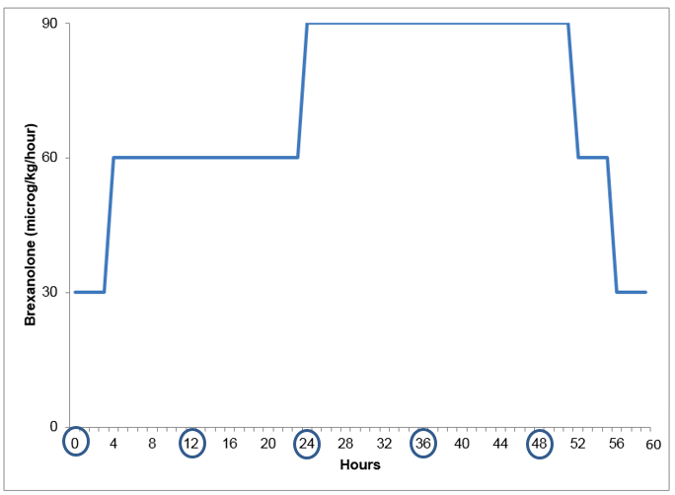
60-hour brexanolone infusion significantly reduced post-partum depression (PPD); therapeutic effects persisted up to 1 month; relapse in 6%.

Slide 47
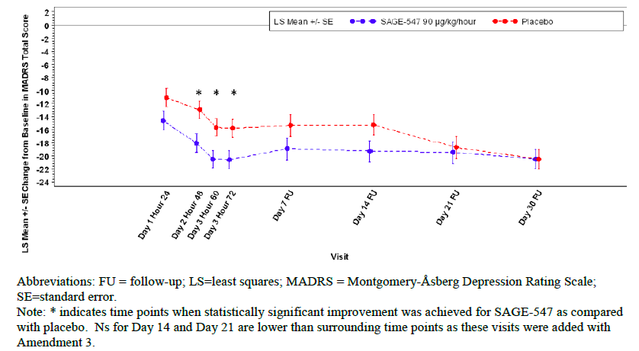
FDA Registrational Study: 202C

Slide 48
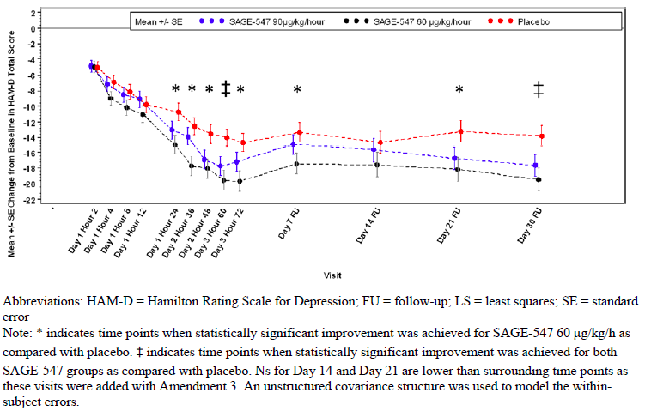
FDA Registrational Study: 202B

Slide 49
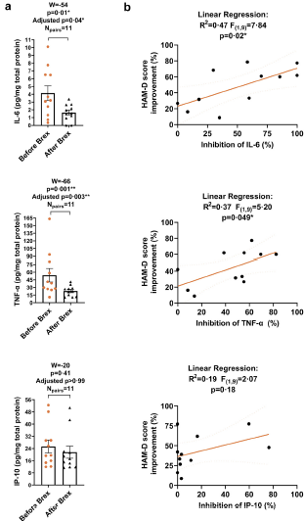
Balan et al., 2023
Decreases in serum IL-6 & TNF-α across open-label brexanolone treatment of PPD correlated with improvements in HAM-D scores (N=11; no placebo controls).
IL-6
TNF- α
2. Increased inhibition of TNF-α, IL-1β and IL-6 responses to lipopolysaccharide (LPS) and imiquimod (IMQ) correlated with decreases in HAM-D scores (p < 0.05) across treatment, suggesting that improvements in PPD were associated with modulation of TLR-4 and TLR-7 mediated immune responses.

Slide 50
Deficient Allo + PA Synthesis Capacity
Rasmusson et al., 2006, 2019 (CSF) Pineles et al., 2018 (plasma)
Pinna & Rasmusson, 2014 (male mice)
Pineles et al., 2020 (females with PTSD)
Increased PTSD Symptom Severity
Impaired Extinction Retention
Shalev et al., 2019
Chronic PTSD

Slide 51
Are impairments in extinction retention
due to roles of deficient Allo + PA synthesis capacity
in synaptic modulation & memory consolidation?

Slide 52
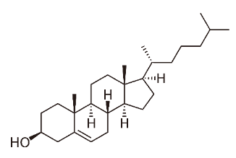
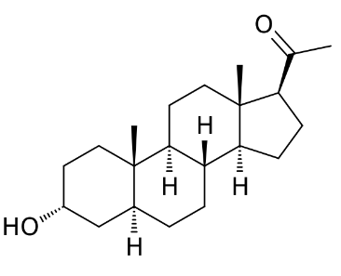
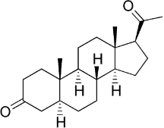
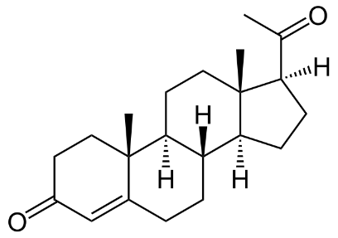
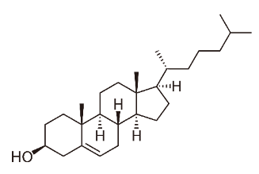
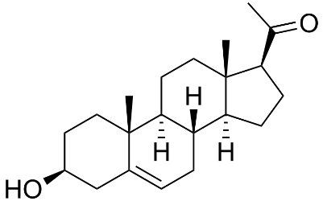
30-Minute De Novo Synthesis Process
Requires NADPH
LDL
Requires NAD+
HMG-CoA
LDL
LDL-R
LAL
Cytoplasm
NPC1
NPC2
Cholesterol
StarD4/5
Allopregnanolone
TSPO
StAR
OMM
3α-HSD
IMS
3β-HSD2
P450scc
5α-DHP
Progesterone
IMM
ER
5α-R1
Cholesterol
Pregnenolone
JJ Liang & AM Rasmusson, Chronic Stress, 2018

Slide 53
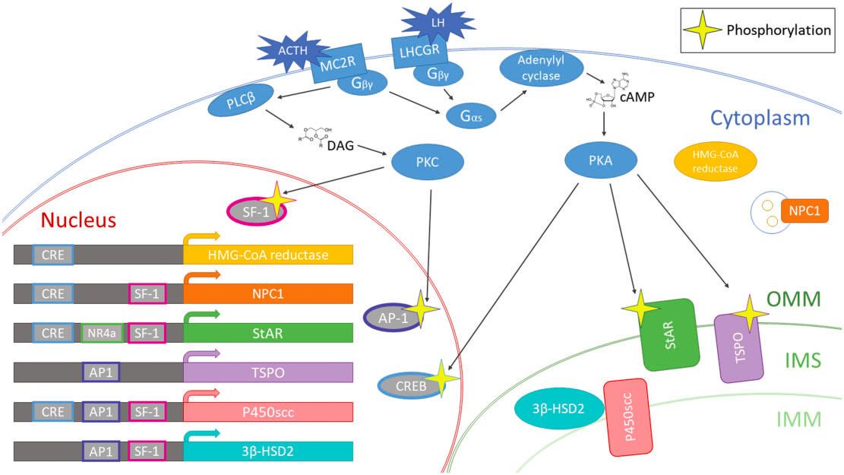
ACTH-, LH-, and NMDAR-dependent processes activate Increase transcription of several genes involved in neurosteroidogenesis.
JJ Liang & AM Rasmusson, Chronic Stress, 2018

Slide 54
Allo & Memory?
1. Extinction relies on both LTD and LTP in the amygdala.
Maren S. Out with the old and in with the new: synaptic mechanisms of extinction in the amygdala. Brain Research 2015;1621:231-8.
2. LTD &/or LTP interference depend on neurosteroidogenesis (CA1 hippocampal slice).
Izumi Y, O’Dell KA, Zorumski CF. Metaplastic LTP inhibition after LTD induction in CA1 hippocampal slices
involves NMDA receptor-mediated neurosteroidogenesis. Physiological Reports, 2013
3. LTP interference is thought to protect newly modulated synapses from
further modification during the subsequent 5-to-6-hour memory consolidation period.
Stefan K, Wycislo M, Gentner R, Schramm A, Naumann M, Reiners K, Classen J (2005): Temporary occlusion of
associative motor cortical plasticity by prior dynamic motor training. Cerebral Cortex. 16(3):376-385.

Slide 55
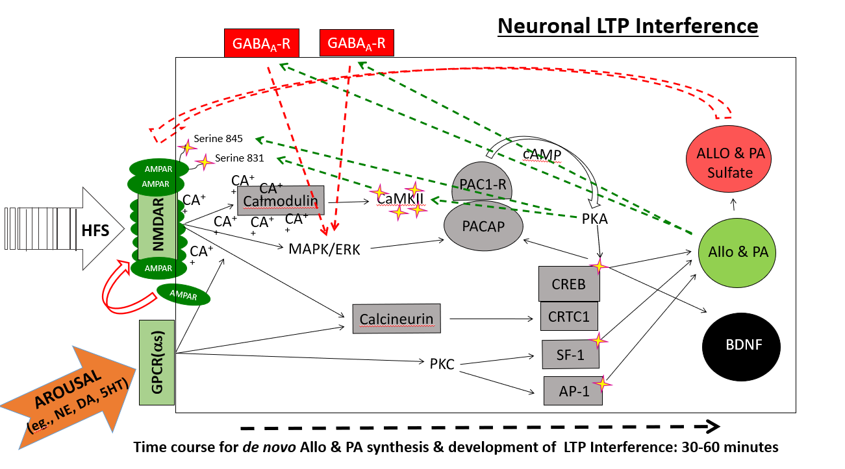

Slide 56
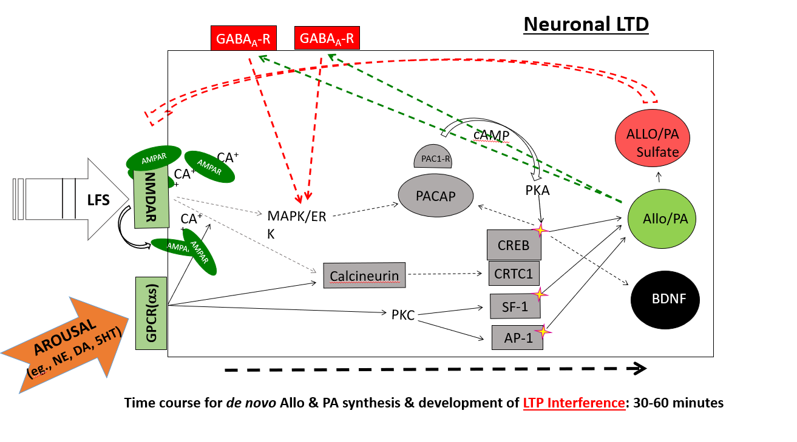

Slide 57
Low Plasma (Allo+PA)/5α-DHP Resting Levels & Reactivity
in Women with PTSD (Pineles et al., 2018)
Day 1
Day 2
Test
of
Extinction
Retention
Differential Fear Conditioning
Fear Extinction Learning
PTSD: N=15
TC: N=21

Slide 58
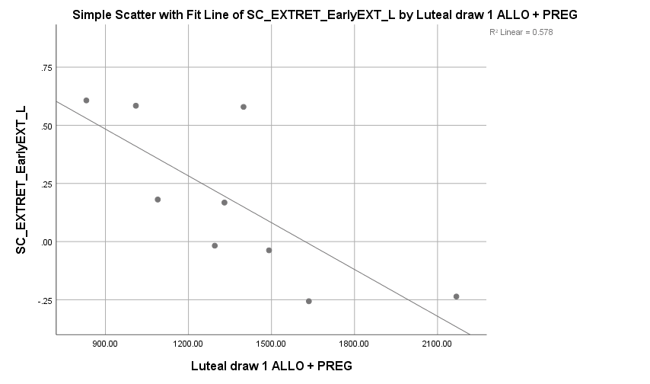
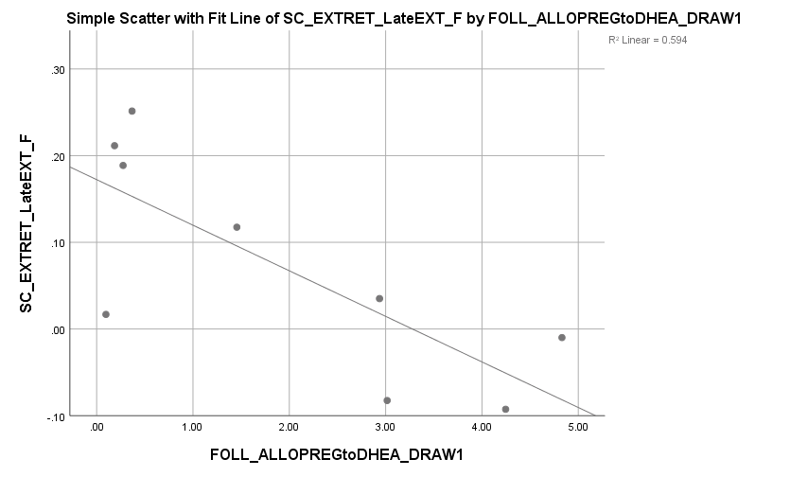
Left: High correlation between resting plasma Allo+PA levels and extinction retention in luteal phase
Right: High correlation between plasma (Allo+PA)/DHEA ratio and extinction retention in follicular phase
R= -0.87; p = 0.003
R= -0.65; p = 0.058
(Pineles et al., 2020)

Slide 59
But timing of IV Allo administration is likely critical to the
blockade of reconsolidation of fear memory-related defensive reactions?

Slide 60
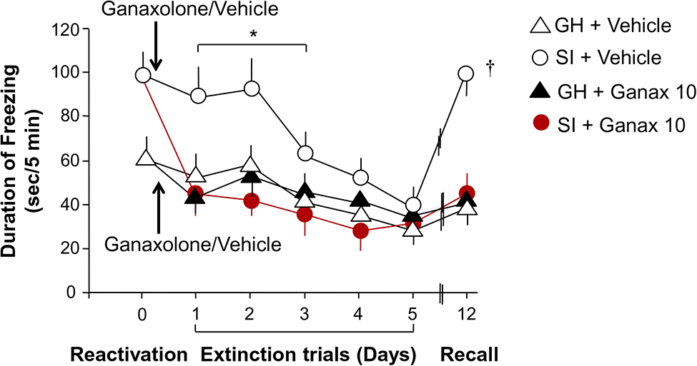
Timed Single Dose Allo Analogue Ganaxolone:
Facilitated Extinction Retention vs. Reconsolidation Blockade
(Pinna & Rasmusson, 2014)

Slide 61
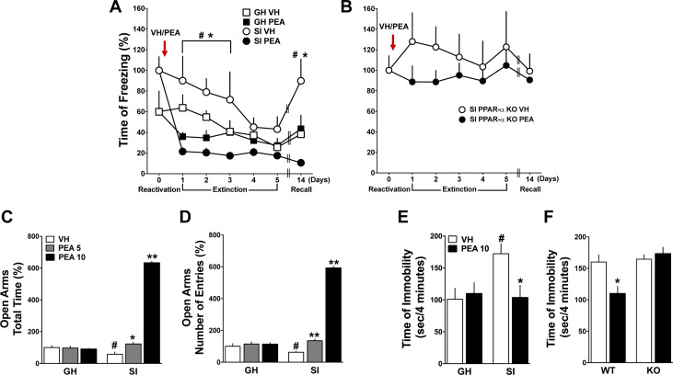
Facilitation of Extinction Retention vs. Reconsolidation Blockade
by a Timed Single Dose of the endocannabinoid N-Palmitoylethanolamine (PEA), a peroxisome proliferator-activated receptor-alpha activator
*PEA increased Allo and Allo-S, effects that were blocked by finasteride (which inhibits 5α-reductase I, II). PEA was also anxiolytic (e.g., plus maze), an effect that was lost after finasteride.
(Locci & Pinna, 2019)

Slide 62
THANK YOU!

Slide 63
Question & Answer

Slide 64
However, up until recently, studies have not taken into account:
1. GABAergic disinhibition (Letzkus et al., 2015) mediated by local circuit “GABA neuron on GABA neuron” on-off switches, which rapidly reconfigures circuit/brain region connections in response to stress.
Model 1 (Rest):
Model 1 (Stress):
2. Placement (expression) of ALLO-sensitive synaptic and extrasynaptic GABA_{A} receptors on the first GABA neuron vs. second GABA neuron regulating amygdala output.
GABA
off
GABA
on
Amygdala
off
GABA
on
GABA
off
Amygdala
on

Slide 65
General problems with the design of PTSD treatment trials:
Net Result: Only 2 drugs of the same drug class have been FDA-approved for treatment of PTSD in 20 years (sertraline & paroxetine). These SSRIs show modest general efficacy & wide-ranging individual efficacy. Notably, SSRIs are neurosteroidogenic at < 1/10th IC₅₀ for serotonin reuptake.
1. Use one-size fits all study designs despite clear individual & subpopulation variability in multiple interacting neurobiological systems dysregulated in PTSD
(Kim et al., 2020; Rasmusson & Pineles, 2018 Rasmusson et al., 2021)
2. Typically dose study drug to steady-state levels without considering underlying phasic neurobiological processes critical to PTSD recovery.
(Pineles, 2020; Rasmusson et al., 2021 )
3. Novel ‘brief drug infusions’ are administered in a hit or miss fashion without clear targets, rationale, or sensitivity to phasic neural mechanisms critical to PTSD recovery.
4. Biomarkers of potential underlying pathophysiological processes/targets are not assessed.

Slide 66
De-Risking Treatment Trials
If GABAergic neurosteroid production is downstream from the drug or psychotherapy point of engagement in the therapeutic process, capacity for GABAergic neurosteroid synthesis deficiency
will predict response.
Neurosteroid Precursor Treatment
(e.g., pregnenolone)
Normal Capacity for
GABAergic Neurosteroidogenesis
Therapeutic Response
Endocannabinoid or SSRI Enhancement of Synthesis
(e.g., PEA or FAAH-Inhibitor)
Deficient Capacity for
GABAergic Neurosteroidogenesis
GPCR Activator
(e.g., antidepressants, stimulants, MDMA)
No Therapeutic Response

Slide 67
GABAergic NS synthesis deficiency thus may serve as a treatment target but:
Can low resting GABAergic NS levels be increased without suppressing trauma memory circuit activation, which is essential to extinction & reconsolidation blockade?
Can dysfunction of specific enzymes involved in GABAergic neurosteroid synthesis be corrected epigenetically or otherwise?
Can GABAergic neurosteroid infusions be targeted time-wise in trauma-focused therapies to promote LTD and LTP interference and facilitate extinction and extinction retention?

Slide 68
Identifying GABAergic neurosteroid (NS) deficiency
1. Measurement of resting GABAergic NS levels must control for stress
a) Allow a 1-hour resting period between stressor and NS measurement
b) Normalize NS levels by accounting for ACTH levels that reflect the size of the stress signal
activating NS production
2. To measure GABAergic NS synthesis deficiency
a) Use NS product to immediate steroid precursor ratios
b) Use ACTH stimulation testing after resting baseline
3. Characterize sex-specific measures of enzyme blocks that limit GABAergic NS synthesis
Male/Female pregnancy: 5α-DHP/progesterone ratio as a proxy for 5α-reductase deficiency
Female: Allo+PA/5α-DHP ratio as a proxy for 3α-HSD deficiency
4. Be aware of subpopulation or individually variable factors that alter:
a) HPA axis activity (exercise; eating; acute/chronic nicotine, opiates, antidepressants, neuroleptics,
benzodiazepines)
b) GABAergic NS production directly (cannabinoids, OCPs, SSRIs)
5. Use gas chromatography-mass spectrometry (GC-MS) to get accurate, sensitive & specific GABAergic NS levels
6. Measure 3β-isomers of Allo & PA, as well as DHEA/DHEAS because they antagonize the GABAergic 3α-isomers

