Slide 1

Differentiated Service Delivery within PMTCT Programs
John Humphrey & Jimmy Carlucci
Indiana University School of Medicine
September 24, 2024

Slide 2
Disclosures
None

Slide 3
Differentiated service delivery (DSD)
Evidence-based strategy to improve quality and efficiency of HIV services¹
  Simplifies services for clients established on ART
  Intensifies services for clients who are not established
Models
  facility vs. community
  individual vs. group
  DSD implementation is widespread in settings with high HIV burdens
DSD models
 | Facility | Community
Individual | A | B
Group | C | D
¹ WHO. Consolidated guidelines on HIV prevention, testing, treatment, service delivery and monitoring, 2021.
Notes:
Consolidated guidelines on HIV prevention, testing, treatment, service delivery and monitoring: recommendations for a public health approach

Slide 4
Differentiated service delivery (DSD)
Knowledge gap: what is the optimal DSD model for pregnant and postpartum women with HIV and their infants?
Need for DSD to this population:
    Suboptimal PMTCT cascade outcomes
    Multiple barriers to retention & adherence
    Integration HIV & MCH services
    Women prefer fewer appointments
Retrospective cohort of pregnant WLH at Moi Teaching and Referral Hospital in Kenya, 2015-2019
Characteristic | Total n=856 | New HIV-Positive n=167 | Known HIV-Positive n=689
Postpartum retention in care
6 months | 88% | 70% | 92%
12 months | 85% | 67% | 89%
18 months | 77% | 53% | 83%
Humphrey J. AIDS and Behavior, 2022

Slide 5
Differentiated service delivery (DSD)
Knowledge gap: what is the optimal DSD model for pregnant and postpartum women with HIV and their infants?
Need for DSD to this population:
    Suboptimal PMTCT cascade outcomes
    Multiple barriers to retention & adherence
    Integration HIV & MCH services
    Women prefer fewer appointments
Factors influencing retention in care for pregnant and postpartum WLH
Humphrey J. PLOS Glob Public Health, 2021

Slide 6
Differentiated service delivery (DSD)
Knowledge gap: what is the optimal DSD model for pregnant and postpartum women with HIV and their infants?
Need for DSD to this population:
    Suboptimal PMTCT cascade outcomes
    Multiple barriers to retention & adherence
    Integration HIV & MCH services
    Women prefer fewer appointments
Self-reported reasons for loss to follow-up among 111 WLH
Silently transferred N=32 (%) | Disengaged from care N=79 (%)
Humphrey J. J Acquir Immune Defic Syndr, 2024

Slide 7
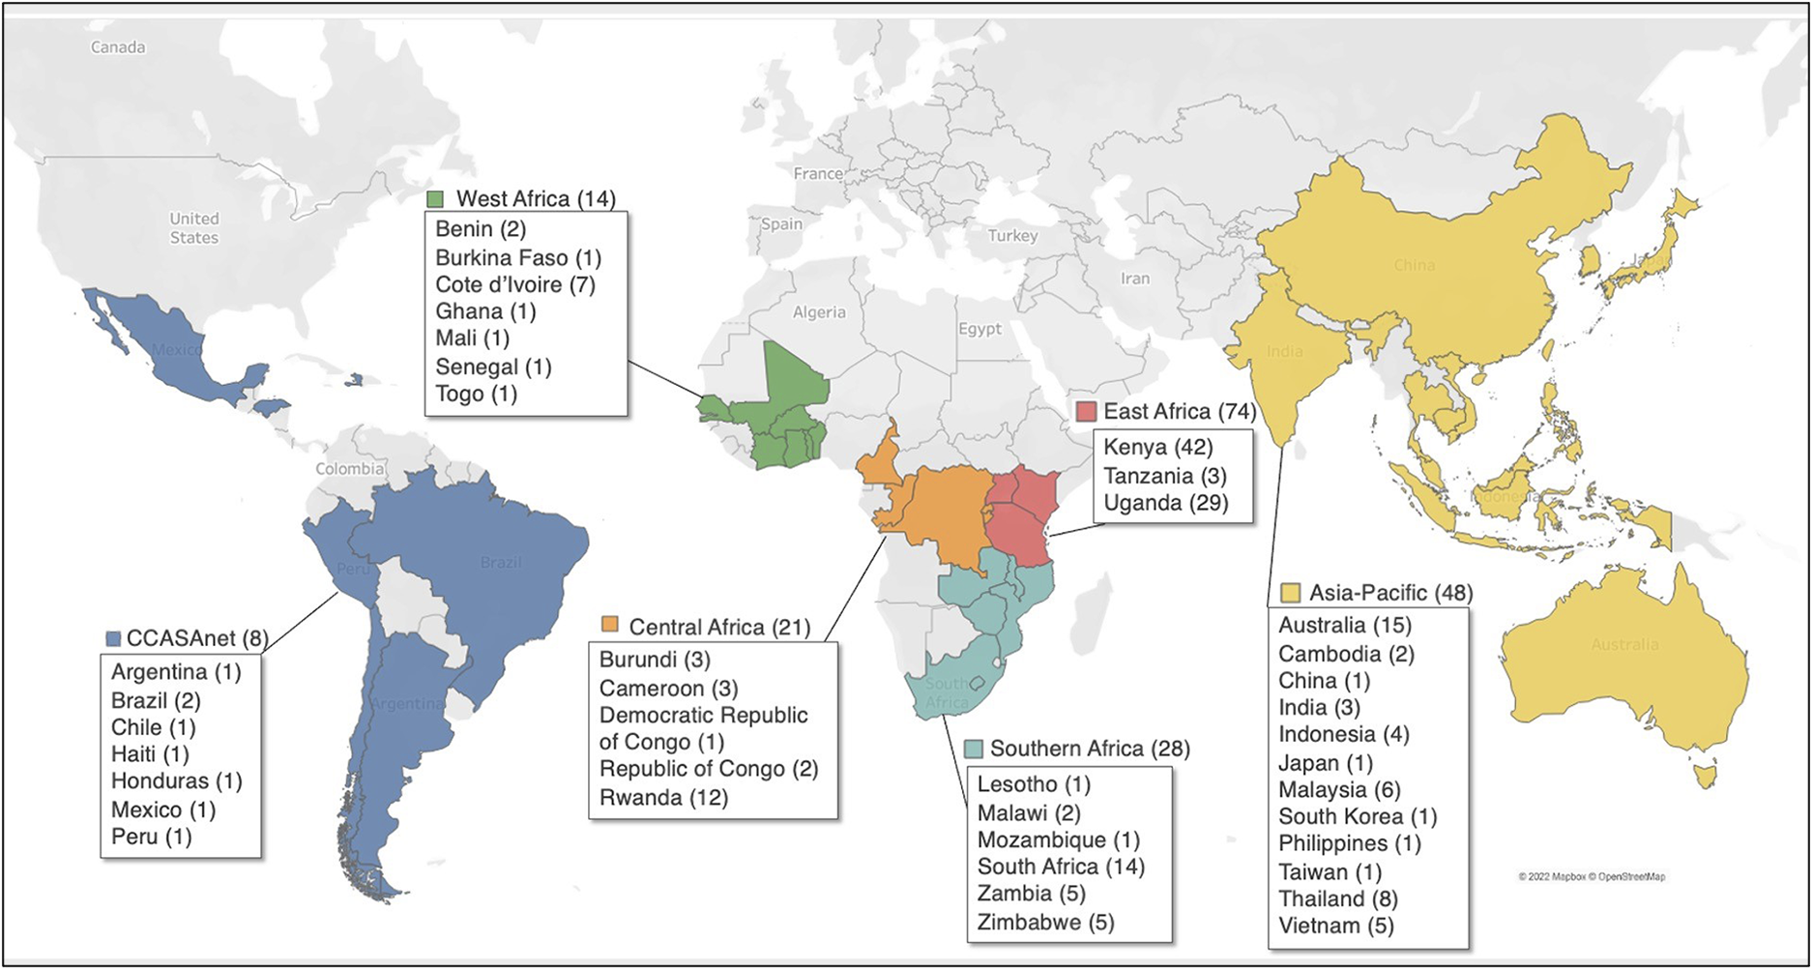
Differentiated service delivery (DSD)
Knowledge gap: what is the optimal DSD model for pregnant and postpartum women with HIV and their infants?
Need for DSD to this population:
    Suboptimal PMTCT cascade outcomes
    Multiple barriers to retention & adherence
    Integration HIV & MCH services
    Women prefer fewer appointments
Integration of HIV and MCH services in the global IeDEA site assessment, 2020
Pregnant/postpartum women: 51-54% fully integrated, highest in Southern Africa (64-80%) and East Africa (76%)
Infants and children with HIV exposure: 56% fully integrated, highest in East Africa (76%), West Africa (58%) and Southern Africa (54%) vs. ≤33% in other regions.
Humphrey et al, Front Glob Womens Health, 2023

Slide 8
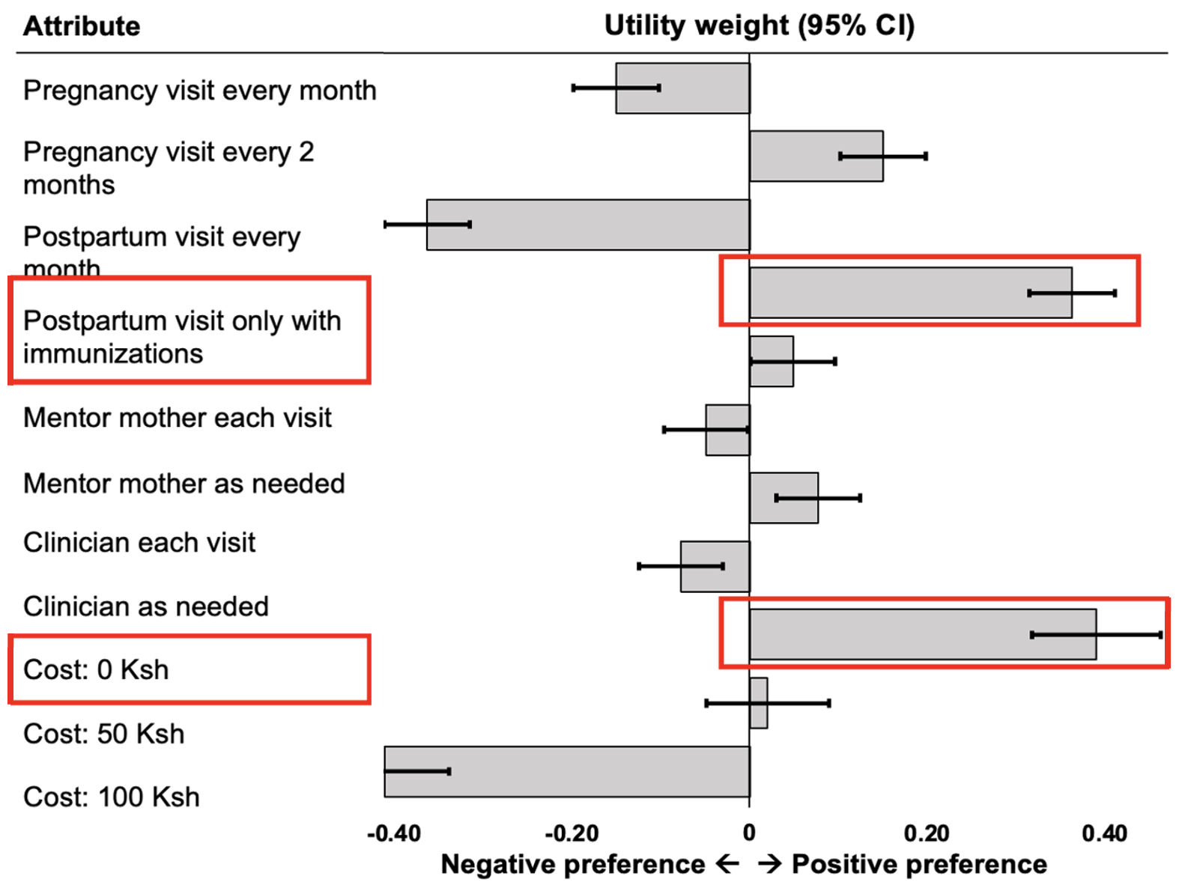
Differentiated service delivery (DSD)
Knowledge gap: what is the optimal DSD model for pregnant and postpartum women with HIV and their infants?
Need for DSD to this population:
    Suboptimal PMTCT cascade outcomes
    Multiple barriers to retention & adherence
    Integration HIV & MCH services
    Women prefer fewer appointments
Discrete choice experiment to understand women’s preferences for PMTCT services
Humphrey J. J Acquir Immune Defic Syndr, 2023

Slide 9
Mentor Mothers (MM)
Peer support service
  HIV-affected women provide counselling, retention support, and other services to pregnant and postpartum women living with HIV (WLHIV)
  Starting at enrollment in antenatal care and continuing through the cascade of PMTCT services
Goals of the MM program
  Improving mother and infant retention in PMTCT services
  Improving adherence to ART and viral suppression
  Decreasing vertical transmission
Notes:
While not the strongest preference expressed in the results John just presented, there was also a trend toward women preferring only as needed encounters with Mentor Mothers, rather than the current standard of Mentor Mothers meeting with clients during each of their clinic visits.
So, let’s unpack that a bit, but first let’s make sure that everyone is familiar with Mentor Mothers…

Slide 10
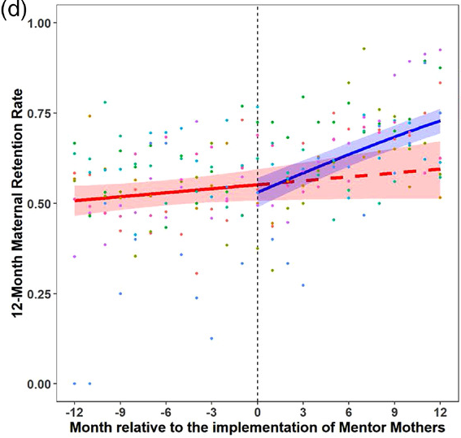
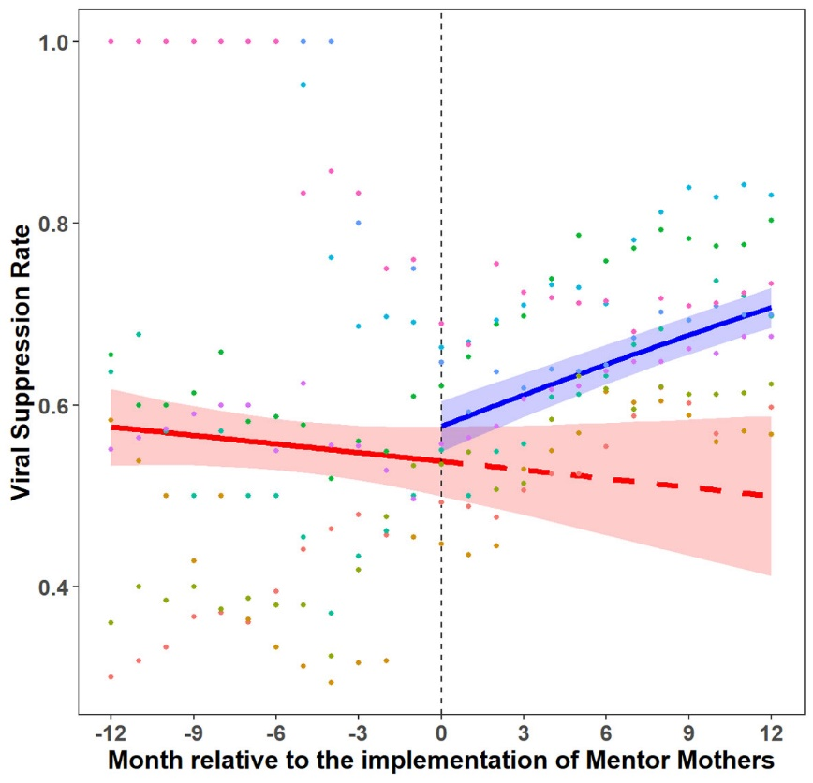
Mentor Mothers significantly improve retention in care and viral suppression, but additional efforts are needed to ensure good outcomes for all WLHIV
Retention
Viral Suppression
Gap
Gap
With MM
With MM
Without MM
Without MM
Carlucci JG, et al. J Int AIDS Soc. 2022 Jun;25(6):e25952
Notes:
A retrospective interrupted time series analysis was done using routinely collected data from 85 FGH-supported sites
Temporal trends in outcomes were stratified by district, and differences in outcomes 1 year before and 1 year after MM implementation were assessed and compared
While Mentor Mother services might vary a bit from country to country – for example these data are from Mozambique where Mentor Mother services are mostly community-based – most programs are similar to Kenya in that they do not provide differentiated services tailored to specific patients needs. That said, it’s clear that the while current model yields significant improvements in retention and viral suppression, additional efforts are needed to ensure good outcomes for all WLHIV.

Slide 11
Hypothesis
A differentiated service delivery model, wherein Mentor Mothers provide risk-stratified, problem-focused services to their clients, has the potential to improve clinical outcomes and clinic efficiency, while also satisfying patient preferences, enhancing its potential for sustained and impactful implementation.
Notes:
With this in mind, we hypothesized that a differentiated service delivery model wherein Mentor Mothers provide risk-stratified, problem-focused services to their clients has the potential to improve clinical outcomes and clinic efficiency, while also satisfying patient preferences, enhancing its potential for sustained and impactful implementation.

Slide 12
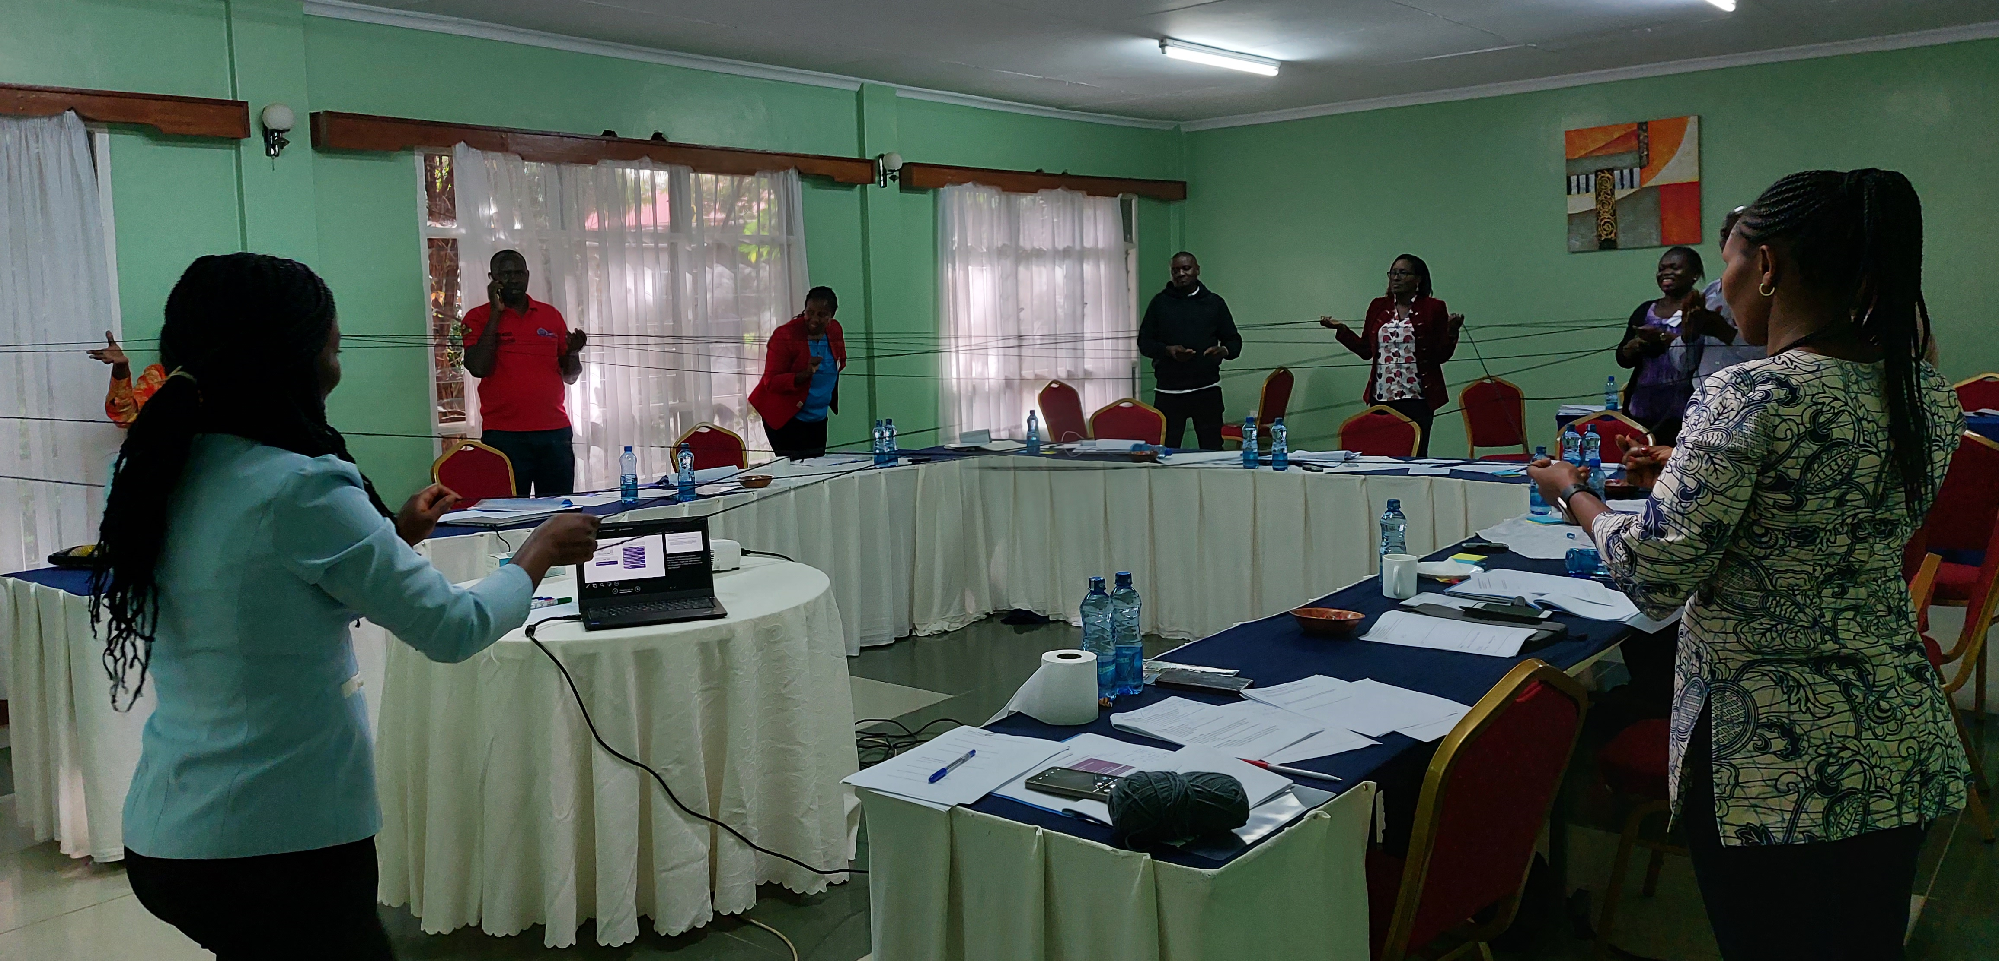
Notes:
And from there, we utilized a human-centered design approach to co-create this enhanced Mentor Mother strategy.
First, through in-depth interviews and Mentor Mothers and their clients…
We performed in-depth interviews with 16 Mentor Mothers from 3 AMPATH sites and 36 postpartum women living with HIV who had been clients of MM at these same 3 sites to better understand how the current Mentor Mother strategy is working and to identify areas for improvement.
Then, through HCD workshops with stakeholders (MM, clinic staff, and PMTCT program leadership)…

Slide 13
Notes:
Data were imported into Miro, a virtual whiteboard workspace (Miro, 2023)
Each captured response was broken into "snippets," each containing a singular idea
Each snippet was placed on a virtual "sticky note"
Affinity diagrams (Kolko, 2011)
A method of discovering relationships among ideas
Generative, in that it creates further knowledge about the ideas
From thousands of discrete data points, a theme or set of themes can be found that point to a more manageable set of patterns
The “output” then helps to visualize idea patterns and connection
And, ultimately refined – with input from the PMTCT team at the initial site of pilot implementation – into something with potential for feasible implementation without additional external resources…
Next slide: Here’s what it looks like…

Slide 14
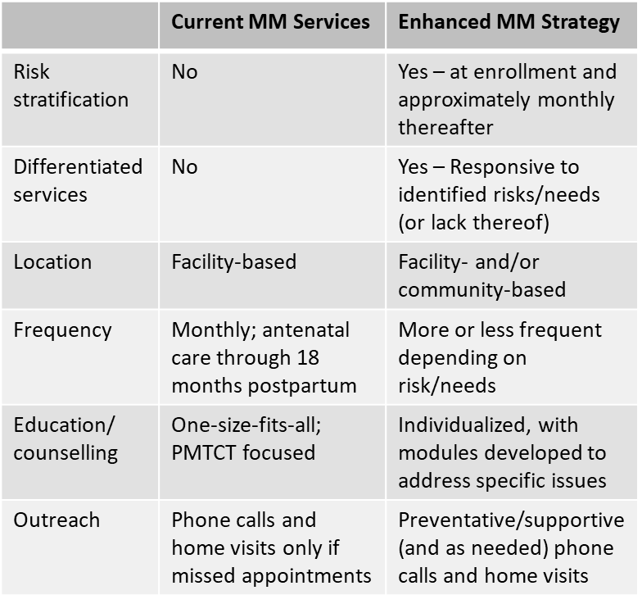
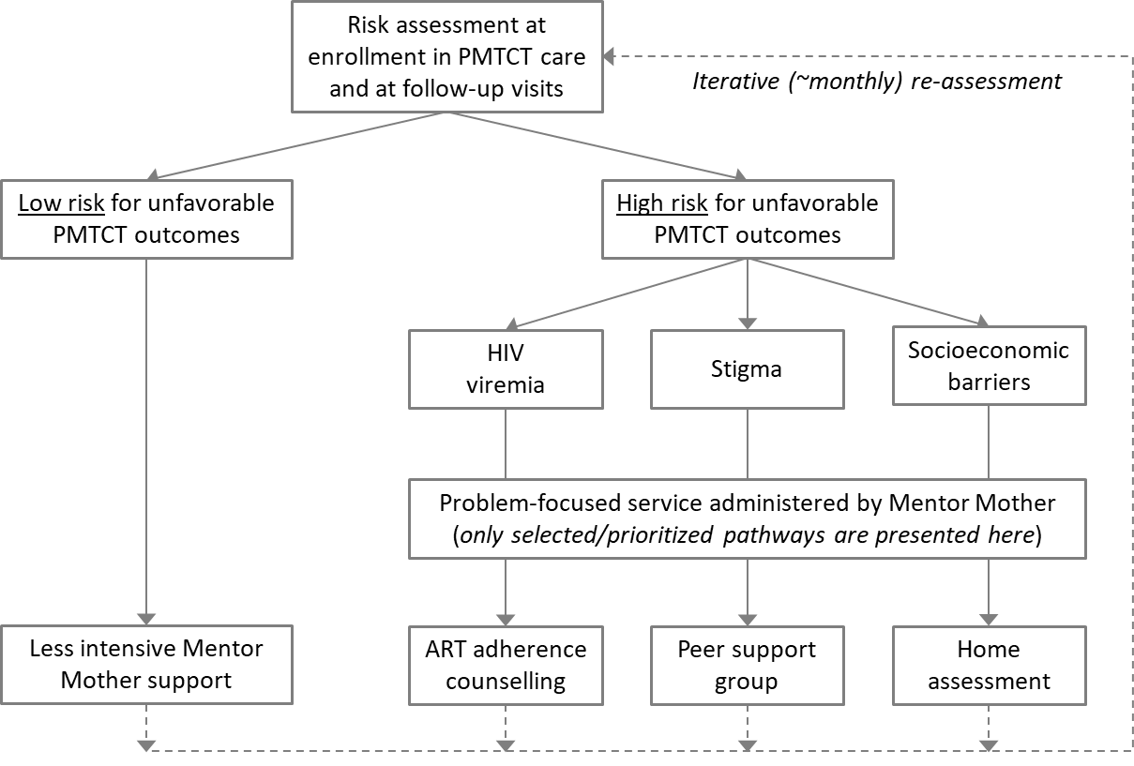
Notes:
The enhanced MM strategy includes iterative risk assessments of WLHIV at approximately monthly clinical encounters, starting at enrollment in PMTCT services (usually at the first antenatal care visit) and continuing through cessation of breastfeeding and discharge from the PMTCT program around 18-24 months postpartum. These risk assessments will involve MM and PMTCT clinician review of medical records (e.g., to review appointment history and HIV viral load results) and administration of brief screening questionnaires (e.g., to assess for stigma and socioeconomic barriers). The results of these risk assessments will then be used to determine which MM services will be provided to address the needs of each WLHIV. If no risk factors are identified, then less intensive MM support will be offered. If multiple risk factors are identified, then MM and WLHIV will negotiate which risk factor to prioritize based on client preferences. This process will be repeated at each encounter, and reassessments will determine which (if any) additional interventions need to be administered to WLHIV.
And, now we are in the process of performing a pilot hybrid implementation-effectiveness study of the enhanced MM strategy…

Slide 15

Depression
Risk Assessment
Education/Services
Assessed by MMs (with clinician support)
Screening tools:
  PHQ2 → PHQ9
Education on “positive living”
Psycho-social support groups
Counseling and treatment for depression
  Led by trained MM
  Referral to Psych or SW when needed
  Linked to clinician for medication when needed
Screen for other issues that might be impacting mood
  E.g., assess and provide support for disclosure
Notes:
Link it back to IMPAACT…
While not prioritized for the initial phase of implementation, another pathway that we created was to address the needs of WLHIV who might be struggling with depression.
Certainly not ready for prime time, but we think the process of human centered design could be used to craft a strategy the embraces the priorities of the IMPAACT Brain and Mentor Health Scientific Committee, and that could be tested through a future IMPAACT supported clinical trial.

Slide 16




Acknowledgements
NIH/NICHD
  K23HD109056 (Carlucci)
  K23HD105495 (Humphrey)
Academic Model Providing Access to Healthcare (AMPATH)
  Moi University
  AMPATH Qualitative Research Core
Indiana Clinical and Translational Sciences Institute (CTSI)
  Patient Engagement Core / Research Jam
Indiana University School of Medicine
  Pediatric Accelerator for Careers Engaged in Research (PACER)
  Children's Health Services Research
  Center for Global Health Equity
  Dept of Medicine, Division of Infectious Diseases
  Dept of Pediatrics, Center for Pediatric Infectious Diseases and Global Health

