Slide 1
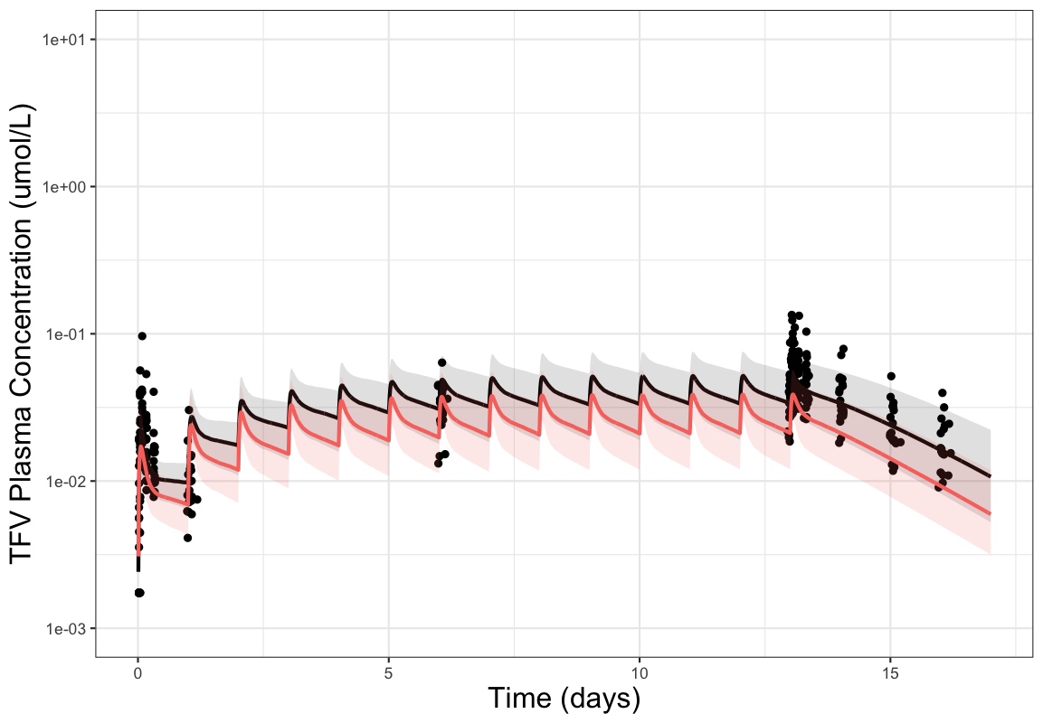
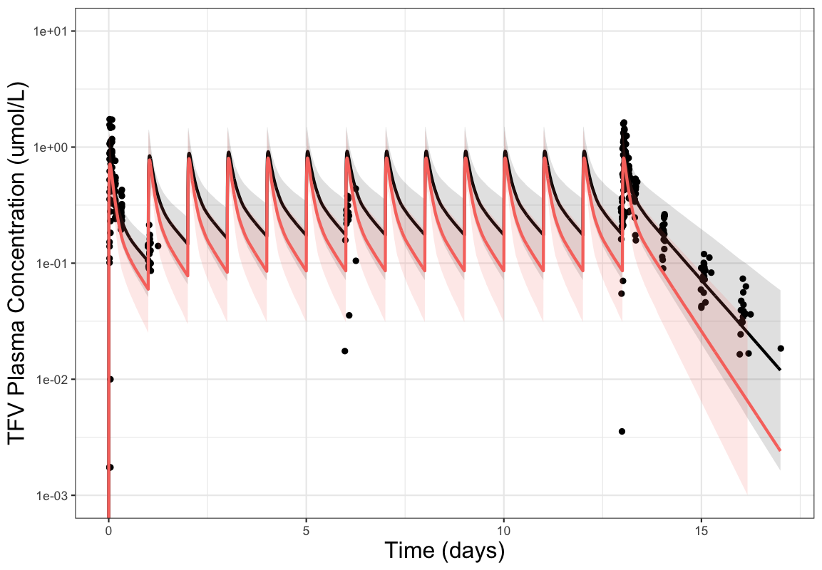
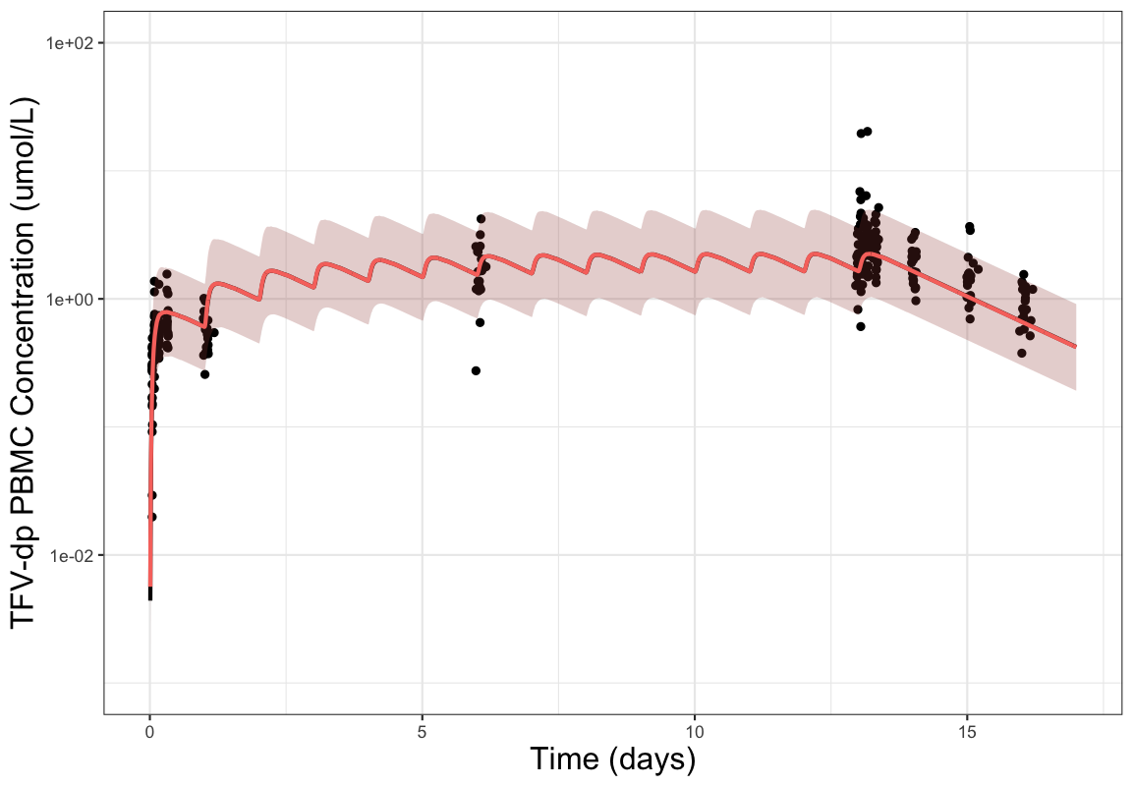
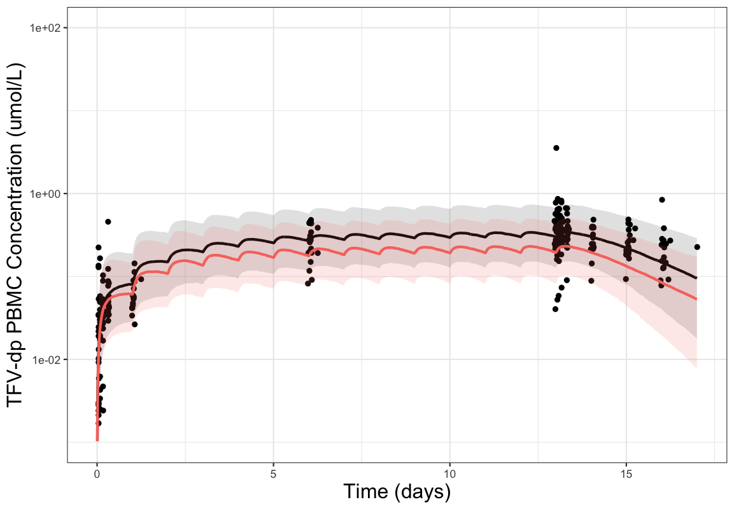


Prediction of intracellular tenofovir-diphosphate concentrations during pregnancy using a semi-mechanism-based population pharmacokinetic model
Yifan Yu¹, Gustavo Doncel², Kristina Brooks³, Brookie Best^{4,5}, Mark Marzinke⁶, Mark Mirochnick⁷, Peter Anderson³, London Myer⁸, Connie Celum⁹, Renee Heffron¹⁰, Dvora Joseph Davey^{8,11}, Jeremiah Momper⁴, Craig Hendrix⁶, Robert Bies¹, Rachel K Scott^{12,13}
1. University at Buffalo, School of Pharmacy and Pharmaceutical Sciences, Buffalo, NY, USA. 2. CONRAD, Eastern Virginia Medical School, Norfolk, VA, USA. 3. University of Colorado-Anschutz Medical Campus, Aurora, CO, USA. 4. University of California San Diego, Skaggs School of Pharmacy and Pharmaceutical Sciences, La Jolla, CA, USA. 5. Pediatrics Department, University of California San Diego School of Medicine-Rady Children’s Hospital San Diego, San Diego, CA, USA. 6. School of Medicine, Johns Hopkins University, Baltimore, MD, USA. 7. Boston University Chobanian & Avedisian School of Medicine, Boston, MA, USA. 8. Division of Epidemiology and Biostatistics, School of Public Health, University of Cape Town, Cape Town, South Africa. 9. Departments of Global Health, Medicine & Epidemiology, University of Washington, Seattle, WA, USA. 10. Department of Medicine, University of Alabama at Birmingham, Birmingham, AL, USA. 11. Division of Infectious Diseases, Geffen School of Medicine, University of California Los Angeles, Los Angeles, CA USA. 12. Medstar Health, Washington D.C. USA 13. Georgetown University School of Medicine, Washington D.C. USA
Background
Tenofovir (TFV)-based regimens are backbones of both HIV treatment and pre-exposure prophylaxis (PrEP) during pregnancy
Multiple cohorts demonstrated up to one-third decreases in dried blood spot (DBS) tenofovir-diphosphate (TFV-dp) concentrations during pregnancy among participants on TFV disoproxil fumarate (TDF)
Recently, two clinical studies in Kenya and South Africa by Mugwanya et al. and Joseph Davey et al. reported similar TFV-dp concentrations in peripheral blood mononuclear cells (PBMCs) of pregnant women receiving TDF, compared to non-pregnant and postpartum populations
For tenofovir alafenamide (TAF), Brooks et al. reported approximately 30% lower PBMC TFV-dp levels and approximately 60-80% lower DBS TFV-dp levels in pregnant individuals, compared to historical data in non-pregnant adults
Currently, there are no mechanism-based models describing the concentrations of TFV-dp inside PBMCs of pregnant individuals receiving TDF or TAF. The mechanism behind the differing observations between DBS and PBMCs remains unclear
Results
We developed a seven-compartment model that simultaneously describes plasma TAF, plasma TFV, and PBMC TFV-dp concentrations after administration of TAF or TDF
Simulation of PK in pregnant individuals on TDF showed a 30% reduction of steady-state trough TFV-dp concentrations in PBMC relative to non-pregnant individuals (Figure 2.D)
Simulated steady-state trough PBMC TFV-dp concentrations among pregnant individuals on TAF were not distinguishable from those of non-pregnant individuals (p=0.92)(Figure 2.C)
Table 2 Covariate relationships identified within models for each study dataset
Study | Covariate relationship
Partners Demonstration Project | 23.2%, 34.9%, and 58.1% increments on CL/F of TFV across the 1st, 2nd, and 3rd trimesters, respectively
IMPAACT P1026S TDF arm | 31% increments on CL/F of TFV during the 2nd & 3rd trimesters compared with postpartum
IMPAACT P1026S TAF25 without boosted PI | CL/F of TAF increased 56.2% during the 2nd trimester and 12.2% during the 3rd trimester in comparison to postpartum
Methods
Using data from CONRAD 137, we developed a semi-mechanism-based population pharmacokinetic (PK) model that simultaneously describes plasma TAF, plasma TFV, and PBMC TFV-dp concentrations among non-pregnant cisgender women on TAF or TDF. We converted the PBMC TFV-dp concentration unit from femtomoles per million cells to micromoles per liter, using a PBMC cell volume of 282 femtoliters per cell
We separately developed population PK models using data from the Partners Demonstration Project and IMPAACT P1026s to identify the impact of pregnancy (specifically the 2nd and 3rd trimesters) on PK parameters (Tables 1 and 2)
We performed simulations (14 days of daily TDF or TAF dosing) using the developed models, integrating the pregnancy effects. For TDF, we assumed the clearance of TFV will increase during 2nd and 3rd trimesters. For TAF, we assumed the clearance of both TAF and TFV will increase during 2nd and 3rd trimesters. The simulated reduction in PBMC TFV-dp concentrations was compared to the reduction observed in IMPAACT 2009 DBS TFV-dp concentrations during pregnancy.
Figure 2 Concentration-time profiles for TFV and TFV-dp in non-pregnant and pregnant individuals on TDF and TAF. Population pharmacokinetic simulations for 14 days oral 25 mg TAF or 300 mg TDF dosing every 24 hours in 1000 virtual patients. (A) Plasma concentration of TFV after TAF dosing, (B) Plasma concentration of TFV after TDF dosing, (C) PBMCs TFV-dp concentration after TAF dosing, (D) PBMCs TFV-dp concentration after TDF dosing. The solid lines represent the predicted median pharmacokinetics profile for non-pregnant (Black) and pregnant (Red) population. The regions encompass the 5% and 95% percentiles of prediction for non-pregnant (Grey) and pregnant (Pink) population. The black dots represent non-pregnant data from the CONRAD 137 multiple-dose phase.
A
B
Model Structure and Assumptions
The PK of TAF were best described by a one-compartment model with first order absorption
The PK of TFV were best described using a two-compartment model with first order absorption
We included a transit compartment to reflect the slower elimination rate of plasma TFV after receiving TAF
Based on the plasma PK model, cellular matrices were included using a biophase distribution model
After oral absorption, TDF undergoes de-esterification by gut and plasma esterase. Plasma TFV is subsequently intracellularly converted to TFV-dp. Therefore, we assumed that after receiving TDF PBMC TFV-dp concentrations were directly related to the plasma TFV concentrations
TAF
Depot
KA1
TAF
Plasma
F*CL1
(1-F)*CL1
Transit
TFVdp
PBMC
Kslow
C
D
TDF
Depot
KA2
TFV
Plasma
Q
TFV
Peri
CL2
Figure 1 Final model structure
TAF is more stable in plasma compared to TDF. After oral absorption, TAF is rapidly absorbed into cells. Intracellularly, TAF is then be converted to TFV and TFV-dp sequentially. We assumed that after receiving TAF PBMC TFV-dp concentrations are directly related to both plasma TFV and intracellular TAF (reflected by the transit compartment) levels
Conclusions
Among pregnant individuals on TDF, our simulation showed a 30% reduction in PBMC TFV-dp concentrations. This discrepancy between simulation and reported clinical data suggests potential impact of pregnancy on the kinetics between plasma TFV and PBMC TFV-dp
Increased PrEP failure with TDF-based PrEP in pregnancy has not been reported, but would be challenging to evaluate.
Among individuals on TDF-based treatment in pregnancy, decreased TFV-dp exposure has not been associated with virologic failure. Dose adjustment is not recommended given the presence of a third antiviral.
Among individuals on TAF during pregnancy, since we assumed pregnancy would only affect the clearance of TAF (which represents the conversion of TAF to TFV in this model), we predicted a negligible reduction in PBMC TFV-dp concentrations
Table 1 Studies utilized for model building and evaluation
Study | Tenofovir dose regimen | HIV Status | Number of female participants | Pregnancy trimester(s)
CONRAD 137 single dose phase | TDF 300 mg TAF 25 mg | Negative | 24 non-pregnant | NA
CONRAD 137 multiple dose phase | TDF 300 mg TAF 10 mg TAF 25 mg | Negative | 73 non-pregnant | NA
Partners Demonstration Project | TDF 300 mg | Negative | 33 pregnant 83 non-pregnant | 1st trimester 2nd trimester 3rd trimester
IMPAACT P1026s TDF arm | TDF 300 mg | Positive | 46 pregnant | 2nd trimester 3rd trimester postpartum
IMPAACT P1026s TAF arm without cobicistat | TAF 25 mg | Positive | 25 pregnant | 2nd trimester 3rd trimester postpartum
References
Anderson PL, Liu AY, Castillo-Mancilla JR, et. al. Antimicrob Agents Chemother. 2017 Dec 21;62(1):e01710-17.
Brooks KM, Momper JD, Pinilla M, et. al. AIDS. 2021 Mar 1;35(3):407-417.
Brooks KM. (2023 September 12). Intracellular Tenofovir-Diphosphate Concentrations with Tenofovir Alafenamide During Pregnancy and Postpartum in People with HIV: Results from IMPAACT 2026. International Workshop on Clinical Pharmacology of HIV, Hepatitis, and Other Antiviral Drugs 2023.
Eke AC, Shoji K, Best BM, Momper JD, Stek AM, Cressey TR, Mirochnick M, Capparelli EV. Antimicrob Agents Chemother. 2021 Feb 17;65(3):e02168-20.
Joseph Davey DL, Dadan S, Khoo S et al. [CROI Abstract 900]. In Special Issue: Abstracts From the CROI 2024 Conference on Retroviruses and Opportunistic Infections. Top Antivir Med. 2024;32(1):277.
Kawuma AN, Wasmann RE, Sinxadi P et al. CPT Pharmacometrics Syst Pharmacol. 2023 Jun;12(6):821-830.
Mugwanya KK, Mugo NR, Donnell D et al. [CROI Abstract 170]. In Special Issue: Abstracts From the CROI 2024 Conference on Retroviruses and Opportunistic Infections. Top Antivir Med. 2024;32(1):41.
Pyra M, Anderson PL, Hendrix CW, et. al. AIDS. 2018 Aug 24;32(13):1891-1898.
Thurman AR, Schwartz JL, Cottrell ML, et. al. EClinicalMedicine. 2021 May 23;36:100893.
Acknowledgements
The authors would like to thank the study participants. This work is supported by NICHD 7R21HD106582-03 and NIH P30HD106451 Maternal and Pediatric Precision in Therapeutics (MPRINT). Overall support for the International Maternal Pediatric Adolescent AIDS Clinical Trials Network (IMPAACT) was provided by the National Institute of Allergy and Infectious Diseases (NIAID) with co-funding from the Eunice Kennedy Shriver National Institute of Child Health and Human Development (NICHD) and the National Institute of Mental Health (NIMH), all components of the National Institutes of Health (NIH), under Award Numbers UM1AI068632-15 (IMPAACT LOC), UM1AI068616-15 (IMPAACT SDMC) and UM1AI106716-15 (IMPAACT LC), and by NICHD contract number HHSN275201800001I. The content is solely the responsibility of the authors and does not necessarily represent the official views of the NIH.

